Slide 1

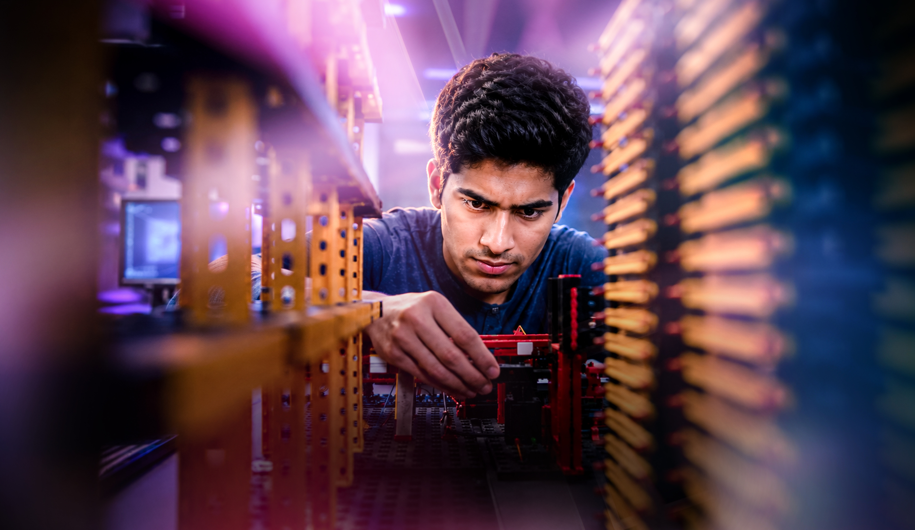



AI reinvention made real
Accenture Innovation Challenge 2026
Copyright © 2025 Accenture. All rights reserved.
‹#›

Slide 2
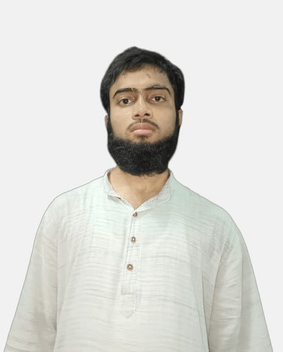
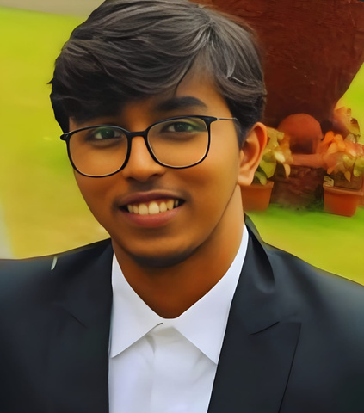
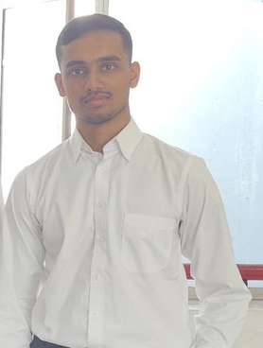
Team details
TEAM NAME: TRACE
Mobashshir
(Team Leader)
Aadil Mulani
College: IIT Kharagpur
Stream: Engineering
Year of graduation: 2028
College: IIT Kharagpur
Stream: Engineering
Year of graduation: 2028
Eisa Shaiju
Photo
College: IIT Kharagpur
Stream: Engineering
Year of graduation: 2028
All fields are mandatory
3

Slide 3
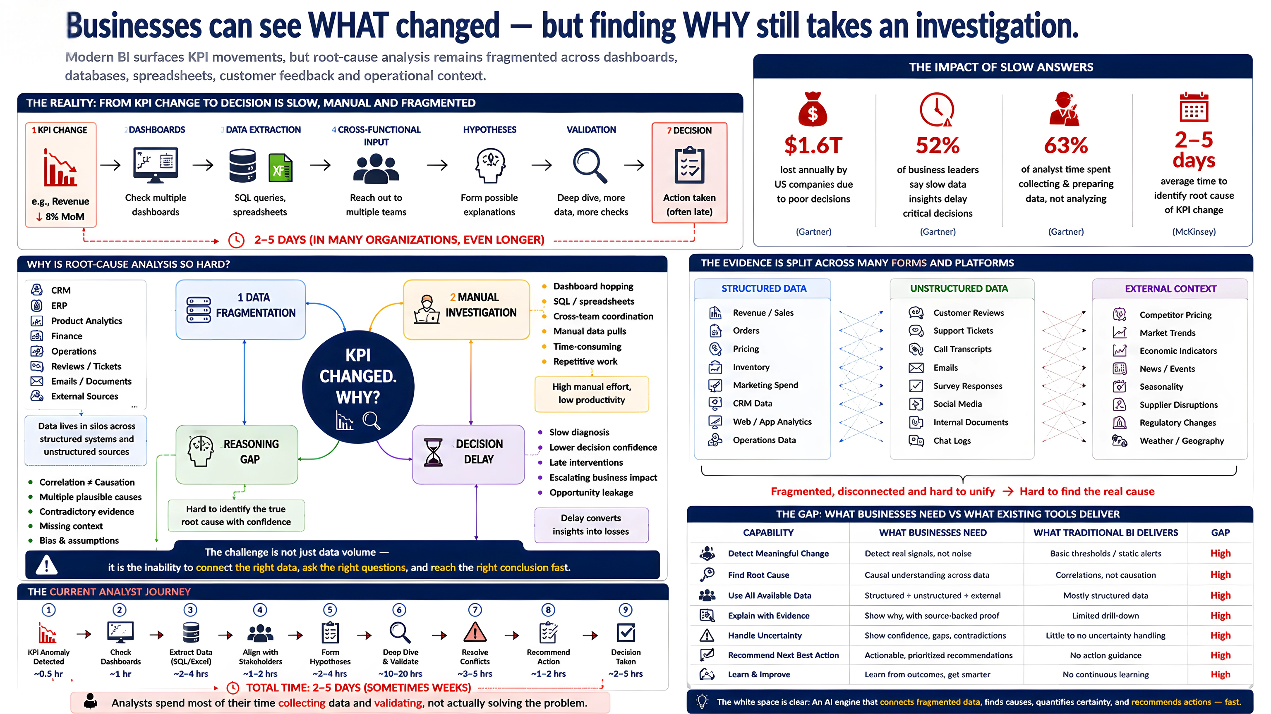
Businesses can see WHAT changed but finding WHY still takes an investigation.

Slide 4
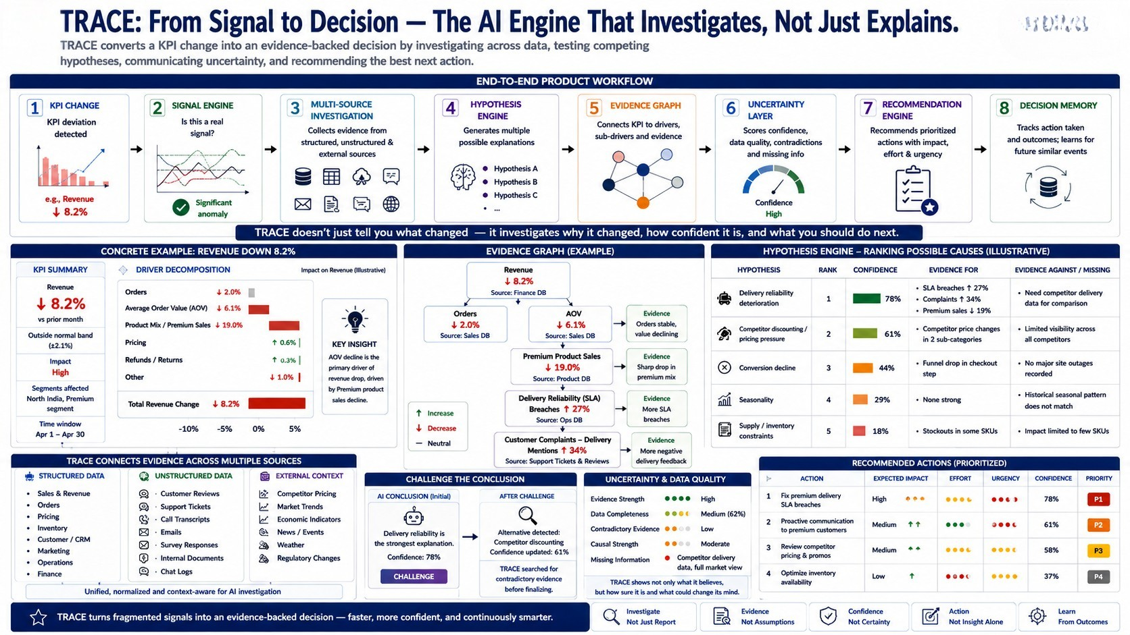
TRACE: From Signal to Decision. The AI Engine That Investigates, Not Just Explains.

Slide 5
https://drive.google.com/file/d/1QWwF-sLV9u5qilusE0eiT2KI9Xk5zfTs/view?usp=sharing

Slide 6

Thank you
Copyright © 2026 Accenture. All rights reserved.
‹#›

