Slide 1

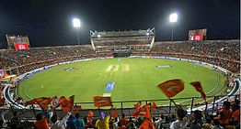
Score Predictor for
Indian Premier League (IPL)
A Machine Learning Web App, Built with Flask, Deployed using Heroku.

Slide 2
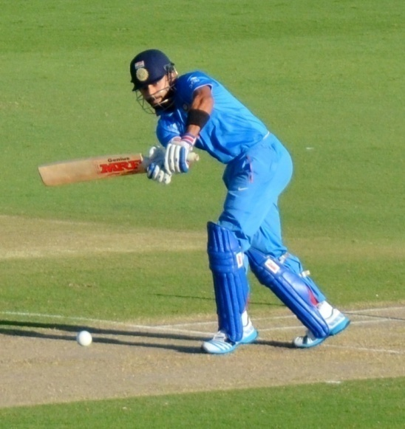
Objective
To predict current score of a team based on previous data
Model
Predicted final score
CURRENT SCORE DATA

Slide 3
DATASET
Indian Premier League (IPL) is a Twenty20 cricket format league in India. It is usually played in April and May every year. As of 2019, the title sponsor of the game is Vivo. The league was founded by Board of Control for Cricket India (BCCI) in 2008.
Content
Data till Season 10 (2008 - 2017)
ipl.csv - Match by match data with complete details of each over and balls.
Data source from 2008-2017 – Kaggle

Slide 4
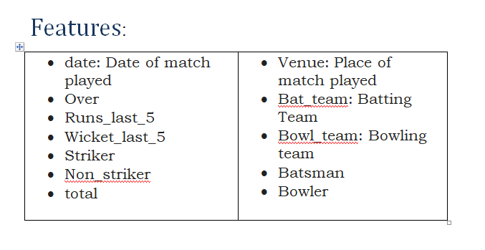

Slide 5
PROJECT FLOW
Data Cleaning
Data Preprocessing(OneHotEncoding)
3. Splitting the data into train and test set
4. Model Building
5. Deployment

Slide 6
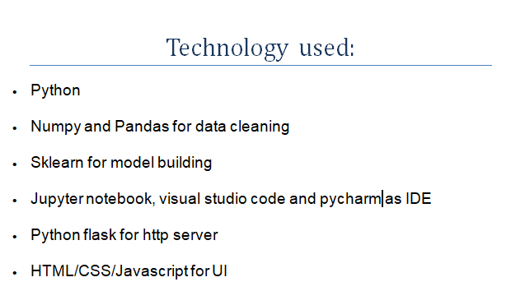

Project Github link:
https://github.com/mobashshirurrahman/ipl-score-predictor

Slide 7
Model Building
We will experiment with 2 different algorithms, they are as follows:
• Linear Regression • Decision Tree Regression

Slide 8
Model Evaluation
---- Linear Regression - Model Evaluation ----
Mean Absolute Error (MAE): 12.11861754619329
Mean Squared Error (MSE): 251.00792310417438
Root Mean Squared Error (RMSE): 15.843229566732106
---- Decision Tree Regression - Model Evaluation ---
Mean Absolute Error (MAE): 17.08963282937365
Mean Squared Error (MSE): 531.0550755939524
Root Mean Squared Error(RMSE): 23.044632251219642

Slide 9
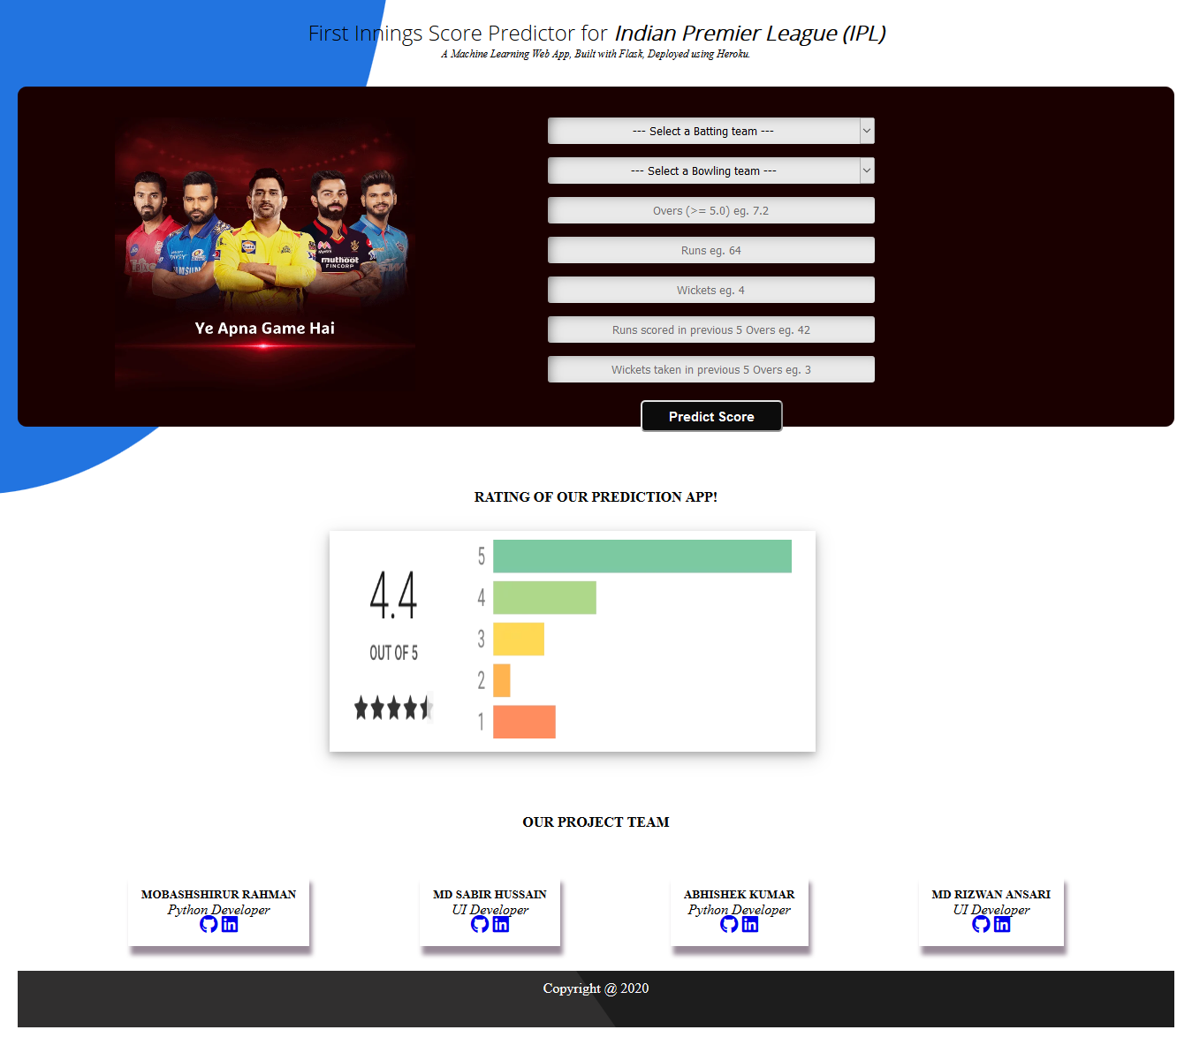
Project Snapshot:
Deployed Heroku Link:
https://iplscorepredictortrick.herokuapp.com/

Slide 10
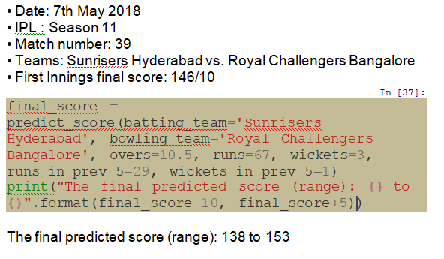
Conclusion
Model predicts on data from IPL Seasons 11 to 12 ie: (2018 to 2019)
Prediction:

Slide 11

Github Link of Project:
https://github.com/mobashshirurrahman/ipl-score-predictor
Deployed Link of Project on Heroku:
https://iplscorepredictortrick.herokuapp.com/

