Slide 1
Basic Tags In html
Mobeen Anwar
Week: 03

Slide 2

!Doctype html
The DOCTYPE declaration is an instruction to the web browser about what version of HTML the page is written in.
DOCTYPE is not a tag/element, it just an instruction to the browser about the document type.
Syntax:

Slide 3

Head tag
The <head> tag in HTML is used to define the head portion of the document which contains information related to the document.
The <head> tag contains other head elements such as <title>, <meta>, <link>, <style> <link> etc.
Syntax:

Slide 4


Title tag
A title tag is an HTML element that specifies the title of a web page.
Title tags are displayed on search engine results pages (SERPs) as the clickable headline for a given result.
Syntax:
Output:

Slide 5
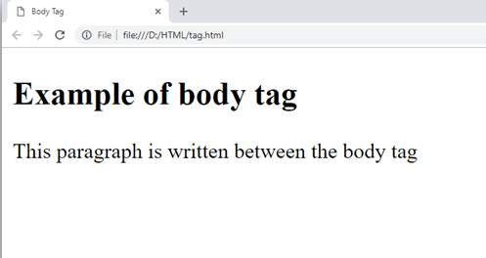

Body tag
HTML <body> tag defines the main content of an HTML document which displays on the browser.
It can contain text content, paragraphs, headings, images, tables, links, videos, etc.
The <body> must be the second element after the <head> tag or it should be placed between </head> and </html> tags.
Syntax:

Slide 6
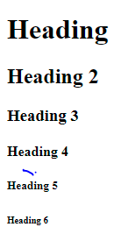
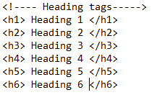
Heading tags
Heading tags indicate headings on a webpage by using code to tell a web browser how to display content.
This tag is used organize your content into a format that's easy to read.
he heading elements are H1, H2, H3, H4, H5, and H6 with H1 being the highest (or most important) level and H6 the least.
Syntax:

Slide 7

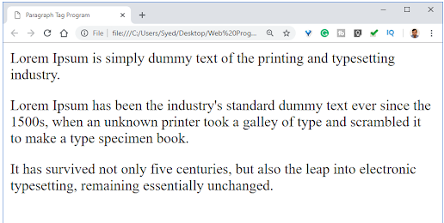
Paragraph tag
The <p> tag is a block element used to designate a paragraph.
Syntax:
Output:

Slide 8
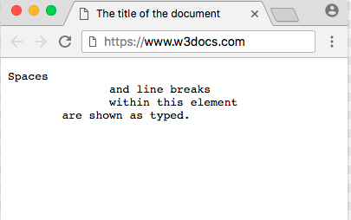

Pre tag
The <pre> tag in HTML is used to define the block of preformatted text which preserves the text spaces, line breaks.
Text in a <pre> element is displayed in a fixed-width font, and the text preserves both spaces and line breaks.
Syntax:

Slide 9

Hr tag
Hr tag is used to display the horizontal line on the screen.
The <hr> tag is an empty tag, and it does not require an end tag.
Syntax:
Output:

Slide 10
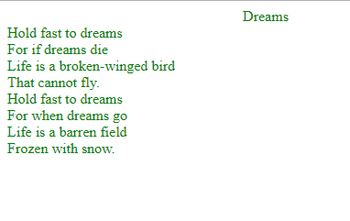
Break attribute
The <br> tag in HTML document is used to create a line break in a text.
It is generally used in poem or address where the division of line is necessary.
It is an empty tag, which means it does not need a company of end tag.
Syntax:
<br>

Slide 11

Hyper link tag
The <a> tag defines a hyperlink, which is used to link from one page to another.
By default, links will appear as follows in all browsers:
An unvisited link is underlined and blue
A visited link is underlined and purple
An active link is underlined and red.

Slide 12


Image tag
The <img> tag is used to embed an image in an HTML page.
Images are not technically inserted into a web page; images are linked to web pages.
Syntax:

Slide 13
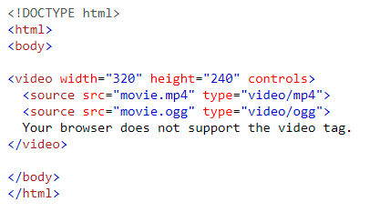

Video tag
The HTML <video> element is used to show a video on a web page.
The controls attribute adds video controls, like play, pause, and volume.
Syntax:

Slide 14
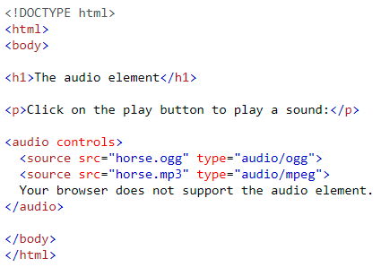
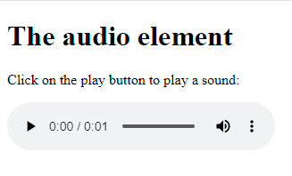
Audio tag
The <audio> tag is used to embed sound content in a document, such as music or other audio streams.
The text between the <audio> and </audio> tags will only be displayed in browsers that do not support the <audio> element.
There are three supported audio formats in HTML: MP3, WAV, and OGG.

Slide 15
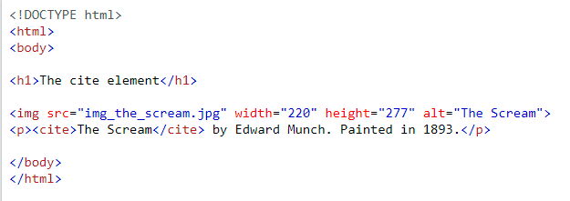
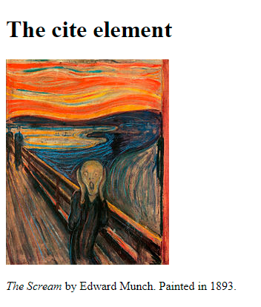
Cite tag
The main purpose of adding <cite> element is to provide or identify the source of the quote or any content.
The content written between <cite> tag renders in the italic form on the browser, and it can be overridden using CSS in your HTML document.
Syntax:

Slide 16
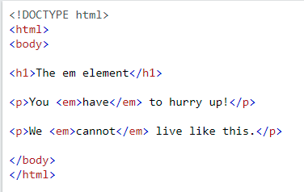
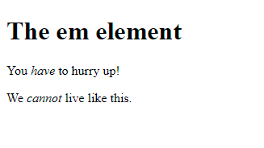
Em tag
The <em> tag is used to define emphasized text.
The content inside is typically displayed in italic.
Syntax:

Slide 17
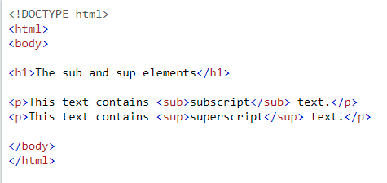
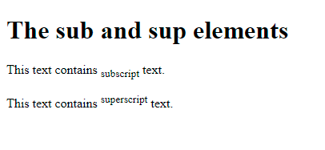
Sub tag
The <sub> tag is used to add a subscript text to the HTML document.
The <sub> tag defines the subscript text.
Subscript text appears half a character below the normal line and is sometimes rendered in a smaller font.
Syntax: OUTPUT

Slide 18
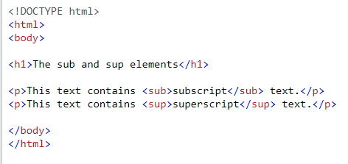
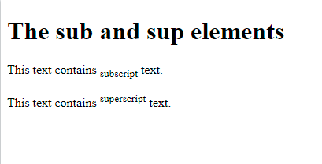
Sup tag
The <sup> tag defines superscript text.
Superscript text appears half a character above the normal line, and is sometimes rendered in a smaller font.
Syntax:

Slide 19
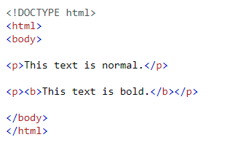
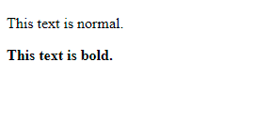
Bold tag
HTML bold tag is represented by <b> tag.
HTML <b> tag is used to display the written text in bold format.
Syntax:

Slide 20
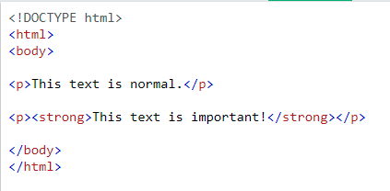
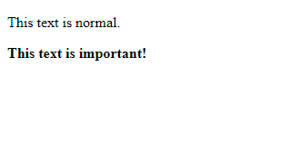
Strong element
The HTML <strong> element defines text with strong importance.
The content inside is typically displayed in bold.
Syntax:

Slide 21




Other tags
Italic text
Marked text
Smaller text
Deleted text
Inserted text

Slide 22
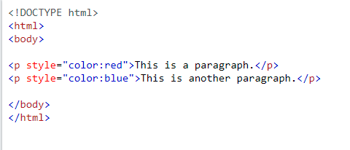
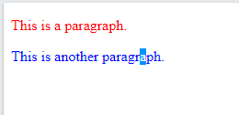
Set the color of the text

Slide 23
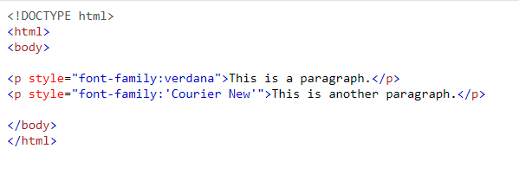
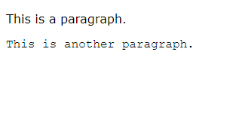
Set the font of the text

Slide 24
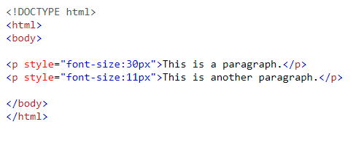
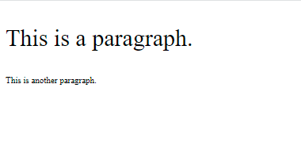
set the size of the text

Slide 25
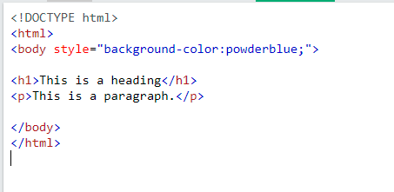

Background color

Slide 26
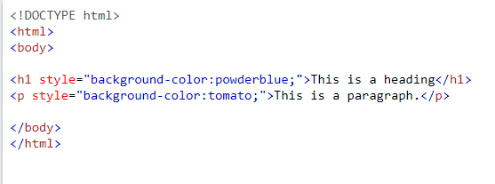
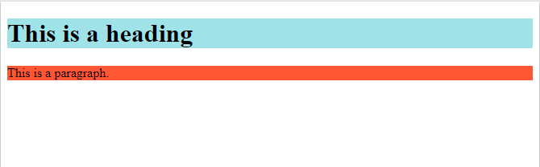
Set background color for two different elements

Slide 27
Any question?

