Slide 1
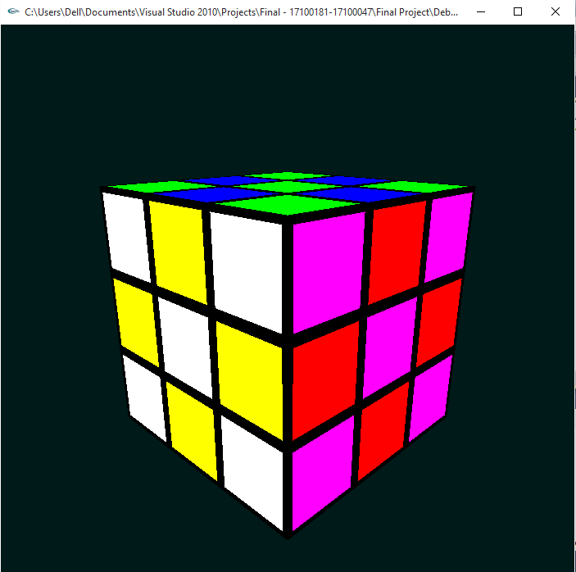
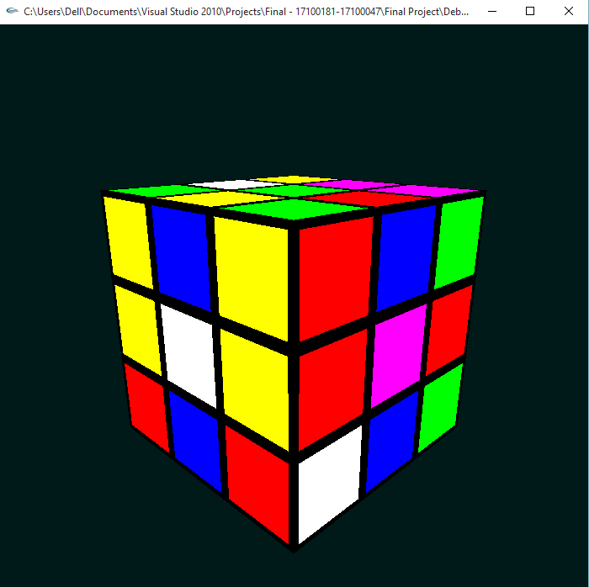
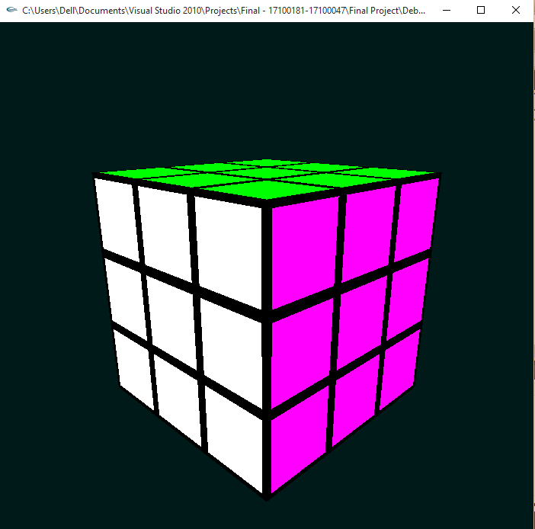
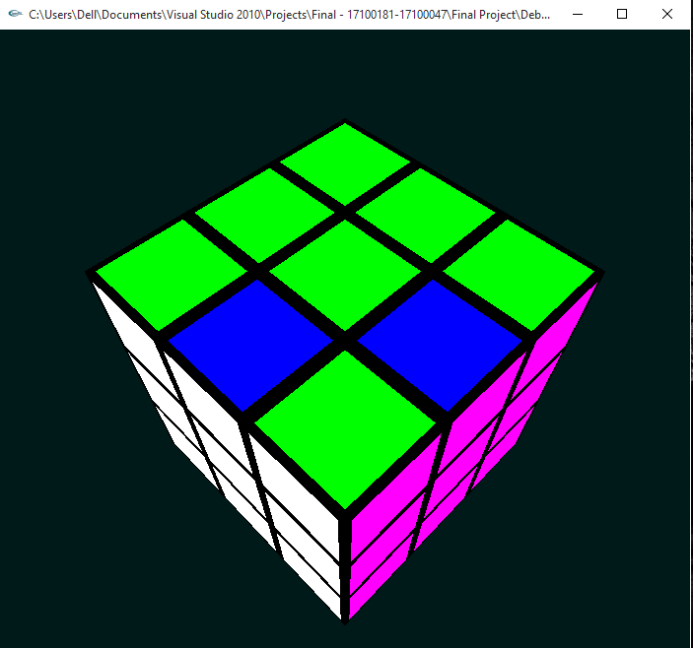
RUBIK’S CUBE
Three kinds of rotations called Pitch, Roll and Yaw
Texture Mapping used to color faces
Vectors used to store colors for each face of the cube
Vectors Updated according to each Rotation
Cubes are reset after 90 degree rotation in any direction but since vectors updated the colors change
Both Concepts combine to form our rotations for the cube

