Slide 1
Basic Image Manipulation & Processing Techniques
Introduction to Filtering with OpenCV & scikit-image
Harish Kashyap : harish@pandita.ai

Slide 2
Overview
- Basic Image Manipulation Techniques
- Introduction to Image Filtering & Processing
- Implementing Filters Using OpenCV (cv2.filter2D)
- Using scikit-image for Image Processing
- Techniques: Thresholding, Edge Detection, and More

Slide 3
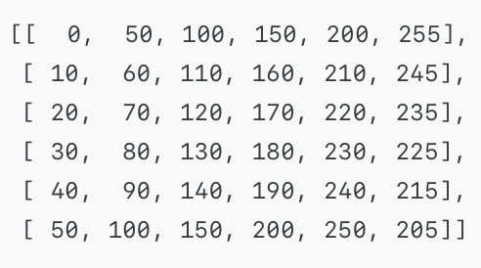
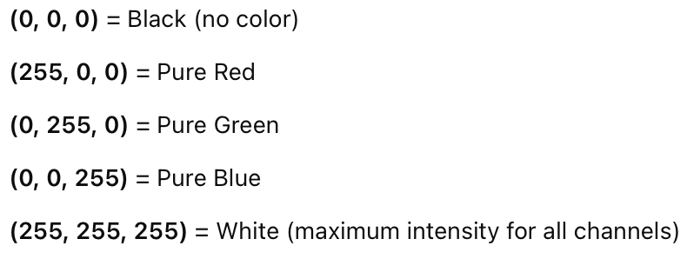
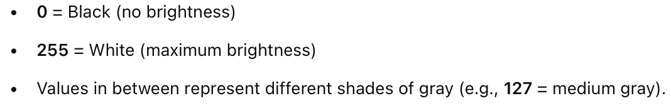
Basic Image Concepts
- Digital Image Basics: 2D array of pixel values
- Grayscale vs. Color (RGB) images
- Pixel intensity & channels
- Common Formats: JPEG, PNG, BMP

Slide 4
Basic Image Manipulation Techniques
Resizing: Change image dimensions
Cropping: Extract a region of interest (ROI)
Rotating & Flipping: Reorient images
Color Conversions: RGB ↔ Grayscale, RGB ↔ HSV

Slide 5
Introduction to Image Processing & Filtering
Why Filter?
Smooth noise
Enhance edges/structures
Detect features
Linear & Non-Linear Filters
Linear: Convolution-based (blur, sharpen)
Non-Linear: Median filtering (noise removal)

Slide 6
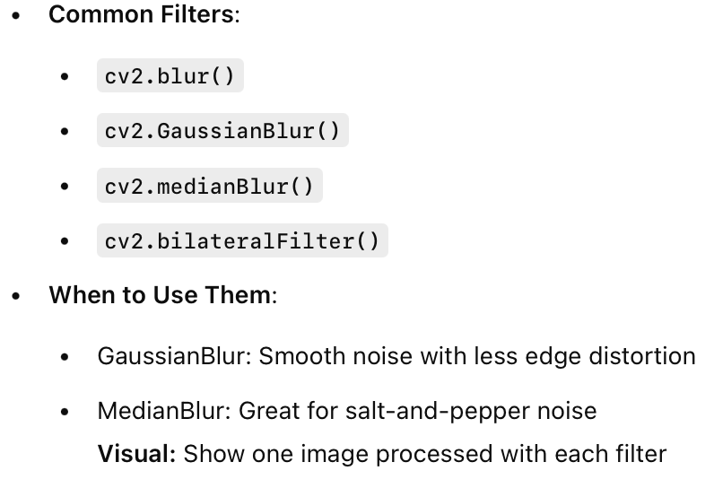
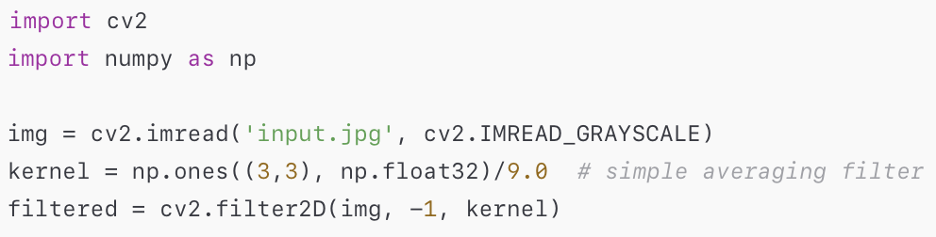
Using OpenCV for Filtering

Slide 7
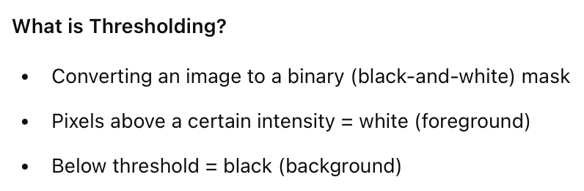
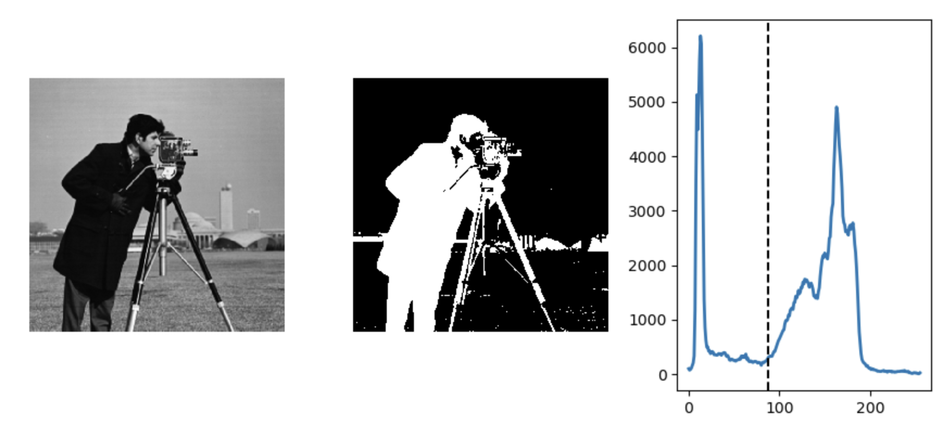
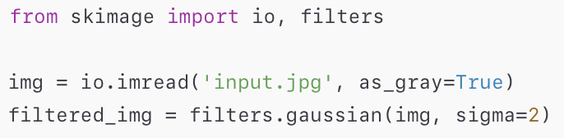
Thresholding
https://scipy-lectures.org/packages/scikit-image/auto_examples/plot_threshold.html

Slide 8
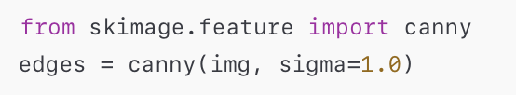
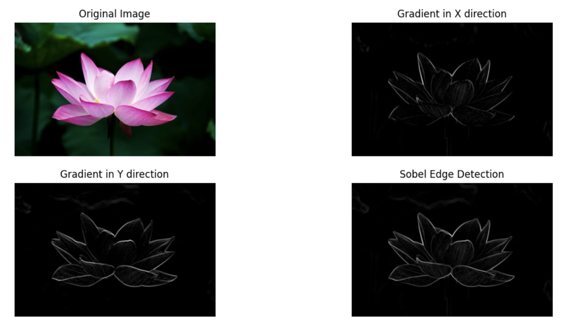

Edge Detection

Slide 9
Notebooks
Q & A

