Slide 1
Generative Models I – Variational Autoencoders (VAEs)

Slide 2

Harish Kashyap: harish@pandita.ai
An Entrepreneur and an expert in Machine learning, Robotics, Big data, GenerativeAI and Signal processing.
Over a decade of experience as a researcher across various industries, including Amazon Robotics, KLA Tencor and BBN Technologies.
Career highlights include leading the development of AI-driven algorithms that interact with robotic systems.
Founder of two companies, Mysuru Consulting Group(MCG) and Pandita AI.
GitHub: https://github.com/harishkashyap
LinkedIn: https://www.linkedin.com/in/hkashyap/

Slide 3
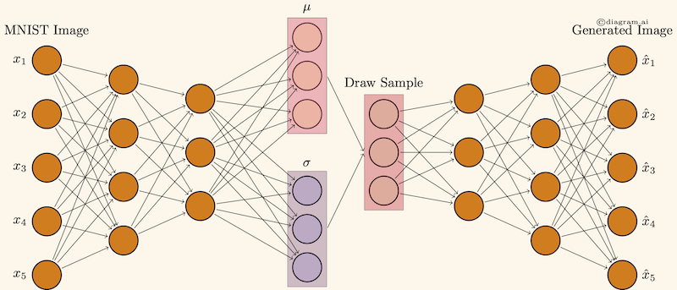
Introduction to VAEs
What are VAEs?
A type of generative model combining deep learning and probabilistic inference.
Key Applications:
Image generation
Anomaly detection
Data compression
ref: diagram.ai

Slide 4

Mathematical Foundations of VAEs
Core Concepts:
Encoder-decoder architecture
Latent space zzz (low-dimensional representation)
Reconstruction and generation
Key Loss Components:
Reconstruction Loss: Measures how well the generated image matches the original.
KL-Divergence Loss: Ensures latent space aligns with a prior distribution.
Equation Highlight:

Slide 5
Implementation: Building a VAE
Steps to Implement:
Design the encoder: Maps input data to latent space.
Design the decoder: Maps latent variables to output data.
Optimize the VAE loss function.
Notebook Concepts:
Sampling latent space
Training with stochastic gradient descent

Slide 6
Introduction to VAEs
What are VAEs?
A type of generative model combining deep learning and probabilistic inference.
Key Applications:
Image generation
Anomaly detection
Data compression
ref: diagram.ai

Slide 7
Applications of VAEs
Image Generation:
- Generate realistic, unseen images (e.g., MNIST, faces).
Latent Space Exploration:
Interpolating between points in latent space to create hybrid images.
Anomaly Detection:
Identify unusual patterns based on reconstruction loss.
Other Areas:
- Data augmentation, text generation, and 3D modeling.

Slide 8
Advantages and Limitations
Advantages:
- Scalable to large datasets.
- Effective latent space representation.
- Probabilistic framework enables uncertainty modeling.
Limitations:
Blurry outputs compared to GANs.
KL-divergence tuning can be tricky

Slide 9
Summary
Key Takeaways:
- VAEs are powerful for generative modeling with probabilistic underpinnings.
- Effective for tasks requiring compact representations and controlled generation
Future Directions:
Explore VAEs in multimodal data, healthcare, and robotics.

