Slide 1
Current Research and Future Directions
Section 10

Slide 2
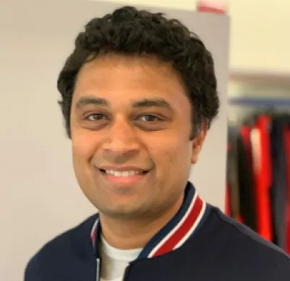
Harish Kashyap: harish@pandita.ai
An Entrepreneur and an expert in machine learning, robotics, big data, generativeAI and signal processing
Over a decade of experience as a researcher across various industries, including Amazon Robotics, KLA Tencor and BBN Technologies
Career highlights include leading the development of AI-driven algorithms that interact with robotic systems
Founder of two companies: Mysuru Consulting Group(MCG) and Pandita AI
GitHub: https://github.com/harishkashyap
LinkedIn: https://www.linkedin.com/in/hkashyap/
2

Slide 3
Recent Papers and Emerging Trends
The field of generative models and computer vision (CV) has witnessed significant advances, with research focusing on improving model performance, efficiency, and real-world applicability
Some notable areas are
Generative Models for Creative Applications
Efficient and Sustainable AI
Multimodal Generative Models
Unsupervised and Self-Supervised Learning
Domain-Specific Generative Models

Slide 4
Generative Models
Recent papers have highlighted applications in art, design, and entertainment, where generative models like DALL-E and Stable Diffusion create visually compelling and novel outputs
Researchers are improving controllability and customization to meet user-specific requirements

Slide 5
Efficient and Sustainable AI
To address the computational challenges of large-scale models, new architectures such as lightweight GANs and efficient transformers have been proposed
Methods like pruning, quantization, and distillation are emerging as essential tools for reducing the energy footprint of generative models without compromising quality

Slide 6
Multimodal Generative Models
Cross-modal models, which integrate text, image, and audio modalities, are growing in popularity
Notable examples include CLIP and Flamingo, which seamlessly link visual and textual representations to enable diverse applications, from image generation to video synthesis

Slide 7
Un-Supervised and Self-Supervised Learning
Advances in self-supervised learning (SSL) frameworks, such as MAE (Masked Autoencoders), are driving improvements in CV tasks
These methods reduce reliance on labeled data, enabling scalable training and wider adoption in industries with limited annotated datasets.

Slide 8
Domain-Specific Generative Models
Research into applying generative models to specialized domains such as medicine (e.g., synthetic medical imaging for diagnostics) and engineering (e.g., aerodynamic simulations in aerospace) is gaining traction

Slide 9
Ethical Considerations
Bias and Fairness
Training on biased datasets can perpetuate societal inequities
Solutions: Fairness-aware algorithms and bias auditing tools
Deepfake Detection
Malicious use of generative models (e.g., deepfakes) raises security concerns
Solutions: Robust detection methods and watermarking technologies to verify authenticity
Privacy Concerns
Sensitive data, especially in healthcare, requires stringent privacy measures
Solutions: Differential privacy and federated learning to protect data
Environmental Impact
High computational demands lead to significant energy consumption
Solutions: Optimization techniques, green energy adoption, and efficient model designs

Slide 10
Future Directions
Human-Centric Design
AI tools that augment creativity and decision-making
Explainable Models
Interpretable frameworks to enhance trust
Integration with Edge Computing
Real-time generative capabilities on devices
Open-Source Collaboration
Democratization through shared datasets and tools

Slide 11
Core Technologies Shaping Computer Vision
Cloud Computing
AutoML
Transformer Architectures
Mobile and Edge Computing

Slide 12
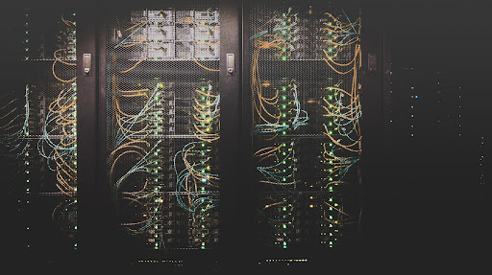
Cloud Computing
Provides scalable storage and compute resources
Platforms:
AWS, GCP, Azure
Tools:
NVIDIA Triton Inference Server, NGC Catalog
Growth driven by real-time applications
Reference: https://developer.nvidia.com/blog/the-future-of-computer-vision/

Slide 13
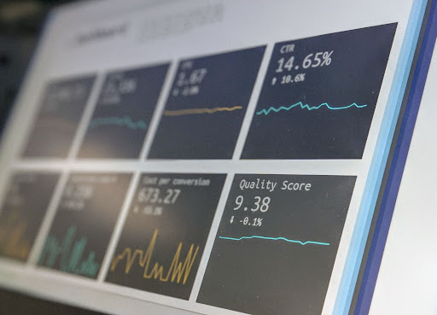
AutoML
Automates tasks like feature engineering and hyperparameter tuning
Tools:
TPOT, RAPIDS
Benefits:
Saves time, simplifies workflows
Growing market value, enabling non-experts to adopt ML
Reference: https://developer.nvidia.com/blog/the-future-of-computer-vision/

Slide 14
Transformer Architectures
Originally developed for NLP, transformers are being applied in computer vision, revolutionizing tasks like object detection and image generation
Example:
Vision Transformer(ViT)
Applications:
Object detection, image generation
Focus on attention mechanisms, not CNNs
Reference: https://developer.nvidia.com/blog/the-future-of-computer-vision/

Slide 15
Mobile and Edge Computing
On-device inference for reduced latency and enhanced privacy
Applications:
Image recognition, AR/VR
Tools:
TensorFlow Lite, MediaPipe
Reduces dependency on cloud resources
Reference: https://developer.nvidia.com/blog/the-future-of-computer-vision/

Slide 16
Thank You

