Slide 1
Domain Adaptation and Transfer Learning
Section 9

Slide 2

Harish Kashyap: harish@pandita.ai
An Entrepreneur and an expert in machine learning, robotics, big data, generativeAI and signal processing
Over a decade of experience as a researcher across various industries, including Amazon Robotics, KLA Tencor and BBN Technologies
Career highlights include leading the development of AI-driven algorithms that interact with robotic systems
Founder of two companies: Mysuru Consulting Group(MCG) and Pandita AI
GitHub: https://github.com/harishkashyap
LinkedIn: https://www.linkedin.com/in/hkashyap/
2

Slide 3
Cross-Domain Learning Techniques
In the vast world of machine learning, one common challenge is training a model on one domain and deploying it to another domain and this scenario is known as cross-domain learning
Whether you want to apply a model trained on one type of data to a different type of data or transfer knowledge from one task to another, cross-domain learning offers a solution

Slide 4
Key Aspects
Transfer Learning
This is the core concept where a pre-trained model on a source domain is used as a starting point for learning in a target domain, often by fine-tuning the model on the new data
Domain Adaption
Techniques that aim to bridge the gap between the source and target domains, often by aligning feature distributions or using adversarial training methods

Slide 5
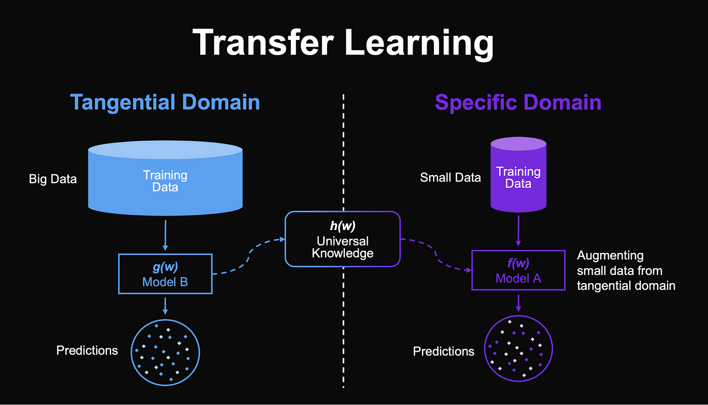
Transfer Learning
Transfer learning involves leveraging knowledge from a source domain to improve learning in a target domain
Domain adaptation is a subset where the source and target domains have different distributions but similar tasks
Reference: https://medium.com/nerd-for-tech/domain-adaptation-problems-in-machine-learning-ddfdff1f227c

Slide 6
Transfer Learning Types
Inductive
Adapt existing supervised training model on new labeled dataset
Example: Classification, Regression
Transductive
Adapt existing supervised training model on new unlabeled dataset
Example: Classification, Regression
Unsupervised
Adapt existing unsupervised training model on new unlabeled dataset
Example: Clustering, Dimensionality Reduction

Slide 7
Transfer Learning Applications
Image classification (most common): learn new image classes
Text sentiment classification
Text translation to new languages
Speaker adaptation in speech recognition
Question answering

Slide 8
Pros and Cons
Pros
Efficiency
Performance Improvement
Scalability
Cons
Overfitting
Negative Transfer
Limited cross-domain compatibility

Slide 9
Domain Shifts
Variations between training (source) and deployment (target) data distributions
Types of Shifts
Covariate Shift
Change in input distribution
Prior Probability Shift
Change in the distribution of output labels
Concept Shift
Change in the relationship between inputs and outputs

Slide 10
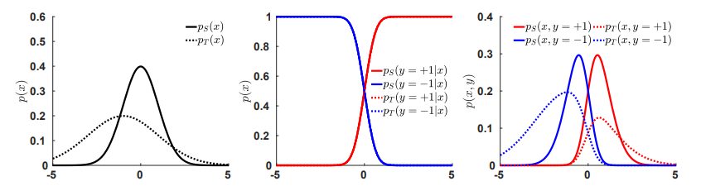
Covariate Shift
Covariate shift is one of the most studied forms of data set shift
It occurs most often when there is a form of sample selection bias
Selection bias is defined as the altered probability of being sampled
Reference: https://medium.com/nerd-for-tech/domain-adaptation-problems-in-machine-learning-ddfdff1f227c

Slide 11
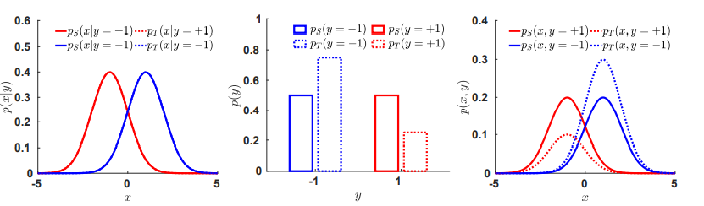
Prior Shift
For prior shift, the prior probabilities of the classes are different, but the conditional distributions are equivalent, pS(x|y) = pT(x|y)
This can occur in for example fault detection settings, where a new maintenance policy might cause less faults, or in the detection of oil spills before versus after an incident
Reference: https://medium.com/nerd-for-tech/domain-adaptation-problems-in-machine-learning-ddfdff1f227c

Slide 12
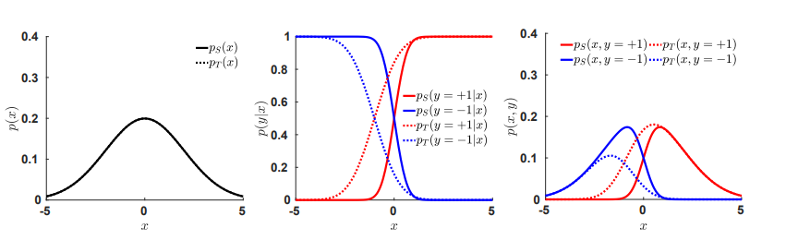
Covariate Shift
In the case of concept shift, the data distributions remain constant while the posteriors change
For instance, consider a medical setting where the aim is to make a prognosis for a patient based on their age, severity of their flu, general health and their socio-economic status
Reference: https://medium.com/nerd-for-tech/domain-adaptation-problems-in-machine-learning-ddfdff1f227c

Slide 13
Strategies to Mitigate Domain Shifts
Data Centric Approaches
Data Augmentation
Enhancing training data to cover a broader range of scenarios
Synthetic Data Generation
Creating artificial data that mimics the target domain
Model Centric Approaches
Robust Training
Incorporating regularization techniques to improve generalization
Ensemble Methods
Combining multiple models to enhance resilience to domain shifts

Slide 14
Real World Challenges in Handling Domain Shifts
Lack of Target Data
Collecting labelled data for the target domain is often expensive or infeasible
Computational Complexity
Fine-tuning or retraining models can require significant computational resources
Evaluation Metrics
Defining success in domain adaptation can be ambiguous without a clear understanding of the target domain's objectives

Slide 15
Thank You

