Slide 1
Serverless Search Architecture

Slide 2



Slide 3



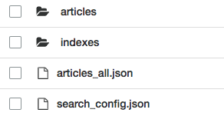


System Architecture
Amazon S3
Lambda function
search article
Document_Search
search config
search indexes
API Layer
Fetch the relevant indexes from S3
Load them in-memory and perform search
Return the query results
on object create
search indexes
Lambda function
Lambda function
/search
/config
/add
Document_Batcher
Document_Indexer
all articles
Amazon API Gateway
Runs every 5 minutes
Cleans up the articles folder to compact individual documents into one larger ”batched” document
Read the search_config for index info
Iterates through all uploaded articles
Uploads search_index as per config, and size of each index as per shard value
Caches data in articles_all
Cloudwatch Event
Search Indexing and Querying powered by lunr.js
rlingineni/lambda-serverless-search

Slide 4
Document Indexing Latency
Upgrading from 320 to 512 mb
Upgrading from 512 to 1024 mb
1024 MB is ideal. Higher can be even better
There are 1000ms in a second
rlingineni/lambda-serverless-search

Slide 5
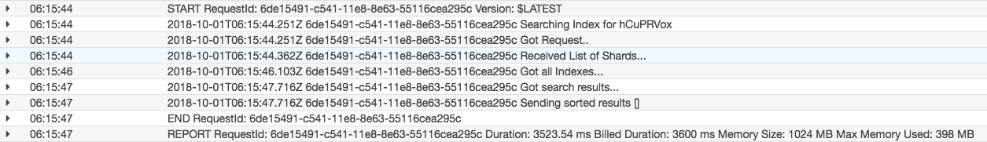
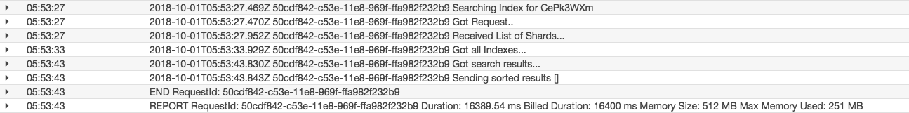
Search Query Latency on 18,000 records
Network latency to fetch index takes ~2s minimum.
1024 mb –> ~4s
Lower memory takes a long time to query the index after it’s loaded from the store
512 mb -> ~15s
*not shown 320mb, which began timing out, trying to load and query the index as the indexes grew in size.
rlingineni/lambda-serverless-search

