Slide 1
SALES PERFORMANCE
AND REVENUE ANALYSIS
Interactive Power BI Dashboard Project
Data-driven view of sales, revenue, orders, channels, regions and payment methods
TOTAL SALES
717.01M
TOTAL REVENUE
638.76M
TOTAL ORDERS
10K
TOTAL QUANTITY
35K
Sales Performance & Revenue Analysis • 1

Slide 2
Project Overview
Purpose, scope and business questions
PROJECT PURPOSE
Build an interactive dashboard to understand sales performance and revenue patterns across multiple business dimensions.
BUSINESS QUESTIONS
• How are sales and revenue performing?
• Which sales channels contribute most revenue?
• How do regions and payment methods perform?
• What order-status patterns are visible?
• Which products contribute to sales?
ANALYSIS AREAS
Sales Amount
Revenue
Orders & Quantity
Sales Channel
Region
Payment Method
Product Category
Order Status
Sales Performance & Revenue Analysis • 2

Slide 3
Tools & Analytical Workflow
From raw data to an interactive business dashboard
01
02
03
04
05
DATA
CLEAN
MODEL
VISUALIZE
INSIGHT
Collect and inspect
sales/order data
Prepare fields and
handle data types
Create relationships and
analytical measures
Build KPIs, charts,
slicers and navigation
Interpret patterns for
business reporting
Sales Performance & Revenue Analysis • 3

Slide 4
Executive KPI Summary
Headline metrics visible across the dashboard
TOTAL SALES
717.01M
Sum of Sales Amount
TOTAL REVENUE
638.76M
Sum of Revenue
TOTAL ORDERS
10K
Count of orders / order status records
TOTAL QUANTITY
35K
Sum of Quantity
TOTAL UNIT PRICE
216.26M
Sum of Unit Price shown in dashboard
COMPLETED ORDERS
8.6K
Order status view
Sales Performance & Revenue Analysis • 4

Slide 5
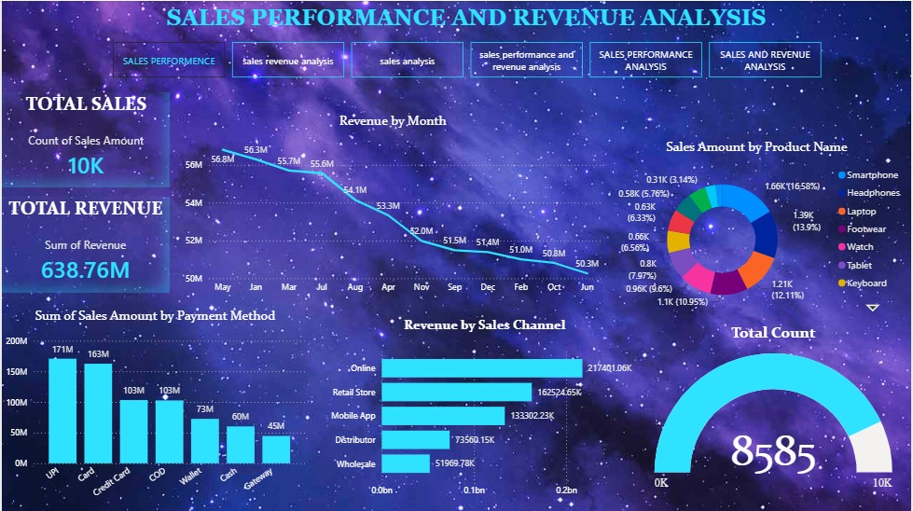
Dashboard View 1 — Sales Performance
Core KPIs, monthly revenue, product mix, payment methods and sales channels
Sales Performance & Revenue Analysis • 5

Slide 6
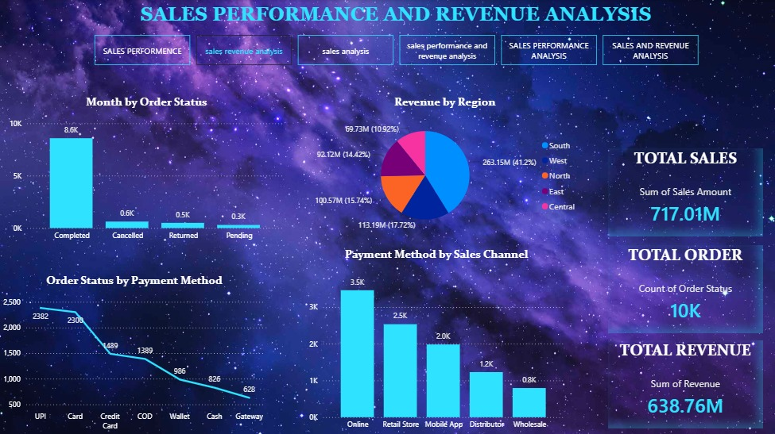
Dashboard View 2 — Orders & Regional Analysis
Order status, region revenue and payment method distribution
Sales Performance & Revenue Analysis • 6

Slide 7
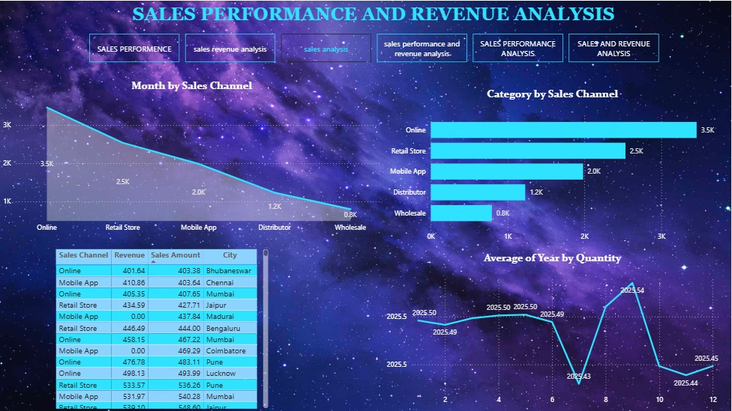
Dashboard View 3 — Channel & Category Analysis
Sales channel performance, category distribution and detailed transaction view
Sales Performance & Revenue Analysis • 7

Slide 8
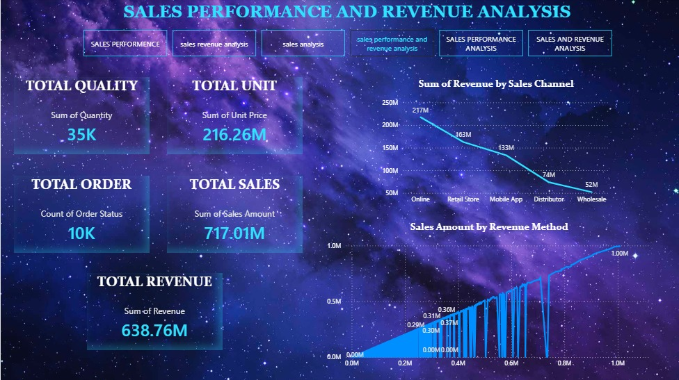
Dashboard View 4 — Revenue & Method Analysis
Revenue by sales channel with supporting sales and revenue method visuals
Sales Performance & Revenue Analysis • 8

Slide 9
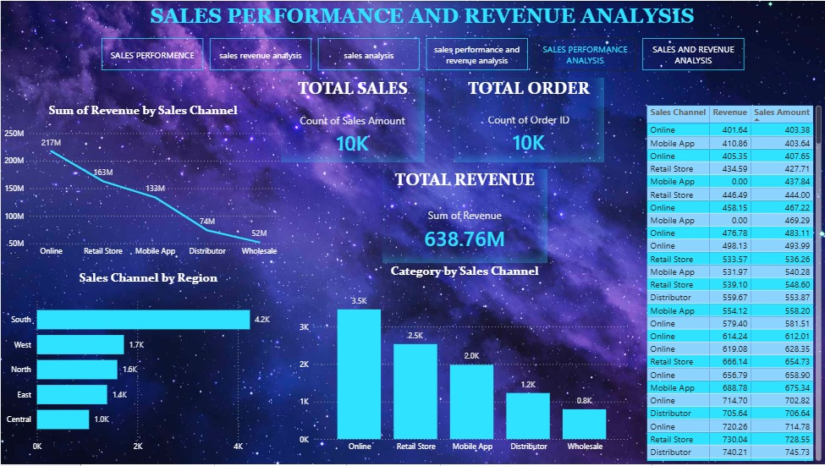
Dashboard View 5 — Channel, Region & Detail
Combined view of revenue, regional sales and category-by-channel performance
Sales Performance & Revenue Analysis • 9

Slide 10
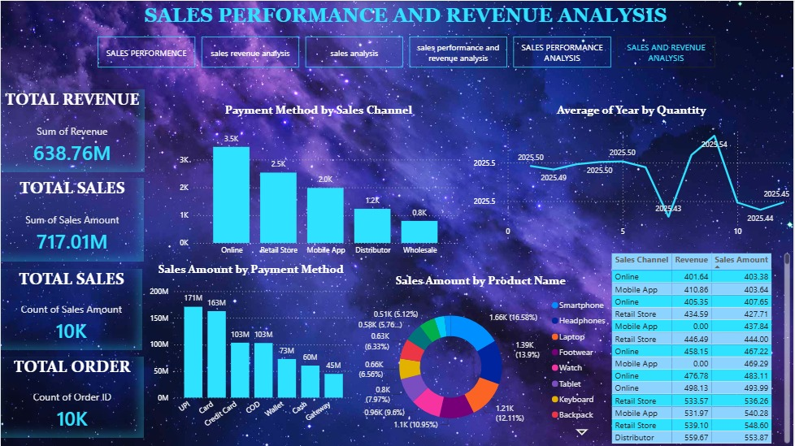
Dashboard View 6 — Payment & Product Analysis
Payment method contribution, product sales distribution and supporting detail table
Sales Performance & Revenue Analysis • 10

Slide 11
Key Insights from the Dashboard
Selected observations directly visible in the presented visuals
Revenue
The dashboard reports total revenue of 638.76M and total sales of 717.01M.
Sales Channel
Online contributes about 217M in revenue, followed by Retail Store at about 163M.
Region
The regional chart shows South at about 263.15M revenue, followed by West at about 113.19M.
Payment
UPI shows about 171M in sales amount, followed by Card at about 163M.
Order Status
Completed orders are shown at about 8.6K, with smaller cancelled, returned and pending counts.
Product Mix
The product donut shows Smartphone as the largest displayed product segment at about 1.66K.
Sales Performance & Revenue Analysis • 11

Slide 12
Conclusion & Business Value
How the dashboard supports data-driven reporting
Converts sales data into an interactive and easy-to-read reporting layer.
Brings KPIs, revenue, orders, channels, regions, products and payment methods into one view.
Makes it easier to compare performance across business dimensions.
Supports faster identification of sales patterns and operational trends.
Provides a reusable dashboard structure for future data updates and analysis.
POWER BI
Interactive
ANALYTICS
Data-driven
REPORTING
Decision support
Sales Performance & Revenue Analysis • 12

Slide 13
THANK YOU
Sales Performance and Revenue Analysis
Power BI Dashboard Project

