Slide 1
Group 14 Presentation
David, Moksh, Connor, Dylan, Priyanka, Injae, Roshan, Mobin

Slide 2





Communication
Communication is essential for success
Our primary digital platform was WhatsApp
Schedule calls
Discuss and split work assignments
Coordinate in-person meetings
Bi-weekly lab sessions
Leveraged Microsoft Teams for video conferencing

Slide 3
OVERVIEW OF THE PURPOSE OF THE PROJECT
PRIYANKA AGHEDA
PA230@STUDENT.LE.AC.UK

Slide 4
AIMS
PROMOTING IBM SKILLSBUILD
ENHANCING USER ENGAGEMENT
ENCOURAGING CONTINUOUS LEARNING
FOSTERING A SENSE OF ACHIEVEMENT
FACILITATING SOCIAL INTERACTION
PROVIDING INSIGHTS FOR IMPROVEMENT

Slide 5
PROMOTING IBM SKILLSBUILD
OFFER AN INTERACTIVE PLATFORM FOR ACCESSING RESOURCES AND COURSES.
ENCOURAGE STUDENT USAGE OF THE WEB APP
SHOWCASE THE BENEFITS OF IBM SKILLSBUILD: VARIETY OF COURSE OPTIONS.

Slide 6
ENHANCING USER ENGAGEMENT
BOOSTS USERS ENGAGEMENT WITH IBM SKILLSBUILD
GAMIFICATION ELEMENTS: INTERACTIVE FEATURES, BADGES, LEADERBOARDS.
MAKE LEARNING ENJOYABLE AND MOTIVATING

Slide 7
ENCOURAGING CONTINUOUS LEARNING
INSPIRE STUDENTS TO PERSIST IN THEIR LEARNING JOURNEY
INTEGRATE PROGRESS TRACKING, BADGES, LEADERBOARD COMPETITIONS.
INCENTIVIZE COMPLETION OF MORE COURSES OVER TIME

Slide 8
FOSTERING A SENSE OF ACHIEVEMENT
ENCOURAGE A SENSE OF ACCOMPLISHMENT AMONG STUDENTS OF THEIR ACHIEVEMENTS.
ACHIEVE MILESTONES AND AWARD BADGES FOR ACCOMPLISHMENTS
MONITOR LEARNING DEVELOPMENT, PROVIDE SIGNALS OF PROGRESSION.

Slide 9
FACILITATING SOCIAL INTERACTION
PROMOTE COLLABORATION AND SOCIAL INTERACTION AMONG STUDENTS
IMPLEMENT FRIEND COMPETITIONS
ENCOURAGE SUPPORTING EACH OTHERS PROGRESS AND LEARNING WITH EACH OTHER.

Slide 10
PROVIDING INSIGHTS FOR IMPROVEMENT
OFFER INSIGHTS INTO ENGAGEMENT PATTERNS AND USER BEHAVIOR
UTILIZE FEATURES LIKE LEADERBOARDS AND ACTIVITY TRACKING.
ENHANCE THE PLATFORM TO BETTER SUIT PREFERENCES AND USER NEEDS.

Slide 11
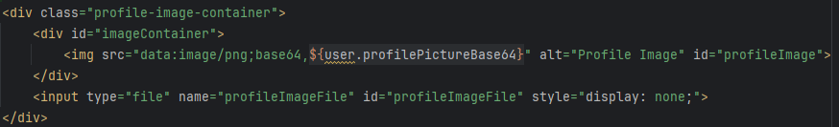
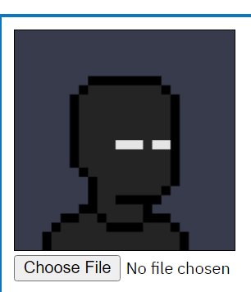
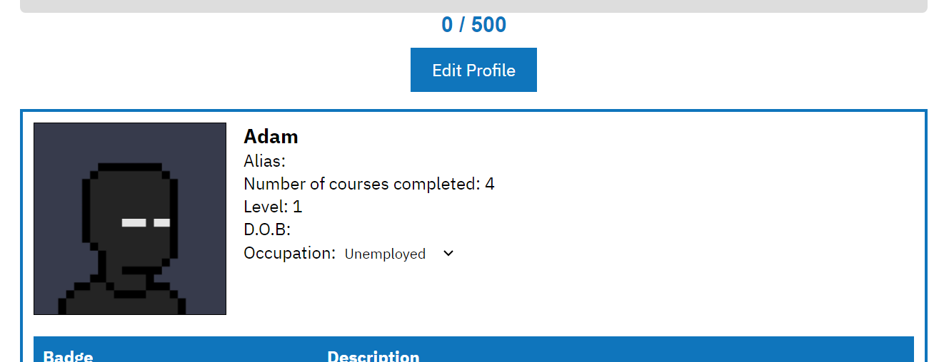
Challenging Feature: Profile Image Upload & Save Feature
HTML code in the JSP where users could input their profile image
Choose file option appears when profile is being edited

Slide 12
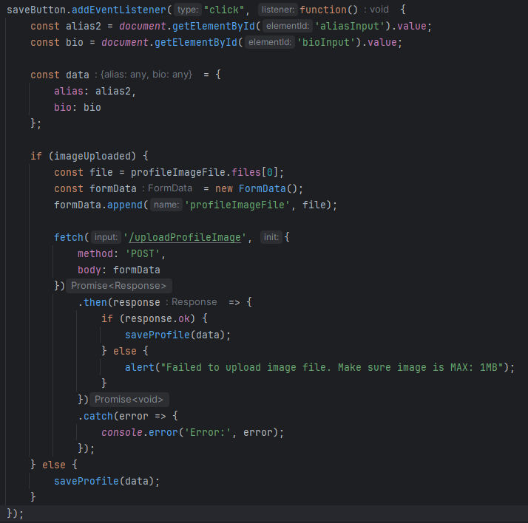
Challenging Feature: Profile Image Upload & Save Feature
JavaScript captures user input and manages the image upload process.
Upon clicking the save button, JavaScript extracts the alias and bio inputs and initiates the upload process.
If an image was uploaded, JavaScript constructs a FormData object and sends it to the server via a POST request, facilitating seamless communication with the backend.

Slide 13

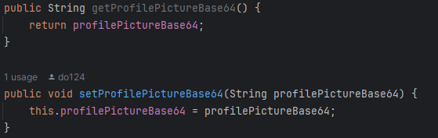
Challenging Feature: Profile Image Upload & Save Feature
The User class serves as a cornerstone in managing user data within our application.
Within this class, the profilePictureBase64 attribute plays a crucial role in storing base64-encoded representations of user profile pictures.
The @Column(length = 110000000) annotation accompanying the profilePictureBase64 attribute signifies the column's maximum length in the corresponding database table.
By specifying a large number, we ensure the column can accommodate images of substantial size after they are encoded as base64 strings, if it is too small then errors will occur even for small image sizes.

Slide 14
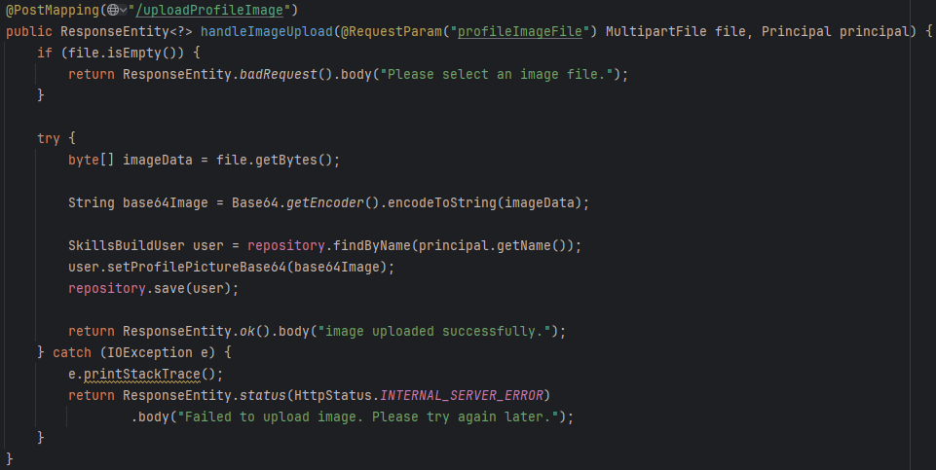
Challenging Feature: Profile Image Upload & Save Feature
Check if the uploaded file is empty. If not, read the file content as a byte array.
Encode the byte array representing the image data into a base64-encoded string.
Base64 encoding converts binary data into ASCII characters, suitable for text-based protocols like HTTP.
Base64 encoding was chosen as it simplifies the storage of image data in the database.
Associate the base64-encoded image string with the user's profile.
Save the updated user object to the repository, persisting the changes to the database.
If successful, return a response indicating the image upload was successful.
If an error occurs, return the error response

Slide 15
EXPLANATION OF A TECHNICALLY CHALLENGING FEATURE
MOKSH PANDYA

Slide 16
SOME FEATURES WE IMPLEMENTED
Login and Signup
Dynamic Leaderboard
Profile customization
Friends system
Level progression system
Most Challenging feature

Slide 17
SOME REASONS FOR THIS:
Authentication:
User Registration:
Scalability:
Roles:

Slide 18
AUTHENTICATION
Implementing secure authentication is vital to guarantee that only users with permission can access the system. The system needs to handle password storage securely, implementing password hashing, and preventing common security vulnerabilities.

Slide 19
USER REGISTRATION & SCALABILITY
Validating user input, addressing registration mistakes, guaranteeing unique usernames and safely storing user data are all necessary to build a strong user registration process.
As the user base grows, the login and signup features need to handle the increase in users and traffic.

Slide 20
ROLES
Implementing set user roles involves defining roles, assigning permissions to roles, and associating roles with users. Ensuring that users are granted appropriate permissions based on their roles requires careful configuration and management of role assignments.

Slide 21
OVERCOMING THE CHALLENGES
To address these challenges, we implemented a robust authentication system that allows users to set their own unique name and password. Our Role-Based Access Control ensures precise user access control. Leveraging a secure database with monitoring, we maintained performance and security as user numbers grew.
With all these measures, we were able to successfully implement a login and signup feature that allows users to securely access the website and enjoy using it without having to worry about security and data breaches.

Slide 22
Allocation of work for IBM SkillsBuild Web App
The IBM SkillsBuild online application's successful development depends on the efficient distribution of work. Tasks can be carefully assigned to improve productivity and guarantee a balanced workload by taking into account each team member's capabilities and workload.

Slide 23
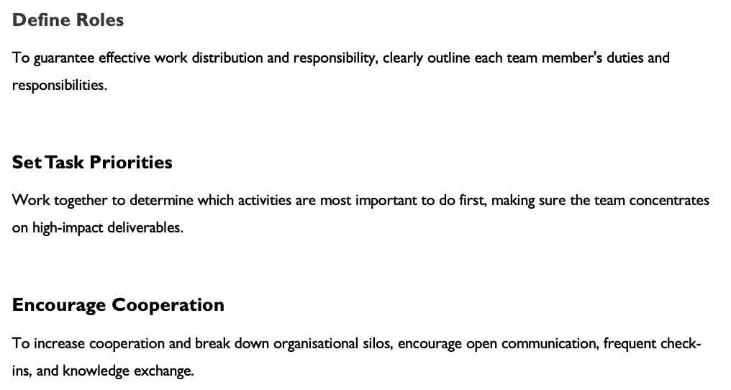
Strategies for Successful Work Allocation

Slide 24
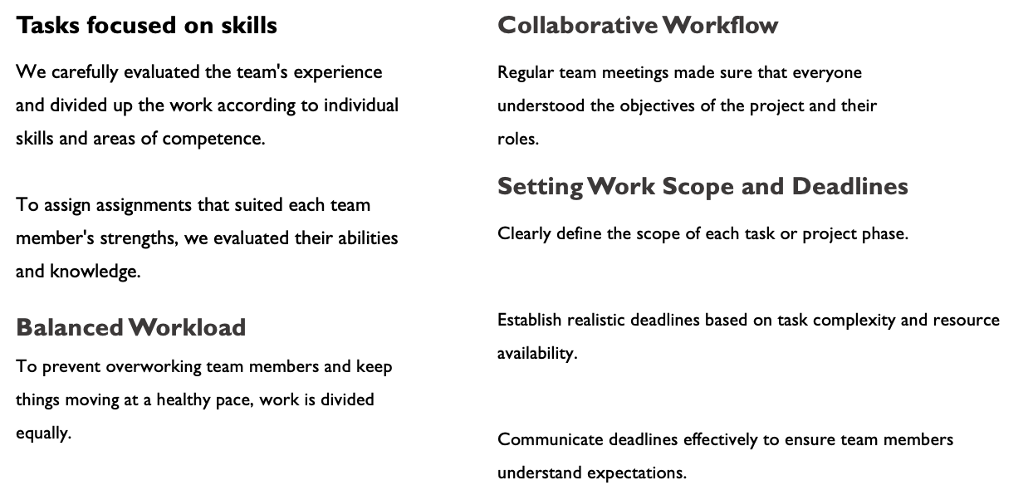
Allocation of work – Strategy and Processes

Slide 25
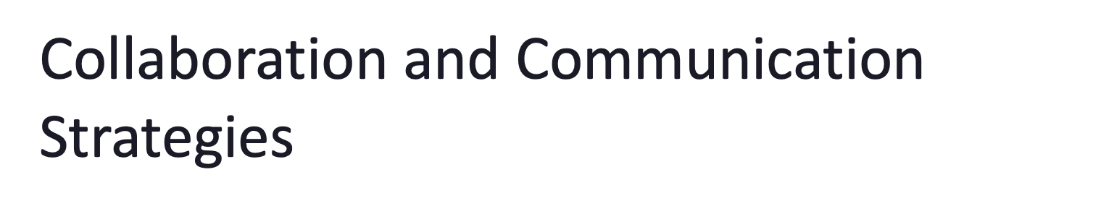
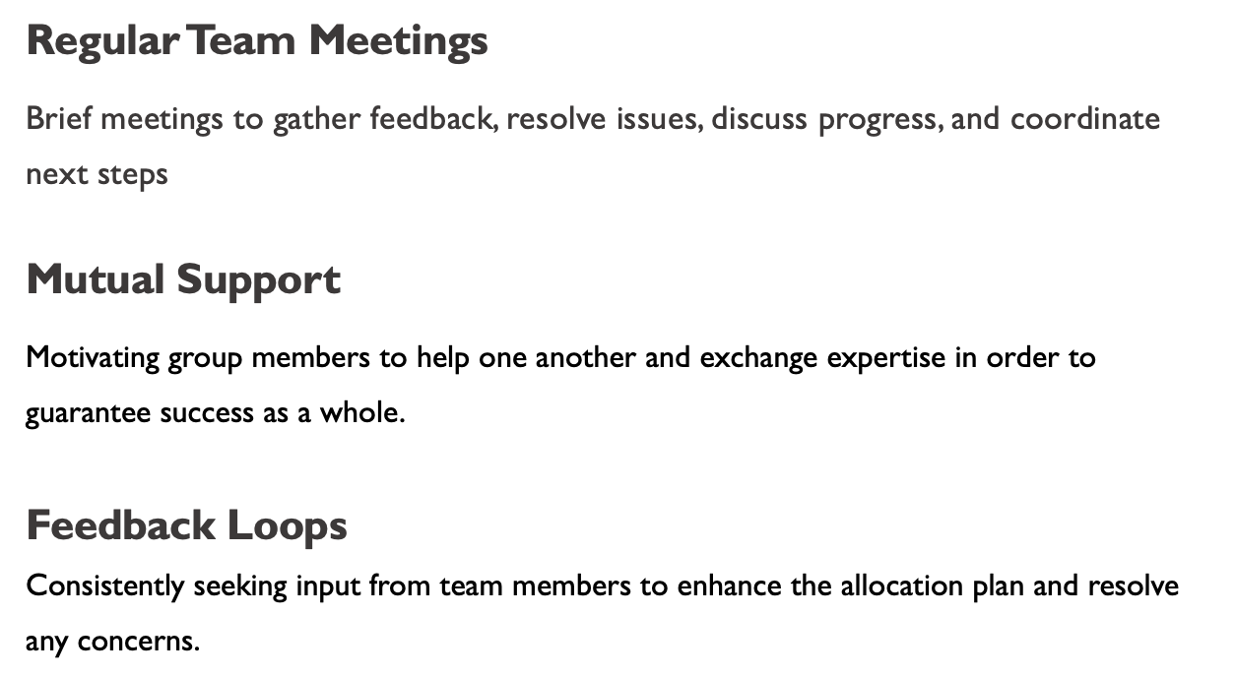

Slide 26
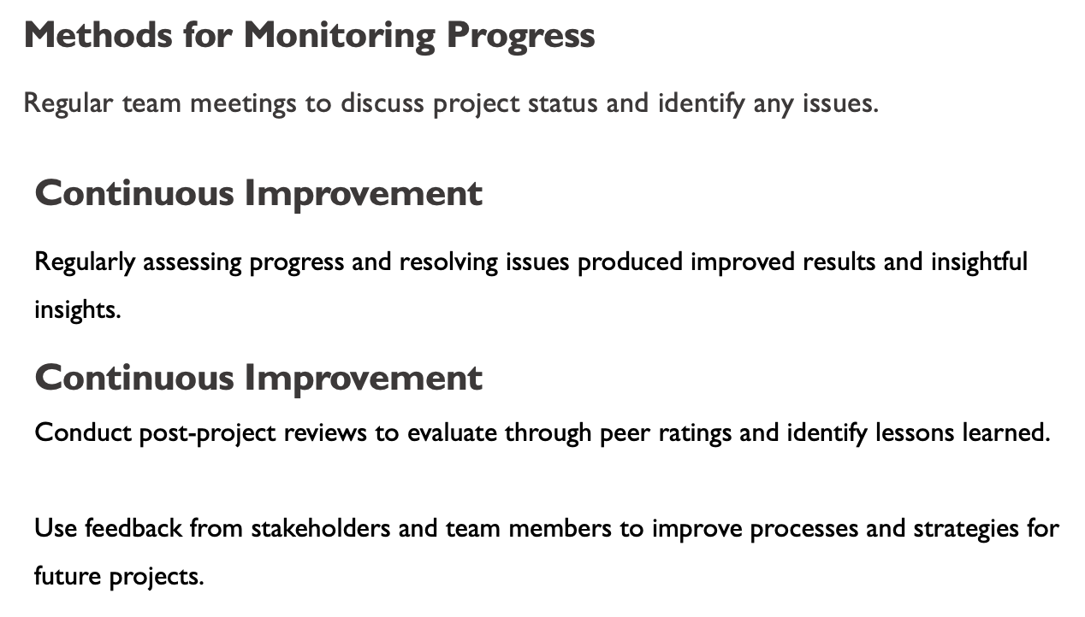
Monitoring Progress & Making Adjustments

Slide 27
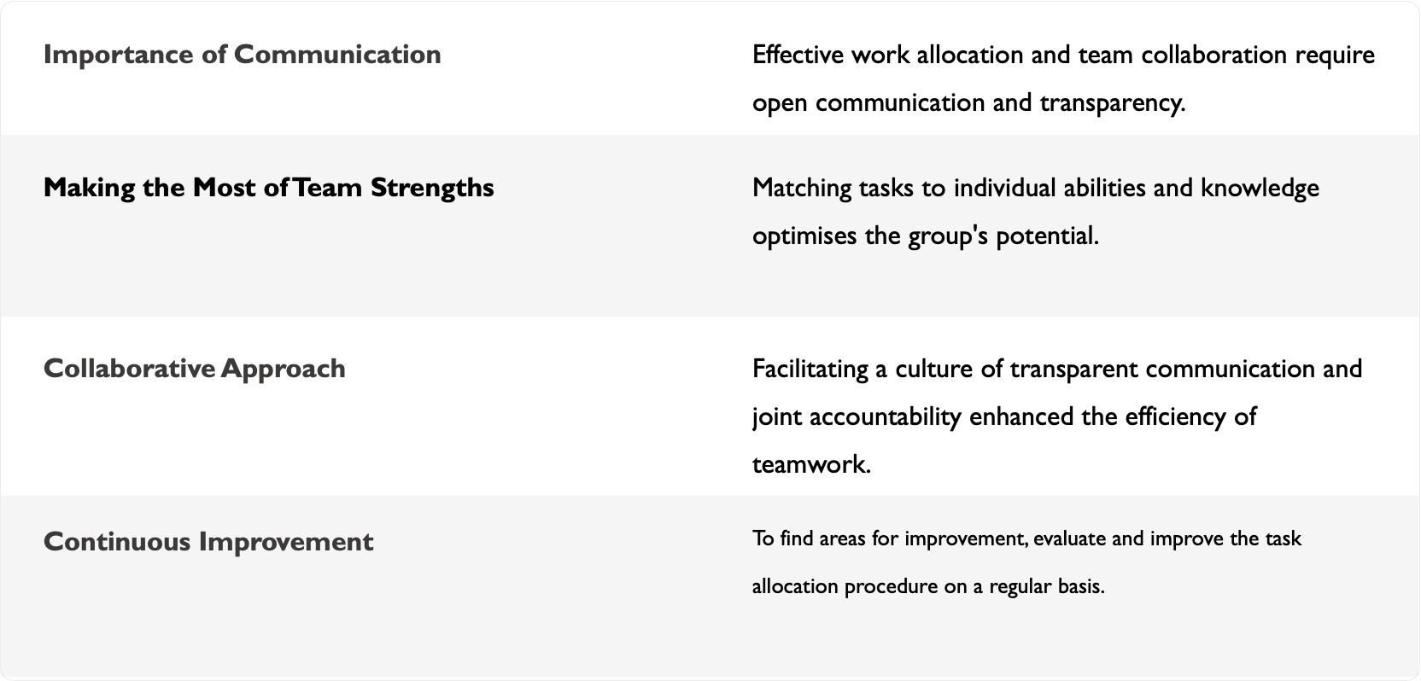
Outcomes and Lessons Learned

Slide 28
What is something non-technical that you learned during the project?

Slide 29

Adaptability
Collaboration with new team members emphasized the need to identify individual strengths for task delegation.
Flexibility and openness to change were vital in addressing unexpected challenges, such as schedule shifts and technical errors.
Adaptability extends outside the technical skills required
For this project

Slide 30

Leadership
Leadership skills are crucial for guiding teams towards success, inspiring and motivating members to perform at their best.
Effective communication and delegating work to each individual is key to keep the project progress running on time
Example:
Scrum Master

Slide 31
Taking the Project Further

Slide 32


Improvements to consider
More focused UI theme to aid navigation of the web app
SSO for users
Reminder notifications for courses that have been started, but not engaged with in a reasonable time period
Personalised course layout

Slide 33
Future Features
Full profile customisation
Better for fostering a sense of community with learners
Ability to show off more achievements you have made
More learning metrics recorded
Give a deeper insight into your learning than the time spent on specific courses
Identify weak points in your learning habits
Deeper integration with IBM SkillsBuild
Real integration would mean better handling of courses, and more ease for users to pick up where they left off
More accurate reporting of time on courses
What could improve the application?

Slide 34

Far future considerations
Improved backend to allow a much larger user base
Better social features
More user engagement than comments on courses
Discussion boards
Moderator features
User safeguarding
Comment content filters
Possible integration with other online learning / certification platforms

Slide 35
Social, Legal or Ethical Considerations
Important: - Social and ethical problems can cause damage to the company and
society as a whole
- Legal problems can cause direct loss of income and lead to fines
Positives ✓ Negatives ❌
Gamification Unreliability of Emerging Tech
Motivation Privacy & GDPR
Competition

Slide 36
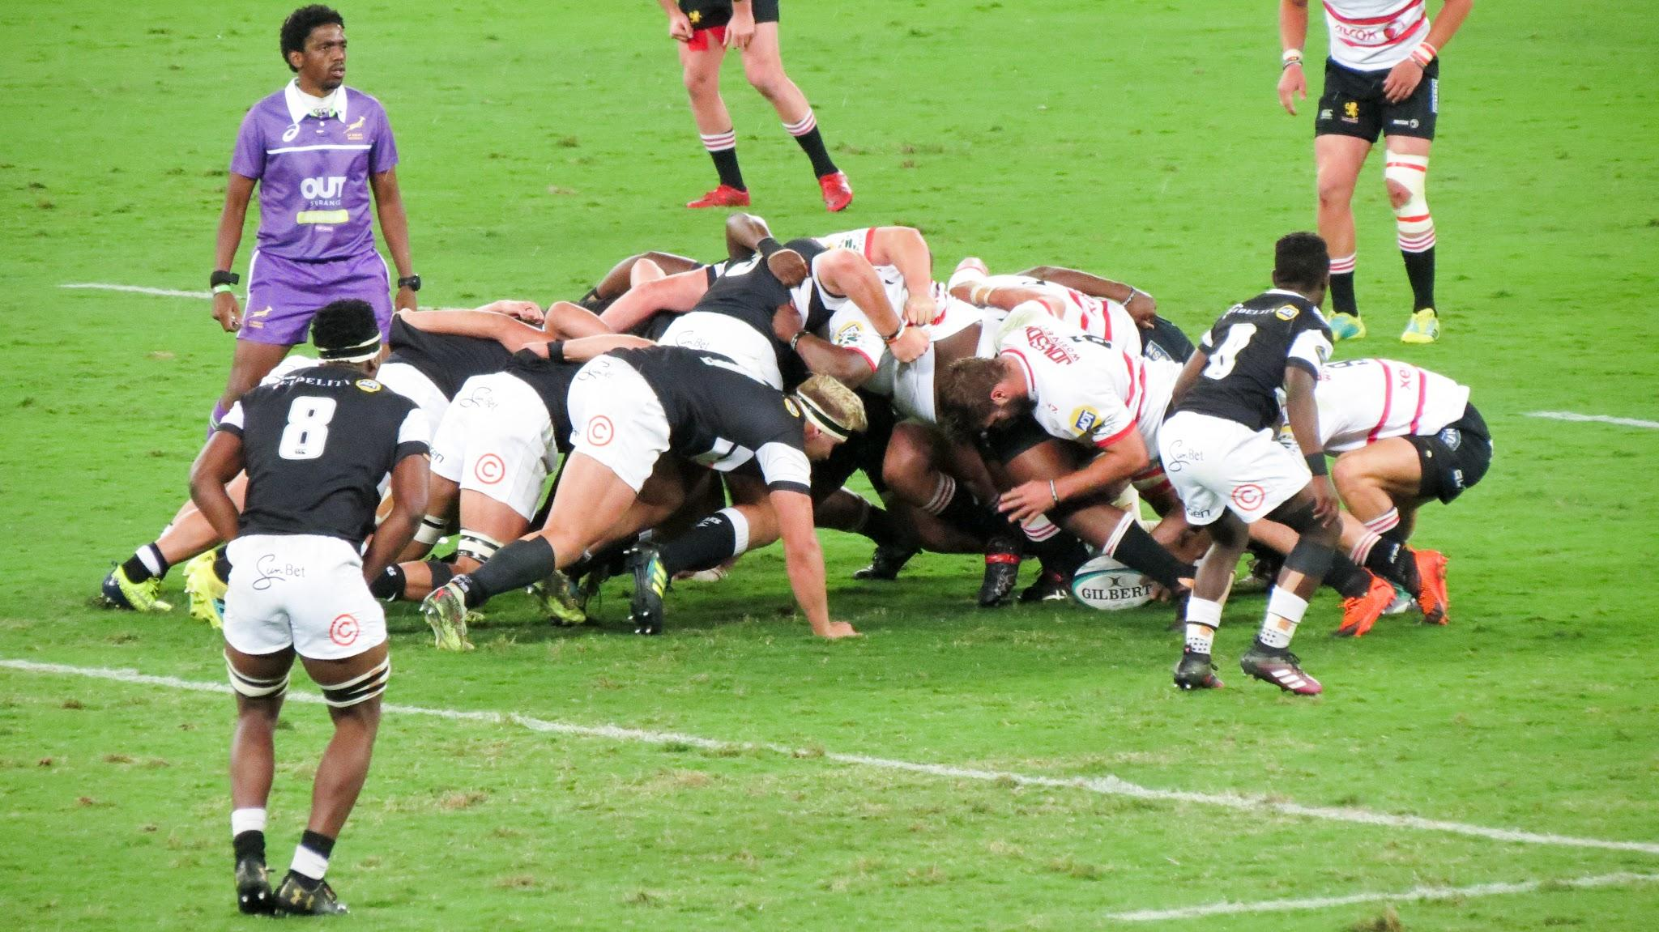
Scrum
Successful use of the Scrum methodology ensures everyone in a team is aware of their tasks and in sync to deliver a high quality product

Slide 37
Scrum - The process
A team using Scrum has it’s work broken down into time-bound iterations, called sprints.
A sprint typically lasts no longer than a month.
To assess the progress made in a sprint, the team should have periodic meetings where everyone can get up to speed and ensure there are no problems.
During sprints, one person is in charge of the team, known as a Scrum Master.

Slide 38

Scrum - Our experience
As a team, we used Scrum to deliver a product to a client.
As per the Scrum methodology, we held many stand-up meetings to ensure we are all up to speed and allow team members to get assistance if needed.
Everyone in our team had the opportunity to be a Scrum Master, lead the stand-ups and gain insightful knowledge into how it works in a professional setting.

Slide 39

Scrum - Was it a success?
In the end, we were able to deliver a high quality product, before the deadline.
Everyone was able to contribute thoroughly to their respective tasks and assignments.
This is thanks to stand-up meetings and other Scrum events that allowed us to work together efficiently.

