Slide 1

A tailless aerial robotic flapper reveals that flies use torque coupling in rapid banked turns
by Matěj Karásek, Florian T. Muijres, Christophe De Wagter, Bart D. W. Remes, and Guido C. H. E. de Croon
Science
Volume 361(6407):1089-1094
September 14, 2018
Copyright © 2018 The Authors, some rights reserved; exclusive licensee American Association for the Advancement of Science. No claim to original U.S. Government Works

Slide 2
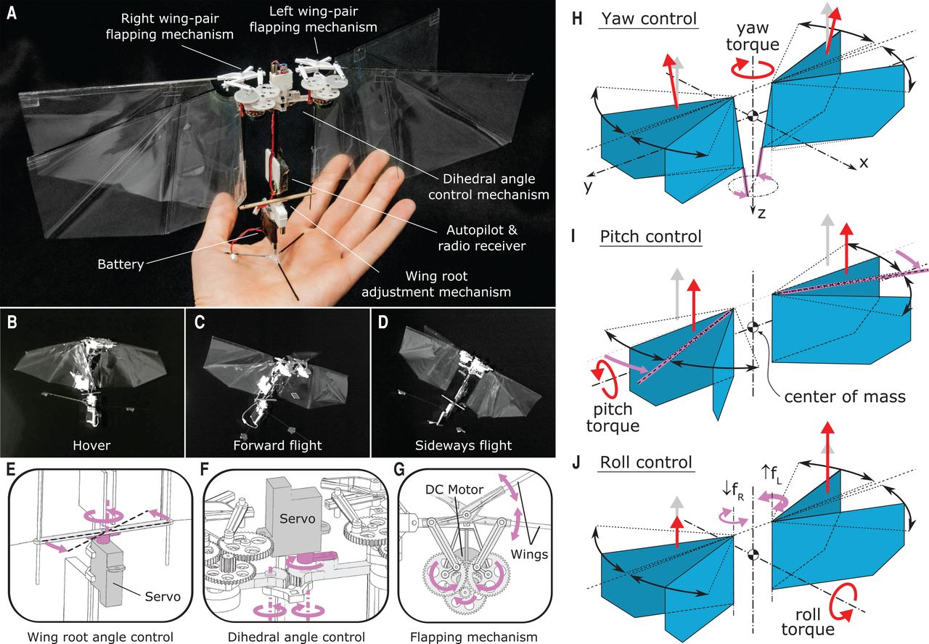
Fig. 1 An insect-inspired free-flying robotic platform is controlled through its two pairs of independently flapping wings.
Matěj Karásek et al. Science 2018;361:1089-1094
Copyright © 2018 The Authors, some rights reserved; exclusive licensee American Association for the Advancement of Science. No claim to original U.S. Government Works
Notes:
An insect-inspired free-flying robotic platform is controlled through its two pairs of independently flapping wings. (A) Description of the robot’s components. (B to D) High-speed camera frames capturing the robot in hover (B), forward flight (C), and sideways flight (D), from movies S1toS3, respectively. (E to G) Details of the robot design: (E) the wing root adjustment mechanism for yaw torque control, (F) the dihedral control mechanism for pitch torque control, and (G) the flapping mechanism (of the left wing pair), used for thrust and roll torque control. (H to J) Wing actuation and aerodynamic forces and torques during yaw control (H), pitch control (I), and roll control (J). Magenta arrows show actuation action, gray arrows show the nominal wingbeat-average aerodynamic thrust vectors, and red arrows show wingbeat-average thrust and torques after control actuation.

Slide 3
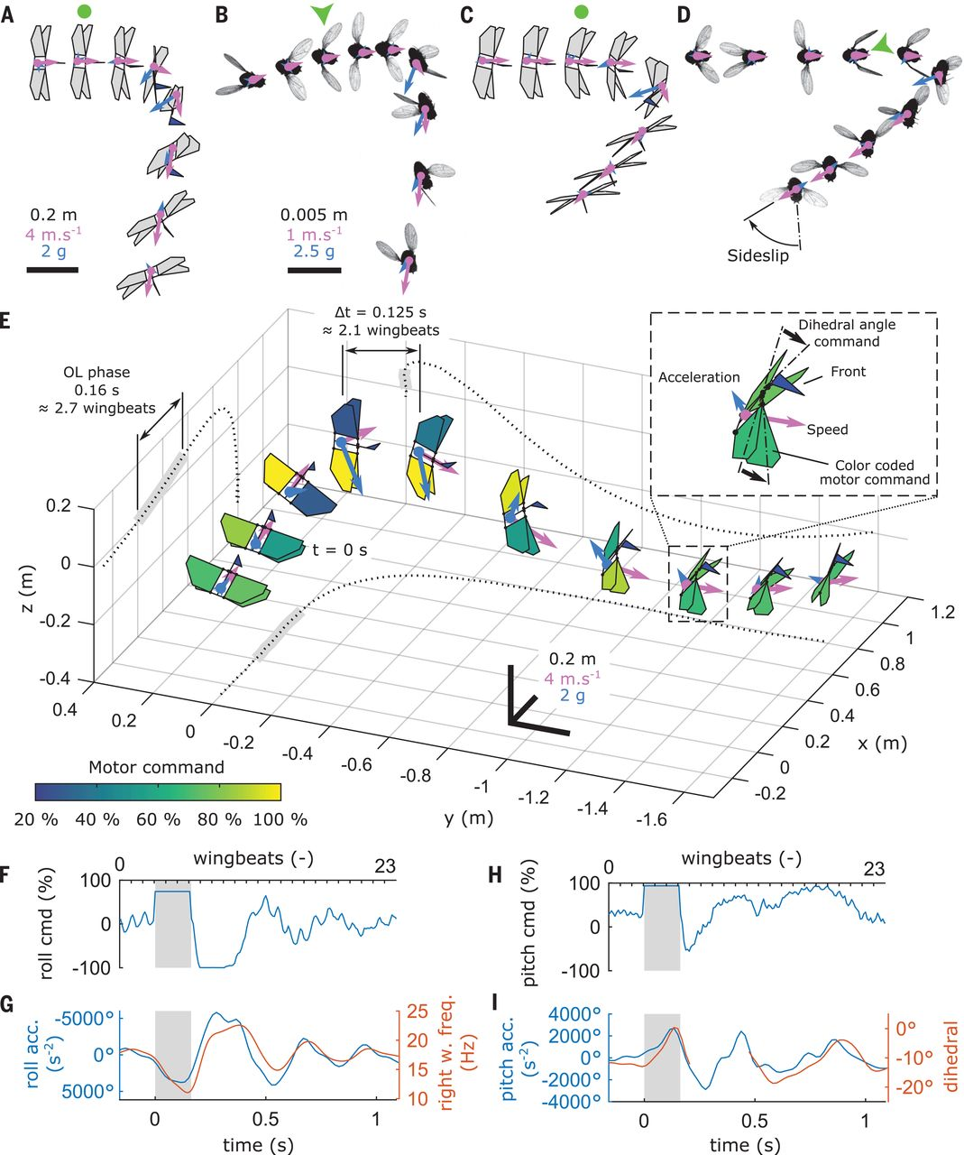
Fig. 2 The robot mimics rapid banked turns observed in escaping fruit flies.
Matěj Karásek et al. Science 2018;361:1089-1094
Copyright © 2018 The Authors, some rights reserved; exclusive licensee American Association for the Advancement of Science. No claim to original U.S. Government Works
Notes:
The robot mimics rapid banked turns observed in escaping fruit flies. (A and C) Time sequences (top view) of a roll-dominated maneuver (pitch rate/roll rate ratio q/p = 0.52) and a pitch-dominated maneuver (q/p = 1.67), respectively. The start of the open-loop (OL) phase is marked with a green circle. (B and D) Time sequences (top view) of the equivalent fruit fly evasive maneuvers with the stimulus (green arrowhead) coming from the left and the front, respectively. (E to I) Detailed analysis of a roll-dominated maneuver (q/p = 0.54). (E) Time sequence with constant time interval of 0.125 s; trajectory projections are shown by dotted lines. Wings are color-coded according to thrust command magnitude, as shown in the color bar. [(F) to (I)] Time histories of roll command (F), roll acceleration and flapping frequency of the right wing pair (G), pitch command (H), and pitch acceleration and dihedral angle (I). In (A) to (E), blue and magenta arrows represent velocity and acceleration vectors, respectively; vectors (arrow lengths) are relative to the black scale bars in (A) and (E) for the robot and in (B) for flies. The OL phase in (F) to (I) is highlighted by gray background.

Slide 4
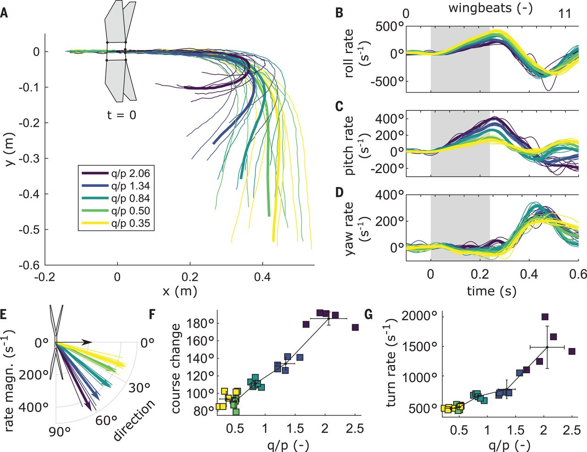
Fig. 3 The turn angle during the banked turn can be controlled by varying the ratio of pitch to roll torque commands.
Matěj Karásek et al. Science 2018;361:1089-1094
Copyright © 2018 The Authors, some rights reserved; exclusive licensee American Association for the Advancement of Science. No claim to original U.S. Government Works
Notes:
The turn angle during the banked turn can be controlled by varying the ratio of pitch to roll torque commands. Results are color-coded [see key in (A)] according to the q/p ratio of the maneuver; thin lines are individual trials and thick lines are series averages. (A) Top view of trajectories, aligned at the start of the OL phase (t = 0 s) where the robot is shown. (B to D) Time histories of angular rates during the maneuvers. The OL phase is highlighted by gray background. (E) Angular rate vector in the horizontal body plane, relative to the forward-directed black arrow. (F and G) Turn angle and turn rate versus q/p, respectively, for individual tests (squares) and mean ± SD per condition (error bars).

Slide 5
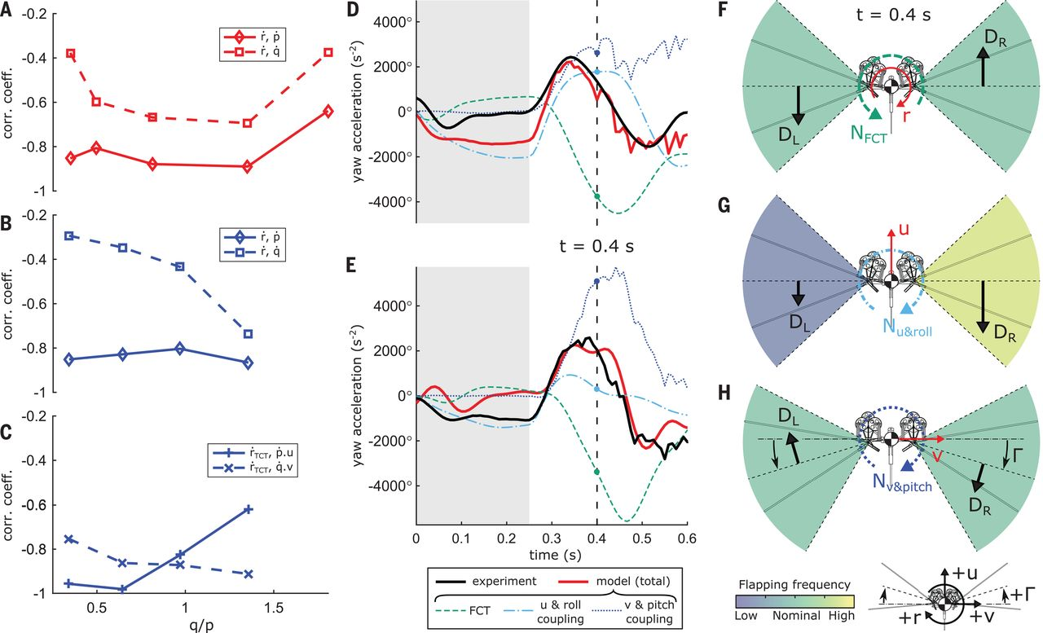
Fig. 4 The passive yaw accelerations during the recovery phase of banked turns originate from the coupling between the roll and pitch torque generation mechanisms and translational body motions.
Matěj Karásek et al. Science 2018;361:1089-1094
Copyright © 2018 The Authors, some rights reserved; exclusive licensee American Association for the Advancement of Science. No claim to original U.S. Government Works
Notes:
The passive yaw accelerations during the recovery phase of banked turns originate from the coupling between the roll and pitch torque generation mechanisms and translational body motions. (A and B) Correlation coefficient between the yaw acceleration and the roll (solid) and pitch (dashed) accelerations at various pitch-to-roll rate ratios q/p for rapid banked turns produced by the robot (A) and for evasive maneuvers produced by fruit flies (B). (C) Correlation coefficients for the same evasive maneuvers of fruit flies, after correcting for the flapping countertorque and including the translational body velocities. (D and E) Measured (black) and modeled (red) yaw accelerations during the banked turn of the robot: (D) roll-dominated banked turn (q/p = 0.50), (E) pitch-dominated banked turn (q/p = 1.34). Line style of individual model components follows the legend below (E). (F to H) The three passive yaw torque–producing mechanisms at t = 0.4 s in (D) and (E) are flapping countertorque (F), torque due to forward motion with uneven left and right flapping frequencies (G), and torque due to sideways motion with nonzero dihedral angle (H). Color coding of the flapping frequency and the positive directions of all the coordinates are shown below (H). D_{L} and D_{R} are the wingbeat-average drag forces of the left and right wing pair, respectively, as defined by eq. S9.

