Slide 1
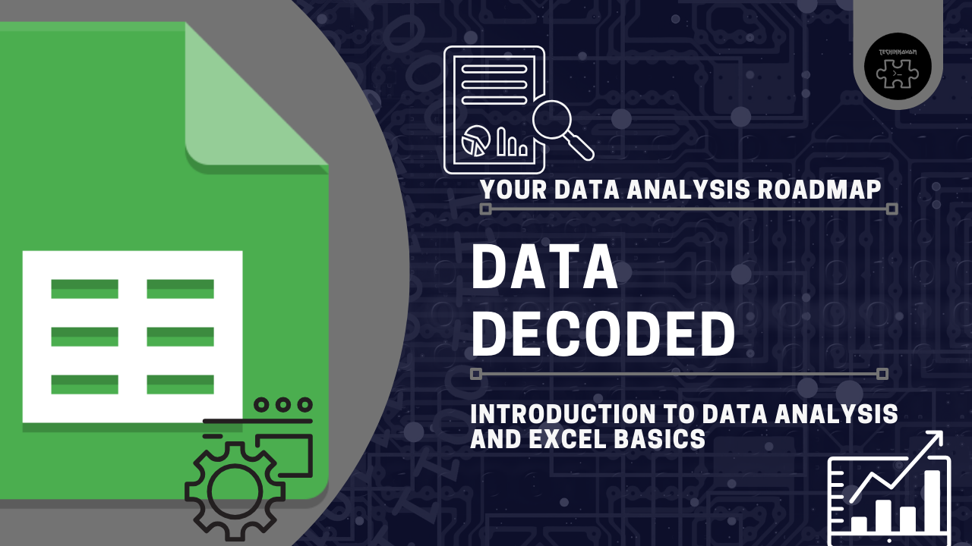

Slide 2
Intro to Data Analysis & Excel Basis PT1

Slide 3
Intro to Data Analysis
Real-World Application
Finance
Healthcare
Retail
Marketing
Government etc
Data Analysis is the process of organizing raw data in order to retrieve insights which are useful to the companies.
Data Analysis | Data Science
Backward Looking | Forward Looking
Not Programming heavy | Programming Heavy
Data Visualization
Why Data Analysis
Make faster and better buisness decisions to reduce overall cost and develop new and innovative produts and services

Slide 4
Data Analysis Process
Define the question
Collect the data
Clean the Data
Analyze the Data
Interprete

