Slide 1


DEM – Session 1
Introduction JQuery Mobile

Slide 2
Agenda
Introduction
Logistics
Some key figures
Developing for mobile in 2013
JQuery Mobile
Theory and hands-on exercises

Slide 3


Your hosts
Christelle Scharf
Thomas Sarlandie
@sarfata

Slide 4
About you
25 mobile developers
With prior experience
And concrete projects
Start networking today!

Slide 5
Sylabus
Friday 26th
Introduction
JQuery Mobile
Monday 29th
Méthodes agiles
Tuesday 30th
Mobile design
Thursday 2nd
Collaborative tools
Analytics
Friday 3rd
Quality Assurance

Slide 6
Logistics
Timing
Let’s start at 17:30
And finish at 21:00
Network
SSID: WARC1
Password: WARC2008

Slide 7
Some Key Figures

Slide 8
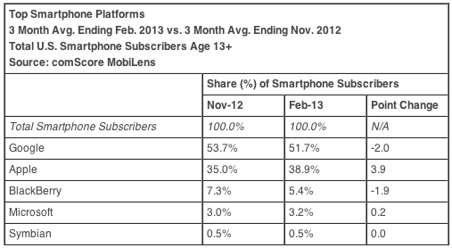
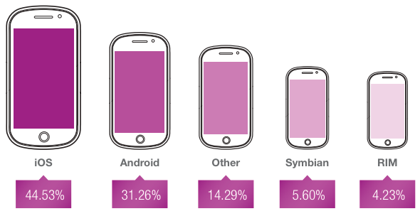
Who wins?

Slide 9
Figures …
The numbers
Never compare the same things
Are often contradictory
And sometimes plain wrong

Slide 10
Figures …
As a mobile entrepreneur, you need to
Understand the real trends
Learn the tricks of the game
Be pro: Always quote sources

Slide 11
Figures …
Some “number tricks”:
Market share vs Devices sold
Activity on the Internet vs Market Shares
Revenue vs Traffic
Mixing mobile and tablets (or not)
Not all countries are equal

Slide 12
http://www.comscore.com/Insights/Press_Releases/2013/4/comScore_Reports_February_2013_U.S._Smartphone_Subscriber_Market_Share
% of traffic - Worldwide
Market Shares - US
http://www.operamediaworks.com/pdf/omw_sma_q1_2013.pdf
Discuss …

Slide 13
What really matters…
iOS and Android are the two leading platforms in the world
More Android users
But more revenues on iOS
Blackberry is going down
(I have no hope for them – Excuse me if I smile when you say otherwise …)
Windows Phone seems to be getting traction

Slide 14
Let’s not forget about …
Feature phones
No apps – Very basic browser – J2ME
SMS + Voice interaction
They exist but they are not the subject of this training.

Slide 15
Mobile in Senegal – Key figures
88% of mobile penetration
# of subscribers / population
10.71 million lines
375k Mobile Internet users
Vs 95k ADSL lines
http://www.itnewsafrica.com/2012/10/senegals-mobile-penetration-passes-88-percent/

Slide 16
Mobile in Senegal - Revenues
Store purchases
Hard without credit cards
Mobile wallets growing
Figures?
Advertising
Emerging
Figures?

Slide 17
Developing for mobile in 2013

Slide 18
Different types of development
Contract work
Your company works for another company and delivers an application under their name
Product development
You are building your own mobile application for your business
Games
A world of its own

Slide 19
Mobile strategy
Native Applications
Using the OS SDK to write an application that is dedicated to one platform
Hybrid Applications
A mix of web technology and native code to save time and reuse some parts of the app
Mobile Web apps
An HTML website optimized for mobile devices

Slide 20
Mobile strategy
 | Ergonomy | Features | Cost
Native Application | +++ | +++ | +
Hybrid Application | ++ | ++ | ++
Mobile web | + | + | +++

Slide 21
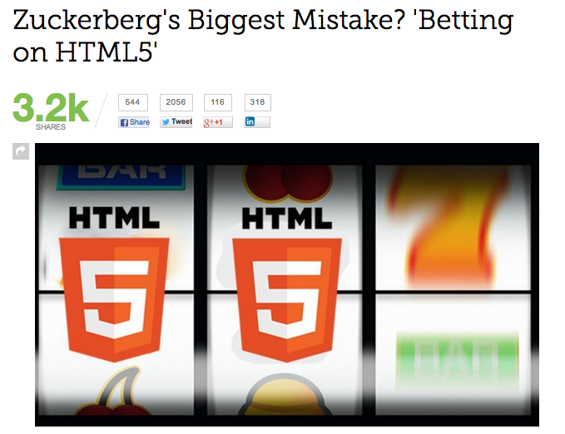
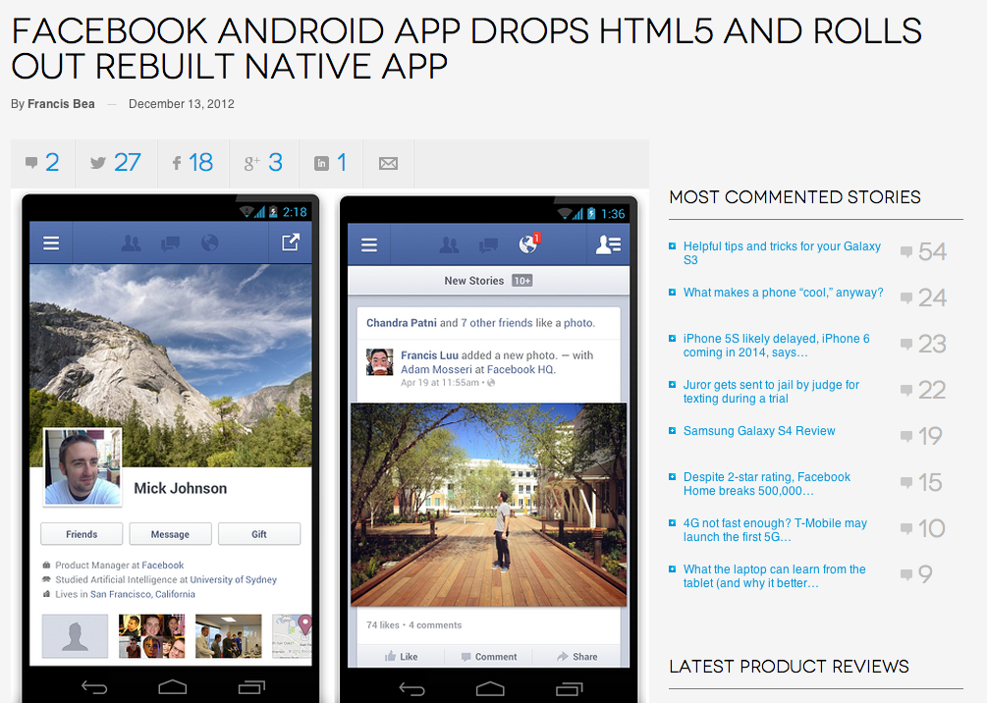
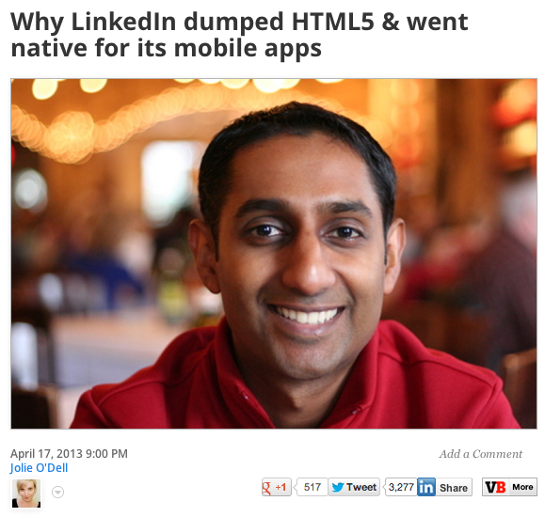
Mobile strategy
2012 09
2012 12
2013 04
http://mashable.com/2012/09/11/html5-biggest-mistake/
http://www.digitaltrends.com/mobile/facebook-ditches-html5-on-android-goes-native/
http://venturebeat.com/2013/04/17/linkedin-mobile-web-breakup/

Slide 22
Mobile Strategy
There is still a strong movement towards hybrid apps – built with HTML frameworks
However, the big players are investing a lot in high quality native applications
Be smart!
Who are my users? What devices do they have? How much time and money can I invest?

Slide 23
Let’s get started!

