Slide 1



Software Processes
Session 2
MobileSenegal et Mobile4Senegal
http://mobilesenegal.org
http://facebook.com/mobilesenegal
http://twitter.com/mobilesenegal

Slide 2
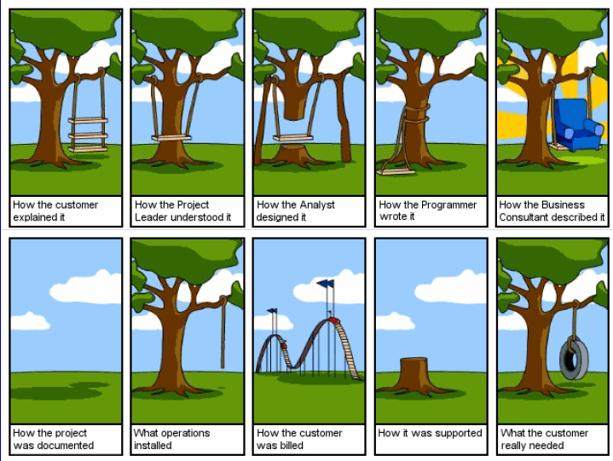

Slide 3
How to choose a process?
How to define a process?
How to audit a process?

Slide 4
The software development process
A structured set of activities required to develop a software
  Requirements
  Design
  Implementation
  Testing
  Evolution and maintenance
A software development process model is an abstract representation of a process, a description from some particular perspective
Software = product
Process = HOW to develop the software

Slide 5
Generic software development process models
Waterfall development
Evolutionary development
Formal development
Reuse-based development
Iterative development
Incremental development
Spiral development
Rational Unified Process (RUP)

Slide 6
Agile methodologies
Extreme Programming (XP)
Scrum
Cockburn's Crystal Family
Open source

Slide 7

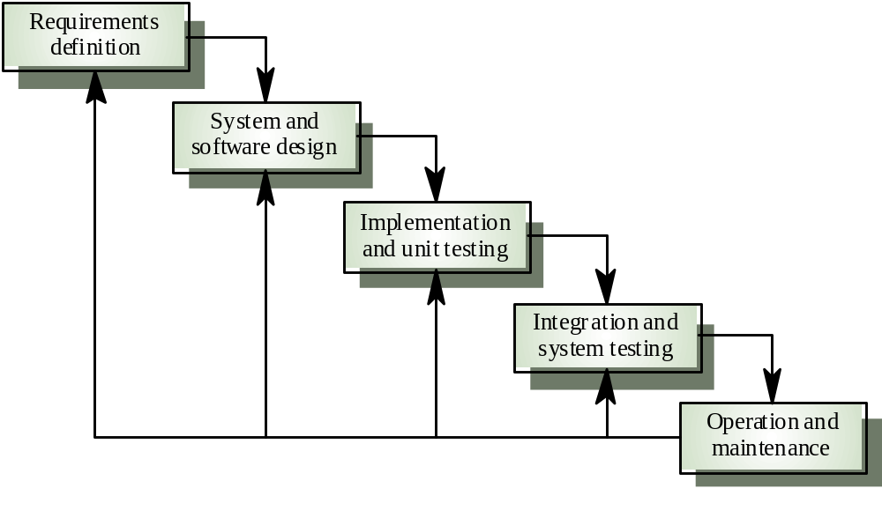
Waterfall development
Good visibility of the project
Inflexible partitioning, difficulties of accommodating requirement changes
Requirements are well-understood

Slide 8

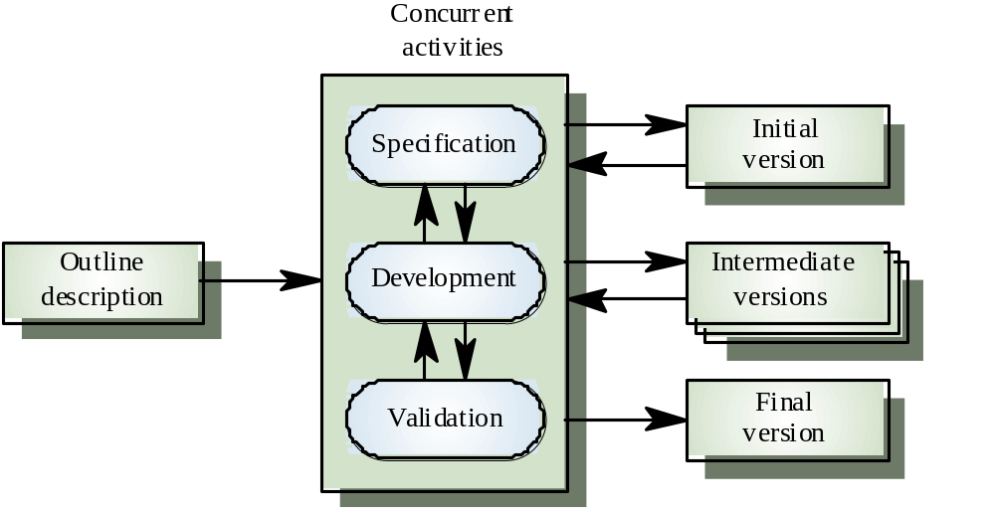
Evolutionary development
Exploratory development
Throw-away prototyping
Lack of visibility of the project, poor structure of the developed software, short life systems
User interface development

Slide 9

Formal development
Formal verification to prove correctness
Executable program
Formal methods skills required, difficulties to formalize some aspects of the software

Slide 10

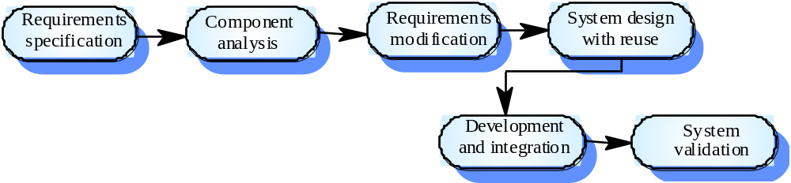
Reuse-oriented development
Reuse paradigm
Component choice
Web services

Slide 11

Iterative development
Process iteration
  Overall life-cycle is composed of multiple iterations
  Each iteration goes through all activities required to develop a software
  Each iteration can use a particular process model
Time

Slide 12

Incremental development
Software increment
- A set of new features to be added
incrementally (step by step)
- Features are prioritized
Software developed as a series of delivery
Feature(s)
Lower risk of failure because delivery at each increment, highest priority features are the most tested

Slide 13

Spiral development
Spiral view rather than sequence with backtracking
Each loop is a phase of the process
  Objectives for the phase are defined
  Risks for the phase are assessed
  Planning for the phase is done
Choice of any development process

Slide 14
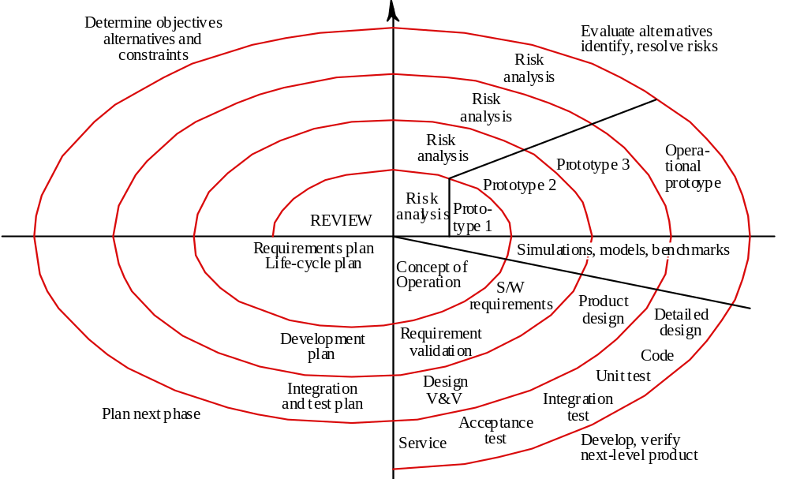
Spiral development

Slide 15

Agile methodologies
Reaction to generic models
Agile Manifesto – February 2001
  http://agilemanifesto.org
  Individuals and interactions over processes and tools
  Working software over comprehensive documentation
  Customer collaboration over contract negotiation
  Responding to change over following a plan

Slide 16

Extreme Programming (XP)
Kent Beck and Ward Cunningham
Payroll project for Chrysler in 1996
XP begins with four values
  Communication
  Feedback
  Simplicity
  Courage
12 practices
Strong emphasis on testing first
Iterations of 1 to 3 weeks

Slide 17
User stories
A story mentions one feature or constraint of the desired software
The stories are estimated by the developers (1 to 3 weeks) and prioritized by the customer
When all stories have been implemented, the software is complete
The stories drive the creation of tests
Around 80 stories for a release

Slide 18
Principles
Customers define application features with user stories
XP teams put small code releases into production early
XP teams use a common system of names and descriptions
Teams emphasize simply written object-oriented code that meets requirements

Slide 19
Principles
Designers write automated unit tests upfront and run them throughout the project
XP teams frequently revise the overall code design, a process called refactoring
Programmers work side by side in pairs, continually seeing and discussing each other’s code
All programmers have collective ownership of the code and the ability to change it

Slide 20
Principles
XP teams integrate code and release it to a repository every few hours and never hold on to it longer than a day
Programmers work at a sustainable pace, with no extended overtime
A customer representative remain onsite throughout the development project
Programmers must follow a common coding standard so all the code in the system looks as if a single individual wrote it

Slide 21

Pair Programming
Two side-by-side programmers (driver and navigator) at one computer and rotate
Collaboration on the same design, algorithm or test
Improves productivity, quality of software and is fun
  More than twice as fast
  Less bugs - quality
Remote pair programming

Slide 22
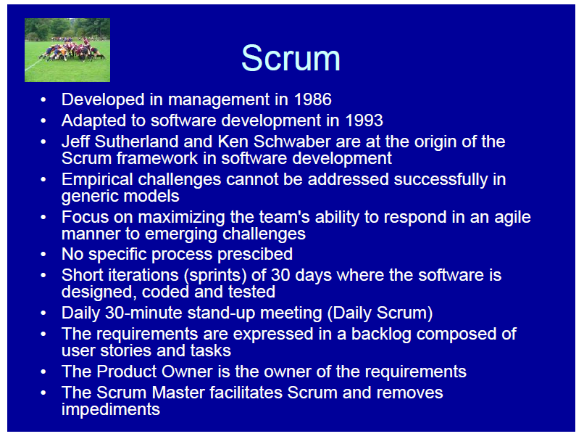

Slide 23
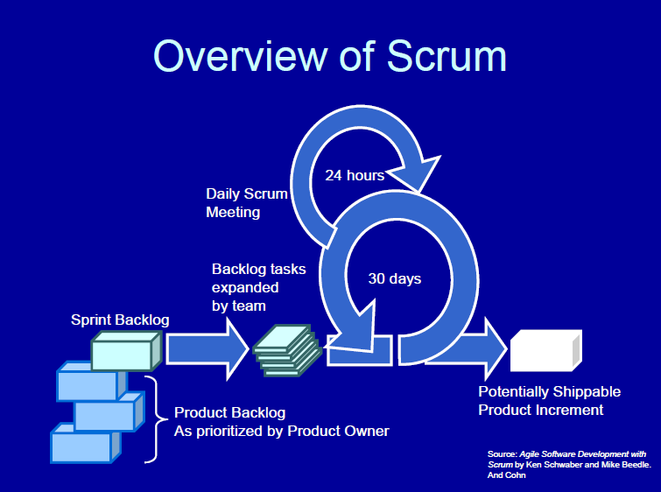
Rally Project Management Software
IBM Rational Team Concert / Jazz

Slide 24
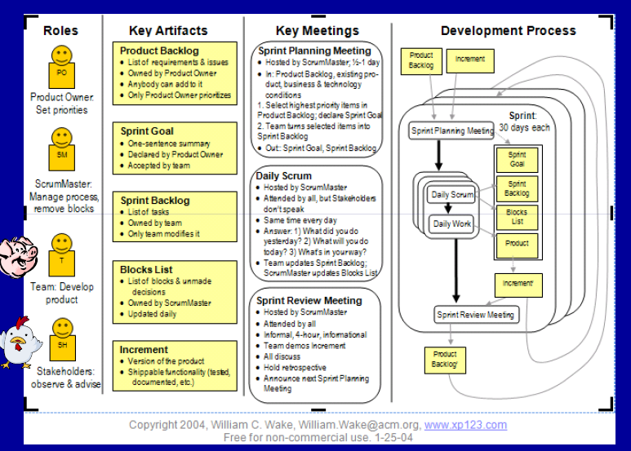

Slide 25
Choosing the process model
One process does not fit all!
Choosing generic methodologies (predictive)
  Large size team
  Fixed price contract with requirements front end
  Critical applications
Choosing agile methodologies (adaptive)
  Average size team
  When you are used to a ad-hoc process
  Responsible and motivated developers
  Requirements are uncertain and volatile
  Customer willing to get involved

Slide 26

References
Software Engineering. Sommerville. Last version.

Slide 27
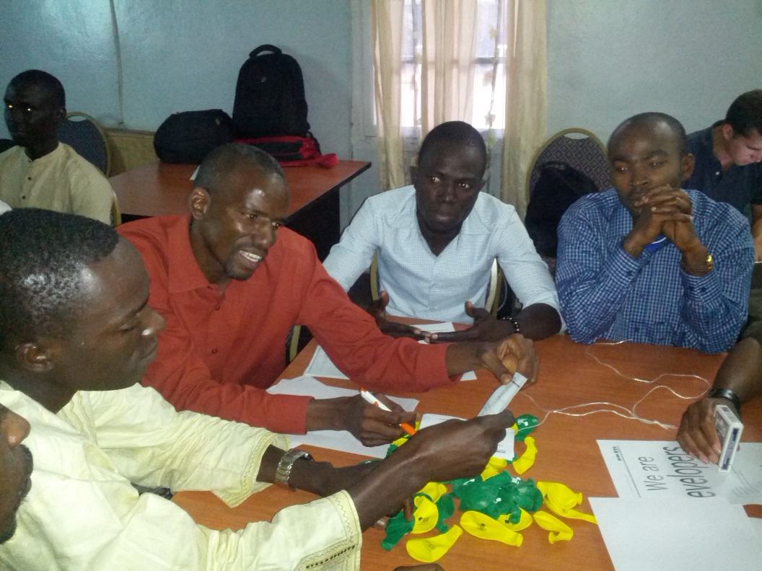
XP game
Enough talk, let’s play the XP game
http://www.xp.be/xpgame.html

