Slide 1



DEM – Session 5
Collaborative Tools

Slide 2
Agenda
Git for your project
Collaboration with Git and GitHub
GitHub pages
GitHub issues
Analytic tools

Slide 3
Git for your project Basics

Slide 4
What is SCM?
Software Configuration Management
Is a tool to manage your source code
Keep an history of your project
Facilitate collaboration on a project

Slide 5
Why you need an SCM
Source code is a valuable asset
One of the most important thing in a software company!
You need to protect it from
Physical damages / Theft of hard drives
Human errors
You will save a lot of time
An SCM is the best way to synchronize multiple developers without wasting hours merging
It is a great tool when you need to find when a bug was introduced

Slide 6
SCM History
SCM have been around for decades now
CVS (1986), Subversion (2000), Mercurial, BitKeeper, Git
They evolved from centralized systems to distributed systems
Git is widely recognized as one of the best SCM available today
and GitHub is the number one place to share code

Slide 7
Let’s get started
Install Git
Linux: aptitude install git
Mac OS: (already installed with Xcode)
Windows: http://git-scm.com/download/win
git config --global user.email thomas@sarlandie.net
git config --global user.name "Thomas Sarlandie"
Create a new project
mkdir myproject && cd myproject
git init

Slide 8
Add a file
Create a README file with some content
git status
git add README
git commit README

Slide 9
$ git status
# On branch master
#
# Initial commit
#
# Untracked files:
# (use "git add <file>..." to include in what will be committed)
#
# README
nothing added to commit but untracked files present (use "git add" to track)

Slide 10
$ git add README
$ git status
# On branch master
#
# Initial commit
#
# Changes to be committed:
# (use "git rm --cached <file>..." to unstage)
#
# new file: README
#

Slide 11
$ git commit -m "Adding README"
[master (root-commit) dc95b92] Adding README
1 file changed, 1 insertion(+)
create mode 100644 README
$ git status
# On branch master
nothing to commit (working directory clean)

Slide 12
Recover from problems
Edit your README file again
Add something “bad” in it
Rollback your change
git reset HEAD README

Slide 13
$ echo "Bad developer joker" >> README
$ git status
# On branch master
# Changes not staged for commit:
# (use "git add <file>..." to update what will be committed)
# (use "git checkout -- <file>..." to discard changes in working directory)
#
# modified: README
#
no changes added to commit (use "git add" and/or "git commit -a")
$ git diff
diff --git a/README b/README
index bb69143..91a4a14 100644
--- a/README
+++ b/README
@@ -1 +1,2 @@
This is a README file for our git exercise
+Bad developer joker

Slide 14
$ git checkout -- README
$ git status
# On branch master
nothing to commit (working directory clean)

Slide 15
Commit a file
Let’s edit the README file again
And this type actually commit the file

Slide 16
$ echo ”Good developer joker ;)" >> README
$ git status
# On branch master
# Changes not staged for commit:
# (use "git add <file>..." to update what will be committed)
# (use "git checkout -- <file>..." to discard changes in working directory)
#
# modified: README
#
no changes added to commit (use "git add" and/or "git commit -a")
$ git add README
$ git status
...
$ git commit –m “Adding a good joke”

Slide 17
$ git log
commit 7552e81a4a6770532ee52d344e67557c2f50c460
Author: Thomas Sarlandie <thomas@sarlandie.net>
Date: Wed May 1 16:59:44 2013 +0000
Adding a good joke
commit dc95b9254b81db32a2fa16116e7f774eedc3a332
Author: Thomas Sarlandie <thomas@sarlandie.net>
Date: Wed May 1 16:52:54 2013 +0000
Adding README

Slide 18

Understanding Git
GitHub Pro book: http://git-scm.com/book/en/Getting-Started-Git-Basics - With permission (CC-BY)

Slide 19
Your essential git basic commands
git init # Creates a new repository
git diff # Diff working directory
git checkout -- FILE # Reverts changes to FILE
git add FILE # Adds a file to staging
git diff --staged # Diff staging
git reset -- FILE # Removes a file from staging
git status # Shows you modified/staged files
git commit # Commits staging
git log # To see the previous commits
git rm FILE # Remove a file
git mv OLD NEW # Rename a file

Slide 20
Basic Git tips
Getting help
git –help
git command –help
Google
Ignoring files
Add names or patterns to .gitignore
Commit messages
First line is a short description
The rest is details of what was done

Slide 21
Exercise #1
Create a new Git project
Add an index.html file
jQuery Mobile headers and one page
Add a photo of you
Add dependencies
jQuery.js / jQueryMobile.js / jQueryMobile.css
Commit!
Files available here: https://github.com/mobile-senegal/jquerymobile101

Slide 22
Git for your project Branches

Slide 23
Understanding branches
Branches allow you to keep different version of your project in parallel
One stable version – one unstable
Make experiments
To try a new library
To prototype a feature
To work with other developers

Slide 24
Working with branches
$ git branch update-jquerymobile # Creates a new branch
$ git checkout update-jquerymobile # Switches to the new branch
$ git add ... ; git commit # Add changes to the branch
$ git checkout master # Come back to the main branch
$ git merge update-jquerymobile # Merges the branch into current
$ git branch –d update-jquerymobile # Deletes a branch
$ git branch # Lists your branches
master#3
master#4
branch#3
branch#4

Slide 25
Exercise #2 - Branching
Create a new branch for your project
Remove the jQuery files and use a CDN instead
<link rel="stylesheet" href="http://code.jquery.com/mobile/1.3.1/jquery.mobile-1.3.1.min.css" />
<script src="http://code.jquery.com/jquery-1.9.1.min.js"></script>
<script src="http://code.jquery.com/mobile/1.3.1/jquery.mobile-1.3.1.min.js"></script>
Go back to your master branch and compare loading time
git checkout master / git checkout branch

Slide 26
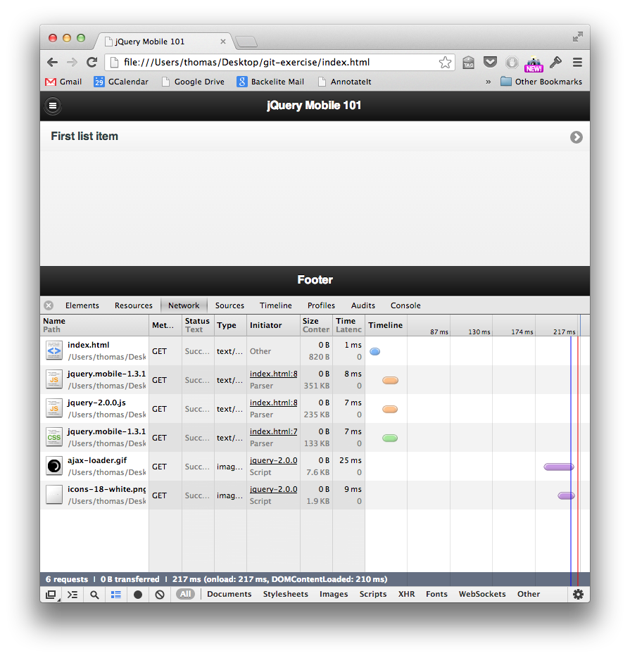

Slide 27
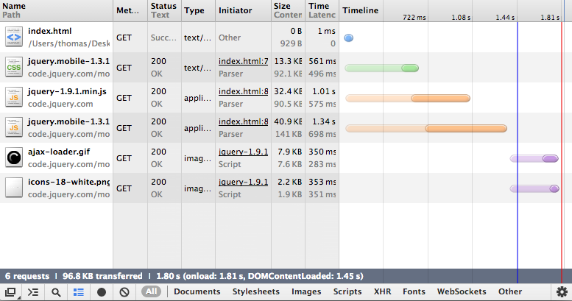

Slide 28
Exercise #3 - Merging
Make sure you are on master
Create a new branch in your project
Add a list on your homepage with two items
Commit – Go back to master and merge
Now merge the jQuery-CDN branch
Delete the two branches – You don’t need them anymore

Slide 29
Exercise #3 - Merging
master#3
Master#5
Master#5+4
jqCDN#3
jqCDN#4
list#3
List#5

Slide 30
Exercise #4 – Merge with Conflicts
Let’s go back in time
Use git log to identify the commit before you switched to CDN jQuery
Create a branch with this version of the project
git branch fix-old-problem dc…a332
Checkout that branch
Change the version of jQuery (download 1.9)
Merge this change into your master

Slide 31
Exercise #3 - Merging
master#3
Master#5
Master#5+4
Master#8
jqCDN#3
jqCDN#4
Conflict
list#3
List#5
jquery19#3
jquery19#7

Slide 32
$ git merge fixjqueryversion
Auto-merging index.html
CONFLICT (content): Merge conflict in index.html
Automatic merge failed; fix conflicts and then commit the result.
$ git status
# On branch master
# Changes to be committed:
#
# new file: jquery-1.9.1.min.js
#
# Unmerged paths:
# (use "git add/rm <file>..." as appropriate to mark resolution)
#
# both modified: index.html
#

Slide 33
$ less index.html
...
<title>jQuery Mobile 101</title>
<<<<<<< HEAD
<link rel="stylesheet" href="http://code.jquery.com/mobile/1.3.1/jquery.mobile-1.3.1.min.css" />
<script src="http://code.jquery.com/jquery-1.9.1.min.js"></script>
<script src="http://code.jquery.com/mobile/1.3.1/jquery.mobile-1.3.1.min.js"></script>
=======
<link rel="stylesheet" href="jquery.mobile-1.3.1.css">
<script src="jquery-1.9.1.min.js"></script>
<script src="jquery.mobile-1.3.1.js"></script>
>>>>>>> fixjqueryversion
</head>
...
$ vi ...
<title>jQuery Mobile 101</title>
<link rel="stylesheet" href="http://code.jquery.com/mobile/1.3.1/jquery.mobile-1.3.1.min.css" />
<script src="jquery-1.9.1.min.js"></script>
<script src="http://code.jquery.com/mobile/1.3.1/jquery.mobile-1.3.1.min.js"></script>
</head>
$ git add / git commit ...
$ git log
This is what a conflict looks like
To fix it: edit the file
Merge the lines manually
Remove the markers

Slide 34

Initial Git Training
http://devopsreactions.tumblr.com/

Slide 35
Regrouping
You have all the basics now
How to work on one branch on your computer
How to create and work with branches
Now let’s do it with friends…

Slide 36
Collaboration with git and github

Slide 37
Remote branches
When working on your computer,
the entire history is saved in your .git folder
Git allows you to connect to remote repositories and exchange code (push/pull)
Code is safer when not on your hard-drive…

Slide 38



GitHub is a web service that provides Git repositories
Free service as long as your repo are public
github.com/plans
7$ /month for 5 private repositories
50$/month for 20 private repositories
And a bunch of other cool tools
Web interface, GH Pages, Issues, Wiki, etc
You should also consider bitbucket.com
Free private repositories
Limited to 5 collaborators

Slide 39
Don’t have an account yet?
???
WTF?

Slide 40
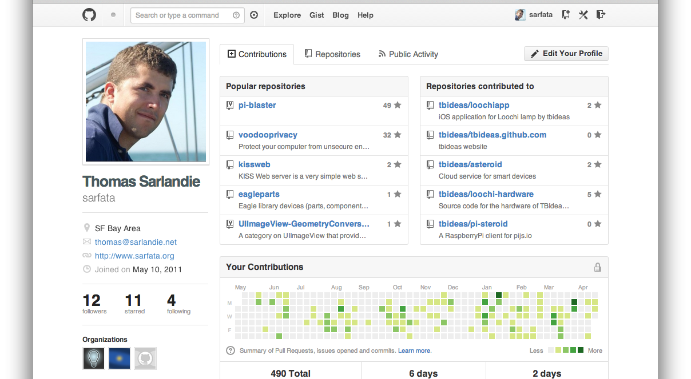

Slide 41

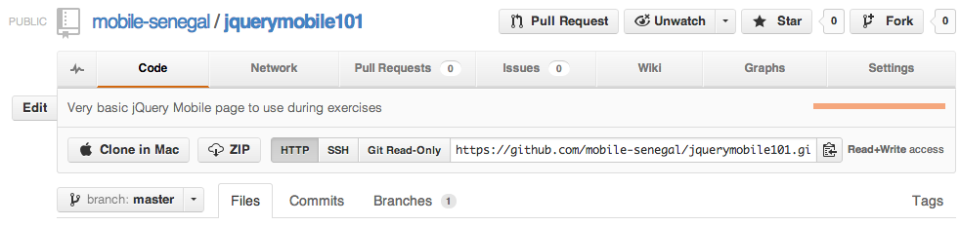
Working with GitHub (Option Dev)
Go on github.com and create a repository
Name it: username.github.io
Get the remote URL from GitHub
Add the remote to your repository
git remote add origin https://…
git push –u origin master

Slide 42
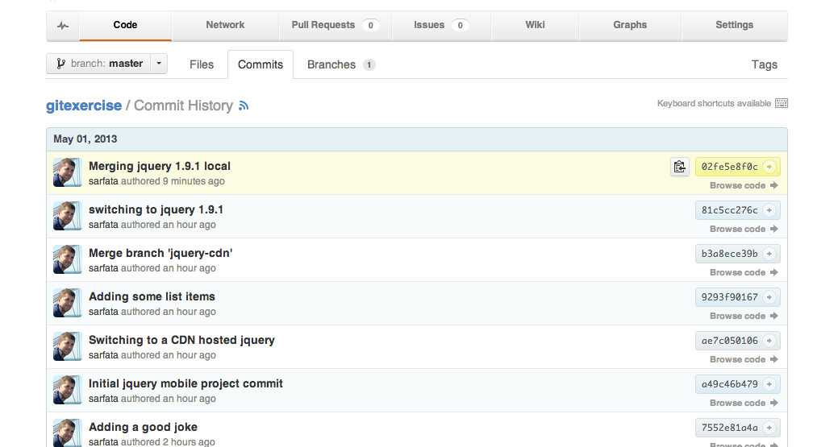
Working with GitHub

Slide 43
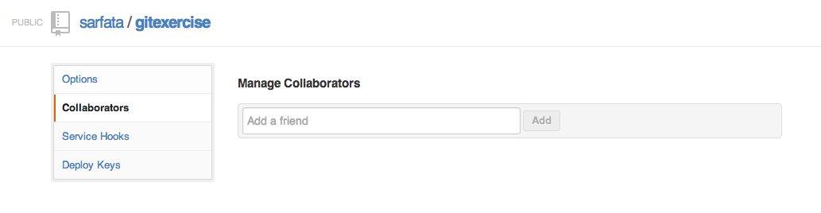
Cloning an existing project
Authorize your right-neighbor as a collaborator of your project
Clone the GitHub project of your neighbor
git clone http://...

Slide 44
Working on an existing project
Add your name into the list on the homepage and a link to your github page
http://username.github.io/
Now commit this change and push it
git add ; git commit ; git push
Use the web interface to see your commit

Slide 45
Fetching remote changes
Now that your neighbor has changed your pages, let’s see exactly what he did
Update your local copy of the remote branch
git fetch
git merge origin/master

Slide 46
$ git fetch
remote: Counting objects: 5, done.
remote: Compressing objects: 100% (3/3), done.
remote: Total 3 (delta 2), reused 0 (delta 0)
Unpacking objects: 100% (3/3), done.
From github.com:sarfata/gitexercise
02fe5e8..85d0f95 master -> origin/master
$ git status
# On branch master
# Your branch is behind 'origin/master' by 1 commit, and can be fast-forwarded.
#
nothing to commit (working directory clean)
$ git merge origin/master
Updating 02fe5e8..85d0f95
Fast-forward
index.html | 1 +
1 file changed, 1 insertion(+)

Slide 47
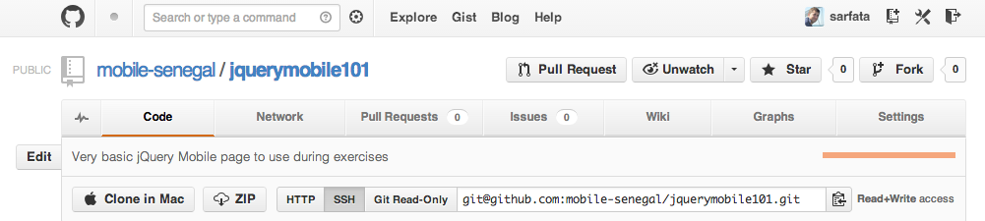
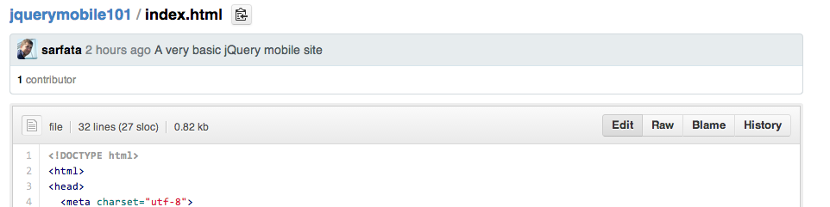
Working with GitHub (Option 2)
Go on github.com and fork our example project
https://github.com/mobile-senegal/jquerymobile101
Rename this repository to username.github.io
Give access to your neighbor
Edit your neighbor file with the web interface

Slide 48
Advanced GitHub GitHub Pages

Slide 49
GitHub Pages
GitHub provides a great free web hosting
Your repository username.github.io is automatically available as a website at
http://username.github.io/
It only works for static files (no PHP, etc)
But we don’t care – we write JavaScript!
Can we get the full-circle to work?
http://mobile-senegal.github.io/

Slide 50
Advanced GitHub Pages
GitHub pages support Jekyll
A static website generator
Great to include header/footer
Transform markdown into HTML
You can use your own domain name
Simply include a file named CNAME
With your full domain name
And DNS-redirect (CNAME) your domain name to username.github.io
RTFM: http://pages.github.com/

Slide 51
Advanced Github GitHub Issues

Slide 52
GitHub issues
Tracking bugs can be complicated …
GitHub offers a free and very capable bugtracker
Commit messages are automatically linked to bugs
Example: This commit solves #42

Slide 53
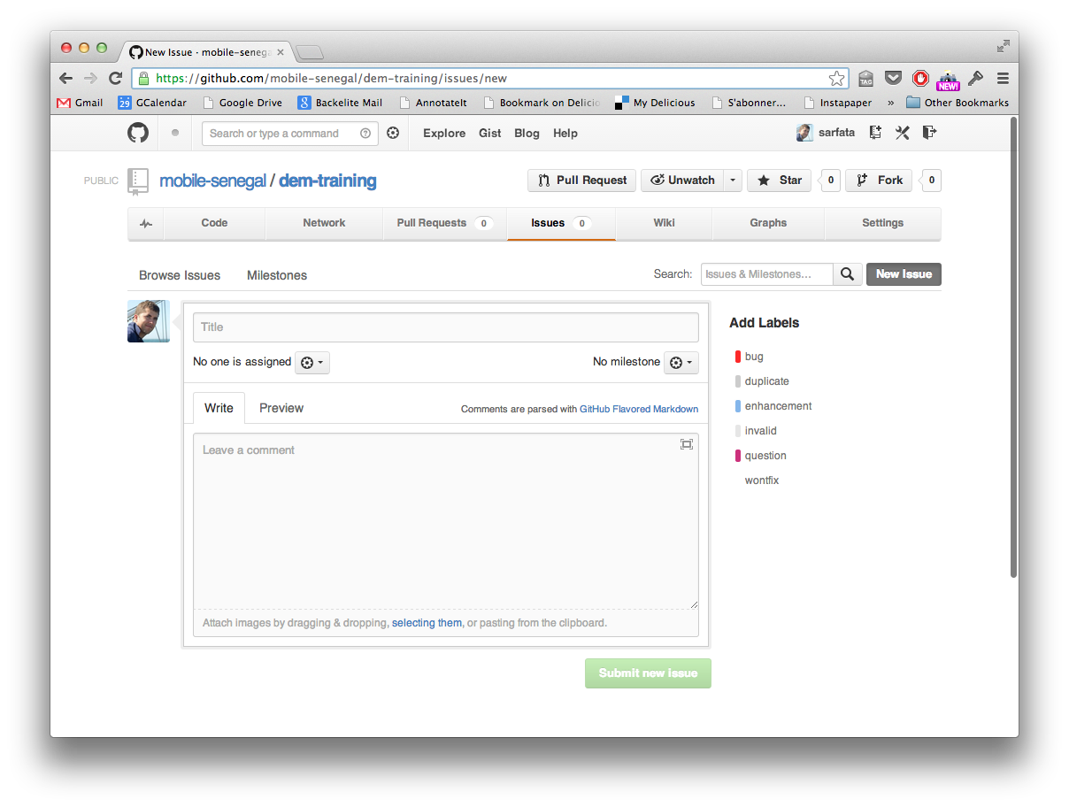
Reporting issues in this training
https://github.com/mobile-senegal/dem-training/issues

Slide 54
Advanced Github Pull-Requests

Slide 55
Pull Requests
When you want to contribute to a project but do not have access to it
Fork the project
You will have your own copy of the project in GitHub
Clone your copy on your computer
Commit your changes in a branch
Use the “Pull-Request” button
The author of the project will get a message asking him/her to review those changes
He can discuss it (comments) and merge it online

Slide 56
Advanced Github Final Exercise

Slide 57
Final Exercise
There is a TRAINING-2013 file in this project
https://github.com/mobile-senegal/dem-training/
You can’t edit this project but
Your name and URL/email needs to be in there!
Option 1: Pull-request
Fork the project and send a pull-request
Option 2: Issue
Create an issue and ask us to add you in the list

Slide 58

Summary
You have learnt how to …
Use Git to be a better developer
Use GitHub to collaborate
Get free hosting for your mobile site
Track bugs
Contribute to open-source projects

Slide 59
Analytic Tools

Slide 60
You need analytics
Understand your users behavior
What are the features they like
How often do they come back
How many page views
In order to
Improve your design
Monetize your app

Slide 61
Analytic tools for mobile apps
If you are reading this slide and the time is not over yet
Then you must be really good at Git
And you don’t need our help to RTFM
http://code.google.com/mobile/analytics/docs/
http://support.flurry.com/index.php?title=Analytics
You should also check out
https://testflightapp.com/

