Slide 1


Mobile Development
MobileSenegal et Mobile4Senegal
http://facebook.com/mobilesenegal
http://twitter.com/mobilesenegal

Slide 2

What is HTML5?
HTML5 is available on all platforms
Desktops, phones, TVs…
HTML5 is mobile (optimized)
Phones and tablets
Size and type of UI components
HTML5 has new tag elements
Video, audio, article, canvas, header, figure …
HTML5 is open
HTML is already known by lots of people
Soon a standard of W3C (World Wide Web Consortium)
HTML5 is capable
Networking, editing pages on the fly, contacts, online / offline, input, videos and geolocation capabilities
HTML5 is flexible
Content (HTML)
Style (CSS)
Logic (JavaScript)

Slide 3

Mobile browsers
Different types of browsers
Focus navigation (highlight of the selected area), cursor navigation (simulation of a cursor), touch navigation, multi-touch navigation (gestures)
Zoom
Basic zoom (font size only), smart zoom (images and pages as a whole)
Reflow engines
Reflowing the pages to a one-column scrollable
Multi-page experience
How many pages can be open at the same time?
WebKit Engine
Open source layout engine for web browsers that render HTML and CSS and execute JavaScript
Used in the current browsers (e.g., Android, iOS, Nokia S60…)

Slide 4
Mobile browsers – Pre-installed
NetFront - low- and mid-level phones (Sony Ericsson, LG, Samsung, ZTE)
Myriad - low- and mid-level phones (Motorola, LG, Kyocera)
Internet Explorer Mobile – the browser on Windows Phone 7 is based on IE7 and IE8
Safari on iOS – WebKit-based browser
Nokia Series 40 browser – WebKit-based browser for Series 40 6th
Symbian browser – WebKit-based browser for Series 60
BlackBerry browser – WebKit-based browser for OS 6.0 and above
Android browser - WebKit-based browser
Notes:
WebKit is a layout engine designed to allow web browsers to render web pages. WebKit powers the Apple Safari and Google Chrome browsers. As of 2012 it has the most market share of any layout engine at 36% of the browser market share according to StatCounter.

Slide 5
Mobile browsers - User installed
Chrome for Android - launched in February 2012 http://googleblog.blogspot.com/2012/02/introducing-chrome-for-android.html
Firefox mobile – appeared in 2011 http://mozilla.com/mobile
Opera – downloadable for most platforms, full browser http://www.opera.com/developer/tools/mobile
Opera Mini – proxy browser that supports videos, Ajax, offline / online… http://www.opera.com/developer/tools/mini

Slide 6

Your toolbox

Slide 7
Go to the opera mini simulator online and go to a specific url
http://www.opera.com/developer/opera-mini-simulator

Slide 8
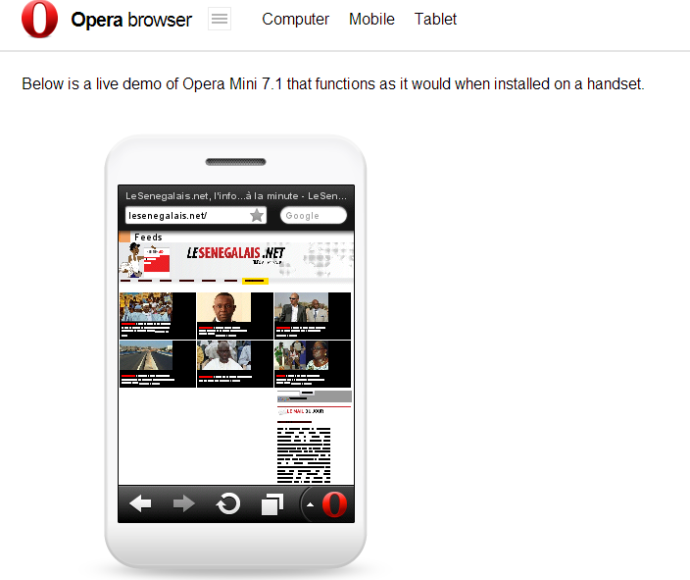

Slide 9
What mobile browsers are subscribers using in SENEGAL and globally?

Slide 10
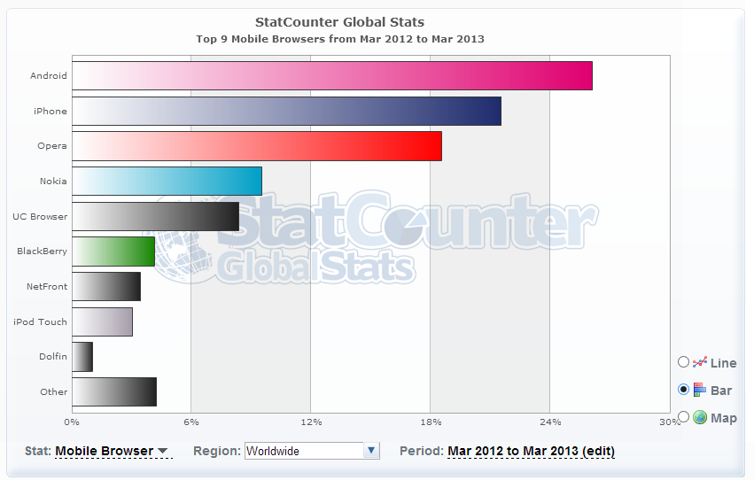
Mobile browsers - Statistics
What mobile browsers are people using in different parts of the world?
http://gs.statcounter.com

Slide 11
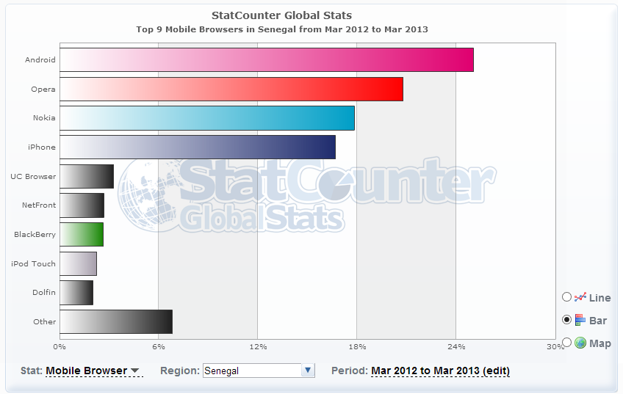
Mobile browsers - Statistics

Slide 12


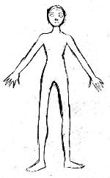
HTML in one slide
HTML = Hyper Text Markup Language
Language based on tags and rendered by a browser
Files with html extension
index.html is the entry file in a web site
Skeleton of an HTML page
<html>
<head>
<title>
…
</title>
</head>
<body>
…
</body>
</html>
Tags
<p> … </p> - paragraph
<em> … </em> - italic
<b> … </b> - bold
<h1> … </h1> - level of title
(from 1 to 6)
<img src …> - image
<a> … </a> - link
<br /> - blank line
<ul> - list
<li> … </li>
<li> … </li>
</ul>
<div> … </div>
Open the tag
Close the tag
Html – cheat sheet
http://bit.ly/tZpQL

Slide 13
Create aN html file using notepad++ and open it in google chrome

Slide 14
Put the file on A server and open it in a mobile device
(Can use a local server)

Slide 15
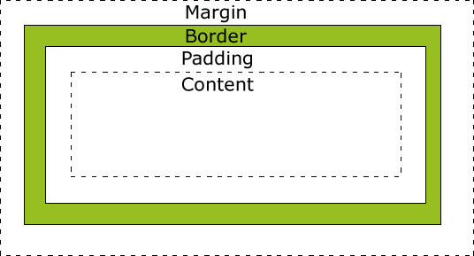
CSS in one slide
CSS = Cascading Style Sheets
For the visual presentation of an HTML document (text color, size, style, layout, gradients, opacity etc)
Files with css extension
Integrate CSS:
<style type="text/css"> body {color:red;} </style>
OR
<link rel="stylesheet" href="file.css" type="text/css">
Based on applying rules on specific elements (selectors). Rules assign values to properties
Example 1: body {color:red; font-style:italic;}
Example 2:
Inline
External file
CSS – cheat sheet
http://bit.ly/O0fMmZ
<h1 class="loud">Hi!</h1> <p id="low">How are you?</p> <ul> <li class="loud">Pizza</li> <li>Soda</li> </ul> | Class: .loud {font-style: bold;} Id: #low{font-style:italic;} (ids are unique)

Slide 16
Create aN html file and a css file TO STYLE IT

Slide 17
JavaScript in one slide
JavaScript is a scripting language that permits to make pages more interactive for users
Examples:
Form validation
Show and hide elements
Database interactions
Animations
Files with js extension
Integrate JavaScript:
<script type="text/javascript" charset="utf-8">
</script>
OR
<script type="text/javascript" src="file.js"></script>
JavaScript – cheat sheet
http://bit.ly/ivbzJ
Inline
External file

Slide 18
Example
<script type="text/javascript" charset="utf-8">
function showAlert(){
alert("Hello");
}
</script>
<button type="button“ onclick="showAlert()">
Click me!
</button>

Slide 19
jQUERy mobile

Slide 20

What is jQuery mobile?
http://jquerymobile.com
To help designers and developers create mobile web experiences easily
Separation of HTML, CSS and JavaScript
To create unified user experiences across popular platforms
Based on HTML5 and a powerful theme mechanism
Lightweight code built with progressive enhancement
Taking advantage of features detected within the browser
Plugins available (e.g., maps and RSS feeds)
Code can be packaged in a native app
Sponsorship from Adobe, Mozilla Corporation, RIM, Nokia dotmobi etc
Notes:
http://sixrevisions.com/web-development/progressive-enhancement/

Slide 21

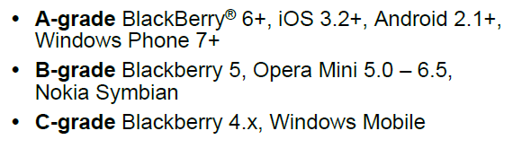
Browser support
Browsers
Browsers’ support
Notes:
http://jquerymobile.com/gbs/

Slide 22
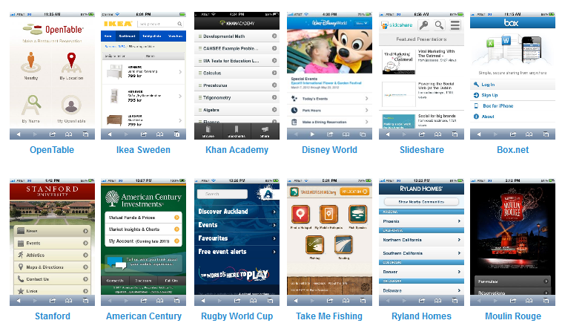
jQuery mobile in the real world

Slide 23
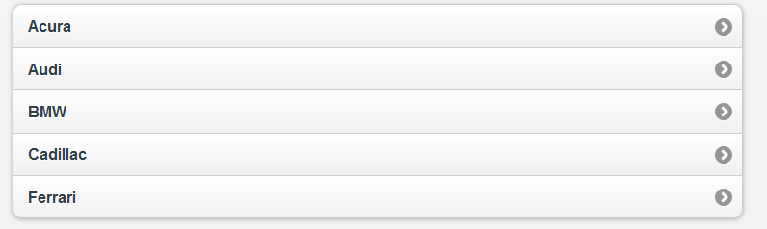
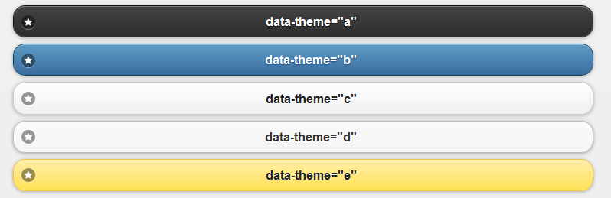
jQuery mobile showcase
See the samples

Slide 24
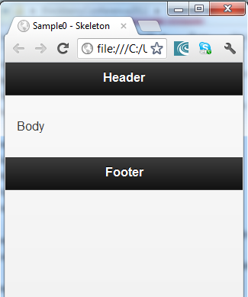
Anatomy of a page
<!DOCTYPE html>
<html>
<head>
<title>Sample0 - Skeleton</title>
<meta name="viewport" content="width=device-width, initial-scale=1">
<link rel="stylesheet" href="http://code.jquery.com/mobile/1.1.1/jquery.mobile-1.1.1.min.css" />
<script src="http://code.jquery.com/jquery-1.7.1.min.js"></script>
<script src="http://code.jquery.com/mobile/1.1.0/jquery.mobile-1.1.0.min.js"></script>
</head>
<body>
<div data-role="page">
<div data-role="header">
<h1>Header</h1>
</div>
<div data-role="content">
<p>Body</p>
</div>
<div data-role="footer">
<h5>Footer</h5>
</div>
</div>
</body>
</html>
Viewport
CSS
JavaScript
Header
Content
Footer

Slide 25
Create your first jquery mobile page and open it in google chrome and then in a mobile device

Slide 26
Data roles
Semantics
Markup elements can have roles (data-role)
They add semantics to the document
They permit also to add attributes to tags while maintaining valid documents
They are implicit contracts between the framework and the developers
data-role include page, header, content, footer, navbar, button, controlgroup, collapsible, collapsible-set, fieldcontain, listview, dialog, slider, nojs
http://jquerymobile.com/demos/1.2.0/docs/api/data-attributes.html

Slide 27

Button
<a href="#" data-role="button">Click me!</a>

Slide 28

Listview
<ul data-role="listview">
<li><a href="#">NYC</a></li>
<li><a href="#">Boston</a></li>
<li><a href="#">San Francisco</a></li>
</ul>

Slide 29
Data attributes
Each UI component has data attributes associated to it
Data attributes (data-*) permit to initialize and configure widgets
http://jquerymobile.com/demos/1.2.0/docs/api/data-attributes.html

Slide 30
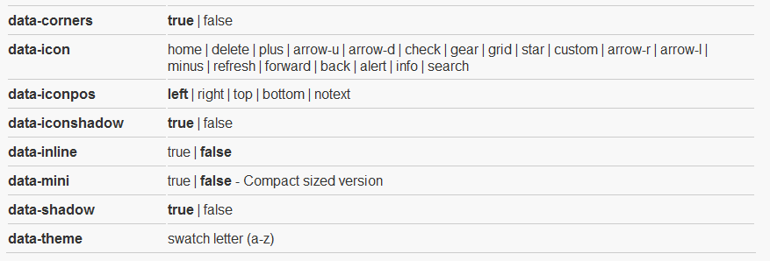

Button
<a href="#" data-role="button" data-icon="arrow-up">Click me!</a>

Slide 31
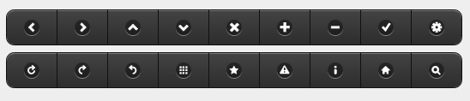
Icons

Slide 32
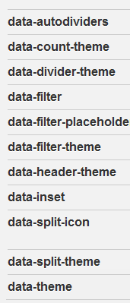
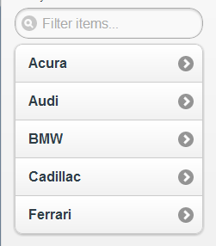
Listview
<ul data-role="listview" data-inset="true" data-filter="true">
<li><a href="#">NYC</a></li>
<li><a href="#">Boston</a></li>
<li><a href="#">San Francisco</a></li>
</ul>

Slide 33
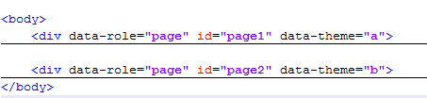
Using multiple pages in a single document
Pages have unique ids
…
…
Going to a particular page:

Slide 34
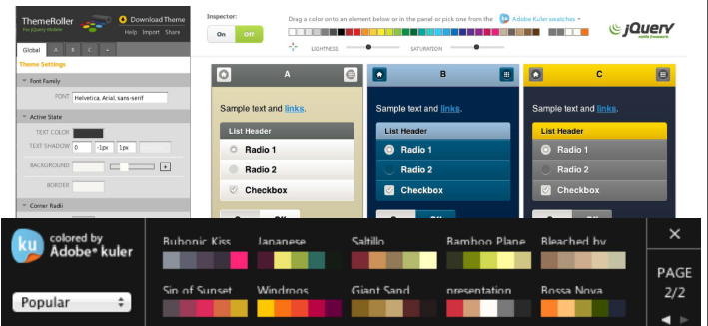
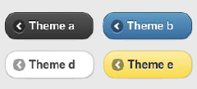
jQuery Mobile - Themes
Introduced with the data-theme attribute and the letters a, b, c and d…
Can be customized using ThemeRoller
http://jquerymobile.com

Slide 35
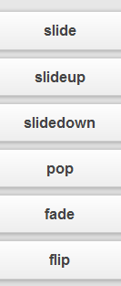

Navigation
<a href="page.html">Here</a>
<a href="page.html" data-rel="dialog">Here</a>
<a href="page.html" data-role="button">Here</a>
<a href="page.html" data-transition="flip">Here</a>
Your files need to be on a server

Slide 36

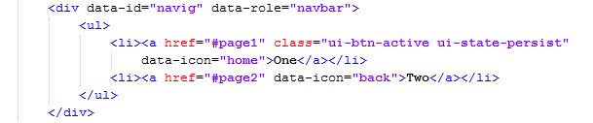
Tabs
A navbar widget is available with up to 5 tabs
It is placed within the header or the footer
It is defined using the data-role navbar and an unordered list (<ul> … </ul>)
To initialize the state of the tab and restore it each time you come back to the page, use class= "ui-btn-active ui-state-persist"
data-id permits to fix the navigation bar outside a transition and create a persistent navigation bar
Notes:
http://jquerymobile.com/test/docs/toolbars/docs-bars.html

Slide 37



Collapsibles
Collapsibles are defined using the data-role collapsible container
They are composed of a header (using h1 to h6) and then any HTML code
data-collapsed permits to set the state of the collapsible to close (true) or open (false)
Notes:
http://jquerymobile.com/test/docs/content/content-collapsible.html

Slide 38
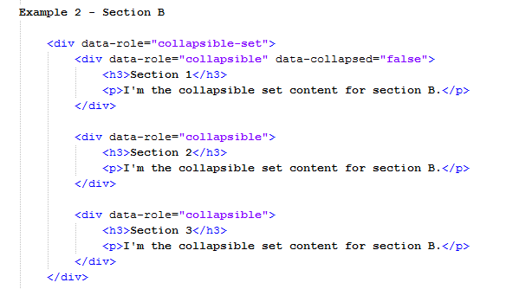
Collapsible sets (Accordion)
Collapsible sets permit to group widgets and make them behave like an accordion (so only one section can be open at a time)

Slide 39
Forms
Forms are wrapped into a form tag with attributes action and method
<form action="form.php" method="post or get">
...
<input type="submit" name="mysubmit" value=“Submit" />
</form>
Forms are composed of different UI components introduced by labels
Notes:
http://jquerymobile.com/test/docs/forms/docs-forms.html

Slide 40

Forms
All the UI elements of a form are contained in a fieldset to present the elements conveniently on the screen
<fieldset>
…
</fieldset>
To improve the look-and-feel of a form each pair (label, UI component) should be in a div tag with data-role called fieldcontain

Slide 41

Text inputs
The type of the text can be:
text, password, email, tel, url, search, number, date, datetime, time, datetime-local, month, week
To require a value, use the required attribute
To provide a value by default, use the placeholder attribute

Slide 42
SHOWCASE OF THE DIFFERENT UI ELEMENTS
Notes:
http://jquerymobile.com/test/docs/forms/forms-all.html

Slide 43
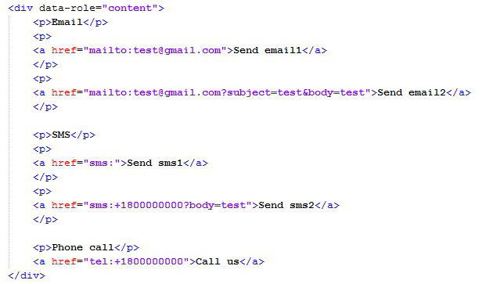
Emails, SMS and phone calls

Slide 44
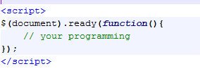
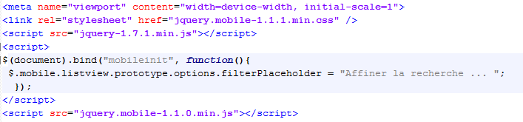
Adding scripts to a page
For adding JavaScript to the page
Waits for the HTML to load
For event management
$(‘#selector’).bind(‘event’,myData, functionName)
Notes:
Several events can be attached
When the jQuery Mobile starts to execute, it triggers a mobileinit event on the document object, to which you can bind to apply overrides to jQuery Mobile's defaults.

Slide 45
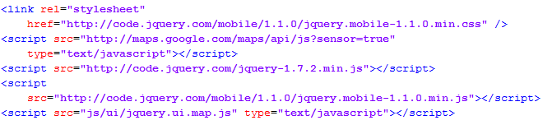
Maps - Configurations
We need a plugin to use maps and interact with them in jQuery Mobile
Google maps v3 plugin for jQuery and jQuery Mobile
http://code.google.com/p/jquery-ui-map/
In the head of the HTML document we add the required scripts
We are ready to go!

Slide 46
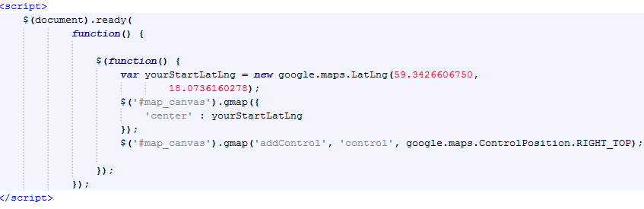
Maps – Adding and using a map

Slide 47

Going native with Apache Cordova
Apache Cordova is an HTML5 app platform that allows you to develop native apps with web technologies and get access to APIs and app stores
It can be combined with UI frameworks such as jQuery Mobile, Sensa Touch or Dojo mobile
Apps are packaged as native apps using the platform SDKs (iOS, Android, Blackberry, Windows Phone, Palm WebOS, Bada, and Symbian)
Install the plugin
http://svn.codespot.com/a/eclipselabs.org/mobile-web-development-with-phonegap/tags/r1.2/download

Slide 48
DEMO
Notes:
http://jquerymobile.com/test/docs/forms/forms-all.html

Slide 49


References
http://jquerymobile.com
http://view.jquerymobile.com/master/demos
http://www.developer.nokia.com/Community/Wiki/JQueryMobile_for_Windows_Phone
http://cordova.apache.org/
http://svn.codespot.com/a/eclipselabs.org/mobile-web-development-with-phonegap/tags/r1.2/download
http://www.mobiledevelopersolutions.com/home/start/twominutetutorials/tmt0

Slide 50
THANK YOU

