Slide 1


WordPress
Content management system

Slide 2


Whole course content.
Introduction and basics of WordPress.
Architecture of WordPress.
understanding of post types and custom post types.
Understanding of taxonomies, custom taxonomies and custom fields.
Developing a theme.
Developing a plugin.
Headless WordPress.

Slide 3
What we are going to learn in this lecture.
What is a WordPress?
Why should you use it.
Difference between wordpress.com and wordpress.org
Required software and how to install it.

Slide 4
What is WordPress?
1
4
It is a content management system. (CMS)
It is a Website builder.
It uses php programming language.

Slide 5





Why should you use it.
2
4

Slide 6

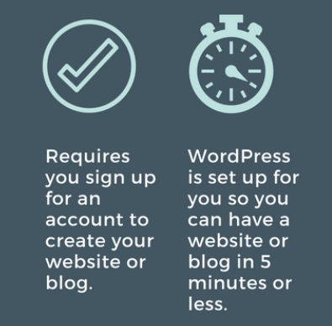

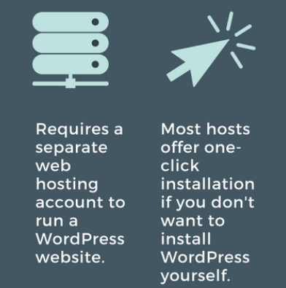
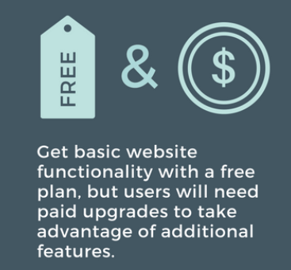
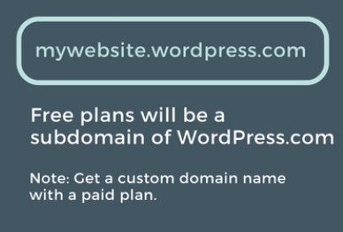
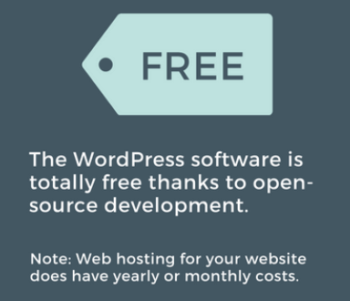
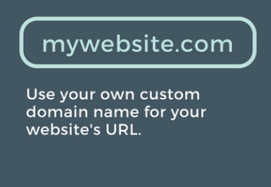
3
4
Difference between wordpress.com and wordpress.org
Wordpress.com
Wordpress.org

Slide 7

Required software and how to install WordPress.
4
4
Php web server I use XAMPP.
MySQL database.
Download WordPress.
WordPress basics and admin panel.

