Slide 1
Flurry for Publishers
Maximize your advertising revenues
Flurry Publisher Team
February 2012

Slide 2
The Flurry Difference
Better Analytics
Being the clear mobile analytics leader with 380M+ devices tracked…
Better Targeting
Flurry targets ads better than any other mobile network…
Higher Bids
Delivering higher quality traffic that advertisers bid up for…
Higher Payouts
And earning more for AppCircle publishers.

Slide 3


How can I integrate Flurry in my app?
Storefront (games with virtual currency)
Banner
Interstitial
Storefront (games with virtual currency)
Interstitial (rewarded or unrewarded)

Slide 4

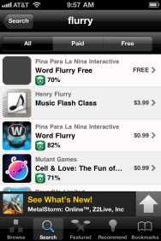
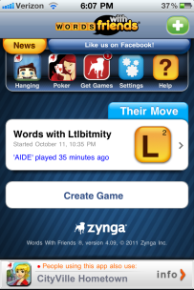
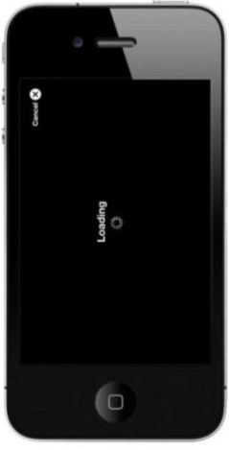
Complete Flexibility in Integration
1) Banner
Re-engagement is a unique ad unit only offered by Flurry
Re-engagement deeply utilizes our analytics
Fill between 10 and 20% of your impressions with Flurry
If no Re-engagement is available backfill to your traditional ad unit or mediation layer
Banner
eCPM: $2-3

Slide 5
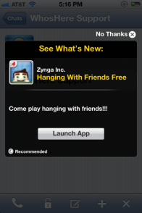


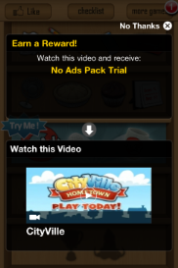
2) Interstitial
No virtual currency required
AppCircle
Reengagements
AppCircle
Recommendations
Video ads
(AC Clips)

Slide 6
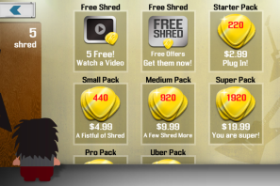
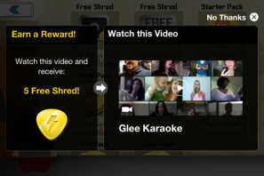


3) Store Integration (AC Clips)
1. Click free credits option
2. Watch a 15-30 sec video
Expected Publisher Payout:
$7-$14 eCPM
$800-$1,200 / Day per 100K DAUs
4. Earn credits. Option to get app
3. Exit video at any time

Slide 7

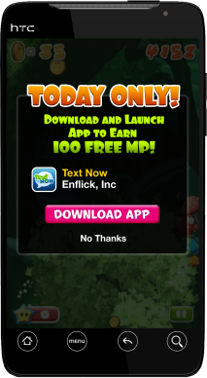
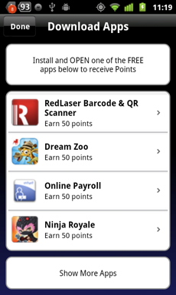
Complete Flexibility in Integration
1) Store implementation: offerwall
Highest payouts in the industry: 42 to 45cts payout for each install
No CPA offers which are hard to monetize (netflix, credit cards, subscriptions), only incentivized installs
High fill with more than 50+ campaigns running on Android daily
Monetize users worldwide
Revenue estimates are 3K to 5K per day per 100K DAU which can account to between 50 and 80% of publishers’ total revenue
Banner
eCPM: $70 and 100$

Slide 8
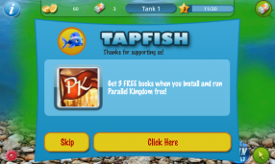
2) Take-over (rewarded or unrewarded)
eCPM for rewarded take-over between 20$ and 45$
Customize the take-over to have the look and feel of your game
Choose the exact placement of the take-over (launch, between levels etc…)

Slide 9



Android Success Story: Drag Racing
Flurry’s better ad targeting drives higher payouts and is simple to integrate
Uses Flurry Analytics
Tracking 110K+ apps
Flexible and fast
$0.40-$0.45 per install
Android AppCircle Rewards Greatly Boosts Creative Mobile Revenue
We are so pleased with AC Rewards that we are adding it in more & more parts of our game, and our revenue keeps on growing.
-Vladimir Funtikov – MD Creative Mobile
Metric
Definition
Result
Daily Installs
Publisher Installs generated per day through AC Rewards
20,000
Pub Payout per Install
Publisher revenue earned from each AC Rewards install
$0.45

Slide 10
Next Steps
1
Create Flurry account at www.flurry.com
2
Request latest SDK with Clips and Reengagement (iOS only) from publishers@flurry.com
3
Get step-by-step integration instructions from: http://support.flurry.com
4
Business questions? publishers@flurry.com
Technical questions? integration@flurry.com

