Slide 1
The Enterprise Application Pipeline
Framework and Language
For and by the Community
Tim Mangan
TMurgent

Slide 2
The Enterprise Application Pipeline
Framework and Language
For and by the Community
Tim Mangan
TMurgent

Slide 3

Thank you LoginVSI
Thanks to Workplace Ninja Boston’s 2026 sponsor:

Slide 4

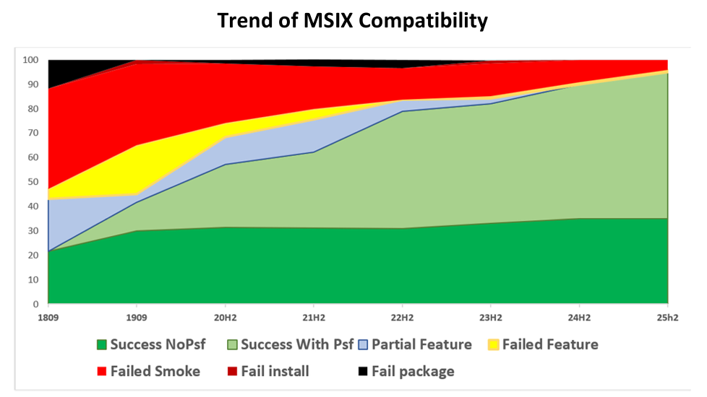
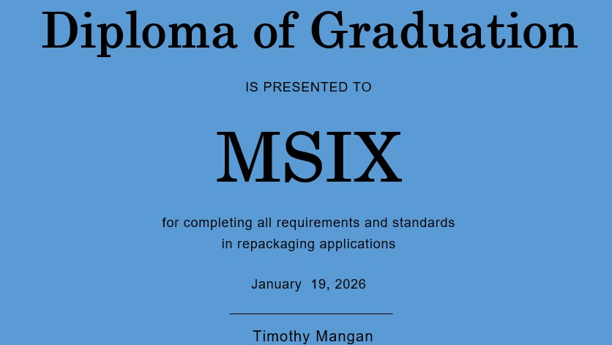
Token slide about MSIX
Better than App-V
Automatable
New OS integrations only via MSIX
https://tmurgent.com/APPV/en/resources/report-cards

Slide 5
The Enterprise Application Pipeline
A standard operating model for dealing with Windows Applications in any organization
A common language for all the industry that is independent of technology.

Slide 6
Why?
Application sprawl
Security risks must be addressed
App delivery backlogs
Manual Processes
Inconsistency
Application lifecycles are shortening
= Slower delivery, higher costs, frustrated users, increased tickets.

Slide 7
Application Pipeline Concept
From Ad hoc art, to industrialization
A standard workflow for every Windows application
Enforced from request to retirement
Integrated with security, deployment, and support.
Goal:
“If an app does not go through the pipeline, it does not exist!”

Slide 8
Pipeline Reference Architecture
Intake
Rationalization
Categorization
Preparation
Preparation
UAT
UAT
Delivery
Delivery
Support

Slide 9
1 - Intake
Formalized method to accept requests from business
Allows for tracking of requests
Sources:
End-user organizations
Monitoring vendors for when new versions are available
Monitoring CVE for high priority needs
Periodic reviews
Goal:
“Don’t wait for the ask/problem; be proactive”

Slide 10
Single Intake →Single Governance Model Parallel processes where necessary
Should have unified model:
Intake through categorization at the beginning
Support at the end
While allowing for different paths:
Preparation, UAT, Delivery

Slide 11
2 - Rationalization
Fit for use
Sprawl
Vendor Reputation
Security risk assessments
Goal:
“Filter and Prioritize”

Slide 12
3 - Categorize
Use-case specific requirements
Application factors
Requirements for different packaging/delivery methods
Automation assessment
Goal:
“There is only one category”
Reality:
“There will be a branch in the pipeline”

Slide 13
4 – Sub Pipelines
Technology Based
Application Based

Slide 14
Sub-pipeline Examples
Standard Applications
Well-known,
Already in org
Security approved
Highly automatable
Line-of-Business Apps
Possible short cycles,
High dependencies (internal)
UAT critical
Higher touch required
“Optimize:
Scale, speed, consistency”
“Optimize:
Risk mgmt, business enablement”
Non-Standard Applications
New to org,
Failed in automation
Problems in production
“Avoid if you can!”

Slide 15
4A - Preparation
How to control required features (in/out)
How to prevent vendor-initiated updates
How to automate / document the installation
Packaging or Wrapping
“Smoke testing” the result
Goal:
“Solid assets that will pass UAT”

Slide 16
4B - UAT
User Acceptance Testing
Automated testing
Expert User Testing
Control board reviews
Goal:
“100% confident it is ready for production”

Slide 17
4C - Deployment
Possibly different teams
Usually highly automated
May include user-assignment and licensing
Goal:
“Fast, secure delivery with no problems”

Slide 18
5 - Support
Triage issues
Solve if can
Escalate if needed
Proactive monitoring
Usage/Misusage
Licensing
Goal:
“Business productivity”

Slide 19
Key Takeaways
One pipeline
Everything uses it going forward
This is an operational model, not a tooling discussion
Adopt the concept before investing in solutions

Slide 20
Goal
“Architect for scale,
Deliver faster,
Improve security,
Gain control”
Action:
“Feedback wanted”
Email: Tmangan@TMurgent.com

Slide 21


Security and App Prep

Slide 22
Software Identity
All software must have a way to be identified

Slide 23
Identity
What
How
Executable file types
exe, dll, etc
Scripts
ps1, jar, py, etc
AI models
onnx, etc
Packages
msi, exe,
appv, msix, etc)
Digital Signatures
Hashes

Slide 24
About Hashes
Hash | Classical | w/ Quantum
CRC32 | Instant | Instant
MD5 | Instant | Instant
SHA‑1 | Minutes–Hours | Minutes
SHA‑256 | >10²⁷ years | ~10¹⁹ years
SHA‑512 | >10⁵⁴ years | ~10²⁷ years

Slide 25
About Digital Signatures
Algorithm | Classical | w/Quantum
DES | Hours | Seconds
3DES | Years | Hours
AES‑128 | ~10³⁸ years | ~10¹⁹ years
AES‑256 | ~10⁷⁷ years | ~10³⁸ years
RSA‑2048 | ~10³⁴ years | Broken
ECC P‑256 | ~10³⁸ years | Broken
ML-Kem‑768 | Designed ≥10⁵⁷ years | Secure

Slide 26
Attestation, Affirmation, Notarization
Approval that a given piece of software is security approved for the environment

Slide 27
Impact on pipeline
Identity as part of the pipeline (Stage 2/3)
Validate assets from vendor
Generate identity when needed
Record identity for downstream processes
Enforce Affirmation as part of the deployment process (4d)
Enforce Affirmation at runtime (~5)

Slide 28
MSIX Repackaging

Slide 29
What has changed
Microsoft:
MSIX Packaging Tool (not so much)
AppXManifest, AppInstaller
OS Integrations
TMurgent:
Package Support Framework
Fuller use of Microsoft changes
Improved analysis/recommendations
Automation
Better App Compat
Less work

Slide 30





Repackage Workflow
📦
Vendor Installer
📜
Script Wrapper
🔧
MMPT
✏️
TMEditX Editor
Installer
Media
Wrapper
Capture
Polish
Test/debug
PSATD
Chocolaty
PassiveInstall
MMPT
Others
TMEditX
Editor
TMEditX
Tools

Slide 31
Script Wrapper
$InstallerFileFolder = "$($executingScriptDirectory)\MSIBluebeamRevu21.8.0x64"
$OptsVC = ''
$OptsOcr = ''
$OptsRevu = ''
if ($DoSilent -eq 1)
{
$OptsVC = '/Q'
$OptsOcr = 'DISABLEADVTSHORTCUTS=1 /qn'
$OptsRevu = 'DISABLEADVTSHORTCUTS=1 ISCHECKFORPRODUCTUPDATES=0 BB_AUTO_UPDATE=0 BB_DESKSHORTCUT=0 DISABLE_WELCOME=1 /qn'
Install-PassiveInstallFile -Installer "$($InstallerFileFolder)\vc_redist.x64.exe" -Arguments $OptsVC -DoSilent
Install-PassiveInstallFile -Installer "$($InstallerFileFolder)\vc_redist.x86.exe" -Arguments $OptsVC -DoSilent
Install-PassiveInstallFile -Installer "$($InstallerFileFolder)\BluebeamOCR x64 21.msi" -Arguments $OptsOcr -DoSilent
Install-PassiveInstallFile -Installer "$($InstallerFileFolder)\Bluebeam Revu x64 21.msi" -Arguments $OptsRevu -DoSilent
}
else
{
$OptsVC = '/Passive'
$OptsOcr = 'DISABLEADVTSHORTCUTS=1 /passive'
$OptsRevu = 'DISABLEADVTSHORTCUTS=1 ISCHECKFORPRODUCTUPDATES=0 BB_AUTO_UPDATE=0 BB_DESKSHORTCUT=0 DISABLE_WELCOME=1 /passive'
Install-PassiveInstallFile -Installer "$($InstallerFileFolder)\vc_redist.x64.exe" -Arguments $OptsVC
Install-PassiveInstallFile -Installer "$($InstallerFileFolder)\vc_redist.x86.exe" -Arguments $OptsVC
Install-PassiveInstallFile -Installer "$($InstallerFileFolder)\BluebeamOCR x64 21.msi" -Arguments $OptsOcr
Install-PassiveInstallFile -Installer "$($InstallerFileFolder)\Bluebeam Revu x64 21.msi" -Arguments $OptsRevu
}
#Remove-PassiveDesktopShortcuts -Names 'Bluebeam Revu'
#Remove-PassiveStartMenuShortcuts -Names 'BlueBeam Revu (x86)'
#Remove-PassiveStartMenuShortcuts -Names 'BlueBeam Stapler (x86)'
Optimize-PassiveNgenQueues

Slide 32
Script Wrapper
$initialFirewallRules = Get-PassiveFirewallRules
$ARGS = "/D='$($env:ProgramFiles)\ObsStudio'"
if ($DoSilent -eq 1)
{
Install-PassiveInstallFile -Installer "$($executingScriptDirectory)\OBS-Studio-30.2.3-Windows-Installer.exe" -Arguments "/S $($ARGS)" -DoSilent
}
else
{
Install-PassiveInstallFile -Installer "$($executingScriptDirectory)\OBS-Studio-30.2.3-Windows-Installer.exe" -Arguments "/S $($ARGS)"
}
Copy-PassiveFile -Source "$($executingScriptDirectory)\Config\global.ini" -Destination "$($env:APPDATA)\obs-studio"
Remove-PassiveDesktopShortcuts -Names 'Obs Studio'
Remove-PassiveStartMenuShortcuts -Names 'Uninstall'
# Check for new firewall rules and touch them from this process so that they are captured by the MMPT
$updatedFirewallRules = Get-PassiveFirewallRules
$changedFirewallRules = Redo-PassiveNewFirewallRules $initialFirewallRules $updatedFirewallRules
if ($DoSilent -eq 0)
{
$changedFirewallRules.Show()
}
Optimize-PassiveNgenQueues

Slide 33
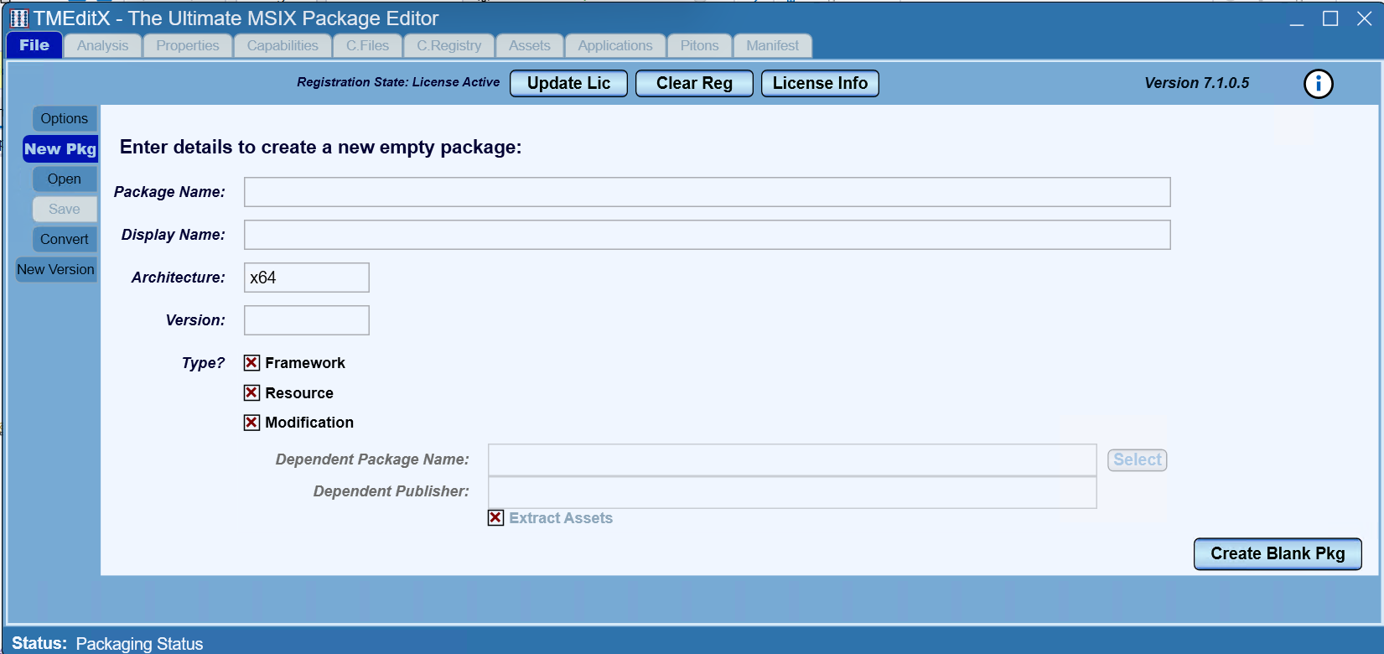
TMEditX Editor

Slide 34
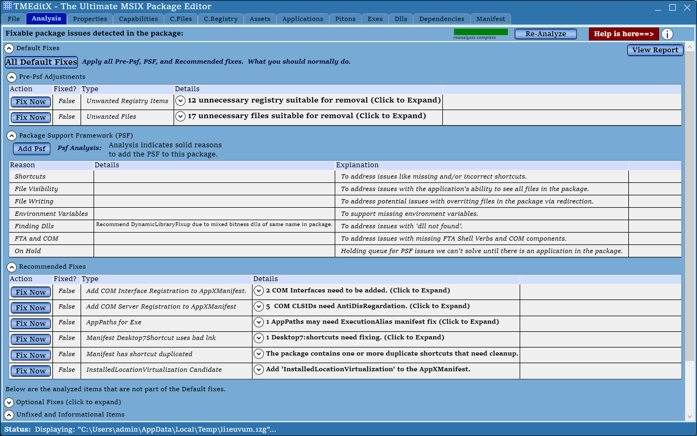
TMEditX Editor

Slide 35
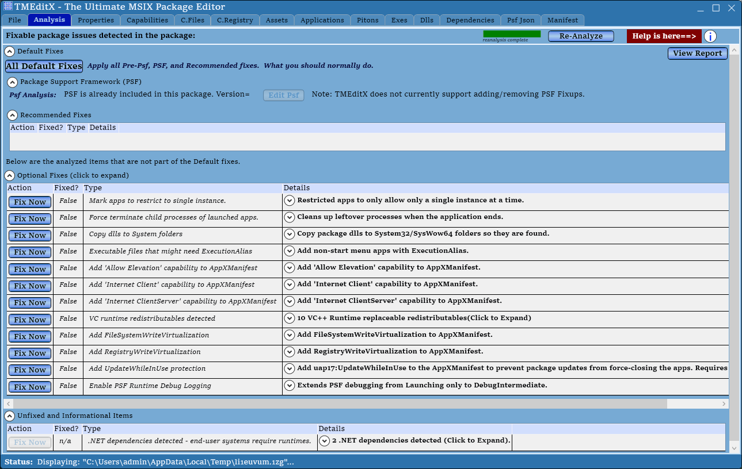

Slide 36
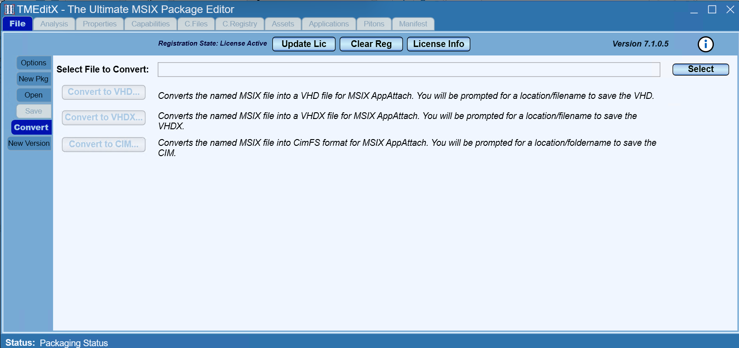
TMEditX Editor

Slide 37

TMEditX Tools (free community tools)
MSIX Deploy:
Locally deploy MSIX and App Attach
Shared Package Containers
Debugging Tools for Container
ParsePsfDebugLog:
Purpose build log parser

Slide 38
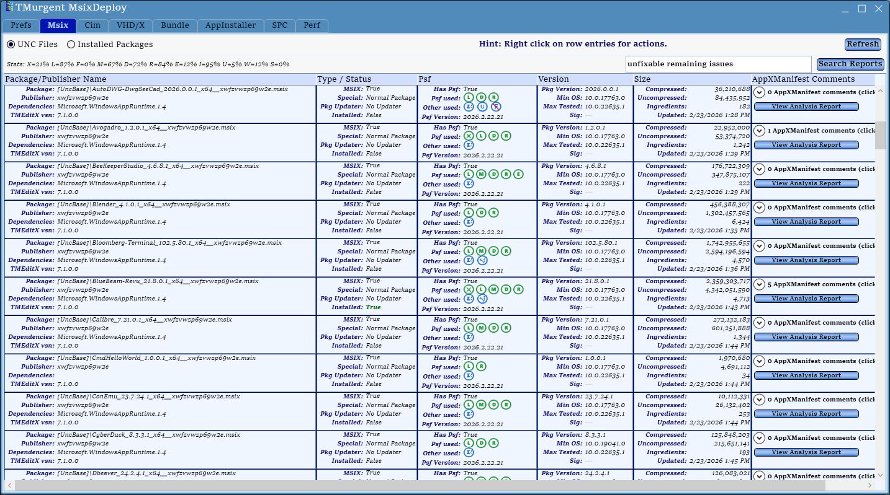
TMEditX Tools

Slide 39
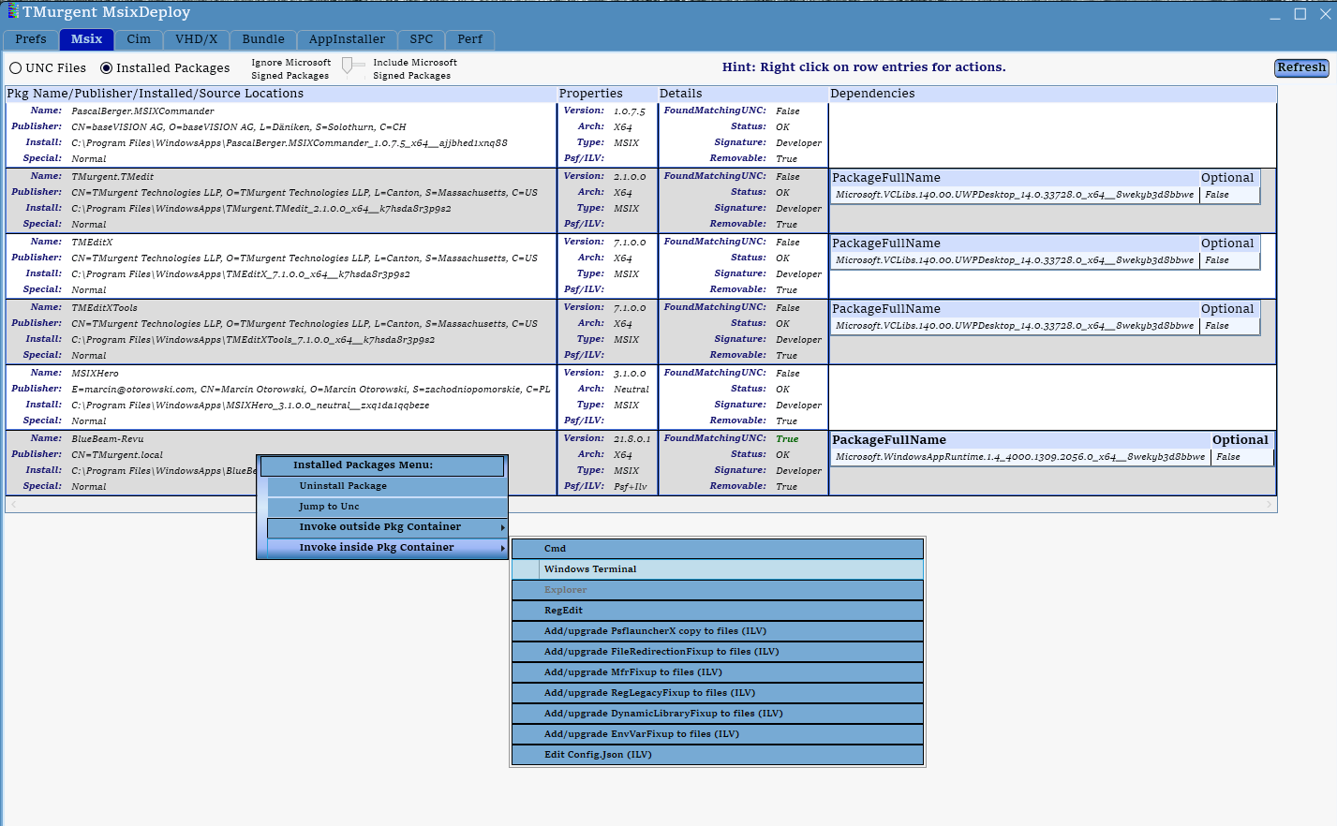
TMEditX Tools

Slide 40
=== Contact ===
Tim Mangan
Email:
tmangan@tmurgent.com
LinkedIn:
timmangan
Website:
tmurgent.com

