Slide 1
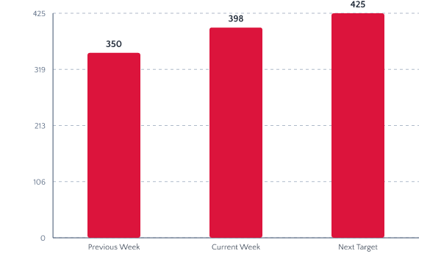
Variant A — Minimal

Slide 2
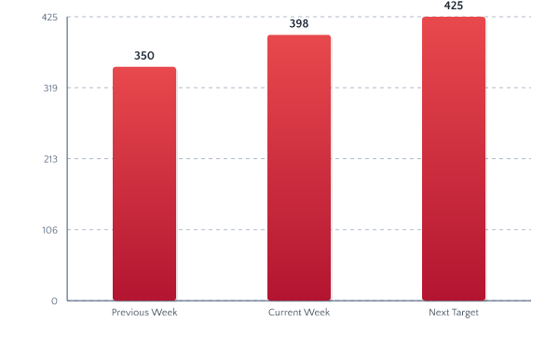
Variant B — Polished (gradient+shadow)

Slide 3
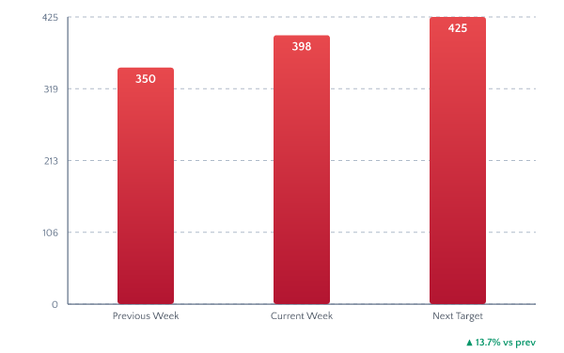
Variant C — Dashboard (trend indicator)

