Slide 1


Nepalcan.com-Weekly Review
Department-Wise Performance Analysis
23 Jestha 2083 - 29 Jestha 2083 (June 5, 2026 - June 12, 2026)
Executive Brief

Slide 2
BUSINESS DEVELOPMENT
PREVIOUS Week
CURRENT STATUS
NEXT WEEK TARGET
Total Vendors: 350
Total Vendors: 398
Total Vendors: 425
Total Verified Vendors: 140
Total Verified Vendors: 169
Total Verified Vendors: 185
Vendors Added: —
10 vendors with less than 10 products
Vendors with less than 10 products: 7
Vendors Added: —
Vendors Added: —
Nepalcan.com | Weekly Status Report
23 Jestha 2083 - 29 Jestha 2083 (June 5, 2026 - June 12, 2026)

Slide 3
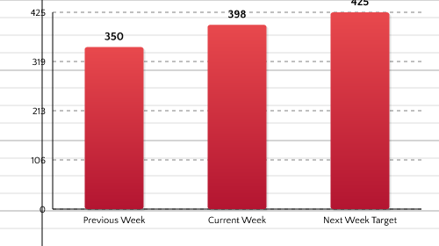
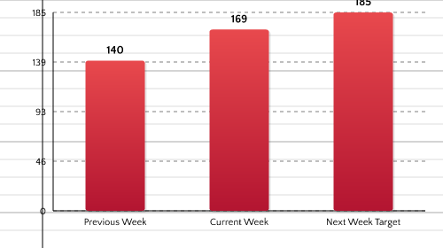
BUSINESS DEVELOPMENT - PROGRESS CHART
Total Vendors
Total Verified Vendors
Nepalcan.com | Weekly Status Report
23 Jestha 2083 - 29 Jestha 2083 (June 5, 2026 - June 12, 2026)

Slide 4
Business Development Report
• We were busy in collecting the brands names. • we wont be doing this
Nepalcan.com | Weekly Status Report
23 Jestha 2083 - 29 Jestha 2083 (June 5, 2026 - June 12, 2026)

Slide 5
LISTING
PREVIOUS Week
CURRENT STATUS
NEXT WEEK TARGET
Total Marketplace Products: 55,000;
Total Marketplace Products: 69,633
Total Marketplace Products: 72,000
Daily Average Listings: 225
Daily Average Listings: 500
Daily Average Listings: 200/day;
Backlog (Products): 15,000
Total Products Shown in Marketplace: —
Total Products Shown in Marketplace: —
Total Specifications Added: 500
Backlog (Products): 1,200 products;
Total Specifications Added: 394
Specification Completion %: 14
Total Products Shown in Marketplace:
Specification Completion %: 11
Total Specifications Added: 200;
Specification Completion %: 10;
Nepalcan.com | Weekly Status Report
23 Jestha 2083 - 29 Jestha 2083 (June 5, 2026 - June 12, 2026)

Slide 6
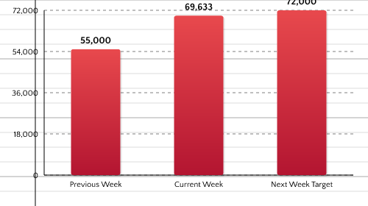
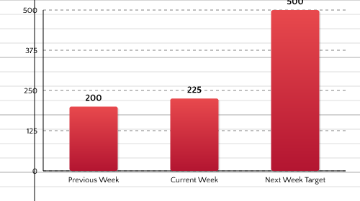
LISTING - PROGRESS CHARTS
Total Products Shown in Marketplace Trend
Daily Average Listings Trend
Specification Completion % Trend
Total Products Shown in Marketplace: 200
Nepalcan.com | Weekly Status Report
23 Jestha 2083 - 29 Jestha 2083 (June 5, 2026 - June 12, 2026)

Slide 7
Listing Report
• We were busy in collecting the listing names. • we wont be doing this
Nepalcan.com | Weekly Status Report
23 Jestha 2083 - 29 Jestha 2083 (June 5, 2026 - June 12, 2026)

Slide 8
QUALITY CONTROL WEEKLY REPORT
PREVIOUS Week
CURRENT STATUS
NEXT WEEK TARGET
-
Products Approved: 1,200
-
Products Approved: 1,400
-
Products Approved: 1,600
-
Products Rejected: 0
-
Products Rejected: 0
-
Products Rejected: 0
-
Products Pending: 0
-
Products Pending: 0
-
Products Pending: 0
Nepalcan.com | Weekly Status Report
23 Jestha 2083 - 29 Jestha 2083 (June 5, 2026 - June 12, 2026)

Slide 9
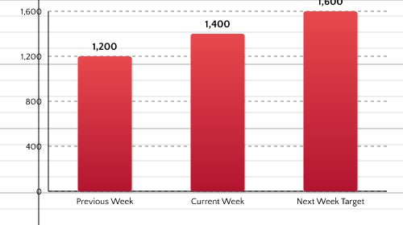
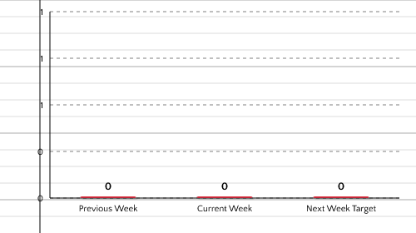
Quality Control - PROGRESS CHART
Products Approved
Products Rejected
Nepalcan.com | Weekly Status Report
23 Jestha 2083 - 29 Jestha 2083 (June 5, 2026 - June 12, 2026)

Slide 10
Quality Control Report
• We were busy in collecting the qality names. • we wont be doing this
Nepalcan.com | Weekly Status Report
23 Jestha 2083 - 29 Jestha 2083 (June 5, 2026 - June 12, 2026)

Slide 11
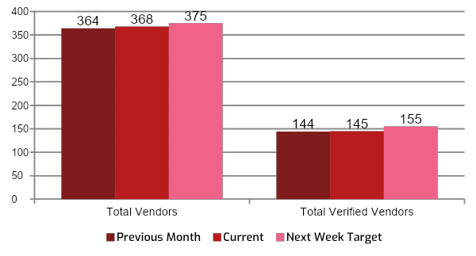
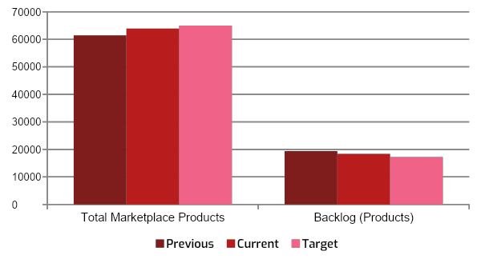
KPI OVERVIEW
Business Development - KPI Metrics
Listing Metrics
Nepalcan.com | Weekly Status Report
23 Jestha 2083 - 29 Jestha 2083 (June 5, 2026 - June 12, 2026)

Slide 12

REPORT CLOSURE
Thank You
Weekly Report | 23 Jestha 2083 - 29 Jestha 2083 (June 5, 2026 - June 12, 2026)
Summary
398
69,633
225
Total Vendors
Total Marketplace Products
Daily Average Listings
Next Review: May 23, 2026 | nepalcan.com

