Slide 1


Nepalcan.com-Weekly Review
Department-Wise Performance Analysis
May 10, 2026 - May 16, 2026
Executive Brief

Slide 2
BUSINESS DEVELOPMENT
PREVIOUS Week
CURRENT STATUS
NEXT WEEK TARGET
-
Total Vendors: 364
-
Total Vendors: 368
-
Total Vendors: 375+
-
Total Verified Vendors: 144
-
Total Verified Vendors: 145
-
Total Verified Vendors: 155+
-
Vendors Added: 16
-
16 vendors with less than 10 products
-
Vendors with less than 10 products: 12+
-
Vendors Added: 4
-
Vendors Added: 7+
Nepalcan.com | Weekly Status Report
May 10, 2026 - May 16, 2026

Slide 3
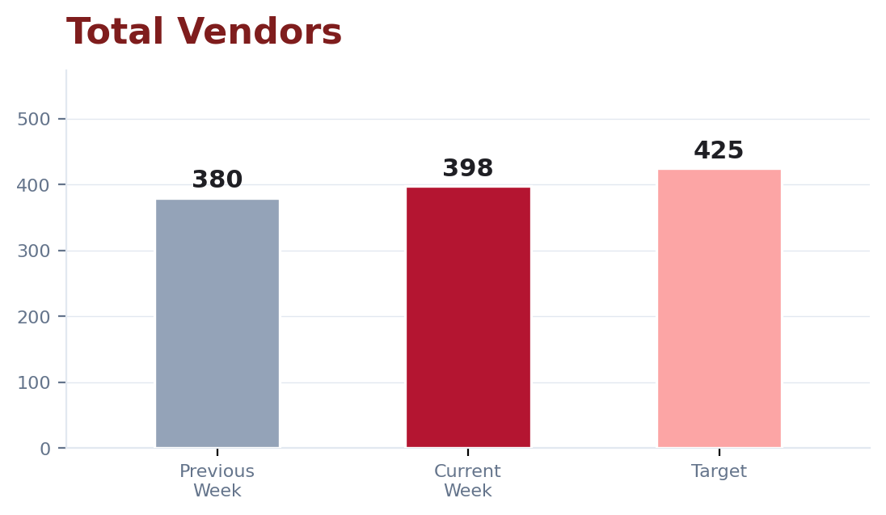
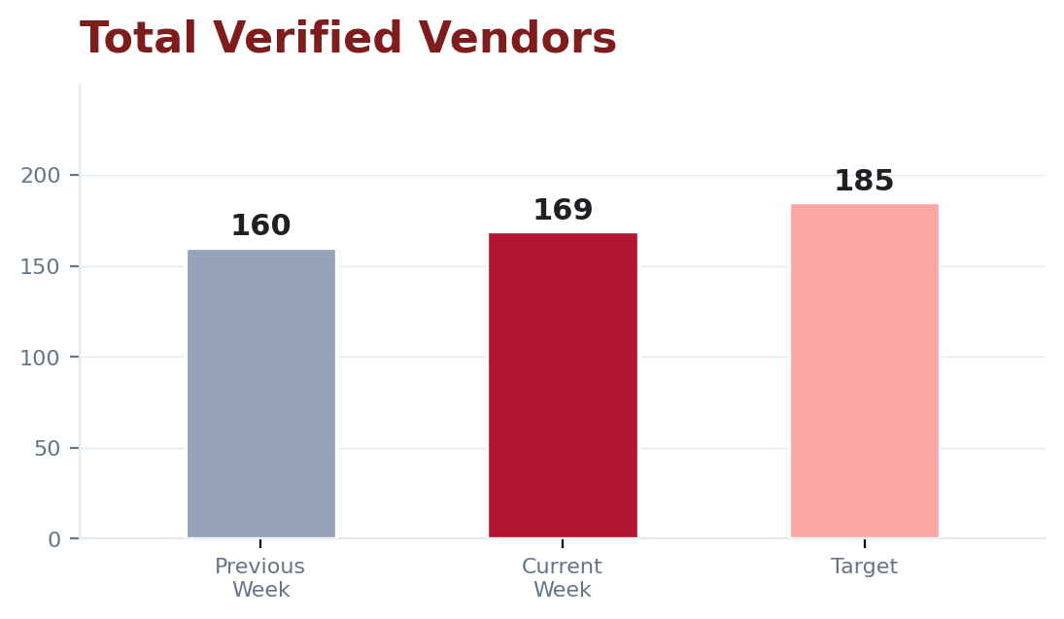
BUSINESS DEVELOPMENT - PROGRESS CHART
Total Vendors
Total Verified Vendors
Nepalcan.com | Weekly Status Report
May 10, 2026 - May 16, 2026

Slide 4
Business Development Report
The onboarding numbers are currently lower as the team is primarily focusing on authorized brands and “Mall”-tagged vendors from other e-commerce platforms.
These vendors require proposal discussions, approval processes, and longer decision-making timelines before onboarding confirmation.
We are currently in active communication with brands such as Softy Hygiene, Aiwibi Nepal, MumBuds Nepal, Bambo Nature Nepal, PADelux, Rohto-Mentholatum Nepal, Syakar Company Philips, Plum Goodness Nepal, JoySoft Nepal, and others.
One Business Development team member is currently on leave, which has slightly impacted follow-up activities.
Despite this, the team continues to prioritize the onboarding of trusted and high-value vendors, as they play a significant role in strengthening customer trust and the overall credibility of Nepalcan.com.
Nepalcan.com | Weekly Status Report
May 10, 2026 - May 16, 2026

Slide 5
LISTING
PREVIOUS Week
CURRENT STATUS
NEXT WEEK TARGET
-
Total Marketplace Products: Actual: 61,443;
-
Total Marketplace Products: 63,889
-
Total Marketplace Products: 65,000+
Target: 63,500
-
Daily Average Listings: 408/day
-
Daily Average Listings: 500+
-
Daily Average Listings: Actual: 350/day;
-
Backlog (Products): 18,400 products
-
Total Products Shown in Marketplace: 50,000+
Target: 400/day
-
-
-
Total Products Shown in Marketplace: 47,200
Total Specifications Added: 1,700+
Backlog (Products): Actual: 19,360 products;
-
-
Target: 18,000 products
Total Specifications Added: 1,543
Specification Completion %: 12+
-
Total Products Shown in Marketplace: Actual:
-
Specification Completion %: 10
43,876; Target: 50,000
-
Some team members focused on adding
-
Total Specifications Added: Actual: 1,504;
specification, some did listing & qc also
Target: 1,700
some did listing & specifications both.
-
Specification Completion %: Actual: 8;
-
The listing team maintained steady progress
Target: 12
during the reporting period by balancing
listing uploads, QC, and specification
updates.
Nepalcan.com | Weekly Status Report
May 10, 2026 - May 16, 2026

Slide 6
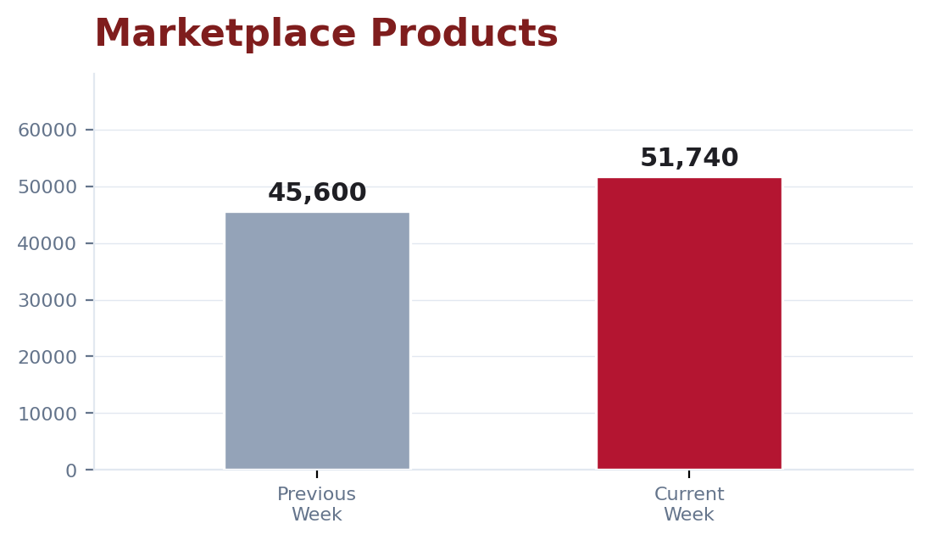
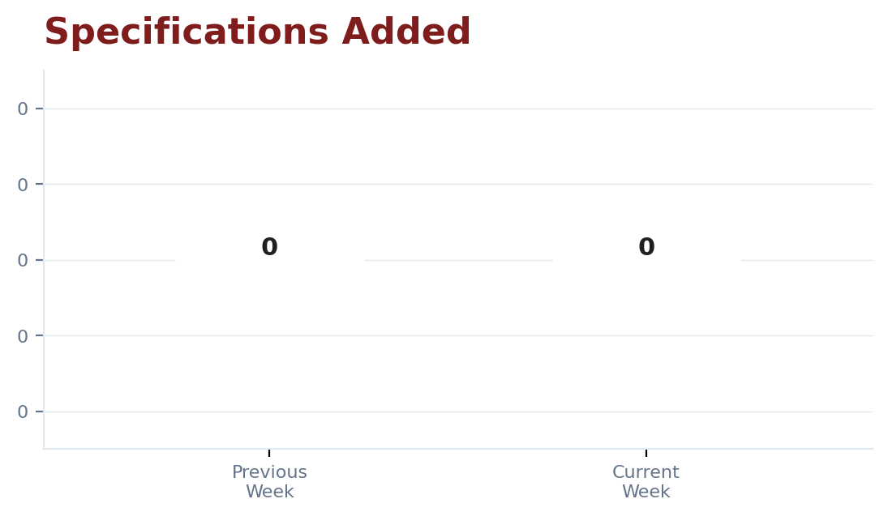
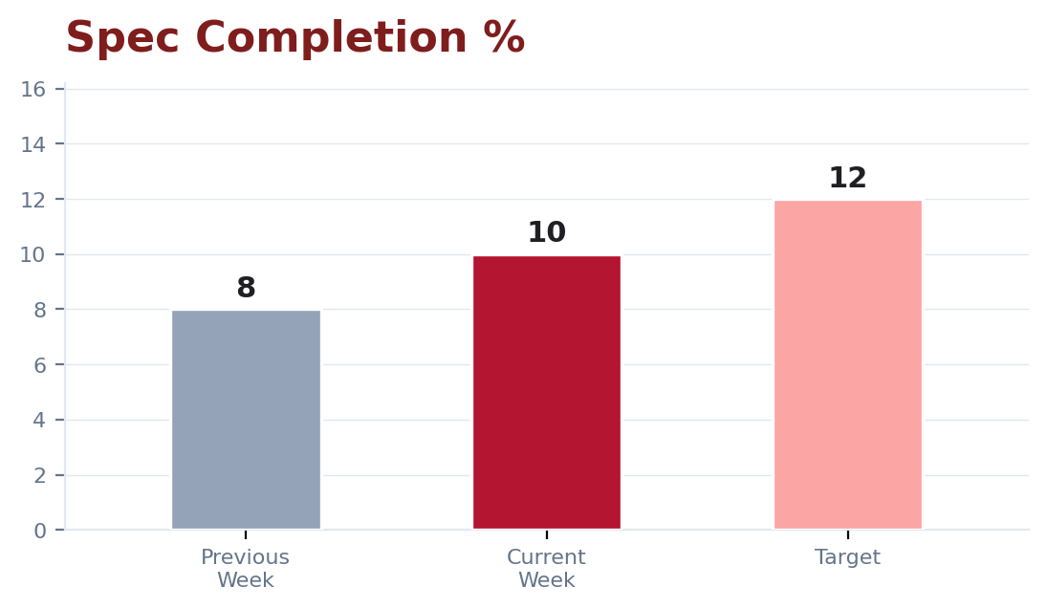
LISTING - PROGRESS CHARTS
Total Products Shown in Marketplace Trend
Total Specifications Added Trend
Specification Completion % Trend
Total Products Shown in Marketplace: +8% (47200 vs 43876) | Total Specifications Added: +3% (1543 vs 1504) | Specification Completion %: +25% (10 vs 8)
Nepalcan.com | Weekly Status Report
May 10, 2026 - May 16, 2026

Slide 7
QUALITY CONTROL WEEKLY REPORT
PREVIOUS Week
CURRENT STATUS
NEXT WEEK TARGET
-
Products Approved: 1855
-
Products Approved: 2161
-
Products Approved: 2300
-
Products Rejected: 1
-
Products Rejected: 0
-
Products Rejected: 0
-
Products Pending: 0
-
Products Pending: 0
-
Products Pending: 0
Nepalcan.com | Weekly Status Report
May 10, 2026 - May 16, 2026

Slide 8
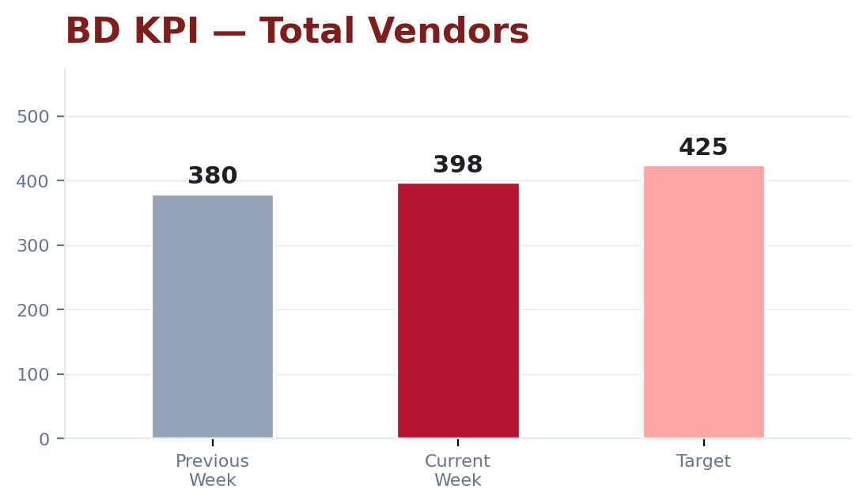
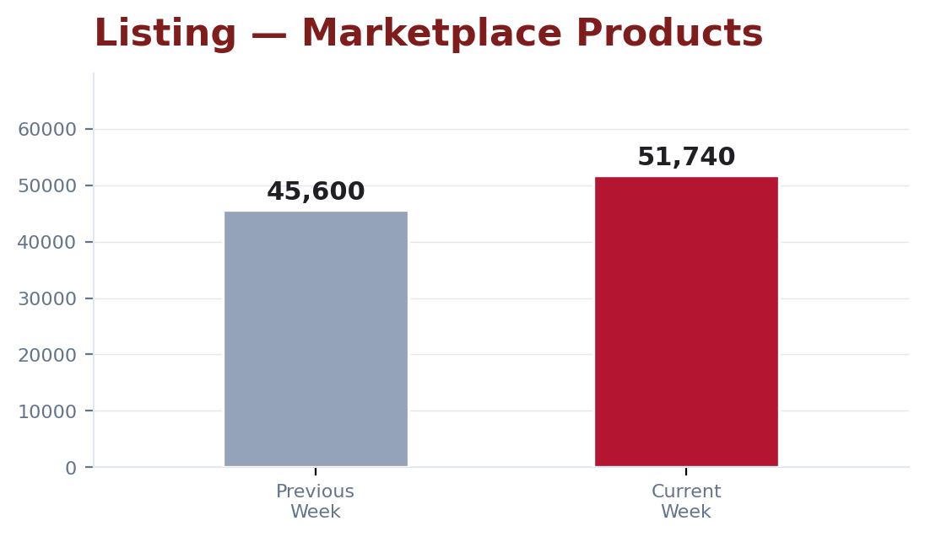
KPI OVERVIEW
Business Development - KPI Metrics
Listing Metrics
Nepalcan.com | Weekly Status Report
May 10, 2026 - May 16, 2026

Slide 9

REPORT CLOSURE
Thank You
Weekly Report | May 10, 2026 - May 16, 2026
Summary
368
63,889
408
Total Vendors
Total Marketplace Products
Daily Average Listings
Next Review: May 23, 2026 | nepalcan.com

