Slide 1
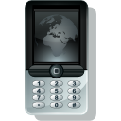





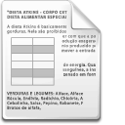


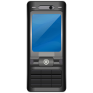


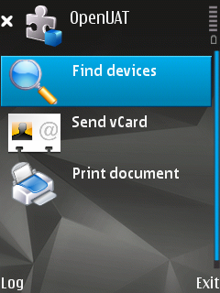
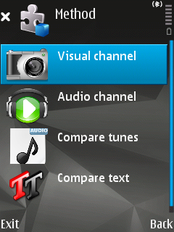
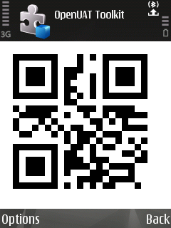
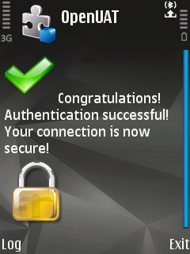
OPEN source Ubiquitous Authentication Toolkit
Usable, secure, context-based authentication
Iulia Ion and Rene Mayrhofer
Summary
Authentication between personal devices and the environment is difficult, because such devices are small, mobile, and typically have limited resources. The absence of large screens and efficient input devices makes authentication based on sensor information even more attractive.
Due to the diversity of requirements, secure device authentication protocols in ubiquitous computing tend to be implemented within specific research prototypes and can not be used easily in other applications. We propose to develop a common toolkit for ubiquitous device authentication to foster wide usability of research results.
OpenUAT provides methods for creating shared secrets between two (or multiple) devices. These secrets are authenticated to prevent man-in-the-middle (MITM) attacks.
Spontaneous device interaction scenarios:
Integrating a newly acquired device into my home network
Connecting to a wireless Access Point
Printing a confidential document on THIS printer in the airport
Sending vCard to a new business partner.
1
Wireless communication is intrinsically not secure due to medium properties. To establish an ad-hoc, secure connection between two devices, so-called OOB channels are used to ensure message authenticity.
Examples of OOB Channels:
Visual channel
  The use of visual barcodes and phone camera.
Audio channel
  The key is encoded and transmitted via the audio channel.
Manual string comparison
  The user compares the output manually.
Accelerometer data
  Devices are shaken together. From the accelerometer time series a key is constructed/verified.
Button presses
  Pushing buttons simultaneously on both devices.
Ad-hoc device pairing
Out of Band (OOB) Channels
2
vCard with PGP key
_x0016_
Session key
_x0016_
_x0016_
Confidential
document
Design goals
Lightweight: minimize resource usage such storage and run-time memory, CPU, communication bandwidth, but also battery lifetime, input/output devices, and user attention.
Self-contained: run out-of-the-box on any device.
Simple to use: _x0002_intuitive for end-users, modular API for developers.
Extensible, vertical and interoperable.
When meeting a new business partner in the airport,
we exchange vCards and my PGP keys through our mobile phones.
Example scenario:
Sending vCard with my confidential data
OpenUAT
3
References
R. Mayrhofer, “Towards an open source toolkit for ubiquitous device authentication,” in Workshops Proc. PerCom 2007: 5th IEEE International Conference on Pervasive Computing and Communications, pp. 247-252, IEEE CS Press, March 2007. Track PerSec 2007: 4th IEEE International Workshop on Pervasive Computing and Communication Security
R. Mayrhofer and H. Gellersen, “Shake well before use: Authentication based on accelerometer data,” in Proc. Pervasive 2007: 5th International Conference on Pervasive Computing, vol. 4480 of LNCS, pp. 144-161, Springer-Verlag, May 2007. awarded best Pervasive 2007 paper..
McCune, J.M., Perrig, A., Reiter, M.K.: Seeing-is-believing: Using camera phones for human-verifiable authentication. In: Proc. IEEE Symp. on Security and Privacy, IEEE CS Press (2005) 110–124.
Goodrich, M.T., Sirivianos, M., Solis, J., Tsudik, G., Uzun, E.: Loud and clear: Human verifiable authentication based on audio. In: Proc. ICDCS 2006: 26th Conf. on Distributed Computing Systems, IEEE CS Press (2006) 10.
More info:
_x0016_
_x0016_
_x0016_
http://www.openuat.org
Find devices
Select authentication method
Take snapshot
Secure interaction successfully established

