Slide 1
Composable Coresets for
Fair Diversity Maximization
Ali Ahmadvand Mohammad Ansari Mobin Razavi
Hamid Zarrabi-Zadeh
Sharif University of Technology
SPAA 2026

Slide 2
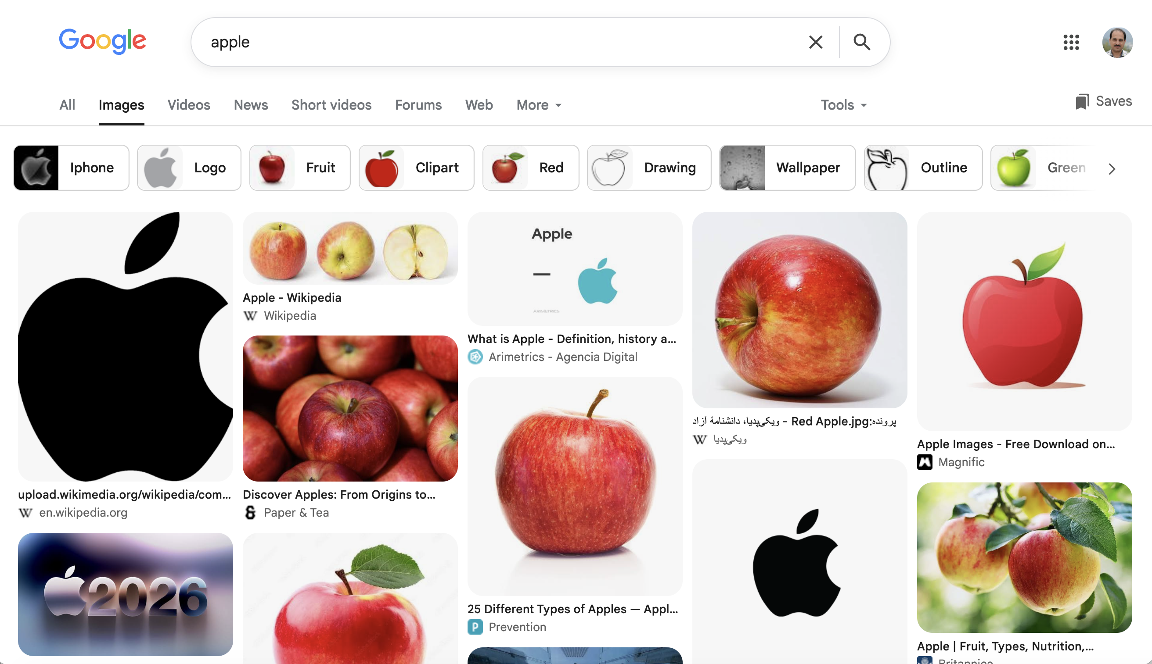
Diversity Maximization
Search results
Apple
Jaguar

Slide 3
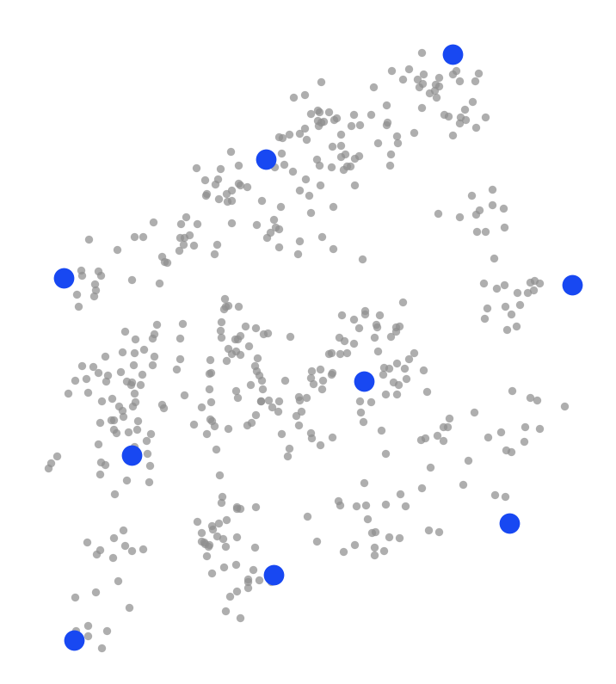
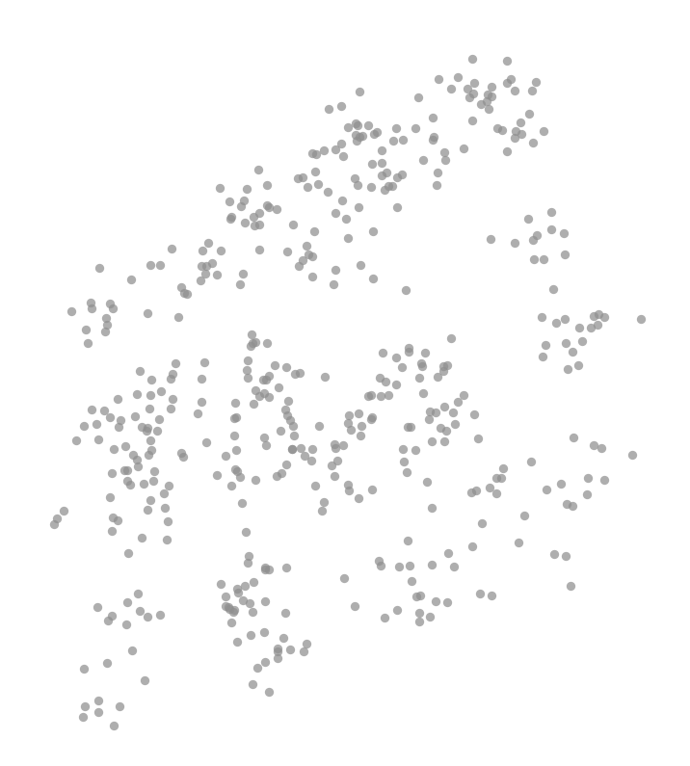
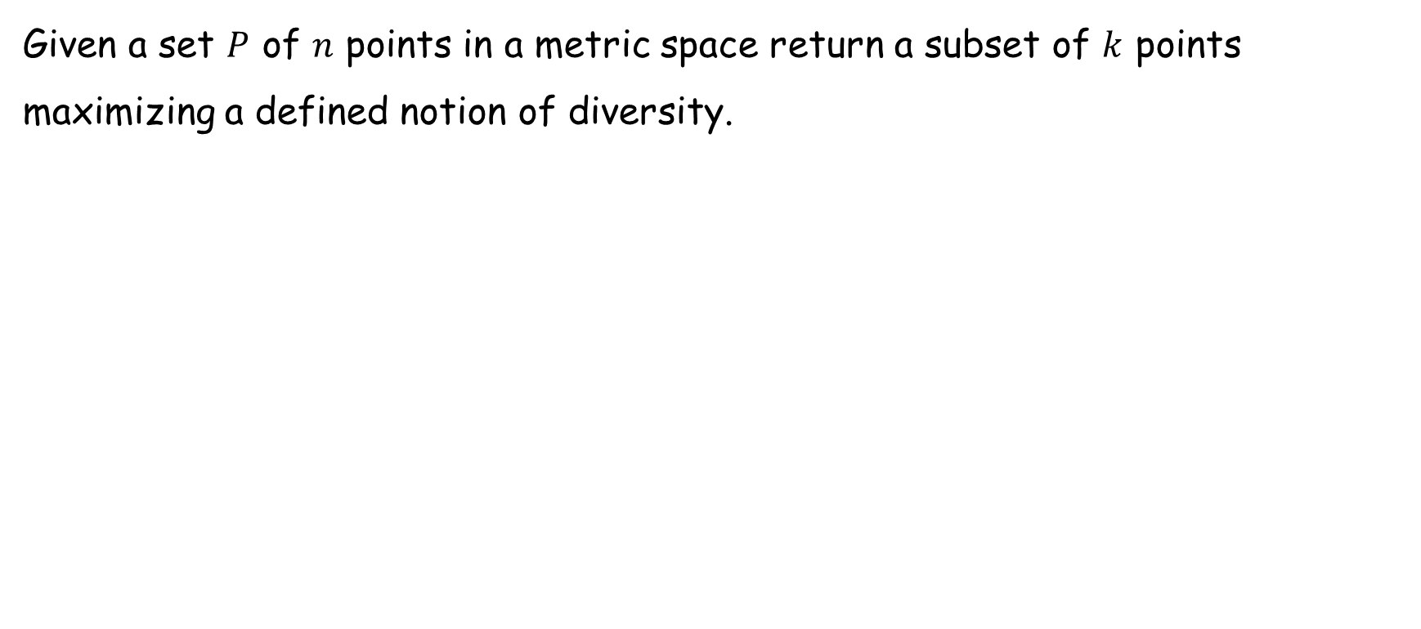
Diversity Maximization: Definition
Given a set $P$ of $n$ points in a metric space return a subset of $k$ points maximizing a defined notion of diversity.

Slide 4
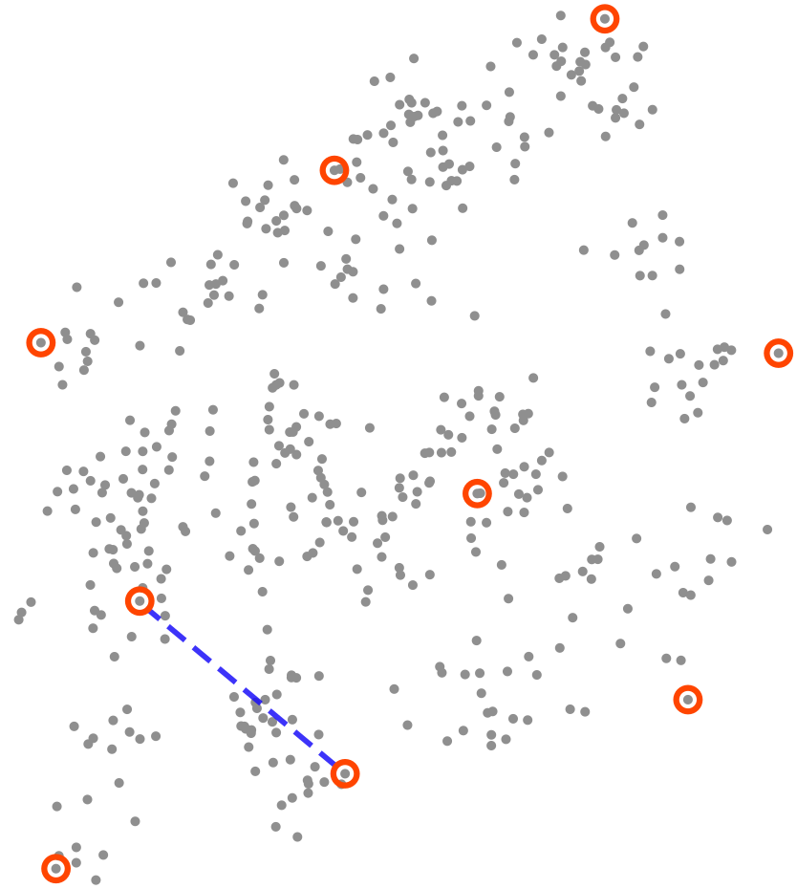
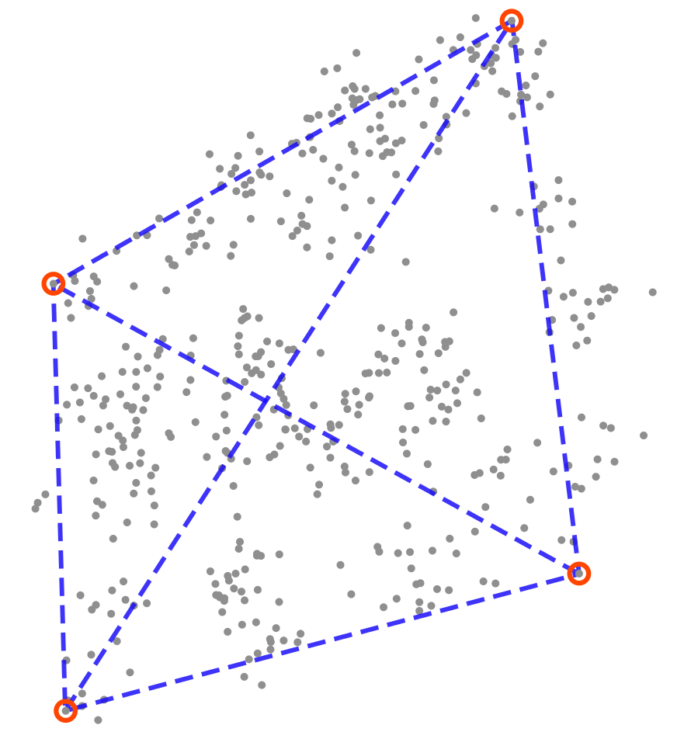
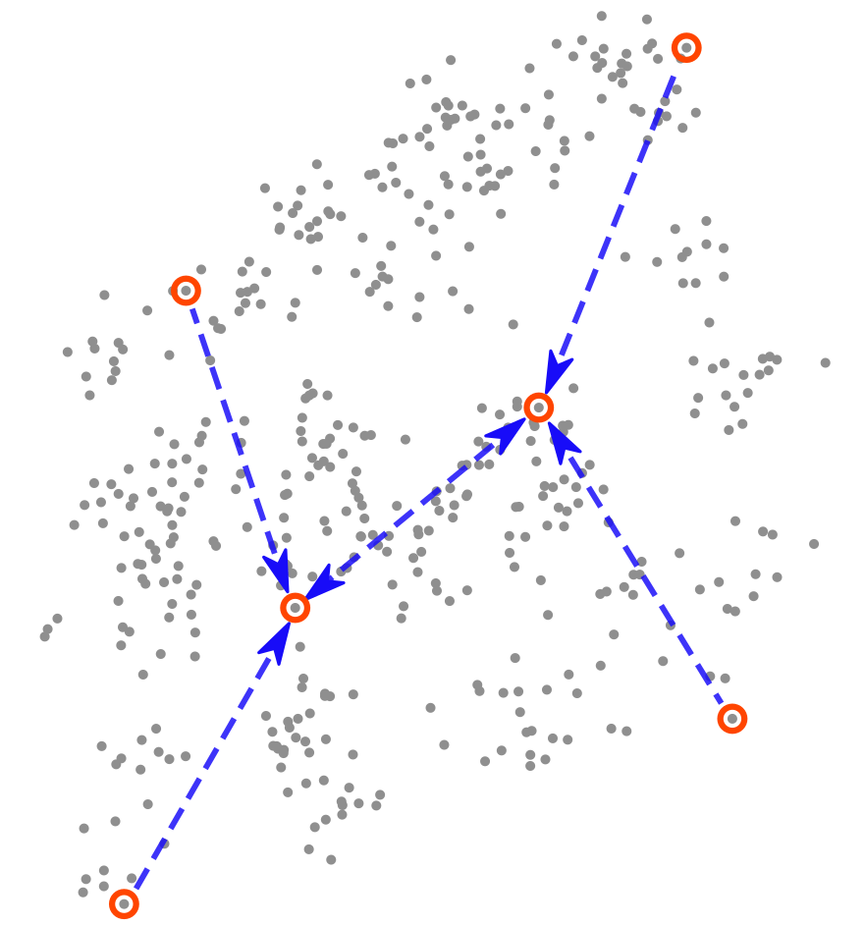



Diversity Notions
Max-Min diversity
for $k=9$
Max-Sum diversity
for $k=4$
Sum-NN diversity
for $k=6$

Slide 5
Diversity Notions (cont’d)
Max-Min: minimum pairwise distance of the points
Max-Sum: sum of pairwise distances of the points
Sum-NN: sum of distances from each point to its nearest neighbor
All three versions are NP-Hard.

Slide 6

Applications
Recommendation systems
  Shopping, movies, …
Document and data summarization
Search results
Facility placement
Machine learning dataset selection
Image from: https://www.marketresearchintellect.com/images/blogs/driving-personalized-journeys-how-content-recommendation-engines-are-revolutionizing-the-auto-industry.webp

Slide 7
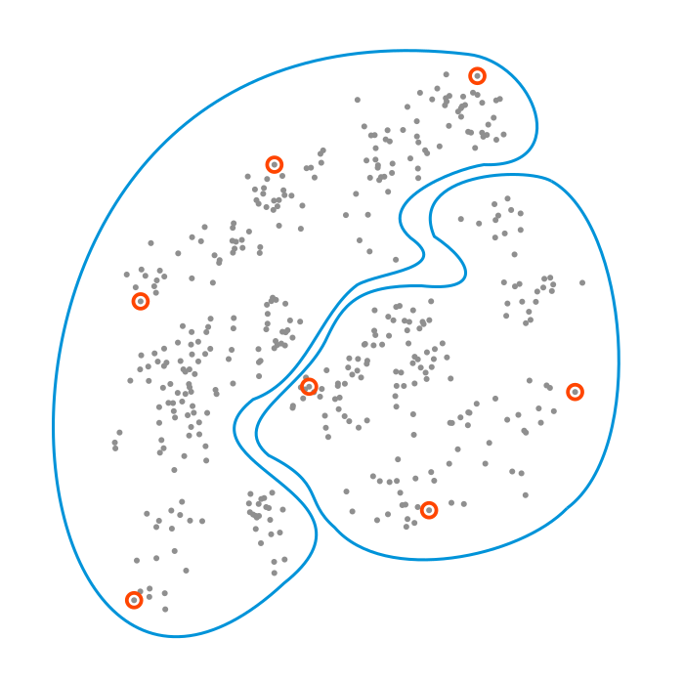

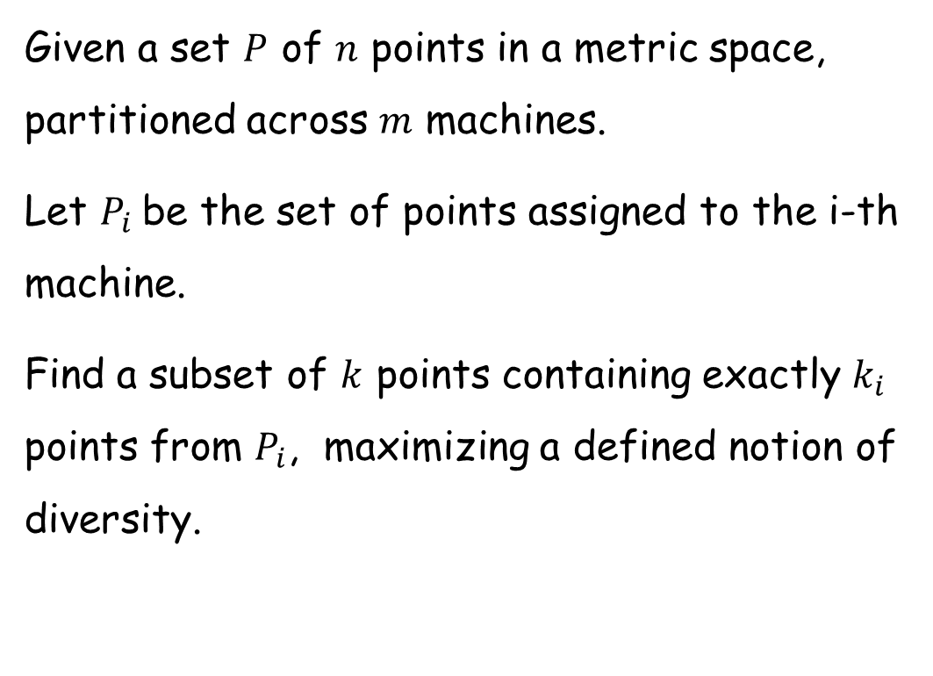



Fair Diversity Maximization
Given a set $P$ of $n$ points in a metric space, partitioned across $m$ machines.
Let $P_{i}$ be the set of points assigned to the i-th machine.
Find a subset of $k$ points containing exactly $k_{i}$ points from $P_{i}$, maximizing a defined notion of diversity.
$$k_{2}=3$$
$$k_{1}=4$$
$$P_{2}$$
$$P_{1}$$

Slide 8



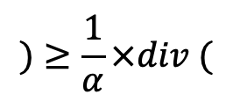










Composable Coresets
$$Alg$$
$$P_{1}$$
$$T_{1}$$
$$Alg$$
$$P_{2}$$
$$T_{2}$$
$$)≥\frac{1}{α}×div ($$
$$div($$
$$)$$
$$T$$
$$P$$
$$Alg$$
$$P_{3}$$
$$T_{3}$$

Slide 9
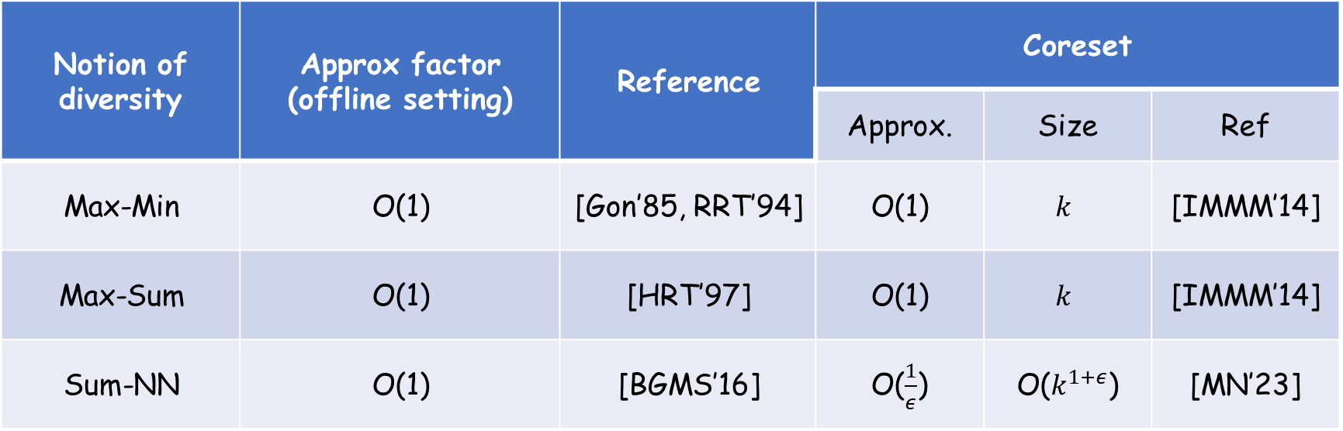
Previous Work: Diversity Maximization
Coreset |  |  | Reference | Approx factor (offline setting) | Notion of diversity
Ref | Size | Approx.
[IMMM’14] | $$k$$ | O(1) | [Gon’85, RRT’94] | O(1) | Max-Min
[IMMM’14] | $$k$$ | O(1) | [HRT’97] | O(1) | Max-Sum
[MN’23] | O($k^{1+ε}$) | O($\frac{1}{ε}$) | [BGMS’16] | O(1) | Sum-NN

Slide 10
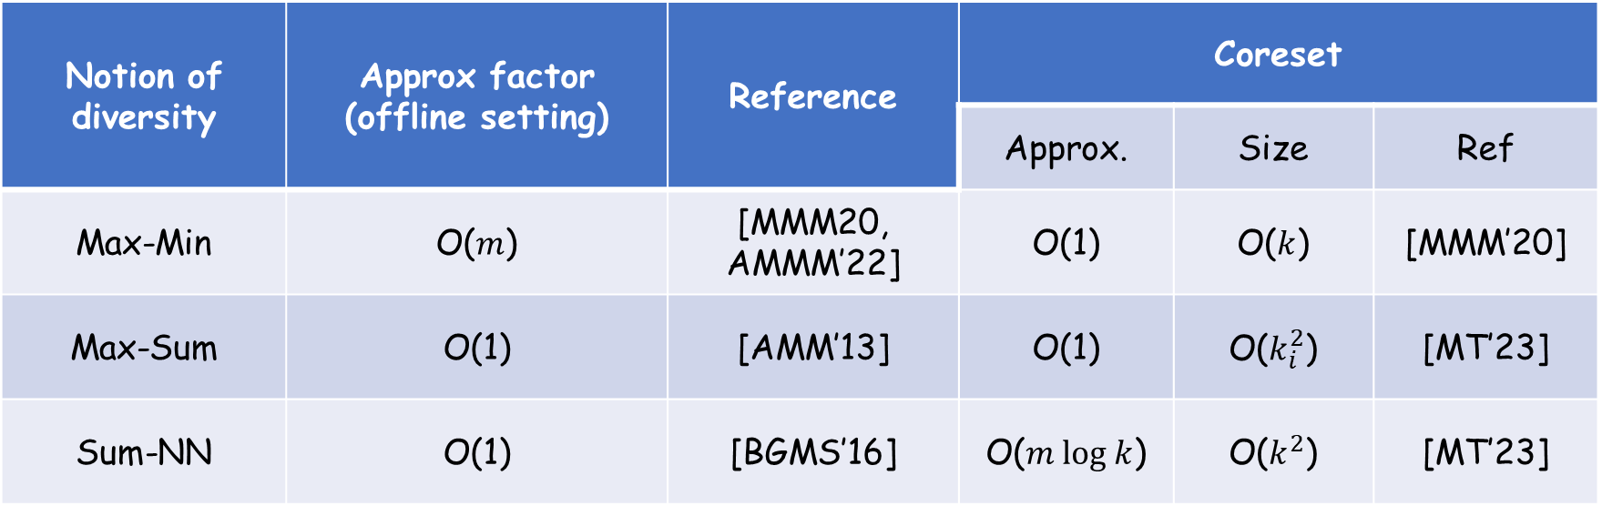
Previous Work: Fair Diversity Maximization
Coreset |  |  | Reference | Approx factor (offline setting) | Notion of diversity
Ref | Size | Approx.
[MMM’20] | O($k$) | O(1) | [MMM20, AMMM’22] | O($m$) | Max-Min
[MT’23] | O($k_{i}^{2}$) | O(1) | [AMM’13] | O(1) | Max-Sum
[MT’23] | O($k^{2}$) | O($m log k$) | [BGMS’16] | O(1) | Sum-NN

Slide 11
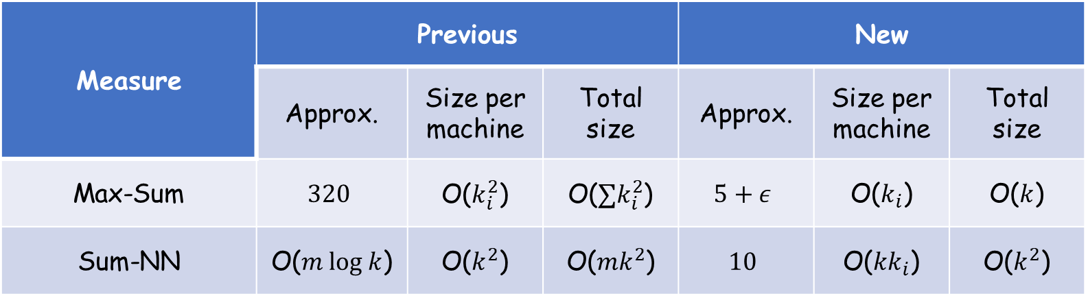
Our Contribution
Better Composable Coresets for Fair Diversity Maximization
New |  |  | Previous |  |  | Measure
Total size | Size per machine | Approx. | Total size | Size per machine | Approx.
O($k$) | O($k_{i}$) | $$5+ε$$ | O($∑k_{i}^{2}$) | O($k_{i}^{2}$) | $$320$$ | Max-Sum
O($k^{2}$) | O($kk_{i}$) | $$10$$ | O(${mk}^{2}$) | O($k^{2}$) | O($m log k$) | Sum-NN

Slide 12
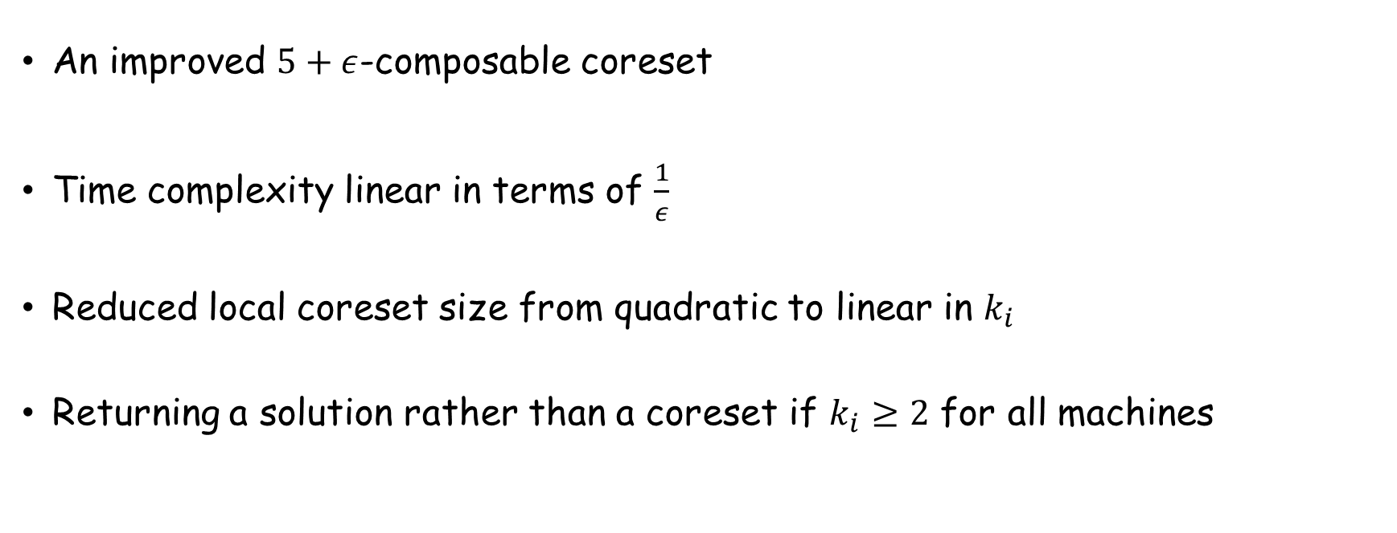
Coreset for Max-Sum
An improved $5+ε$-composable coreset
Time complexity linear in terms of $\frac{1}{ε}$
Reduced local coreset size from quadratic to linear in $k_{i}$
Returning a solution rather than a coreset if $k_{i}≥2$ for all machines

Slide 13
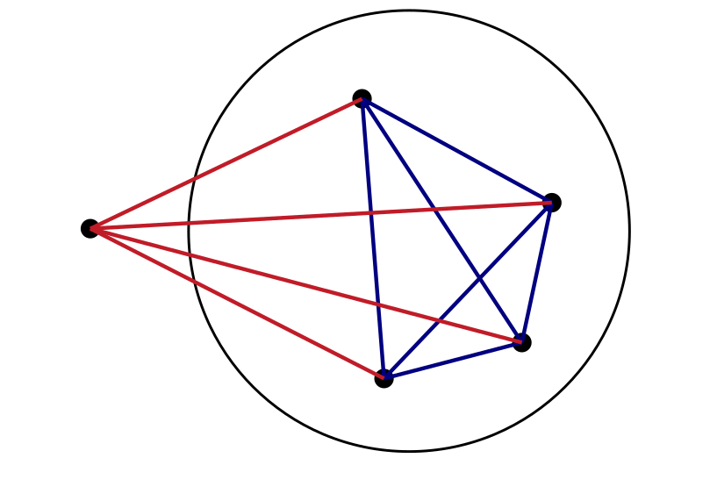
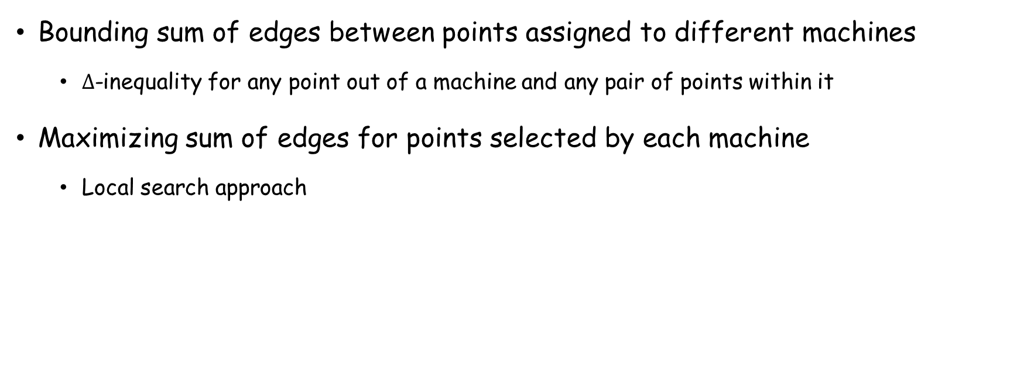
Coreset for Max-Sum (cont’d)
Bounding sum of edges between points assigned to different machines
  $∆$-inequality for any point out of a machine and any pair of points within it
Maximizing sum of edges for points selected by each machine
  Local search approach

Slide 14
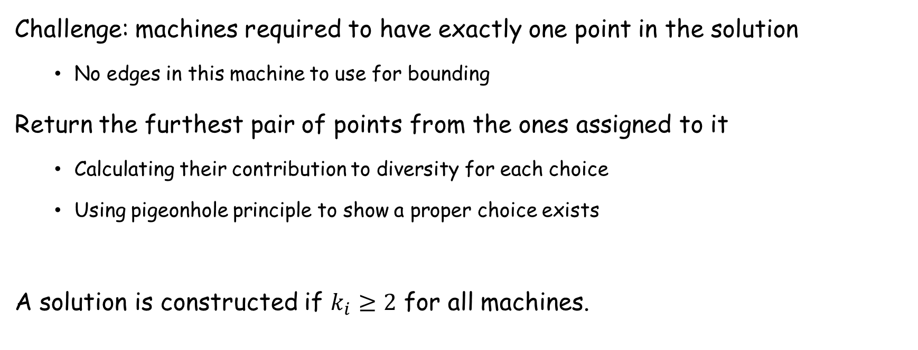
Coreset for Max-Sum (cont’d)
Challenge: machines required to have exactly one point in the solution
  No edges in this machine to use for bounding
Return the furthest pair of points from the ones assigned to it
  Calculating their contribution to diversity for each choice
  Using pigeonhole principle to show a proper choice exists
A solution is constructed if $k_{i}≥2$ for all machines.

Slide 15
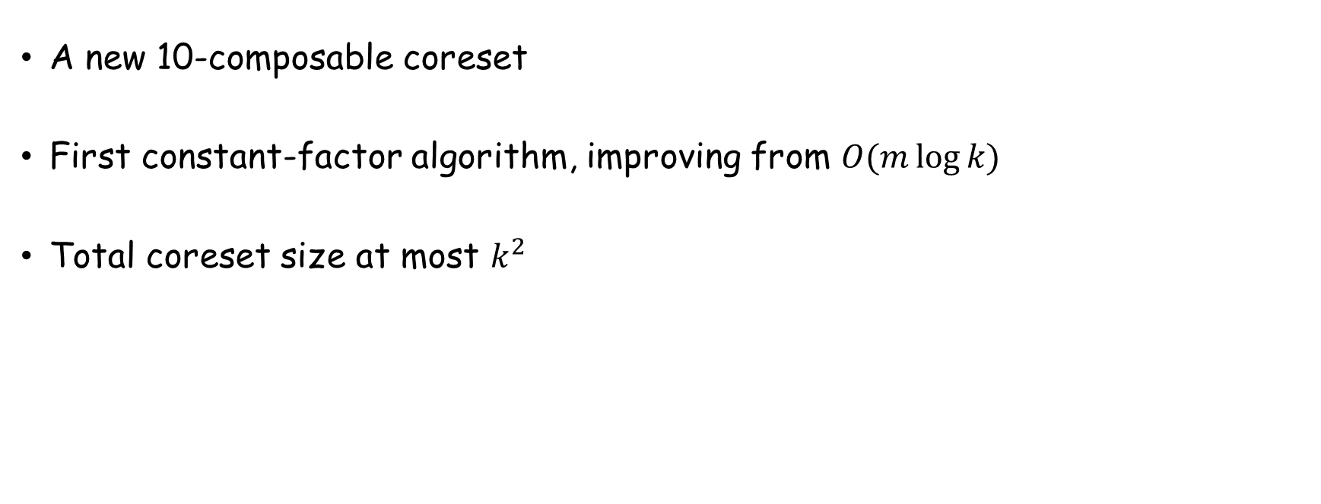
Coreset for Sum-NN
A new 10-composable coreset
First constant-factor algorithm, improving from $O(m\log{k)}$
Total coreset size at most $k^{2}$

Slide 16
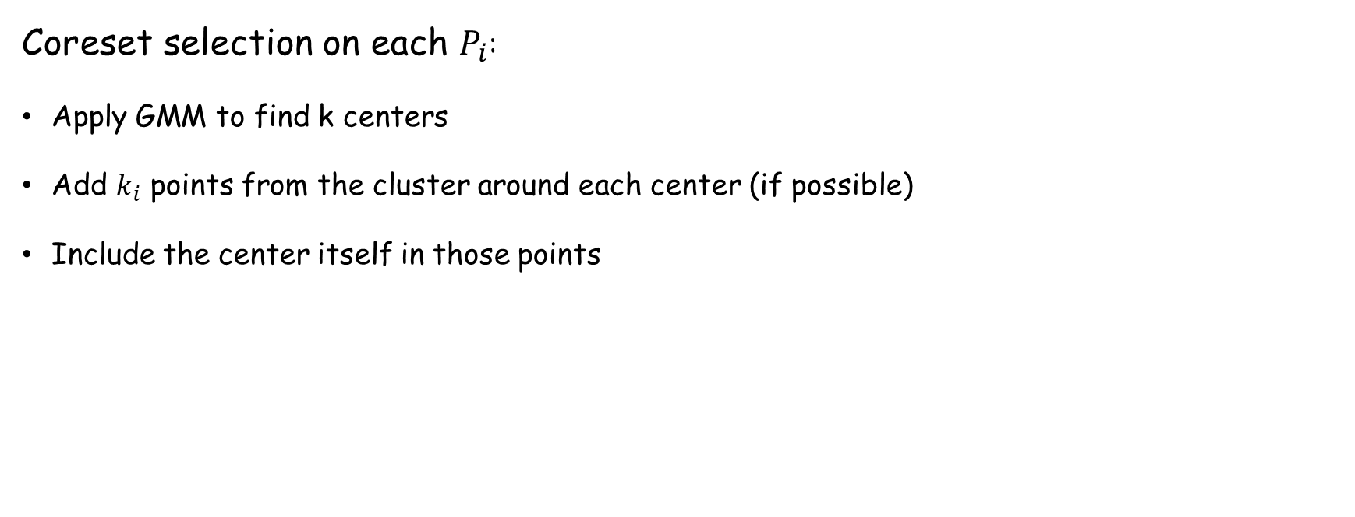
Coreset Construction
Coreset selection on each $P_{i}$:
Apply GMM to find k centers
Add $k_{i}$ points from the cluster around each center (if possible)
Include the center itself in those points

Slide 17
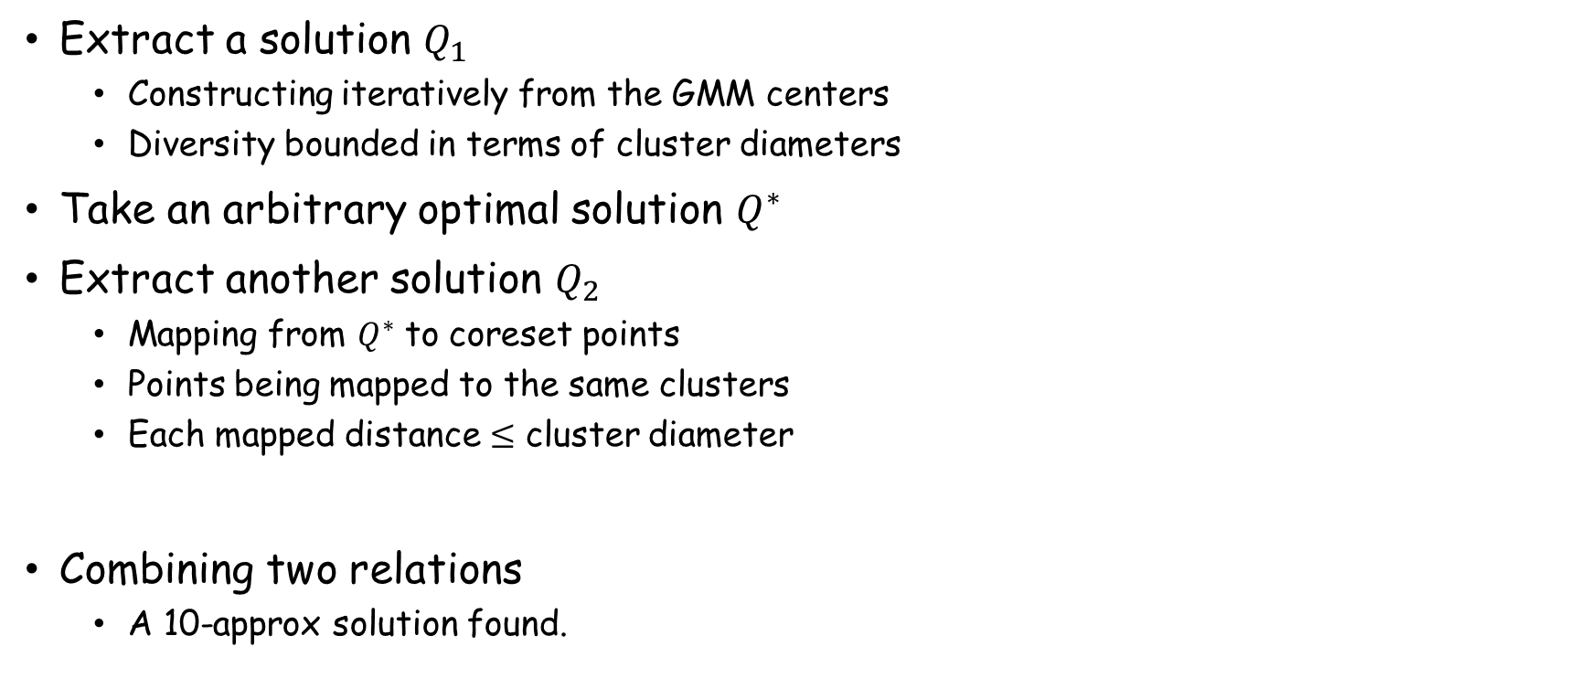
Proof Sketch
Extract a solution $Q_{1}$
  Constructing iteratively from the GMM centers
  Diversity bounded in terms of cluster diameters
Take an arbitrary optimal solution $Q^{∗}$
Extract another solution $Q_{2}$
  Mapping from $Q^{∗}$ to coreset points
  Points being mapped to the same clusters
  Each mapped distance $≤$ cluster diameter
Combining two relations
  A 10-approx solution found.

Slide 18
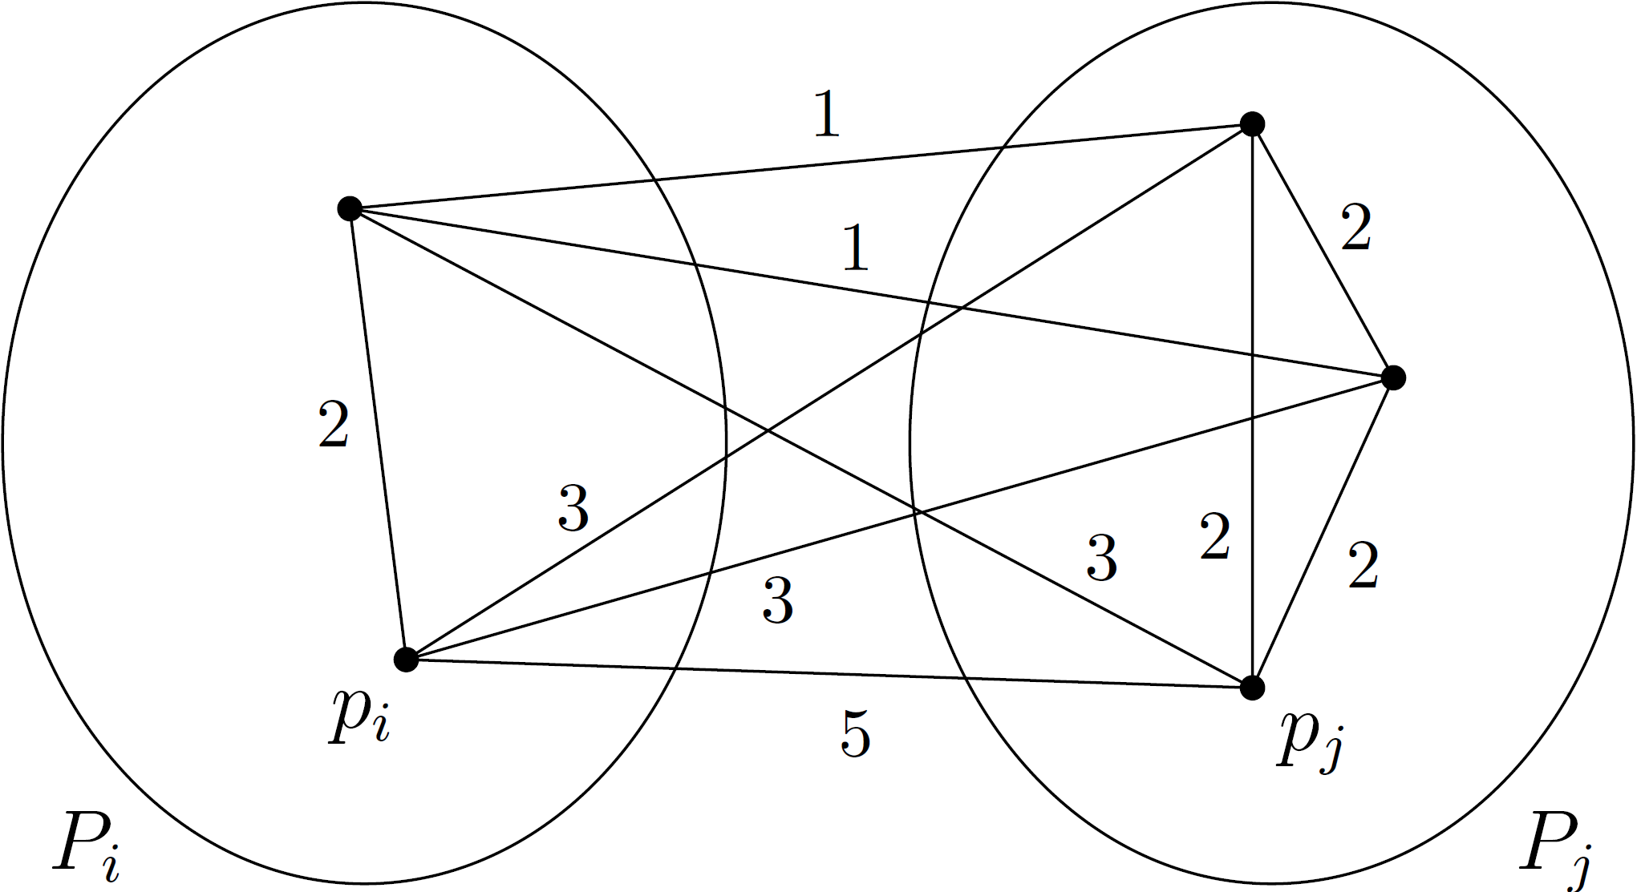
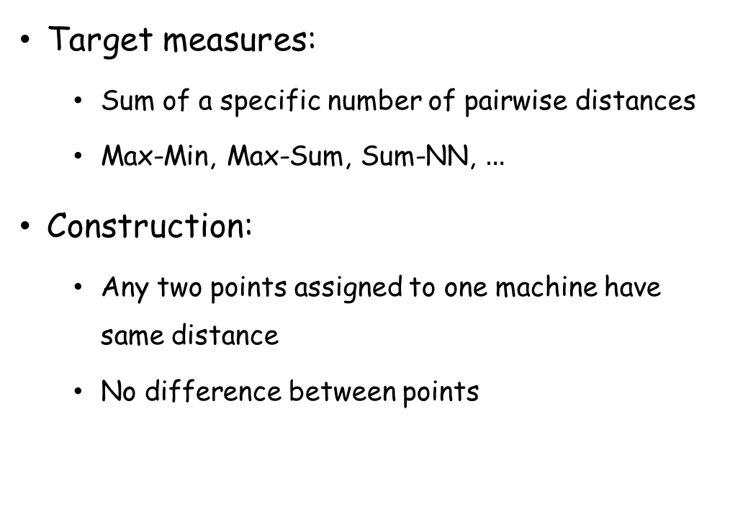
Lower Bound
Target measures:
  Sum of a specific number of pairwise distances
  Max-Min, Max-Sum, Sum-NN, $…$
Construction:
  Any two points assigned to one machine have same distance
  No difference between points

Slide 19
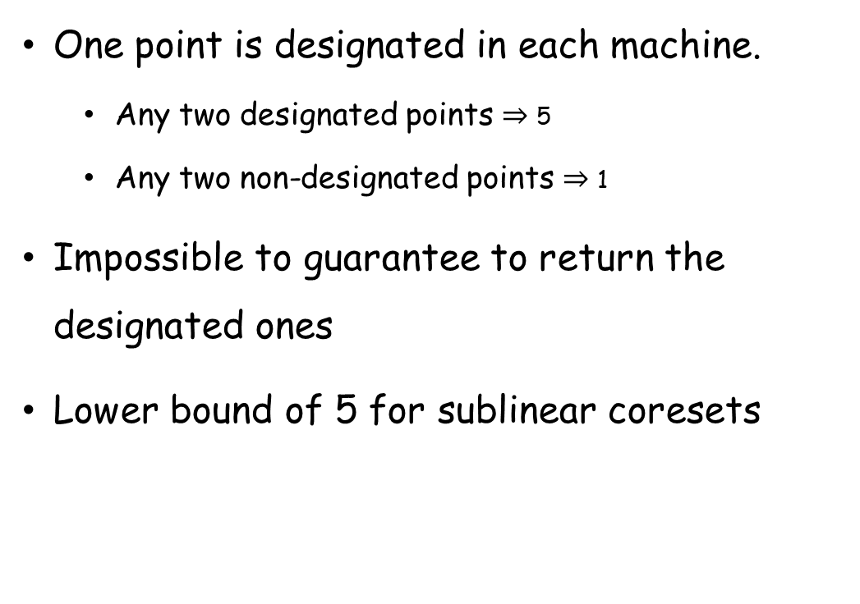
Lower Bound (cont’d)
One point is designated in each machine.
  Any two designated points $⇒$ 5
  Any two non-designated points $⇒$ 1
Impossible to guarantee to return the designated ones
Lower bound of 5 for sublinear coresets

Slide 20
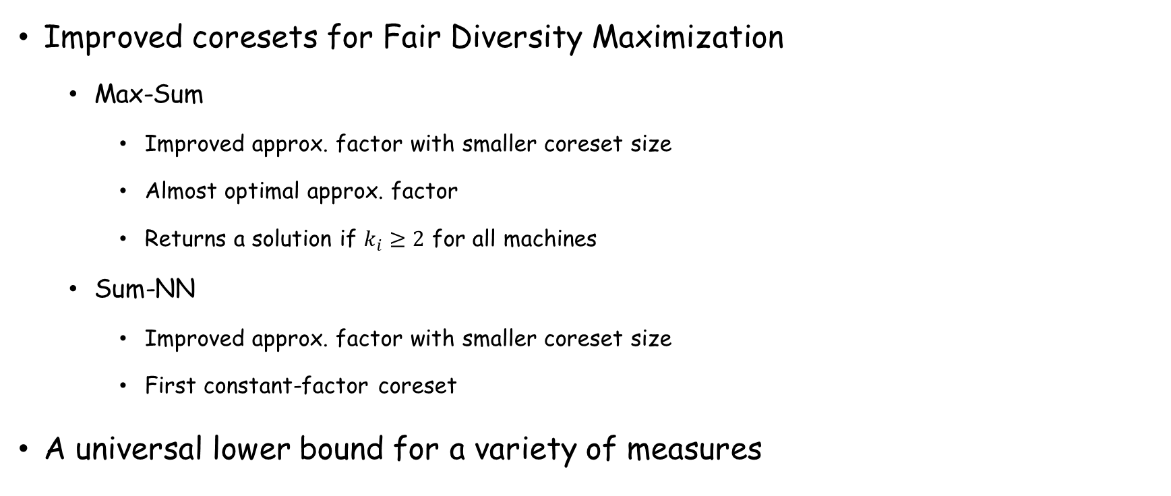
Summary
Improved coresets for Fair Diversity Maximization
  Max-Sum
    Improved approx. factor with smaller coreset size
    Almost optimal approx. factor
    Returns a solution if $k_{i}≥2$ for all machines
  Sum-NN
    Improved approx. factor with smaller coreset size
    First constant-factor coreset
A universal lower bound for a variety of measures

Slide 21
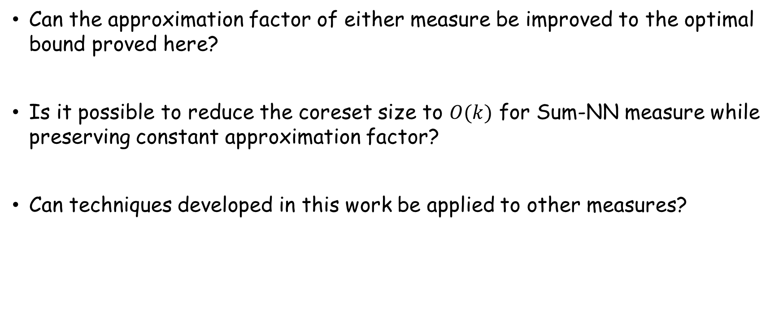
Open Problems
Can the approximation factor of either measure be improved to the optimal bound proved here?
Is it possible to reduce the coreset size to $O(k)$ for Sum-NN measure while preserving constant approximation factor?
Can techniques developed in this work be applied to other measures?

Slide 22
Thank you!

