Slide 1
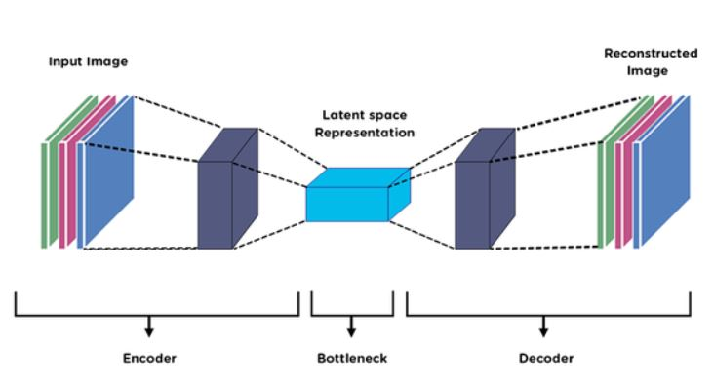
Autoencoders & Dimensionality
Reduction
MSSC 6931 – Fall 2025

Slide 2
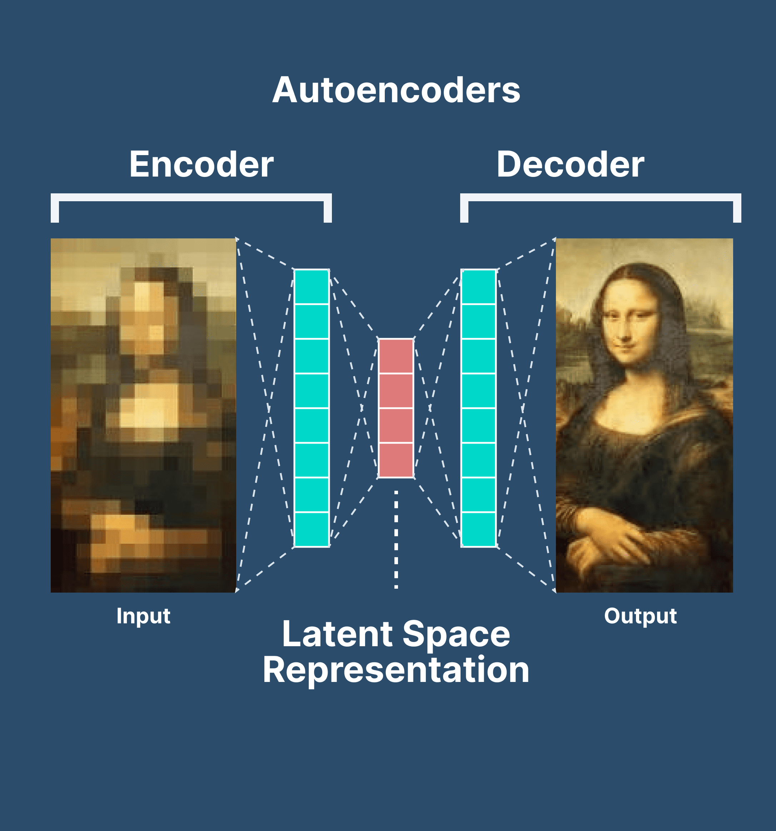
Lecture Overview
Motivation
Dimensionality Reduction
Fully-connected Autoencoders
Implementation
Different types of autoencoders

Slide 3
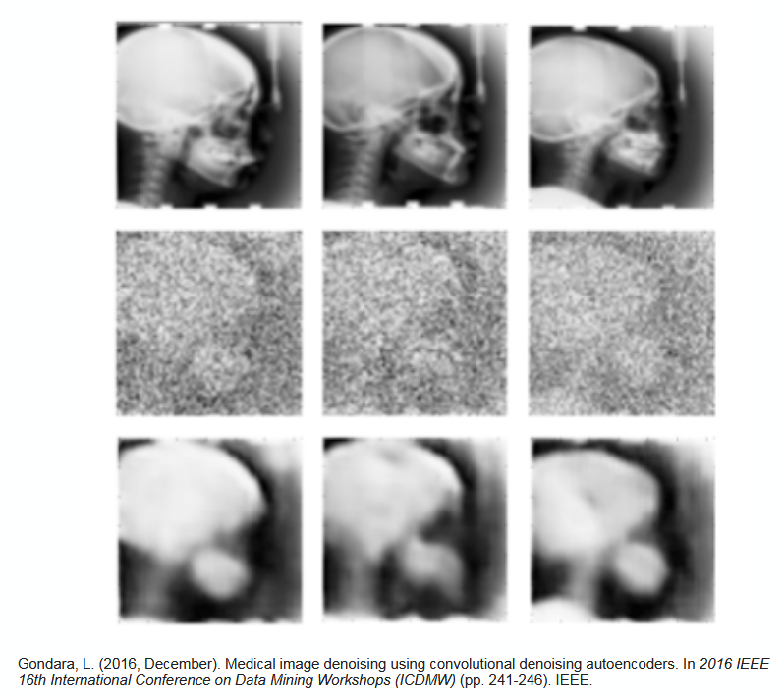
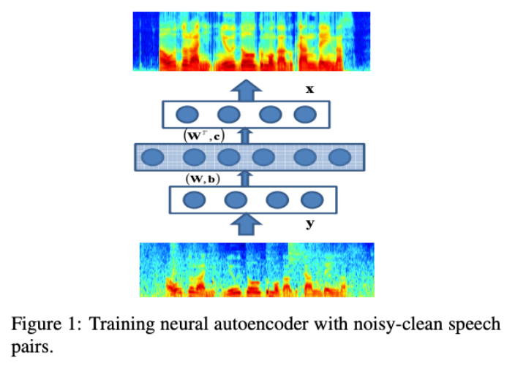
Autoencoder Applications
Denoising autoencoder
Image enhancement
Original image
Noisy image
Recovered image
Reference: https://sebastianraschka.com/blog/2021/dl-course.html

Slide 4
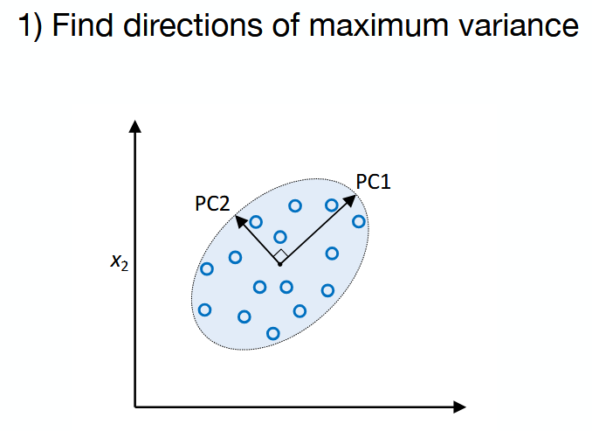
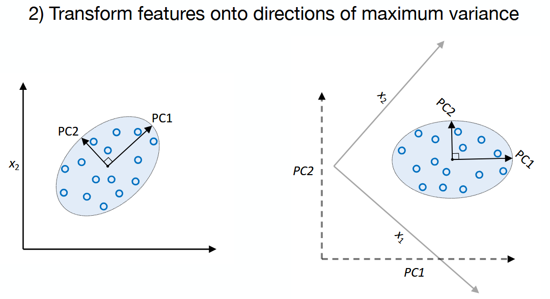
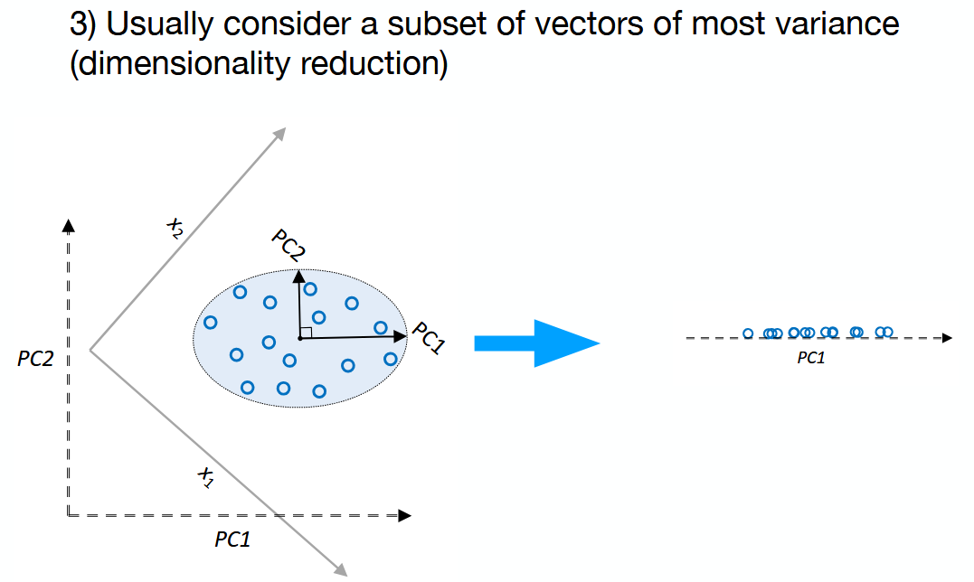
Dimensionality Reduction
Autoencoders are kind of feature extraction (where we don’t keep the original features)
It’s an unsupervised learning (No target variable)
Application and goals: • Finding hidden structures in data • Data compression • Clustering • Retrieving similar objects • Exploratory data analysis • Generating new examples
Principal Component Analysis (PCA)
Reference: https://sebastianraschka.com/blog/2021/dl-course.html

Slide 5
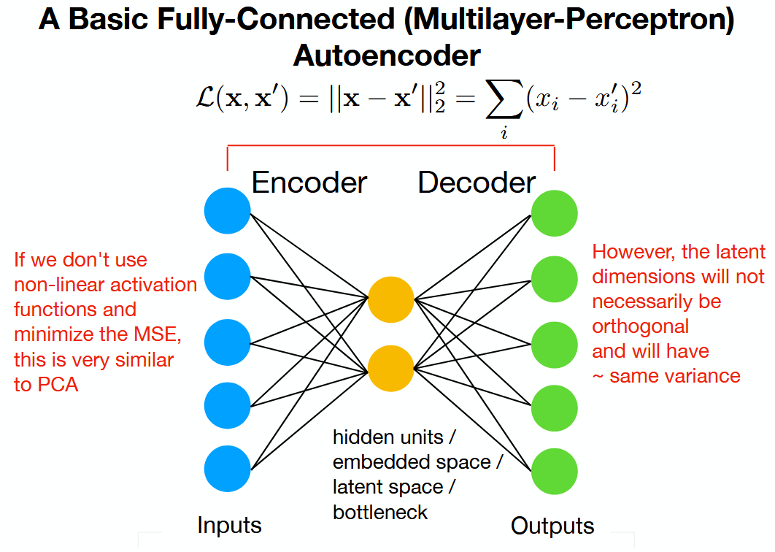
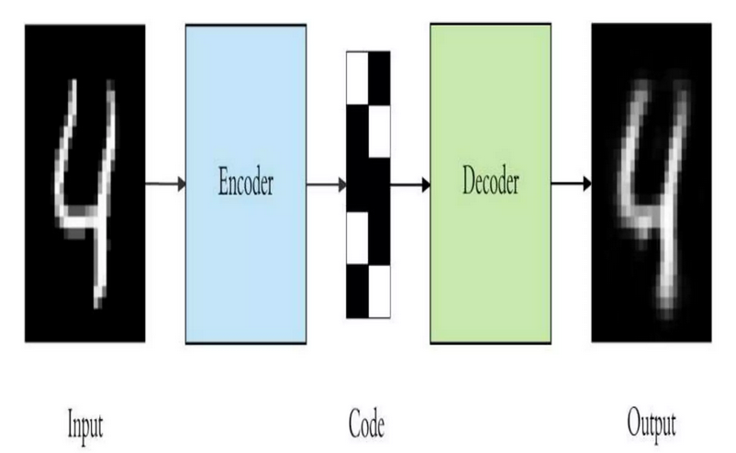
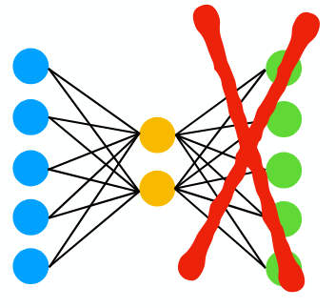
Fully-connected Autoencoders
The input is projected into the lower-dimensional latent space, and the output is a reconstructed version of that.
No orthogonality constraints in this case.
Potential Autoencoder Applications: After training, disregard this part:
  Use embedding as input to classic machine learning methods
  (SVM, KNN, Random Forest, ...)
  Latent space can also be used for visualization (EDA, clustering)
Reference: https://sebastianraschka.com/blog/2021/dl-course.html

Slide 6
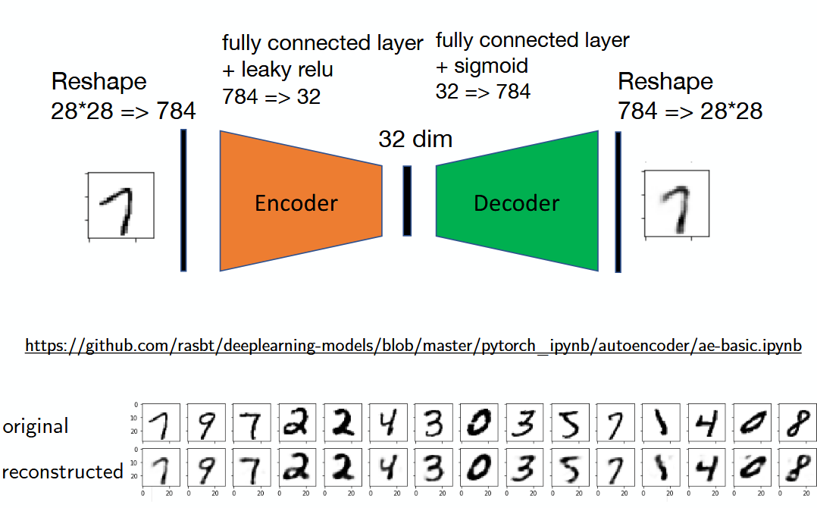
A Simple Autoencoder
Reference: https://sebastianraschka.com/blog/2021/dl-course.html

Slide 7
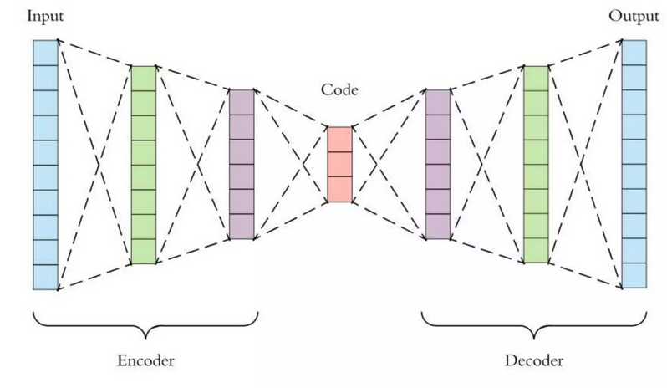
More on Autoencoders
Hyperparameters:
Code Size: Number of nodes in the middle layer.
Number of layers: The encoder and decoder can be deep.
Number of nodes per layer
Loss Function: Either MSE or binary cross entropy. If the input values are in range [0,1] then we use cross entropy, otherwise MSE.
Types of Autoencoders:
Vanilla Autoencoder
Multilayer Autoencoder
Convolutional Autoencoder
Denoising Autoencoder
Regularized Autoencoder
Sparse Autoencoder
Variational Autoencoder
Reference: https://www.slideshare.net/slideshow/autoencoder-141008858/141008858#6

Slide 8
Vanilla and Multilayer Autoencoders
Vanilla Autoencoder
Vanilla Autoencoder are the simplest form used for unsupervised learning tasks. They consist of two main parts an encoder that compresses the input data into a smaller, dense representation and a decoder that reconstructs the original input from this compressed form.
Training minimizes reconstruction error which measures the difference between input and output. This optimization is done via backpropagation which helps in updating the network weights to improve reconstruction accuracy.
They are foundational models helps in serving as building blocks for more complex variants.
Applications
Data Compression: They learn a compact version of the input data making storage and transmission more efficient.
Feature Learning: It extract important patterns from data which is useful in image processing, natural language processing and sensor analysis.
Anomaly Detection: If the reconstructed output is different from the original input, it can show an anomaly or outlier which makes autoencoders useful for fraud detection and system monitoring.
Implementation: https://github.com/mobinapourmoshir/Functional-Deep-Learning/blob/main/Autoencoders.ipynb
Multilayer Autoencoder:
If one hidden layer is not enough, we can add more hidden layers.
Reference: https://www.geeksforgeeks.org/numpy/types-of-autoencoders/

Slide 9
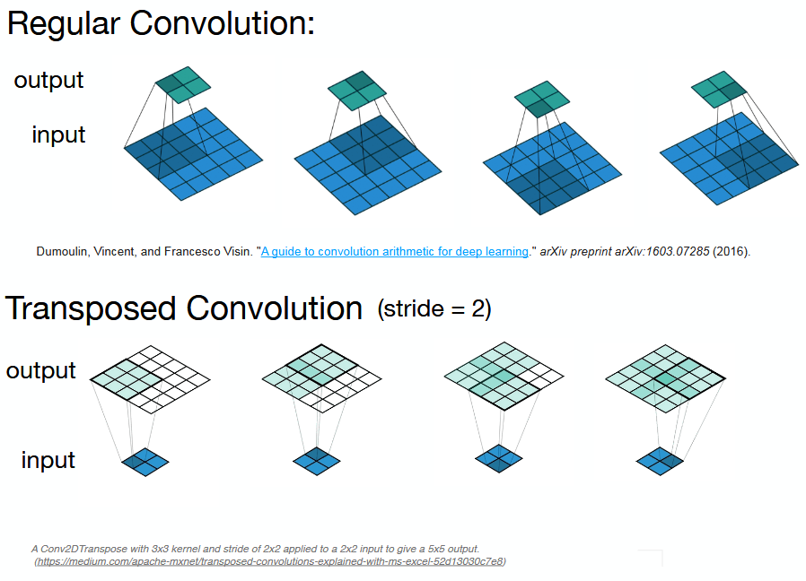
Convolution Autoencoders
Convolution Autoencoder:
Instead of fully connected layers, one may use convolutional layers. Allows us to increase the size of the output feature map compared to the input feature map.
Image Reconstruction: Restores high-quality images from compressed latent codes.
Image Denoising: Removes noise while preserving spatial detail in images.
Feature Extraction: Captures hierarchical spatial features for tasks like classification and segmentation.
Reference: https://sebastianraschka.com/blog/2021/dl-course.html

Slide 10
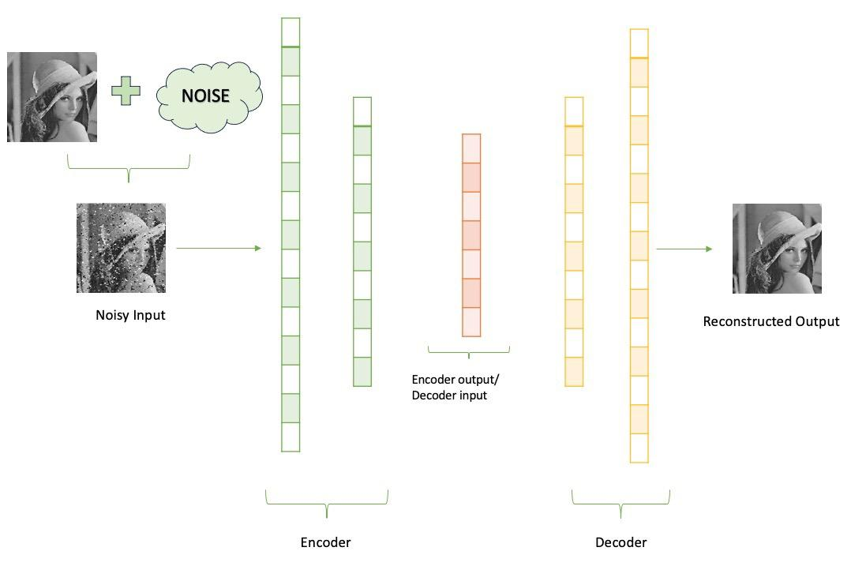

Denoising Autoencoders
Denoising Autoencoder (DAE):
Denoising Autoencoders are designed to handle corrupted or noisy inputs by learning to reconstruct the clean, original data.
Training involves feeding intentionally corrupted inputs and minimizing the reconstruction error against the clean version.
This approach forces the model to capture robust features that are invariant to noise.
Applications
Image Denoising: Removes noise from images to increase quality and improve downstream processing.
Signal Cleaning: Filters noise from audio and sensor signals helps in boosting detection accuracy.
Data Preprocessing: Cleans corrupted data before input to other models helps in increasing robustness and performance.
Encoder: h = f_θ(x̃) → compresses noisy input to latent representation
Decoder: x̂ = g_φ(h) → reconstructs clean data from latent code
$ℒ(x,\hat{x})= {\left\|x − \hat{x}\right\|}^{2}$ = ${\left\|x −g(f\left(\hat{x}\right))\right\|}^{2}$
Implementation: https://github.com/mobinapourmoshir/Functional-Deep-Learning/blob/main/Autoencoders.ipynb
Reference: https://www.slideshare.net/slideshow/autoencoder-141008858/141008858#6

Slide 11


Regularized Autoencoders
A regularized autoencoder adds extra constraints (regularization terms) to the loss function so that the learned latent representation h has desirable properties. e.g., being sparse, smooth, disentangled, or close to a prior distribution.
This helps the model learn more meaningful and generalizable features rather than just memorizing data.
A regular autoencoder minimizes the reconstruction loss:
${ℒ }_{Rec}= {\left\|x − \hat{x}\right\|}^{2}$
In a regularized autoencoder, we modify the total loss as:
$$ℒ= {ℒ }_{Rec}+ λℛ(h)$$
Where $ℛ(h)$ is a regularization term,𝜆>0 is a tuning parameter that controls its strength.
Reference: https://www.slideshare.net/slideshow/autoencoder-141008858/141008858#6

Slide 12





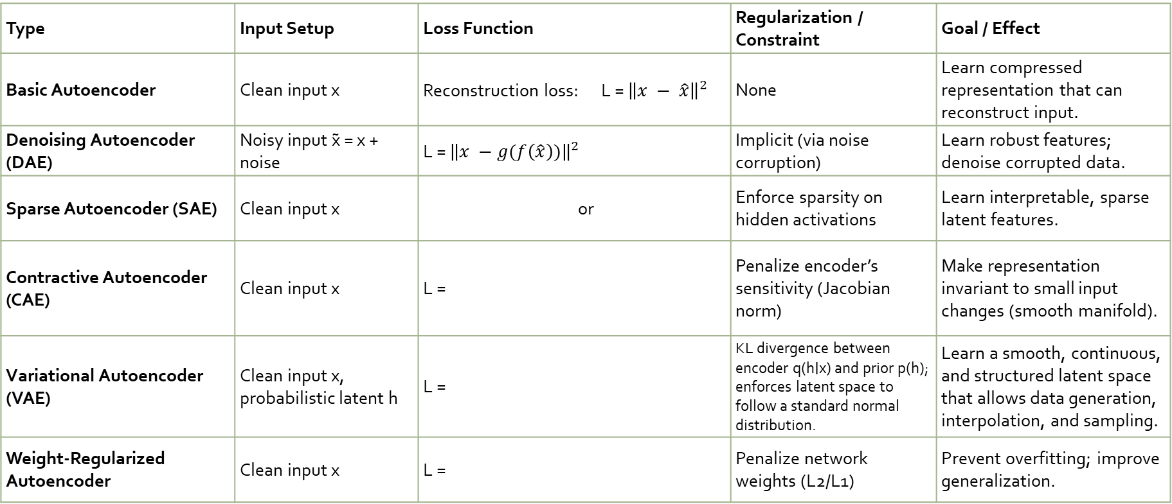
Common Types of Regularization
Type | Input Setup | Loss Function | Regularization / Constraint | Goal / Effect
Basic Autoencoder | Clean input x | Reconstruction loss: L = ${\left\|x − \hat{x}\right\|}^{2}$ | None | Learn compressed representation that can reconstruct input.
Denoising Autoencoder (DAE) | Noisy input x̃ = x + noise | L = ${\left\|x −g(f\left(\hat{x}\right))\right\|}^{2}$ | Implicit (via noise corruption) | Learn robust features; denoise corrupted data.
Sparse Autoencoder (SAE) | Clean input x | or | Enforce sparsity on hidden activations | Learn interpretable, sparse latent features.
Contractive Autoencoder (CAE) | Clean input x | L = | Penalize encoder’s sensitivity (Jacobian norm) | Make representation invariant to small input changes (smooth manifold).
Variational Autoencoder (VAE) | Clean input x, probabilistic latent h | L = | KL divergence between encoder q(h∣x) and prior p(h); enforces latent space to follow a standard normal distribution. | Learn a smooth, continuous, and structured latent space that allows data generation, interpolation, and sampling.
Weight-Regularized Autoencoder | Clean input x | L = | Penalize network weights (L2/L1) | Prevent overfitting; improve generalization.
Implementation: https://github.com/mobinapourmoshir/Functional-Deep-Learning/blob/main/Autoencoders.ipynb

Slide 13

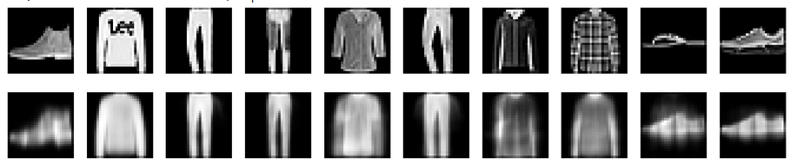

Question?
Can we combine these regularization terms to have a more comprehensive and accurate autoencoder mode?
The answer is YES! As an example combining smoothness and sparsity is both valid and powerful. It helps learn structured, robust, and interpretable representations by blending local stability (smoothness) with parsimony (sparsity).
It can be done by combining L1 and contractive (Jacobian) penalties as below:
Original
Sparse
Contractive
Sparse + Contractive

Slide 14
Thank You!

