Slide 1


M
I
P
S
单周期MIPS设计及实现
小组：
71194506083 周新明
71194506074 张梦祥
71194506017 黄一人
71194506068 喻贤唯
71194506025 雷 馨

Slide 2
01
实验原理
目录
02
设计实现
Contents
03
输出结果

Slide 3

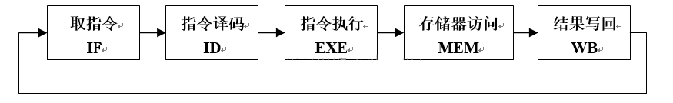
一、实验原理
问题提出
单周期CPU指的是一条指令的执行在一个时钟周期内完成
取指令(IF)：指令读取和更新PC
指令译码(ID)：对取得的指令分析译码
指令执行(EXE)：执行具体的指令动作，转移到结果写回状态
存储器访问(MEM)：读/写数据从/到数据存储器
结果写回(WB)：将结果数据写入寄存器堆中
五个阶段
文献综述
研究设计

Slide 4
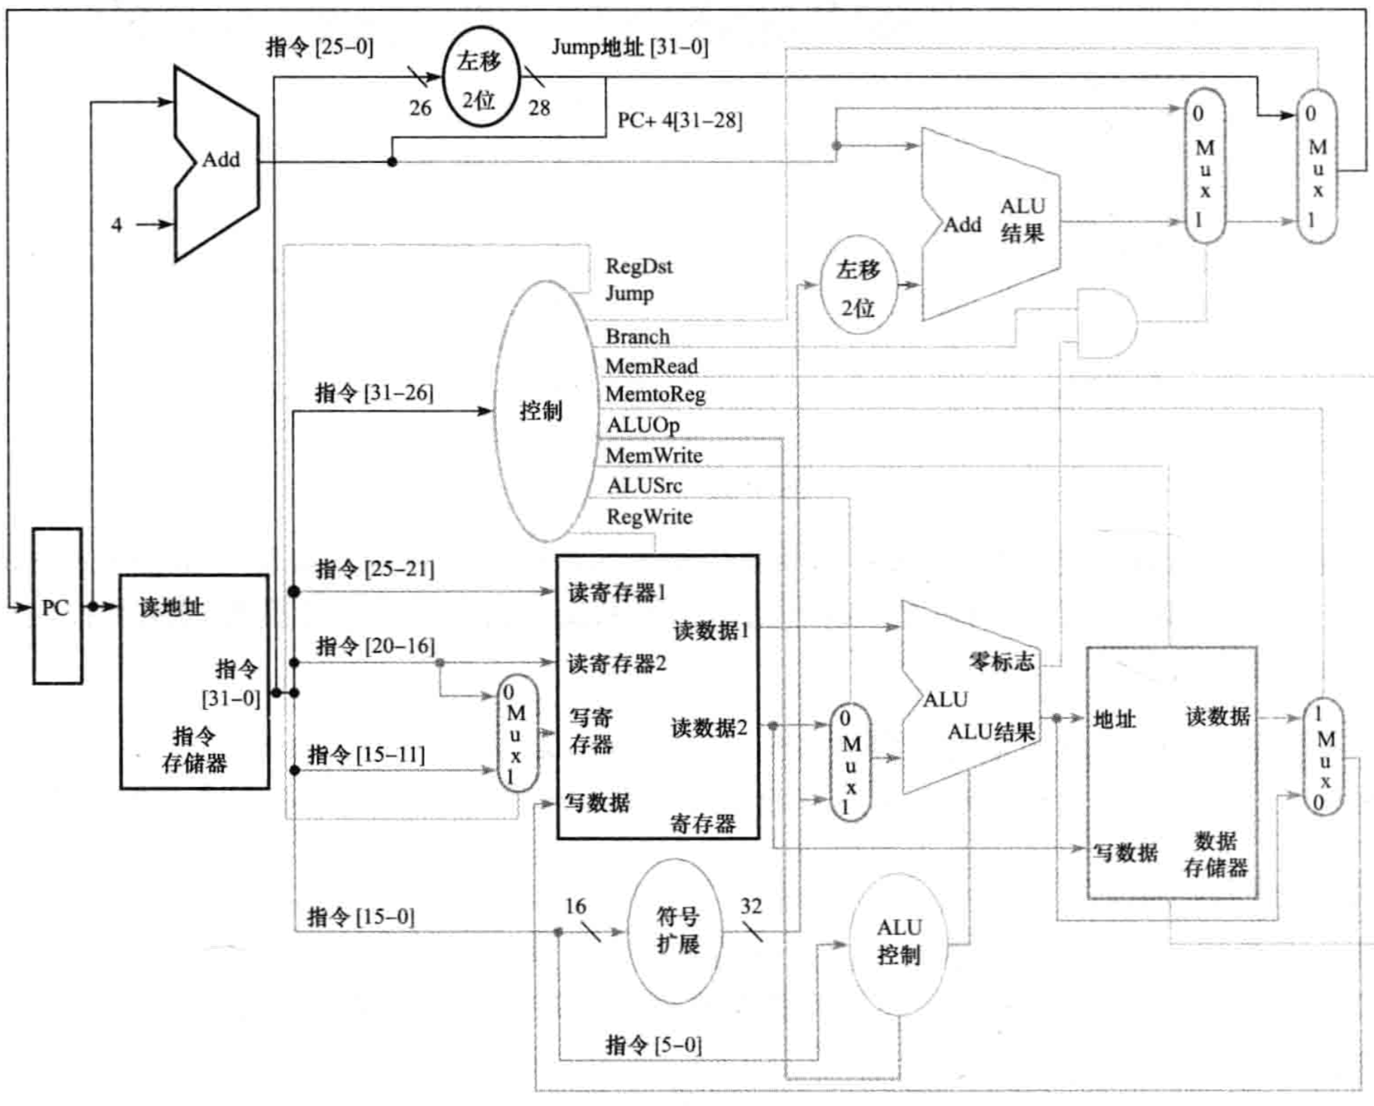
二、设计实现 SingleCycle
问题提出
文献综述
设计实现

Slide 5
总体结构
PC
问题提出
InstructionMemory
RegisterFile
文献综述
SingleCycle
ControlUnit
ALU
设计实现
DataMemory

Slide 6
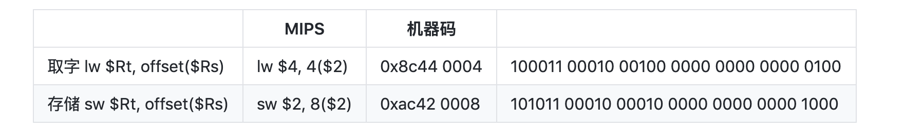
示例指令
问题提出
lw $4, 4($2)
sw $2, 8($2)
文献综述
#模拟两条指令的内存块
i_mem = [
intbv(140)[8:], intbv(68)[8:], intbv(0)[8:], intbv(4)[8:], # lw $4, 4($2)
intbv(172)[8:], intbv(66)[8:], intbv(0)[8:], intbv(8)[8:] # sw $2, 8($2)
]
# 模拟256B大小的数据内存块
d_mem = [intbv(0)[8:]]*256
d_mem[0:4] = [intbv(1)[8:]] * 4
d_mem[4:8] = [intbv(2)[8:]] * 4
d_mem[8:12] = [intbv(3)[8:]] * 4
设计实现

Slide 7
SingleCycle
问题提出
@block
def SingleCycle(period):
"""执行单周期操作，时钟周期period"""
clk = Signal(intbv(0)) # 时钟信号
# cu控制信号
RegDst = Signal(intbv(0)[1:]) # 目标寄存器地址rt还是rd eg. add, sw
ALUSrc = Signal(intbv(0)[1:]) # 第二个操作数来自寄存器还是立即数 eg. add, addi
PCSrc = Signal(intbv(0)[1:]) # PC 由 PC + 4 还是分支信号 eg.beq
MemtoReg = Signal(intbv(0)[1:]) # 内存写入寄存器 eg. lw
RegWrite = Signal(intbv(0)[1:]) # 寄存器写入 eg. add
MemRead = Signal(intbv(0)[1:]) # 内存读 eg. lw
MemWrite = Signal(intbv(0)[1:]) # 内存写 eg. sw
Branch = Signal(intbv(0)[1:]) # 分支 eg. beq, j
ALUOp1 = Signal(intbv(0)[1:]) # ALU控制 eg. 加，减，比较
ALUOp0 = Signal(intbv(0)[1:]) # 与ALUOp1联合使用
Zero = Signal(intbv(0)[1:]) # 零标志分支 eg. beq
文献综述
设计实现

Slide 8
SingleCycle
问题提出
# 其他总线
address = Signal(intbv(0)[32:]) # PC计数器地址总线
iram_out = Signal(intbv(0)[32:]) # 指令内存输出总线
read_addr1 = Signal(intbv(0)[5:]) # rs总线
read_addr2 = Signal(intbv(0)[5:]) # rt总线
write_addr = Signal(intbv(0)[5:]) # 写入寄存器地址总线
rt = Signal(intbv(0)[5:]) # rt总线
rd = Signal(intbv(0)[5:]) # rd
write_data = Signal(intbv(0)[32:]) # 写入寄存器数据总线
read_data1 = Signal(intbv(0)[32:]) # 读寄存器数据总线1
read_data2 = Signal(intbv(0)[32:]) # 读寄存器数据总线1
immediate = Signal(intbv(0)[16:]) # 立即数总线
alu_out = Signal(intbv(0)[32:]) # alu计算结果
文献综述
设计实现

Slide 9
SingleCycle
问题提出
# 状态单元
pc = PC(clk, address) # PC寄存器
iram = IRAM(clk, iram_out, address) # 指令内存
rf = RegisterFile(clk, read_addr1, read_addr2, read_data1, read_data2,
rt, rd, write_addr, write_data, immediate, RegWrite, RegDst, ALUSrc)
dram = DRAM(clk, write_data, alu_out, read_data2,
MemWrite, MemRead, MemtoReg)
# 组合逻辑单元
cu = ControlUnit(iram_out, RegDst, Branch, MemRead, MemtoReg,
ALUOp1, ALUOp0, MemWrite, ALUSrc, RegWrite, read_addr1, read_addr2, rt, rd, immediate) # 控制单元
alu = ALU(iram_out, alu_out, read_data1,
read_data2, Zero, ALUOp0, ALUOp1, ALUSrc)
文献综述
设计实现

Slide 10
SingleCycle
问题提出
@instance
def drive_clk():
"""
每半个周期触发一次时钟边沿改变，
仅当上升沿时为一个周期开始
"""
half_clk = int(period / 2)
count = 0
while True:
yield delay(half_clk)
clk.next = 1
count += 1
print(
f"========================cycle {count} start========================")
yield delay(half_clk)
output_result(alu_out, RegDst, ALUSrc, PCSrc, MemtoReg,
RegWrite, MemRead, MemWrite, Branch, ALUOp1, ALUOp0, Zero,)
clk.next = 0
return instances()
文献综述
设计实现

Slide 11
PC
问题提出
文献综述
设计实现

Slide 12
PC
问题提出
Add
@block
def PC(clk, address):
@always(clk.posedge)
def count():
address.next = Add(address, 4)
return count
4
Instruction
Memory
文献综述
PC
Read
Address
Instruction
clk
eg：分支
PC = (PCSrc == 0)? PC + 4 : PC + 4 + immediate_32 * 4;
设计实现

Slide 13
InstructionMemory
问题提出
i_mem = [
intbv(140)[8:], intbv(68)[8:], intbv(0)[8:], intbv(4)[8:], # lw $4, 4($2)
intbv(172)[8:], intbv(66)[8:], intbv(0)[8:], intbv(8)[8:] # sw $2, 8($2)
]
@block
def IRAM(clk, out, address):
"""指令内存, 根据address地址获得内存指令并由out输出"""
@always(clk.posedge)
def access():
addr = address
byte_arr = i_mem[addr: addr+4]
val = intbv(0)[32:]
val[32:24] = byte_arr[0]
val[24:16] = byte_arr[1]
val[16:8] = byte_arr[2]
val[8:0] = byte_arr[3]
out.next = val
print(f'fetch instruction: {bin(out.next)}')
return access
文献综述
设计实现

Slide 14
RegisterFile
问题提出
文献综述
设计实现

Slide 15
RegisterFile
问题提出
@block
def RegisterFile(clk, read_addr1, read_addr2, read_data1, read_data2, rt, rd, write_addr, write_data, immediate, RegWrite, RegDst, ALUSrc):
mux = Mux(write_addr, rt, rd, RegDst)
@always_comb
def read():
assert len(read_addr1) == 5
assert len(read_addr2) == 5
assert len(read_data1) == 32
assert len(read_data2) == 32
assert len(immediate) == 16
assert len(write_addr) == 5
read_data1.next = _registers[read_addr1.val]
immediate_ext = intbv(0)[32:]
immediate_ext[16:0] = immediate.val
read_data2.next = _registers[read_addr2.val]
print(f'RegWrite {RegWrite.val}')
print(f'RegDst {RegDst.val}')
print(f'ALUSrc {ALUSrc.val}')
文献综述
设计实现

Slide 16
RegisterFile
问题提出
@always(clk.negedge)
def write():
assert len(write_addr) == 5
assert len(write_data) == 32
if RegWrite and write_addr:
_registers[write_addr] = write_data
print(f'write {write_data} to register &{write_addr}')
return mux, read, write
文献综述
设计实现

Slide 17
ControlUnit
问题提出
文献综述
设计实现

Slide 18
ControlUnit
问题提出
@block
def ControlUnit(iram_out, RegDst, Branch, MemRead, MemtoReg, ALUOp1, ALUOp0, MemWrite, ALUSrc, RegWrite, read_addr1, read_addr2, rt, rd, immediate):
@always_comb
def decode():
opcode = iram_out.val[32:26]
if opcode == 0b000000:
tmp = [intbv(1)[1:], intbv(0)[1:], intbv(0)[1:], intbv(0)[1:], intbv(1)[
1:], intbv(0)[1:], intbv(0)[1:], intbv(0)[1:], intbv(1)[1:]]
elif opcode == 0b100011:
tmp = [intbv(0)[1:], intbv(0)[1:], intbv(1)[1:], intbv(1)[1:], intbv(0)[
1:], intbv(0)[1:], intbv(0)[1:], intbv(1)[1:], intbv(1)[1:]]
elif opcode == 0b101011:
tmp = [intbv(0)[1:], intbv(0)[1:], intbv(0)[1:], intbv(0)[1:], intbv(0)[
1:], intbv(0)[1:], intbv(1)[1:], intbv(1)[1:], intbv(0)[1:]]
elif opcode == 0b000100:
tmp = [intbv(0)[1:], intbv(1)[1:], intbv(0)[1:], intbv(0)[1:], intbv(0)[
1:], intbv(1)[1:], intbv(0)[1:], intbv(0)[1:], intbv(0)[1:]]
else:
tmp = [intbv(0)[1:], intbv(0)[1:], intbv(0)[1:], intbv(0)[1:], intbv(0)[
1:], intbv(0)[1:], intbv(0)[1:], intbv(0)[1:], intbv(0)[1:]]
RegDst.next, Branch.next, MemRead.next, MemtoReg.next, ALUOp0.next, ALUOp1.next, MemWrite.next, ALUSrc.next, RegWrite.next = tmp
文献综述
设计实现

Slide 19
ALU
问题提出
文献综述
设计实现

Slide 20
ALU
def ALU(iram_out, alu_out, read_data1, read_data2, Zero, ALUOp0, ALUOp1, ALUSrc):
@always_comb
def access():
ALUControlSignal = [0, 0, 0, 0]
# alu control signal
if ALUOp0 == 0 and ALUOp1 == 0:
ALUControlSignal[2] = 1
elif ALUOp0 == 0 and ALUOp1 == 1:
ALUControlSignal[1] = 1
ALUControlSignal[2] = 1
else:
sum = iram_out[6:0]
if sum == 0b100000: # case 32
ALUControlSignal[2] = 1
elif sum == 0b100010: # case 34
ALUControlSignal[1] = 1
ALUControlSignal[2] = 1
elif sum == 0b100100:
pass
elif sum == 0b100101:
ALUControlSignal[3] = 1
elif sum == 0b101010:
ALUControlSignal[1] = 1
ALUControlSignal[2] = 1
ALUControlSignal[3] = 1
else:
pass
问题提出
文献综述
设计实现

Slide 21
ALU
问题提出
def And(out, in1, in2):
"""与门"""
@always_comb
def _and():
out.next = in1 and in2
return _and
def Or(out, in1, in2):
"""或门"""
@always_comb
def _or():
out.next = in1 or in2
return _or
def Add(out, in0, in1):
"""加法器"""
@always_comb
def _add():
out.next = in0 + in1
return _add
def Sub(in0, in1):
"""减法器"""
return intbv(in0 - in1)[32:]
@block
def Mux(out, in0, in1, sel):
"""2x1多选器"""
@always_comb
def _mux():
out.next = [in0, in1][sel]
return _mux
文献综述
设计实现

Slide 22
DataMemory
问题提出
文献综述
设计实现

Slide 23
DataMemory
问题提出
def DRAM(clk, out_data, alu_out, in_data, MemWrite, MemRead, MemtoReg):
@always_comb
def read():
print('ALU OUT:', alu_out)
if MemtoReg:
if MemRead:
addr = alu_out
data = intbv(0)[32:]
data[32:24] = d_mem[addr]
data[24:16] = d_mem[addr+1]
data[16:8] = d_mem[addr+2]
data[8:0] = d_mem[addr+3]
out_data.next = data
else:
out_data.next = alu_out
@always(clk.negedge)
def write():
addr = alu_out
d_mem[addr] = in_data[32:24]
d_mem[addr+1] = in_data[24:16]
d_mem[addr+2] = in_data[16:8]
d_mem[addr+3] = in_data[8:0]
return read, write
文献综述
设计实现

Slide 24
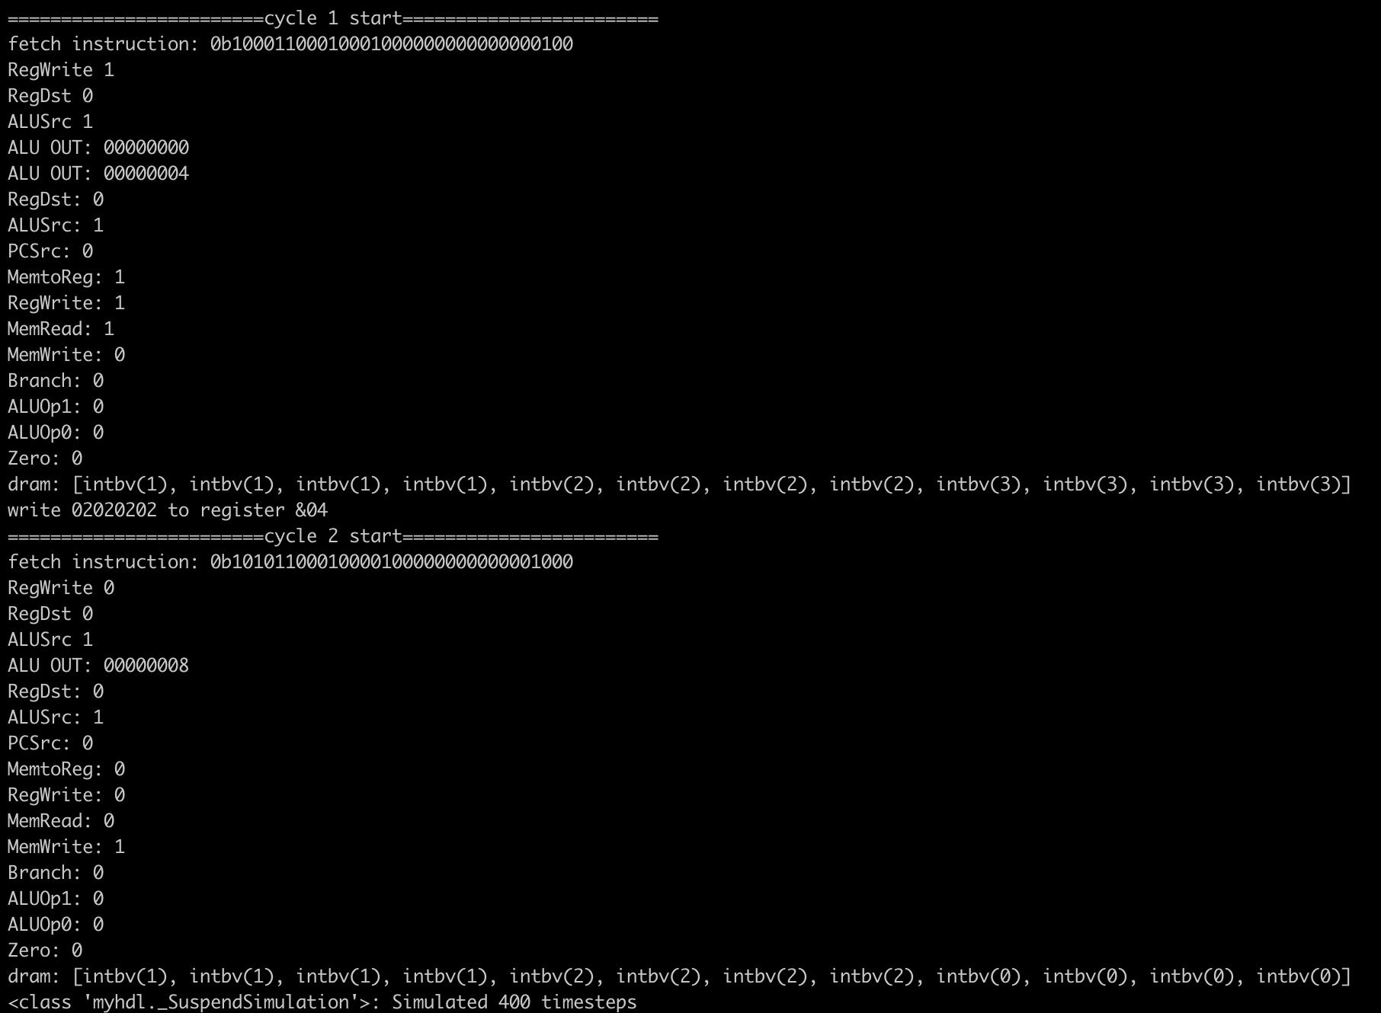
三、输出结果
问题提出
文献综述
设计实现

Slide 25
感
谢
聆
听

