Slide 1
taxm

Slide 2
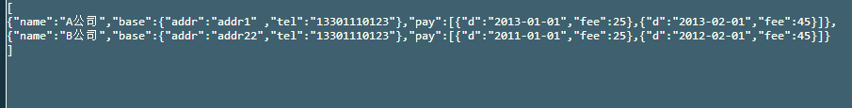
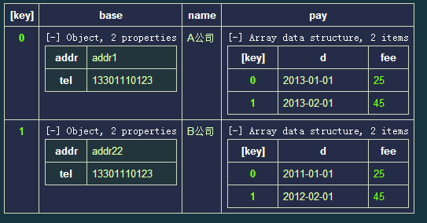
[
{"name":"A公司","base":{"addr":"addr1" ,"tel":"13301110123"},"pay":[{"d":"2013-01-01","fee":25},{"d":"2013-02-01","fee":45}]},
{"name":"B公司","base":{"addr":"addr22","tel":"13301110123"},"pay":[{"d":"2011-01-01","fee":25},{"d":"2012-02-01","fee":45}]}
]
id | info | Update_time
 | {“name”:“A公司”,“base”:{“addr”:“addr1” ,“tel”:“13301110123”}
 | {"name":"B公司","base":{"addr":"addr22","tel":"13301110123"}]
[{name:’Corp1’,{
Addr:’addr1’,}}]
[{name:’Corp2’,{
Addr:’addr2’,}}]
http://json.parser.online.fr/
Corp1
---Info…addr1
Corp2
---Info…addr2

