Slide 1
Final Project
Maksym Musiienko

Slide 2



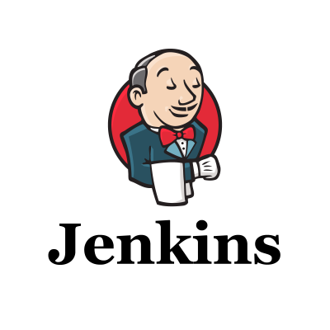
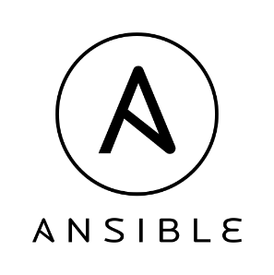
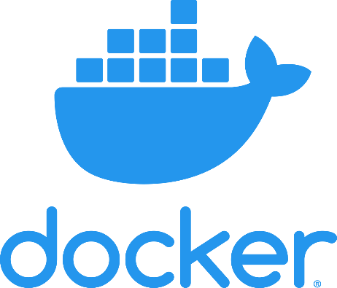
Introduction
Jenkins get configuration for pipelines from GitHub and use Terraform and Ansible to configure and prepare infrastructure on AWS.
Jenkins build docker image and upload it to docker hub. After that it can deploy it on configured EC2 instances.

Slide 3
Create Infrastructure
GitHub
Create 2 EC2 instances by terraform and configure security group. Create 2 records in Route53 service and link them to instances.
Jenkinsfile
Terraform config
AWS
Jenkins
EC2
Instance
Volume
Security Group
Apply / Destroy
EC2
Instance
Volume
Security Group
Terraform Node
AWS
Route53
test.mobiusz.tk
prod.mobiusz.tk
S3 Bucket backend

Slide 4
Install SOFTWARE
Connect to EC2 instances by Ansible to install software for project: Docker, docker-compose.
GitHub
AWS
Jenkinsfile
EC2
Docker
Docker-compose
EC2
Docker
Docker-compose
Jenkins
Install
Ansible Node

Slide 5
Build & Deploy
GitHub
DockerHub
Jenkinsfile
Docker Image
Jenkins
Upload Image
AWS
Docker Node
Build image
Upload image
Deploy containers
Waiting for approve
Deploy prod containers
EC2 (test)
Test docker project (fastAPI + redis)
Staging docker project (fastAPI + redis)
Deploy
GitHub
Python FastAPI project
Dockerfile
docker-compose.yml
EC2 (prod)
Prod docker project (fastAPI + redis)

Slide 6
Summary
This project is the base construction for CI/CD processes:
EC2 Test and Staging environment
EC2 Prod environment
Future evolution of project:
Add new VPC for Prod (public and private subnets)
Create Auto Scaling Group
Create Elastic Load Balancer
Add Bastion for SSH access and NAT Gateway for EC2 instances

