Slide 1
Mini Project 1
Ezra Hill

Slide 2
Initial challenges from playing with the data inspired my goals for the project
Modifying looping mocap data without breaking the loop
Find easier ways to smoothly manipulate the motion
Creating a set of functions that make modifying mocap closer to working with keyframes
New to Python so I wanted to create simpler ways to work with the motion than thinking about array shapes
Extendable framework for manipulating the data more easily

Slide 3
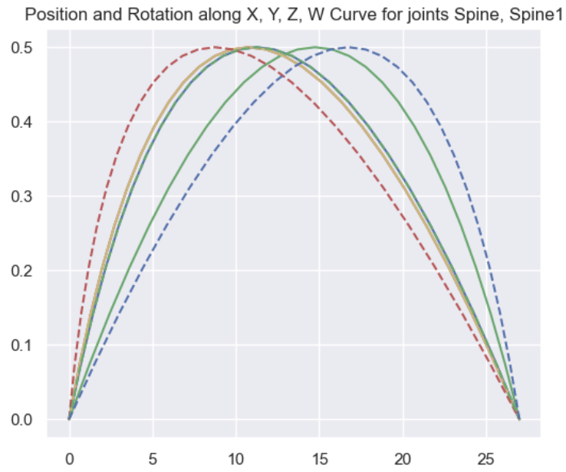
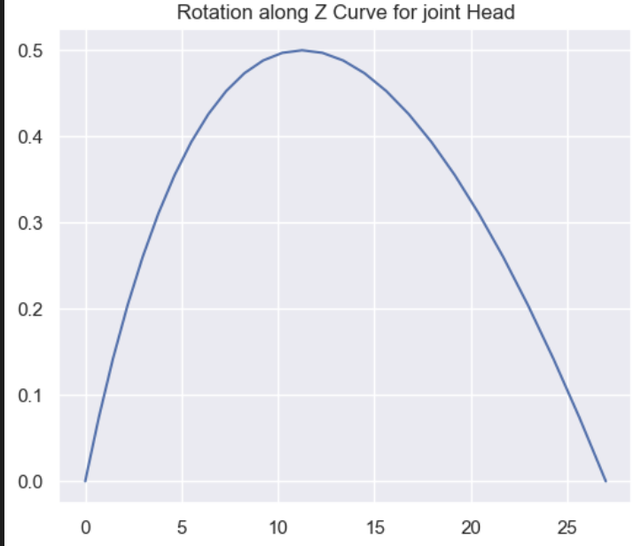
Problem – Raw motion data is difficult to conceptualize
Solution? Let me think about motion as curves and manipulate curve parameters instead
Graph the curve then sample the curve
The same curve can be applied to any number of joints
Parameters of the curve (such as strength of deformation) can be modified on a joint by joint basis
Still printing the curve to help with visualization
Faster insight on how parameters have been manipulated than waiting for preview video
Regular lines are position, dotted are rotation
X axis of the graph is frame length of the total clip
Notes:
Context: I’m a novice at Python but decently experienced with working with 3D tools

Slide 4
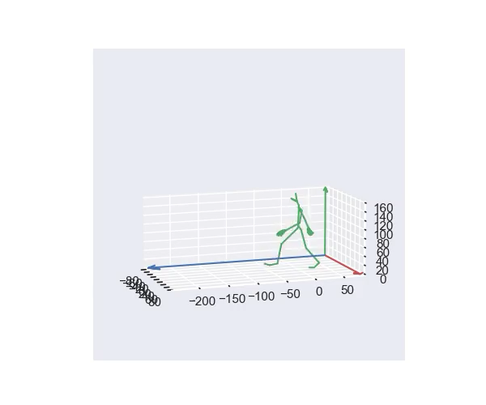
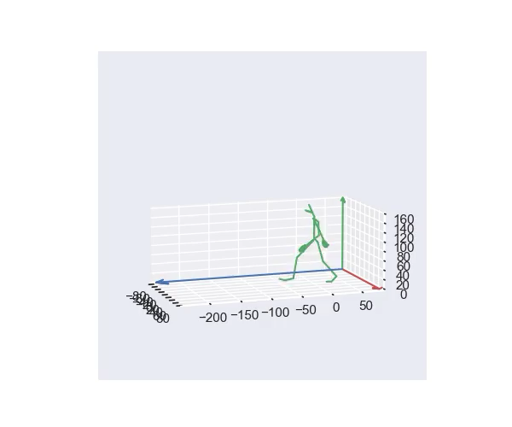
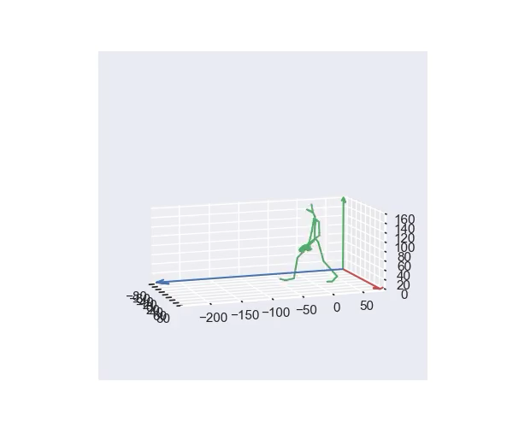
Examples -> Stronger dip
Clamped additional rotation at lowest point in stride
Clamped additional rotation at lowest point, applied to user defined joints

Slide 5



More examples (Same parameters)

Slide 6

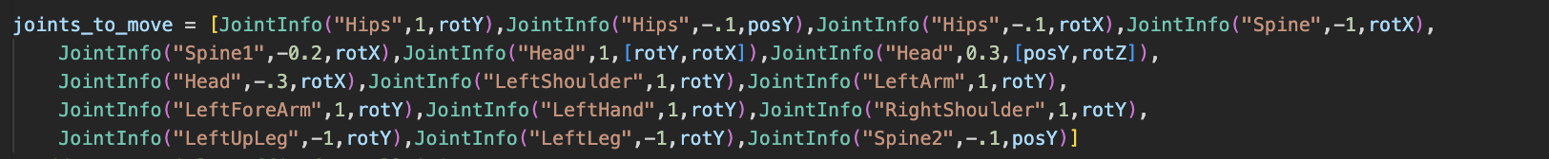
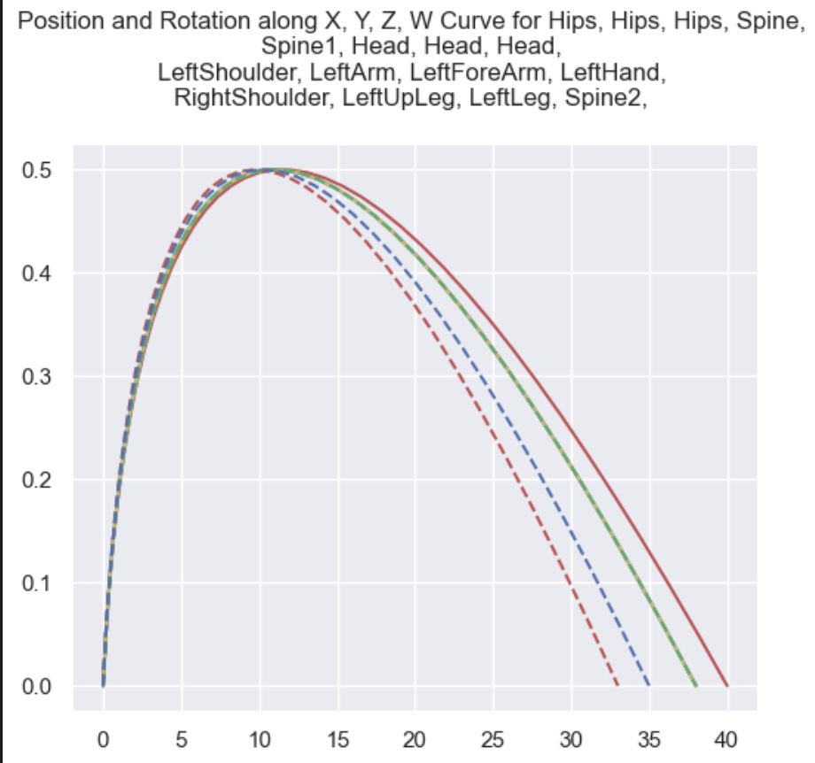
Different Pose: Confident Walk to Exacerbated Walk
Wanted to pick a pose that would test lots of syntax possibilities

Slide 7
Limitations and next steps
Limitations
No current way to blend 2 curves
Limited returns on additional deformation points
Movement curves are generated prior to applying motion, so generating a curve that is aware of the movement of another curve is obtuse
Whole system would work better if certain joints were locked
Can’t rotate past 180 degrees
Next Steps
Whole system would work better if certain joints were locked
Negative strength values don’t behave as intended on rotations
Same rotation but in opposite direction would be intended behavior
More “Auto gathering” of helpful timestamps in the motion
Currently getting when the root is at lowest point, as a parameter to help with pacing the strides

Slide 8
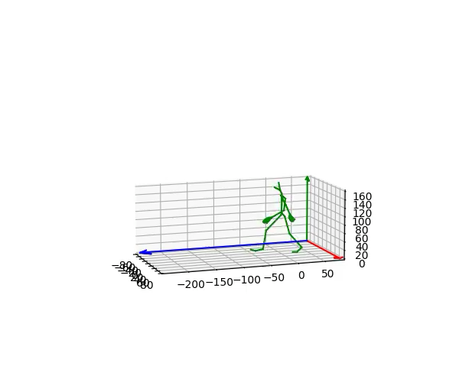


Blooper Reel

