Slide 1
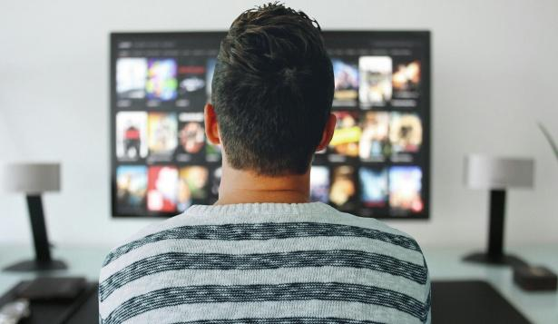
QuizFlix
By: Team Low-Taper

Slide 2

Whys
The Problem:
We all binge-watch shows and feel guilty afterward.
High screen time.
Homework often gets pushed aside.

Slide 3

Fix
Introducing QuizFlix An app that combines
entertainment(yin) with education(yang).
Learn while you stream
Stay productive
Make homework non-negotiable

Slide 4

Demo
How It Works
Start Watching your favorite show or movie
Pick a Subject (e.g., History, Science, Math)
Every chosen interval → Screen locks with a quiz
Answer Correctly → Keep watching
Answer Wrong → Try again!

Slide 5
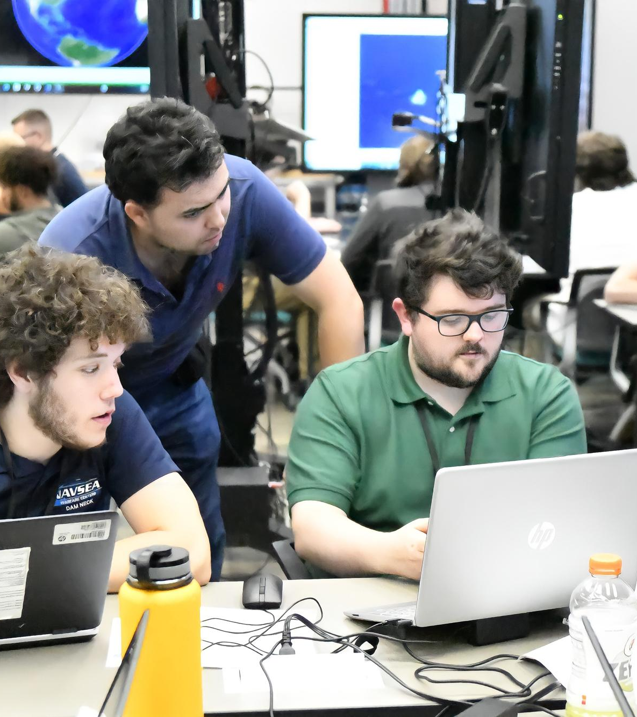
For who
Target Audience
Students
Lifelong learners
Anyone who wants to binge smarter

Slide 6

Thank you for listening
Any Questions?

