Slide 1
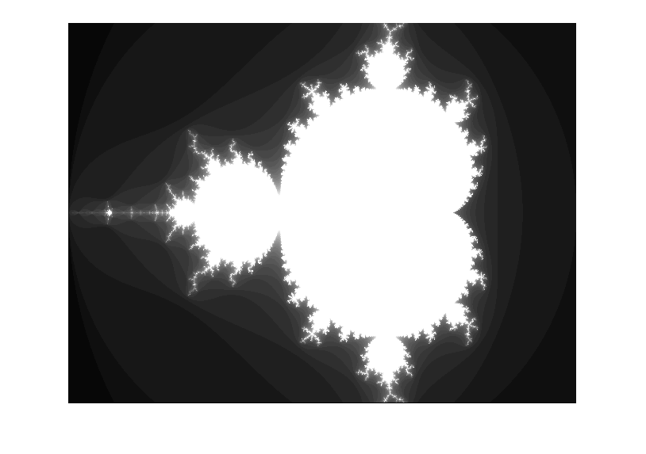
Mandelbrot Zoom
Morris Blaustein
Ece 524/551

Slide 2
Overview
Mandelbrot Set
Computing with Real Numbers
Escape Time Algorithm
Geometry of Zooming Algorithm
Fixed Point Package
State Diagram
BRAM
HDMI-out Library
Simulation and Testing
Utilization
Demo
Challenges/Bugs/Improvements

Slide 3
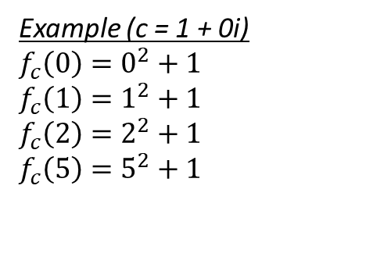
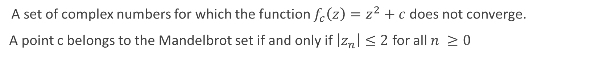
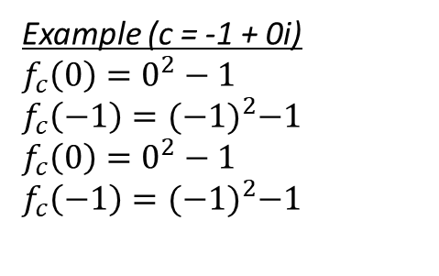
Mandelbrot Set
A set of complex numbers for which the function $f_{c}\left(z\right)=z^{2}+c$ does not converge.
A point c belongs to the Mandelbrot set if and only if $\left|z_{n}\right|≤2$ for all $n ≥0$
Example (c = 1 + 0i)
$$f_{c}\left(0\right)=0^{2}+1$$
$$f_{c}\left(1\right)=1^{2}+1$$
$$f_{c}\left(2\right)=2^{2}+1$$
$$f_{c}\left(5\right)=5^{2}+1$$
Example (c = -1 + 0i)
$$f_{c}\left(0\right)=0^{2}−1$$
$$f_{c}\left(−1\right)={(−1)}^{2}−1$$
$$f_{c}\left(0\right)=0^{2}−1$$
$$f_{c}\left(−1\right)={(−1)}^{2}−1$$

Slide 4

Computing with Real Numbers
$z=x+iy$
$z^{2}=x^{2}+2ixy − y^{2}$
$x=Re\left(z\right)= x^{2}−y^{2}$
$y=Im\left(z\right)=2xy$
$x^{2}+ y^{2}≤4$

Slide 5

Escape Time Algorithm
while ( $x^{2}+ y^{2} ≤4$ and iteration < max_iteration )
$$y=2xy+ y_{0}$$
$x= x^{2}−y^{2}+x_{o}$
iteration += 1

Slide 6
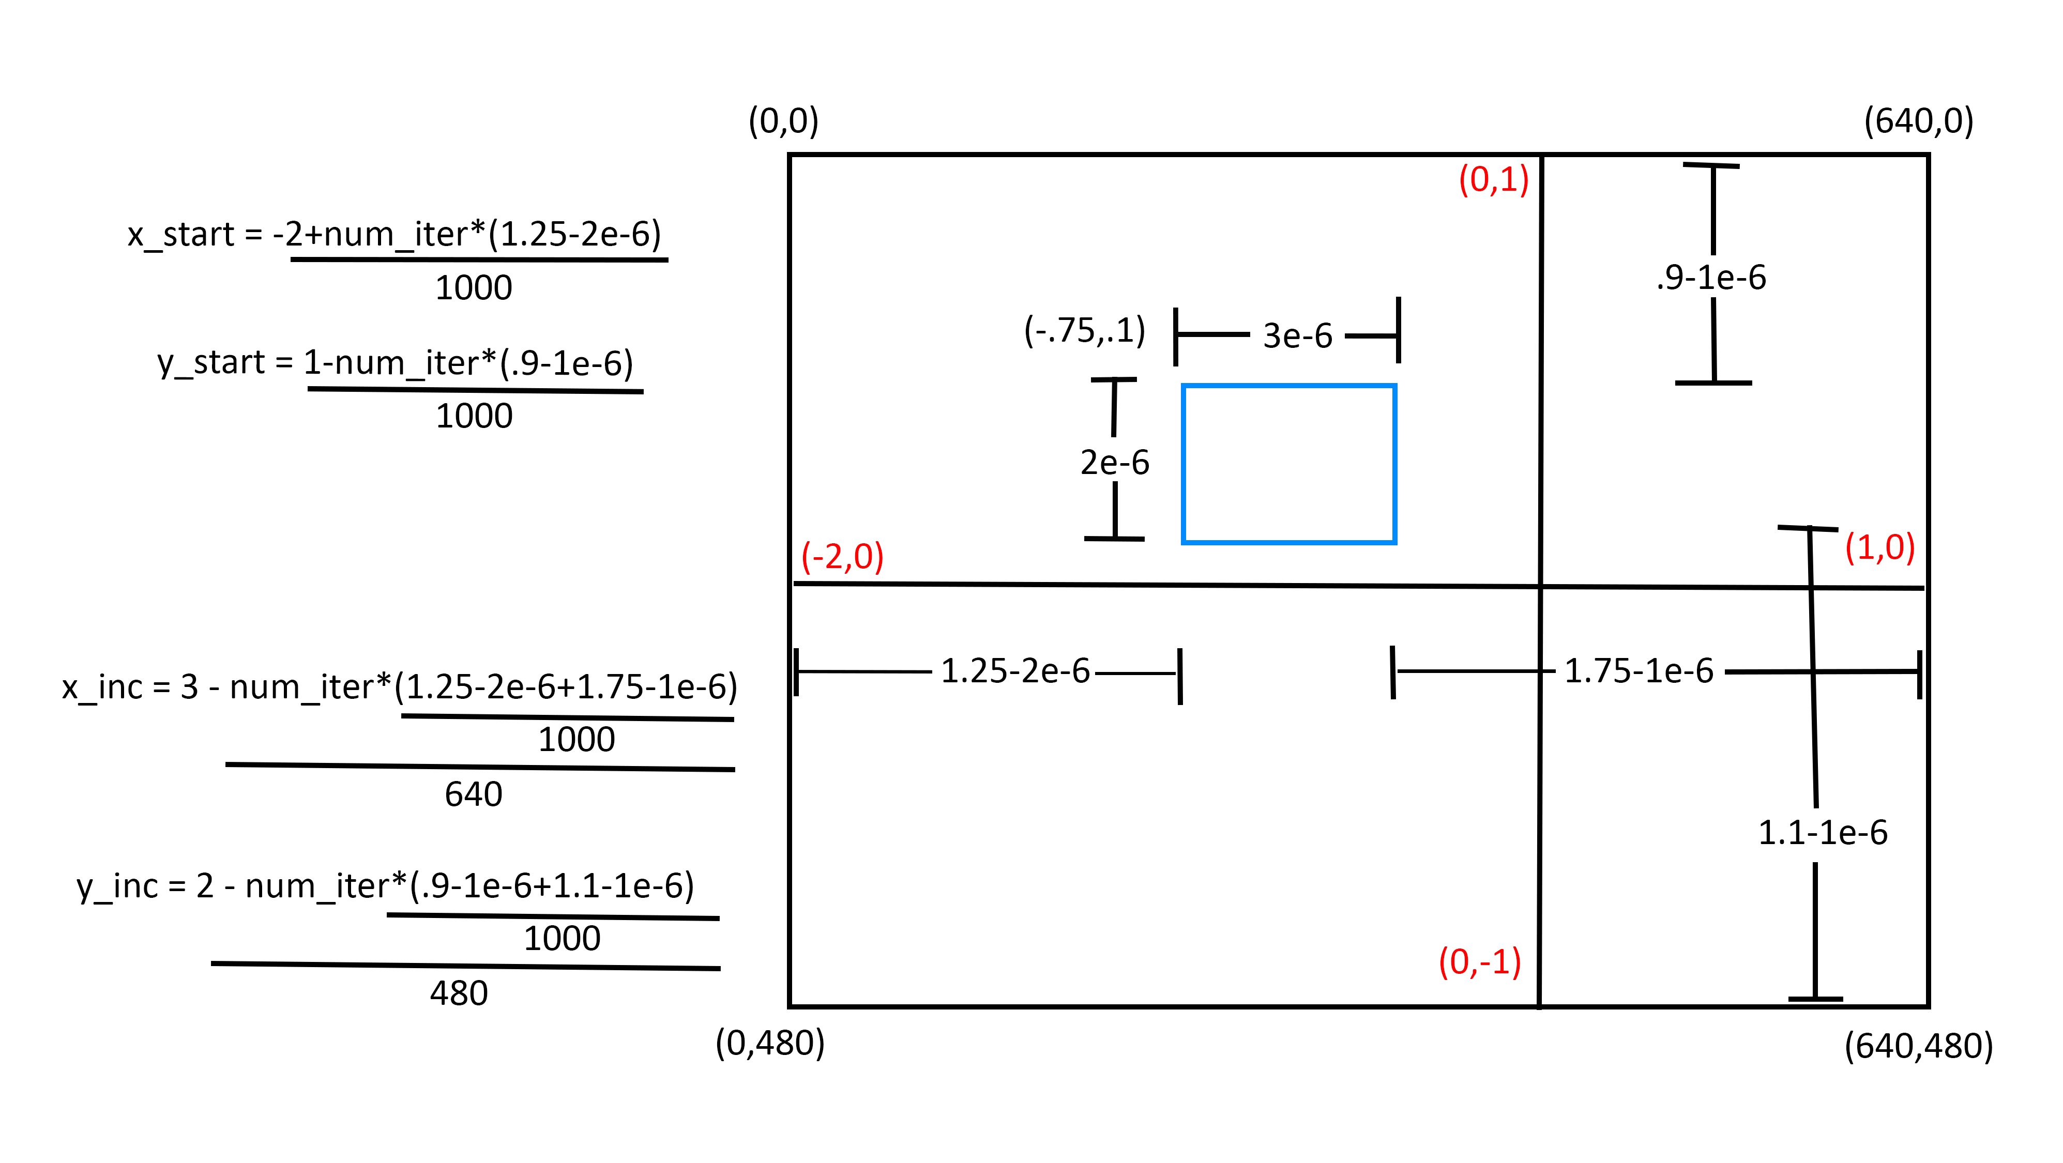

Slide 7

Fixed Point Package
VHDL library that allows use of fractional fixed-point numbers
Not included in standard VHDL IEEE library
Example
signal a, b, c : sfixed(10 downto -37);
…
a <= resize(To_sfixed(1,2,-4)/To_sfixed(2,2,-4),a);
b <= resize(To_sfixed(1,2,-4)/To_sfixed(4,2,-4),a);
c <= resize(a+b,c)
$$c= \frac{1}{2}+\frac{1}{4}=\frac{3}{4}$$
000.1100

Slide 8
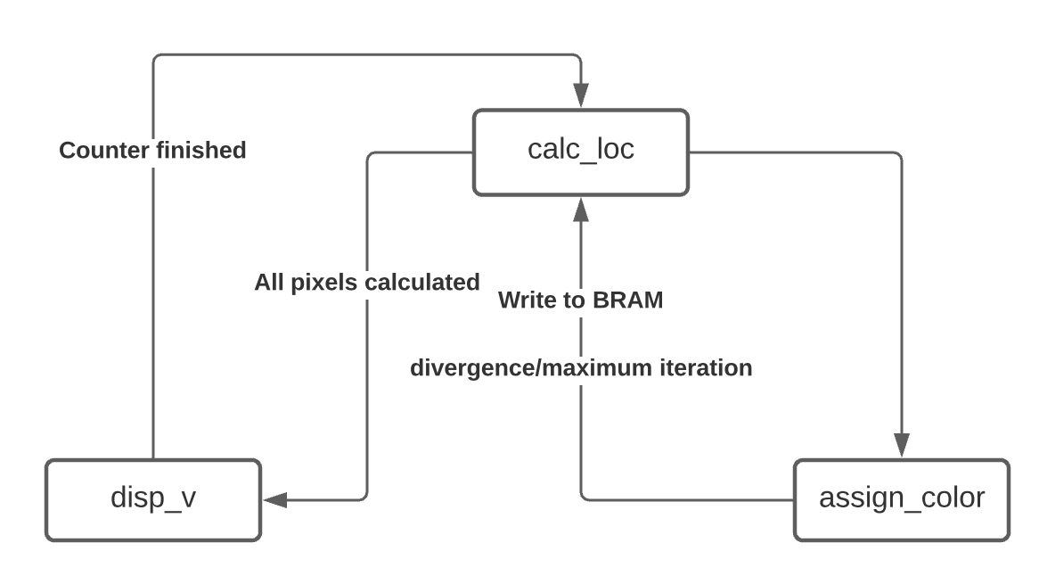
State Diagram

Slide 9
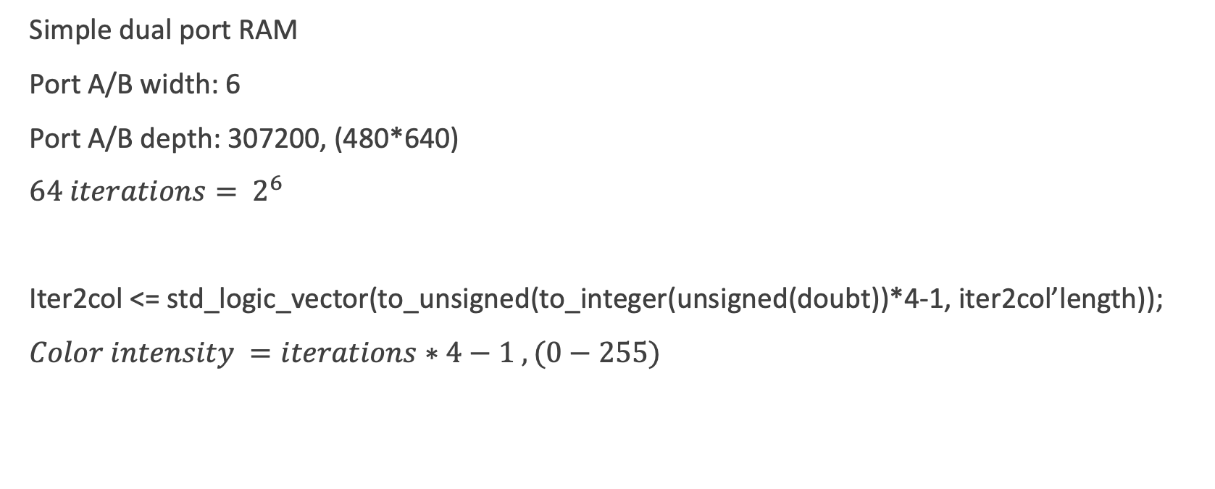
BRAM
Simple dual port RAM
Port A/B width: 6
Port A/B depth: 307200, (480*640)
$64 iterations= 2^{6}$
Iter2col <= std_logic_vector(to_unsigned(to_integer(unsigned(doubt))*4-1, iter2col’length));
$Color intensity =iterations∗4−1 , (0−255)$

Slide 10
HDMI-out Library
VHDL-HDMI-out source code used
HDMI TX port outputted VGA, 640x480
Generated timing signals for VGA (horizontal/vertical sync) and converted video data to TDMS
HDMI uses TDMS (transition-minimized differential signaling) for transmitting high speed serial data

Slide 11
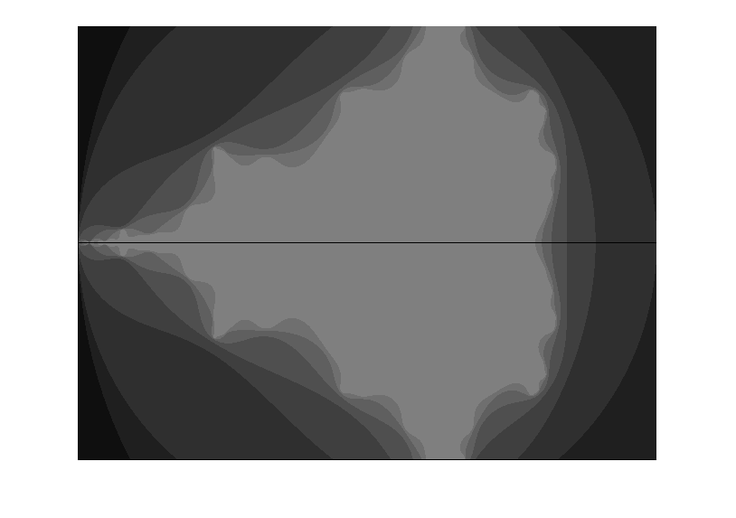
Simulation and Testing
Simulation writes contents of BRAM to file
Matlab makes an image from the data
for I = 1:480
for j = 1:640
img(i,j) = data(640*(i-1)+j);
end
end
8 iterations

Slide 12
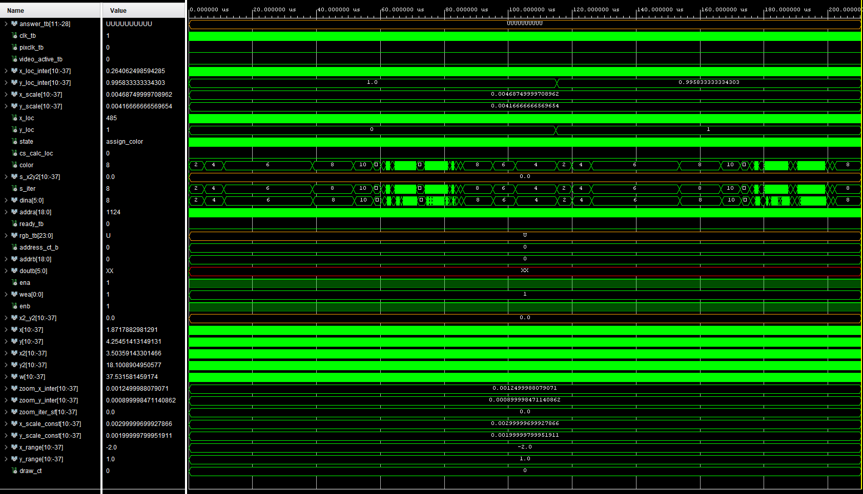

Slide 13
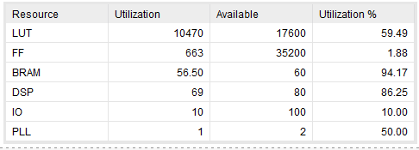
Resource Utilization

Slide 14
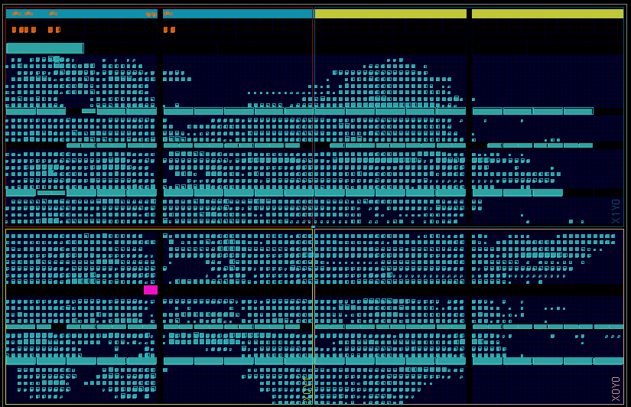
Device Utilization

Slide 15
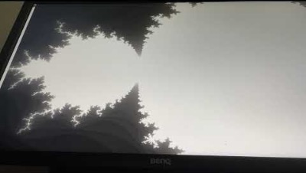

Slide 16
Challenges
Mandelbrot Set
Fixed Library
Meeting resource requirements for Zybo Z7
Geometry of zooming
HDMI out library
Slow simulation, synthesis and implementation

Slide 17
Known Bugs
Screen is slightly misaligned

Slide 18
Future Improvements
Pipeline calculations to increase speed and fluidity of zoom
Joystick to manually control zooming area
Increase number of iterations, currently 64
Increase the amount of zoom, currently 1,000,000x magnification

