Slide 1
Offense vs. Defense: Finding that Winning Combination.
Matthew Oborski
PhD Candidate, Dept. Bioengineering
University of Pittsburgh

Slide 2
Project Overview
Project Goal:
Determine how best to combine all 5 skaters (3 forwards + 2 defensemen) of an NHL hockey team to maximize goals for while minimizing goals against.
Motivations:
More wins = happy fans = ticket sales = team revenue
Top 16 teams advance to the Stanley Cup Playoffs:
More tickets sold
More team merchandise purchased by supporting fans
Data Sources:
Kaggle ~ 6MB (https://www.kaggle.com/open-source-sports/professional-hockey-database)
Hockey Abstract ~ 98 MB (http://www.hockeyabstract.com/)
Notes:
Kaggle -- Professional Hockey Database -- https://www.kaggle.com/open-source-sports/professional-hockey-database
Hockey Abstract -- http://www.hockeyabstract.com/testimonials

Slide 3
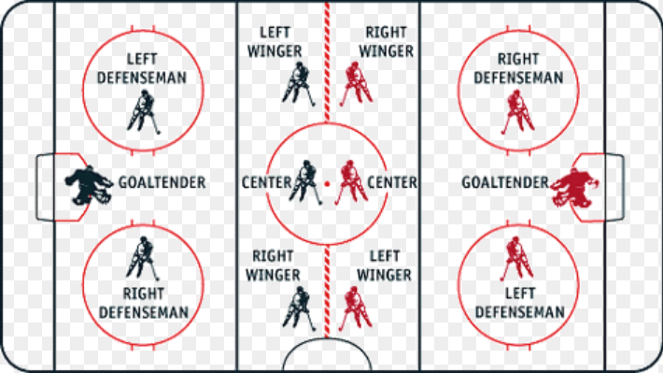
Overview of Player Positions

Slide 4
Player Shot Attempts Correlate with Goals & Assists
* Player Data from the 2016-2017 NHL Regular Season.
* Minimum 40 Games Played.

Slide 5
Optimizing Forward Combinations
Choose combinations of forwards that combine to give the biggest difference in: (Shots Attempted – Goals Allowed)
 | Optimized Combinations of Forwards |  |  |  | Predicted Goals for/against
Rank | LW | C | RW |  | LW | C | RW
1 | Ovechkin | Bergeron | Tarasenko |  | 42.4/81.2 | 32.2/77.4 | 35.5/69.1
2 | Pacioretty | Matthews | Kucherov |  | 33.7/68.5 | 31.9/76.8 | 31.1/62.8
3 | Kane | Carter | Voracek |  | 29.4/62.4 | 31.4/76.1 | 32.2/64.3
4 | Arvidsson | Tavares | Kessel |  | 27.4/59.5 | 31.7/76.5 | 27.1/56.9
5 | Marchand | Eichel | Atkinson |  | 27.2/59.1 | 28.8/71.9 | 26.6/56.2
6 | Saad | Kadri | Vrbata |  | 24.5/55.3 | 28.9/72.1 | 27.2/57.1
7 | Pearson | Crosby | Perry |  | 24.1/54.7 | 27.5/69.9 | 25.5/54.7
8 | Ehlers | McDavid | Wheeler |  | 24.7/55.5 | 28.2/71.0 | 27.5/57.6
* Player Data from the 2016-2017 NHL Regular Season.
* Minimum 40 Games Played.

Slide 6
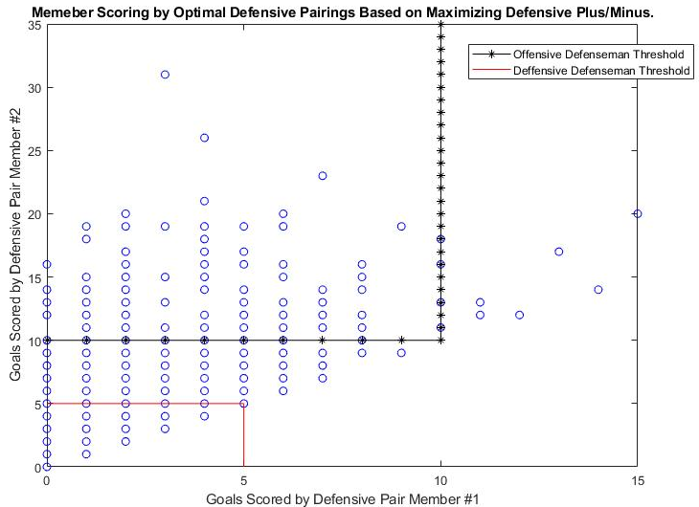
Optimizing Defensive Pairings
“Plus/Minus” = (goals player on ice for – goals player on ice against)
the higher a player’s ‘plus/minus’ the better.
* Player Data from the 2006-2007 thru 2010-2011 NHL Regular Seasons.
Notes:
Defensemen on always plotted as having the fewer goals between the pairing

Slide 7
Take-aways:
Strong correlation (ρ = 0.841) between the number of attempted shots by a player and number of goals scored.
Highest scoring players can be your biggest defensive liabilities.
centers may be the worst offenders.
Combining 2 “Offensive” Defensemen generally leads to more minuses than pluses.

Slide 9
* Player Data from the 2016-2017 NHL Regular Season.
* Minimum 40 Games Played

