Slide 1
POnto: An ontology for the Polkadot multichain ecosystem
Approach proposal and roadmap
Marcio Moreno, PhD marcio@mobr.ai | Rafael Brandão, PhD rafael@mobr.ai
Co-founders
M O B R
S Y S T E M S

Slide 2
Structure
Research overview
POnto discussion
Next steps

Slide 3
Research overview
Initiative towards enhancing integration and communicability in the Polkadot ecosystem
First step: mapping, structuring and formalizing concepts and relationships in an ontology
Long term goal: to build a CNL and querying engine to support relevant analytics use cases

Slide 4
Research questions
General
How a knowledge-oriented approach may benefit the communicability, integration, usage and development of blockchains?
Specific
How ontology-supported development impacts design and building of Polkadot’s parachains and cross-chain communication?
Long-term research questions

Slide 5
Methodology
TR - Blockchain ontology fundamentals
Article - Polkadot Analytics prospective query service
Research grant scope
M1
M2
M3
Research questions
Systematic literature review
Blockchain ontology study
Ontology application study
Validation
Scientific report
TR - Systematic review
Questionnaire
Draft - POnto

Slide 6
Fundamentals
Ontologies are essential in Web2's semantic technologies stack
Conceptual framework for describing, sharing and reusing data in different applications and domains
Enhance communicability among stakeholders, support for reasoning and data integration
Support for representing and defining domain categories (TBox) and instances (ABox)
Properties, relationships between concepts, data and entities
Search
Heuristic engine
Proof
Rules Logic
Rules
Data
Data
Data Ontologies
The "semantic web bus", as originally envisioned
by Berners-Lee
https://www.w3.org/2000/Talks/1206-xml2k-tbl/slide14-0.html
Notes:
Fazer link web2 -> web3

Slide 7
Fundamentals
Why to develop an ontology?
Noy and McGuiness, (2001)
Share common understanding of the information structure among people and/or software agents
Enable reuse of domain knowledge
Make domain assumptions explicit
Analyze domain knowledge

Slide 8
POnto
Tools
Visual Studio Code
Protégé
Jena and Fuseki
http://mobr.ai/ponto

Slide 9
POnto
Design goal
Modular organization
Main concepts (completeness)
Relationships (formal understanding)
(a)kbc

Slide 10
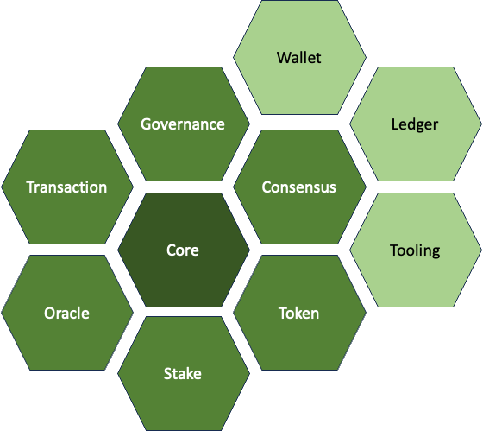
POnto
Metrics
10 Modules
449 Triples
50 Classes
25 Individuals
58 Properties

Slide 11
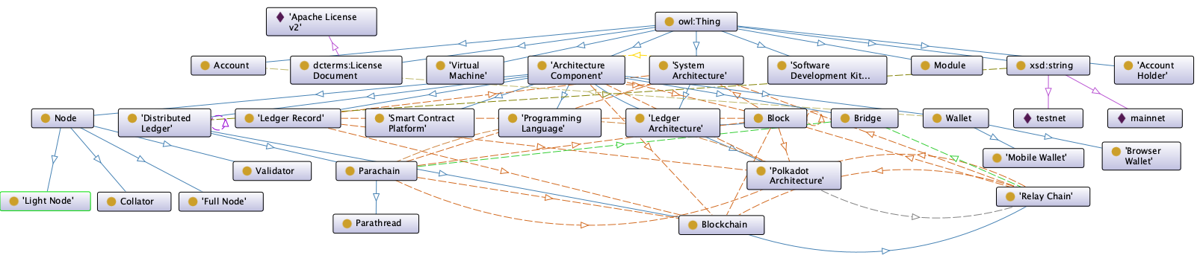
POnto
Core Module

Slide 12
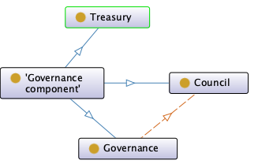
POnto
Governance Module

Slide 13
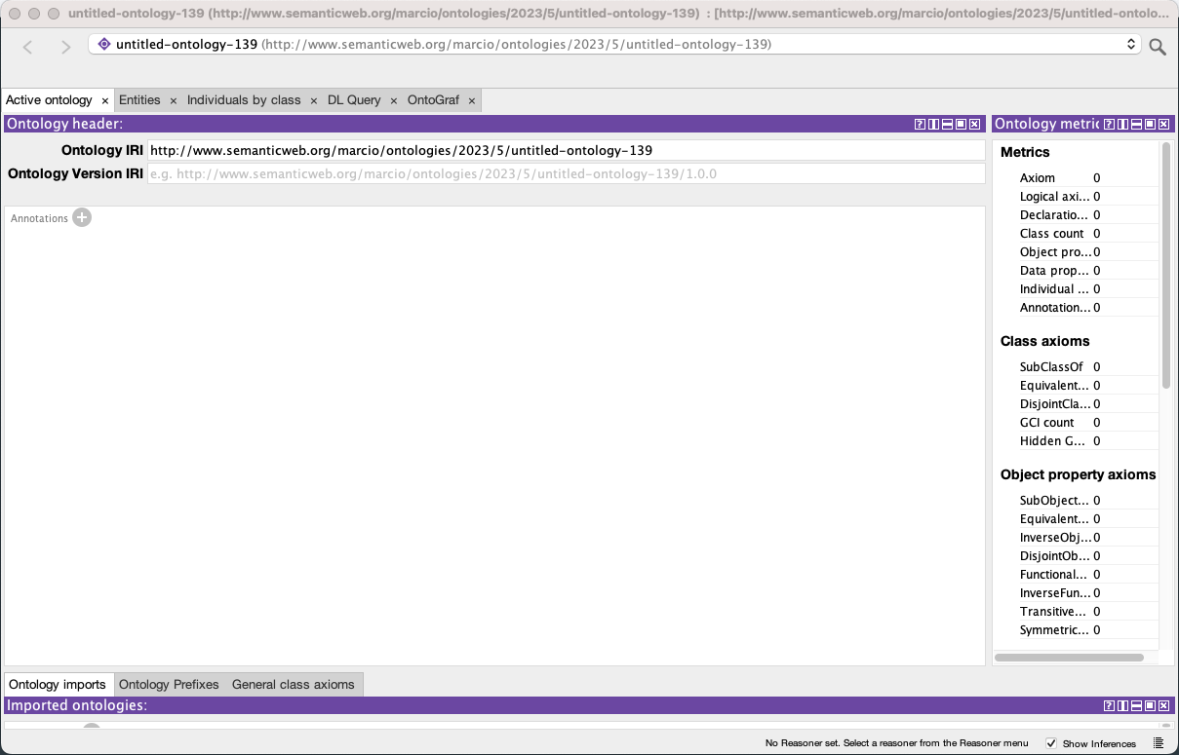
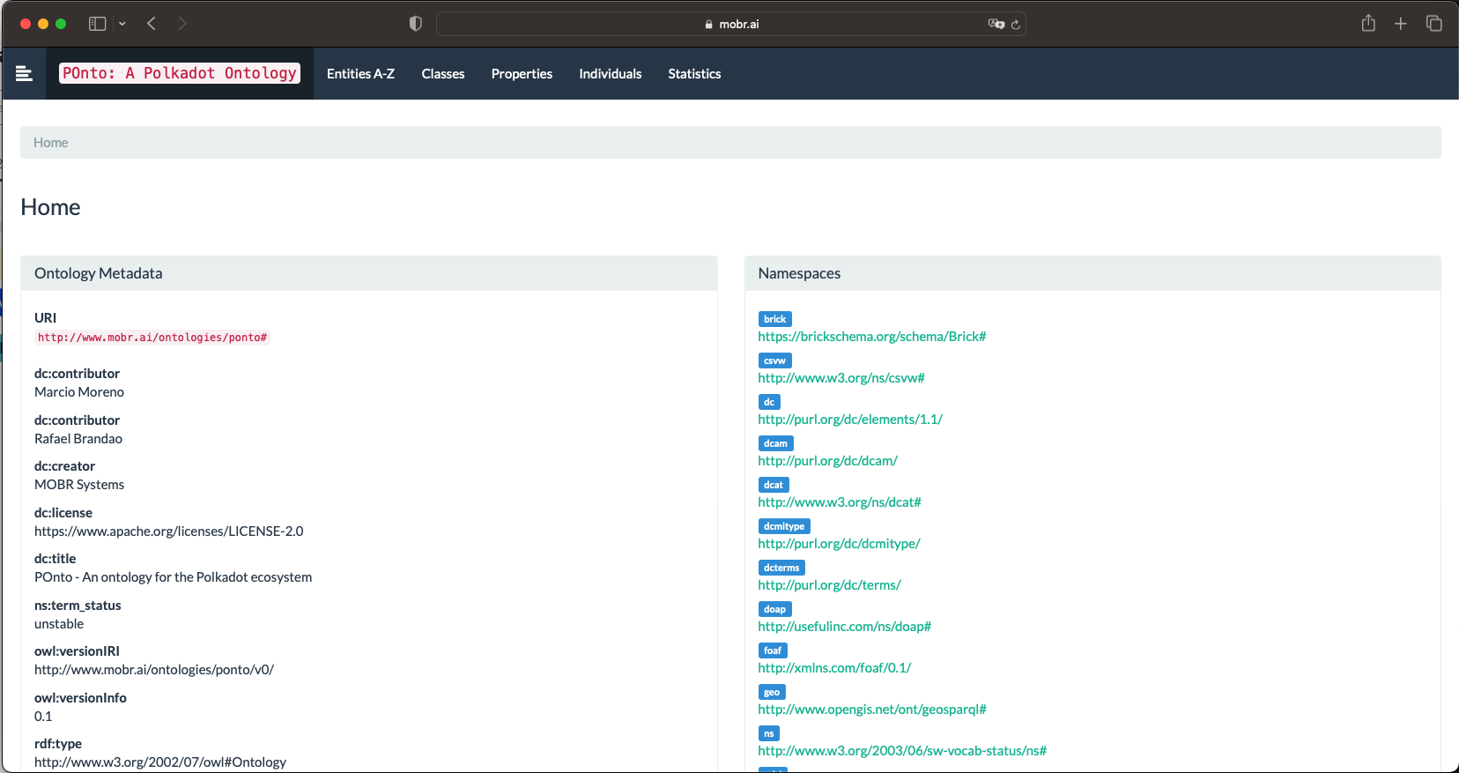
POnto
Browsing the ontology using Protégé and Ontospy documentation

Slide 14
POnto
Continuous Evolution
Community contributions
Scientific paper
Roadmap

Slide 15
Questionnaire discussion
Goal is to assess the perceived value and effectiveness of a query service by the community
Insights for building a CNL to support querying
Validation of the proposed approach
General and/or Polkadot-specific
Communication strategy
Deadline target definition

Slide 16
Roadmap
Creation of the conceptual framework
Knowledge base construction: script to extract data from the Polkadot ecosystem and align the data as individuals of the POnto ontology
Specification of a controlled natural language (CNL) that will use the POnto ontology
Query engine creation that supports users specifying queries using the CNL

Slide 17
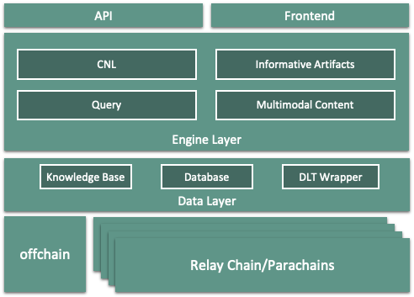
Roadmap
Polkadot Analytics
CNL Engine parses input queries and assists query completion supported by a Knowledge Base with the POnto Ontology
Queries are processed to a structured format by the Query Engine component
Informative Artifacts Engine manages creation of multimodal artifacts, for visualizing query results
Support for composition on user dashboards
Access through web UI frontend and API offering
Proposed architecture for the Polkadot Analytics

Slide 18
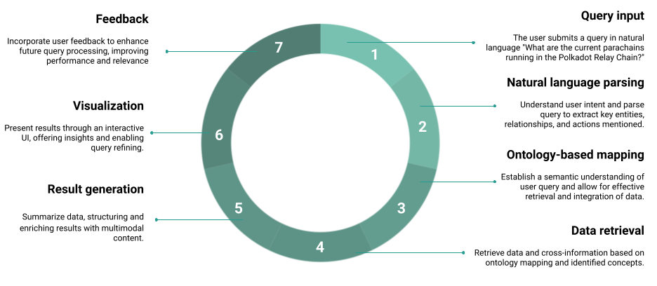
Roadmap
Polkadot Analytics
Support for broad range of queries and data visualization strategies
Query results structured as artifacts with multimodal content, representing data results and summarization aspects
Composability and integration of informative artifacts to create user dashboards
Envisioned query processing in Polkadot Analytics

Slide 19
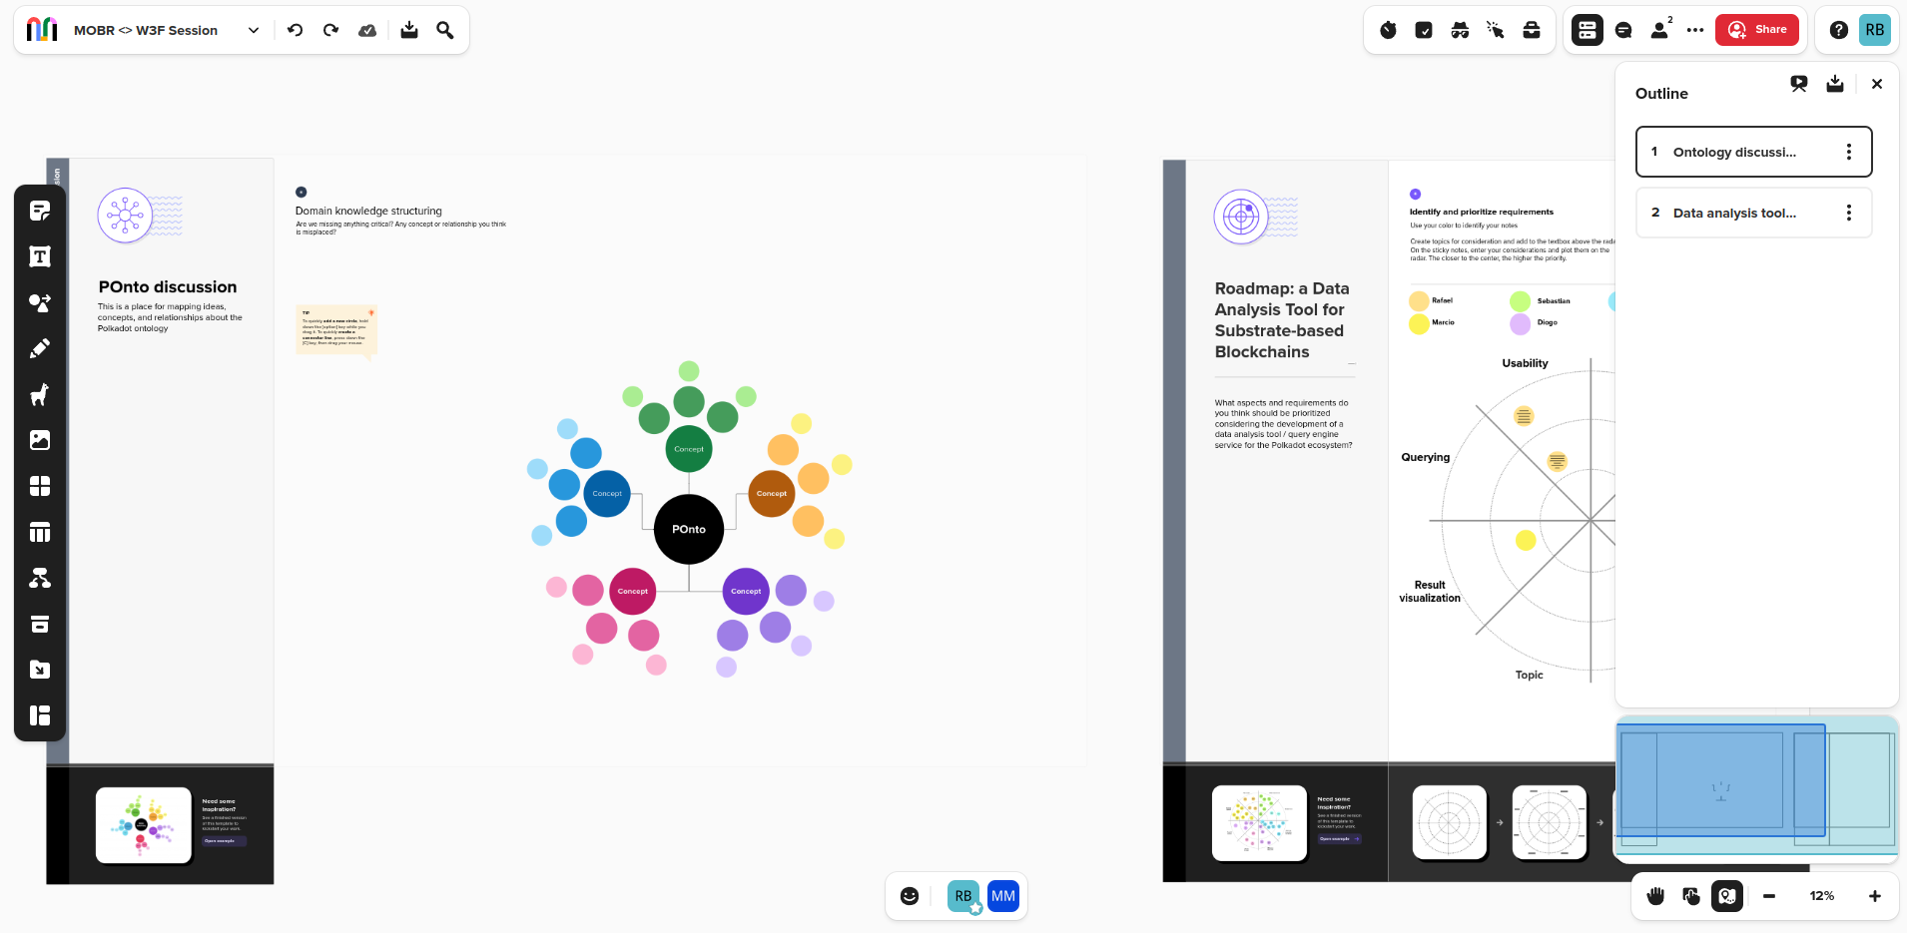
Mural activity
Mural session to support brainstorming and discussion
POnto concept mapping
Analytic tool requirements prioritization

Slide 20
Reflections and action items
Engagement with domain experts
Approach validation
Questionnaire
Should be focused on Polkadot ecosystem
Pilot-tested with domain experts
Ready to be deployed in the wild
Action items
➤ Support for new concepts referred in suggested queries
➤ Improvements over the POnto modeling
Modules: Network, Pallet, Account, and others
➤ Considerations for the envisioned query engine

Slide 21
M O B R
S Y S T E M S
Thank you!

