Slide 1
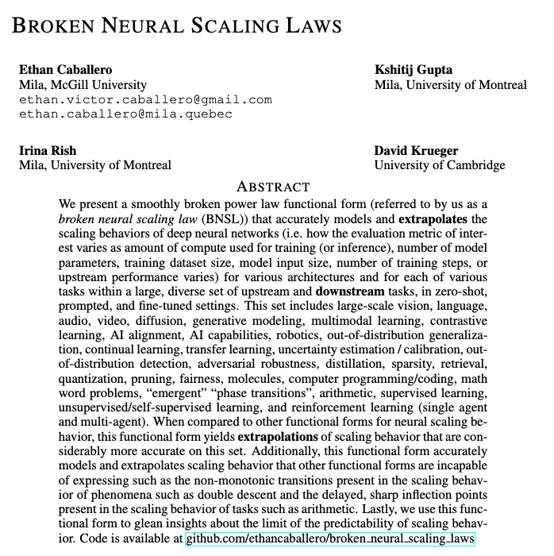
BROKEN NEURAL SCALING LAWS (BNSL)
Zilong Wang, Bzdok Lab,
Statsjam
Oct.10 2023
Notes:
Today I’m gonna talk about a paper by our colleagues at Mila, called Broken Neural Scaling Law. In this pape, the authors mostly discussed the advantage of modeling the scale behavior using BNSL than other neural scaling laws

Slide 2
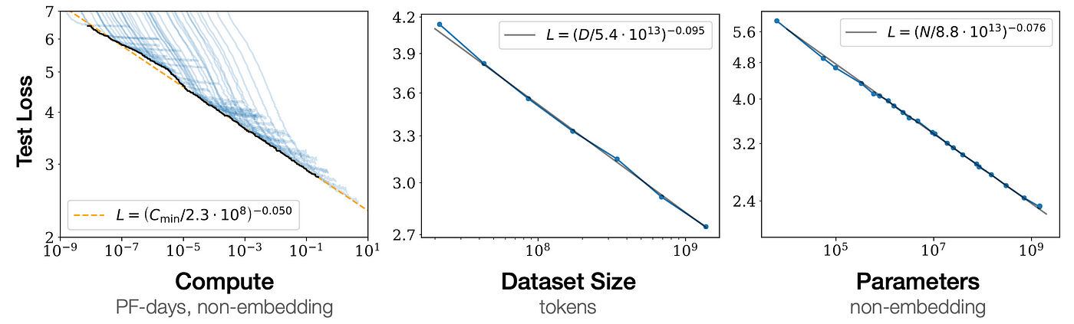
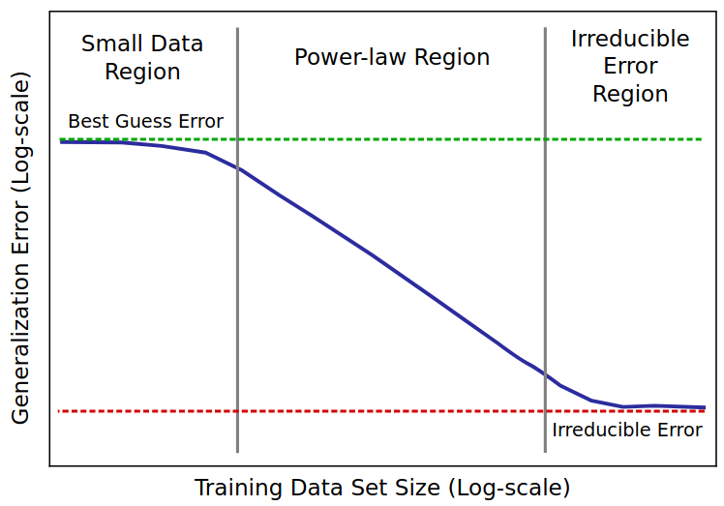
Previous neural scaling laws
M1: y = ax^{b}.
M2: y = ax^{b} + c Kaplan et al. (2020)
M3: y = a(x+d)^{b} + c Zhai et al. (2021), Bansal et al. (2022)
log(a)
x: number of model parameters, amount of compute used for training (or inference), training dataset size, model input size, number of training steps, or upstream performance
y: prediction error, cross entropy, calibration error, AUROC, BLEU score percentage, F1 score, reward, Elo rating, or FID score.
d
log(c)
Notes:
Neural scaling law is not a single function, but a family of functions. These functions take model size, compute, training data size and etc as x and the test loss, cross entropy, F1 score etc as y. These data come from the experiments conducted on different models by different groups.
First one called M1 which is a linear function for all X on a log-log plot shown here. Because we are in a log scale, log(a) is the offset of y.
M2 introduced a constant C which is the irreducible error, such that when x goes to infinity there will still be an error. Because we are in a log scale, this is equal to log(c).
In M3, there is additionally a constant d in the base of the exponentiation term. d represent the scale at which the performance starts to improve beyond the random guess loss, or accuracy & transitions to a power law scale.
Graphically it represents a shift on the x-axis when x is zero the modal can still achieve non-zero accuracy.
These three neural scaling laws are strictly monotonic, meaning that they can only express one direction of scaling behavior.

Slide 3
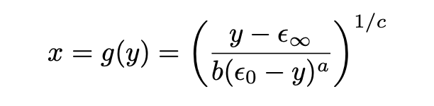
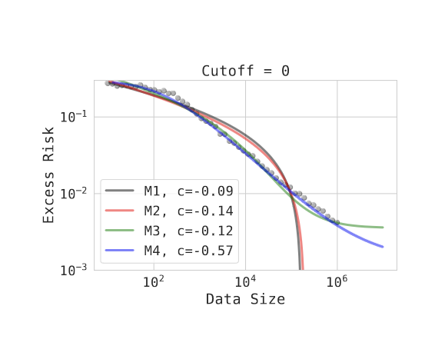
Previous neural scaling laws
M4:
Notes:
Then there is M4 which is Expressed as an inverse function of y. Here epsilon-infinity, equivalent to c in previous slide, is the irreducible error and epsilon_0, equivalent to d in previous slide is random guess performance.
The additional alpha parameter is learnable and when alpha = 0, this reduce to M2. When alpha>0, this function can handle the case when learning curve does not fall
into the power law scale.
But, this function is still monotomic, but it can model inflection points.

Slide 4
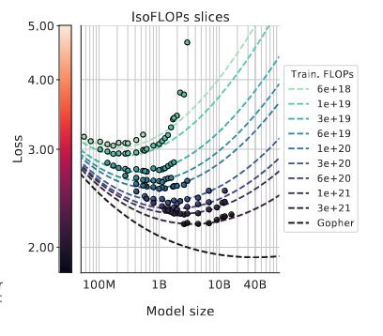
What about scaling behaviors like this?
Notes:
This is non-monotonic, thus M1 TO M4 can’t model or predict this.

Slide 5
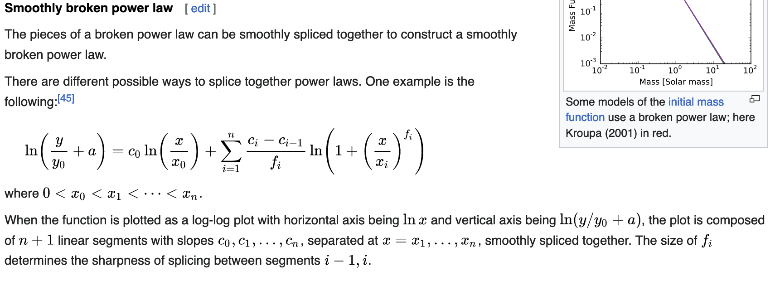
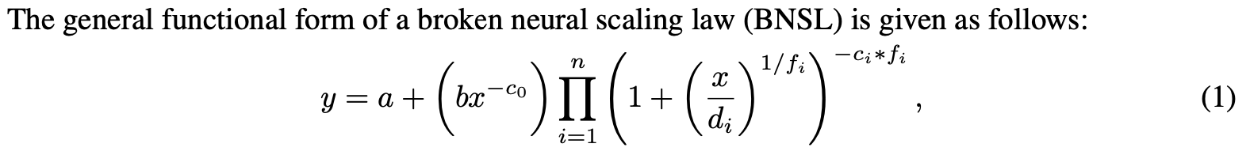
Functional form of BNSL
Notes:
This is where broken neural scaling laws is introduced. Here is the functional form, or can also be written in a different functional form. (Go back)

Slide 6
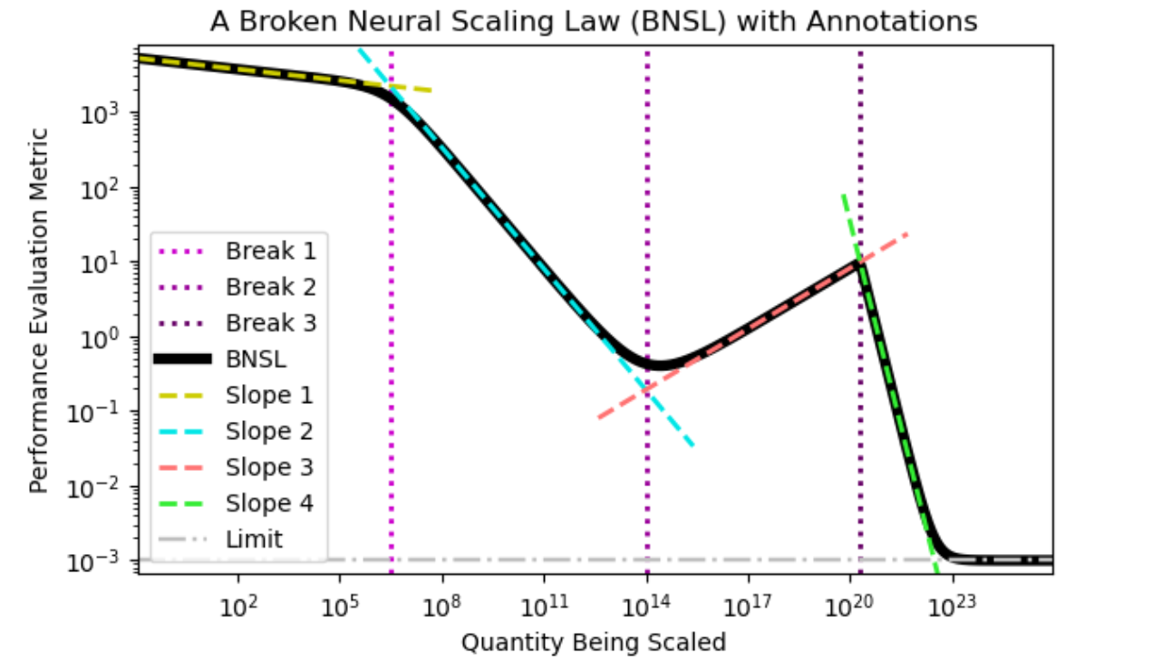
log(b)
f_{i}
d_{i}
c_{i}
log(a)
Notes:
Constant n represents the number of (smooth) “breaks” (i.e. transitions) between n + 1 consecutive approximately linear segments. when n = 0, equation becomes M2.
The parameters a, b, c0, c1...cn, d1...dn, f1...fn
Represents the irreducible limit, the offset of y, the slope of each linear segment, where the breaks happen and the sharpness of each break. They are unknown and must be estimated by fitting the above functional form to the (x, y) data points.
Constant a represents the irreducible limit. Constant b represents the offset of y on a log-log plot. Constant c_0 is the slope of the first power law segment, which is a linear region on log-log plot. C_i repreesents the difference between the slope of the ith linear segment and (i+1)th linear segment. D_i representsw where the breek occurs between ith tan di+1th linear segment. Constant fi represents the sharpness of the break between the (i)th and the (i + 1)th approximately linear region on a log-log plot
A Broken Neural Scaling Law (BNSL) (dark black solid line) (with 3 breaks where purple dotted lines intersect with dark black solid line) that contains 4 individual power law segments (where the dashed lines that are yellow, blue, red, and green overlap with the dark black solid line). Each slope represents a different exponent of the power. The 1st and 2nd break are very smooth; the 3rd break is very sharp.

Slide 7
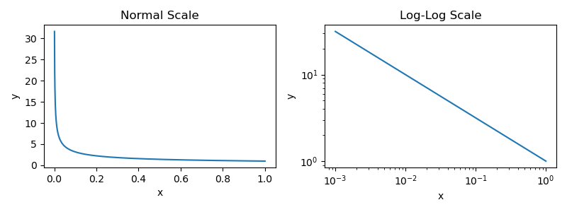
Differentiating linear-linear scale and log-log scale
Notes:
So far all the scaling laws we saw are in the log-log scale.
But the authors also noted M1 to M4’s scaling behaviors on a linear scale missed something.

Slide 8
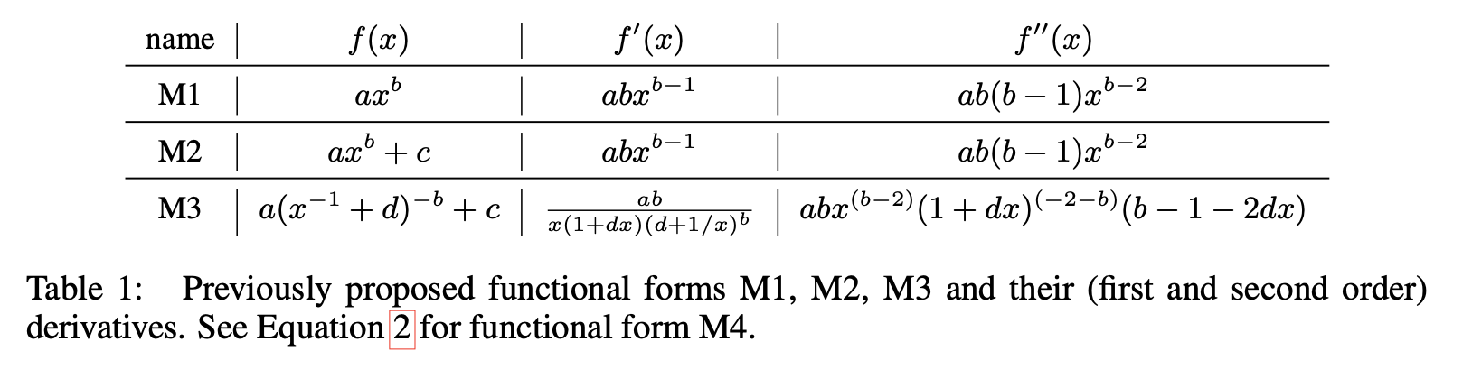

Monotone and inflection points
 | M1/M2 | M3 | M4 | BNSL
Non-monotonic | No | No | No | Yes
Inflection (lin) | No | No | Yes | Yes
Inflection (log) | No | Yes | Yes | Yes
Notes:
Here is a comparison between these different functional forms.
From M1 to M4, none of them can be non-monotonic. Because the First-order derivative of m1/M2 and M3 does not change its sign for x > 0, they are all strictly monotonic, thus can’t model double descent phenomena. Because M4 is an inverse function of y, this imply it can only be monotonic, otherwise, there will be two x values for the same y.
Because Second order derivative can’t be equal to zero for x > 0 and b < 0, M1, M2, M3 can’t express inflection points in a linear-linear scale. But M4 can. As the authors claimed here based on wolfram alpha and matplotlib.
BNSL can be non-monotonic, model inflection points in both linear-linear and log-log scale.

Slide 9
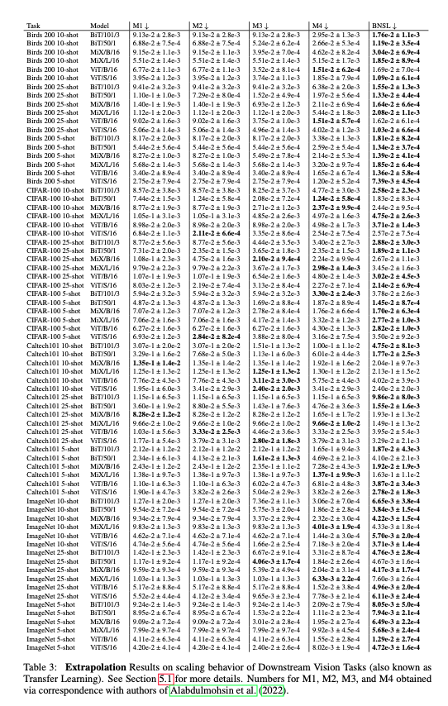
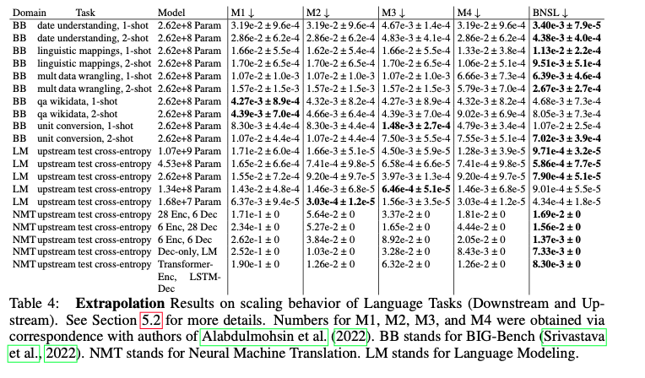
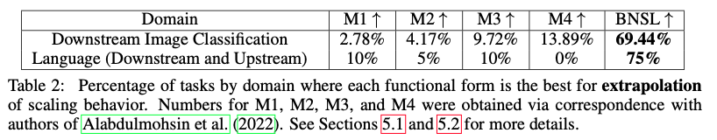
BNSL is good at extrapolation
x: number of model parameters, amount of compute used for training (or inference), training dataset size, model input size, number of training steps, or upstream performance
y: prediction error, cross entropy, calibration error, AUROC, BLEU score percentage, F1 score, reward, Elo rating, or FID score.
Notes:
As mentioned before, if one wants to see how a neural scaling law predicts or extrapolates the scaling behavior, one needs to take the x and y from different experiments and fit the neural scaling laws on training x and training y, then predicts y from the testing x and compare with testing y. Here the authors used RMSLE (Root Mean Squared Logarithmic Error) as the extrapolation evaluation metric.
(next) These TABLEs SHOW THAT BNSL yields extrapolations with the lowest RMSLE (Root Mean Squared Logarithmic Error in 50 out of 72 experiments shown left of downstream vision tasks (or transfer learning) and 15 out of 20 experiments of language downstream and upstream tasks.

Slide 10
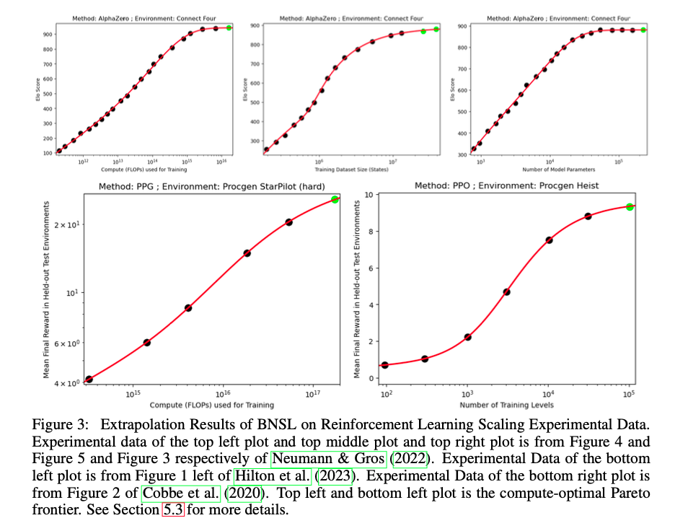
Extrapolating Reinforcement Learning’s scaling behavior

Slide 11
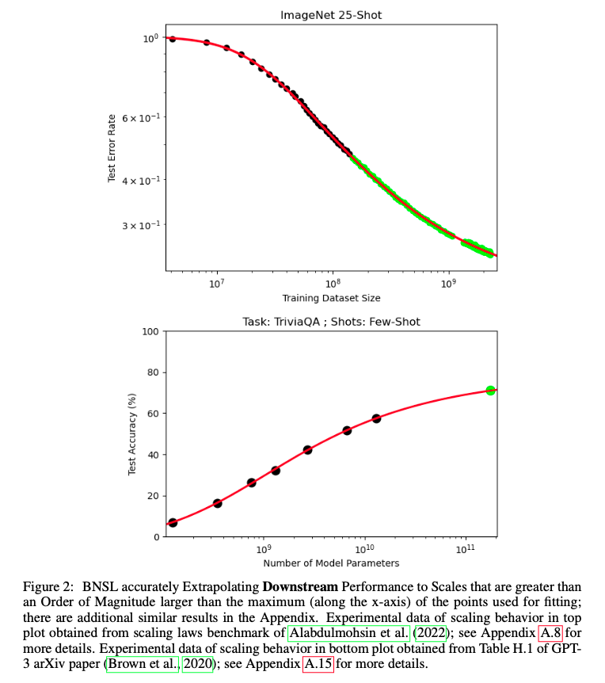
Large-scale extrapolation
Notes:
black points are training data points used for fitting a functional form, green points are held-out testing data points used for evaluating extrapolation of functional form fit to the black points, & a red line is BNSL that has been fit to black points.
BNSL can also extrapolate the scaling behavior that’s over order of magnitude than the maximum scale seen during training. The top is a vision downstream task and bottom is a language downstream task from GPT-3.
Also notice there is one inflection point in the top plot, point it.

Slide 12
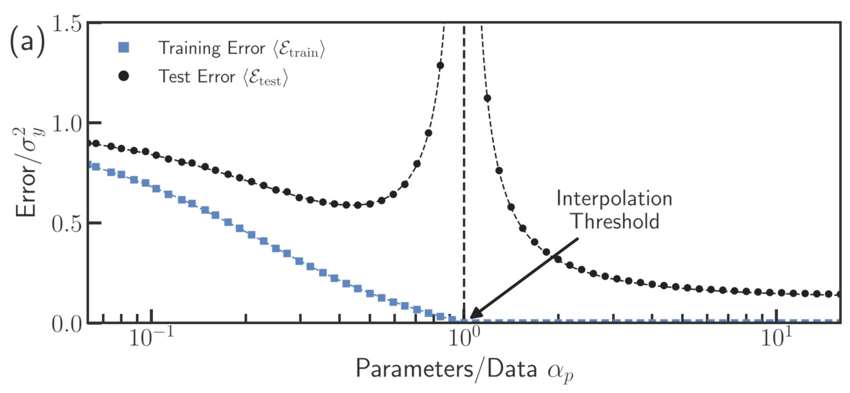
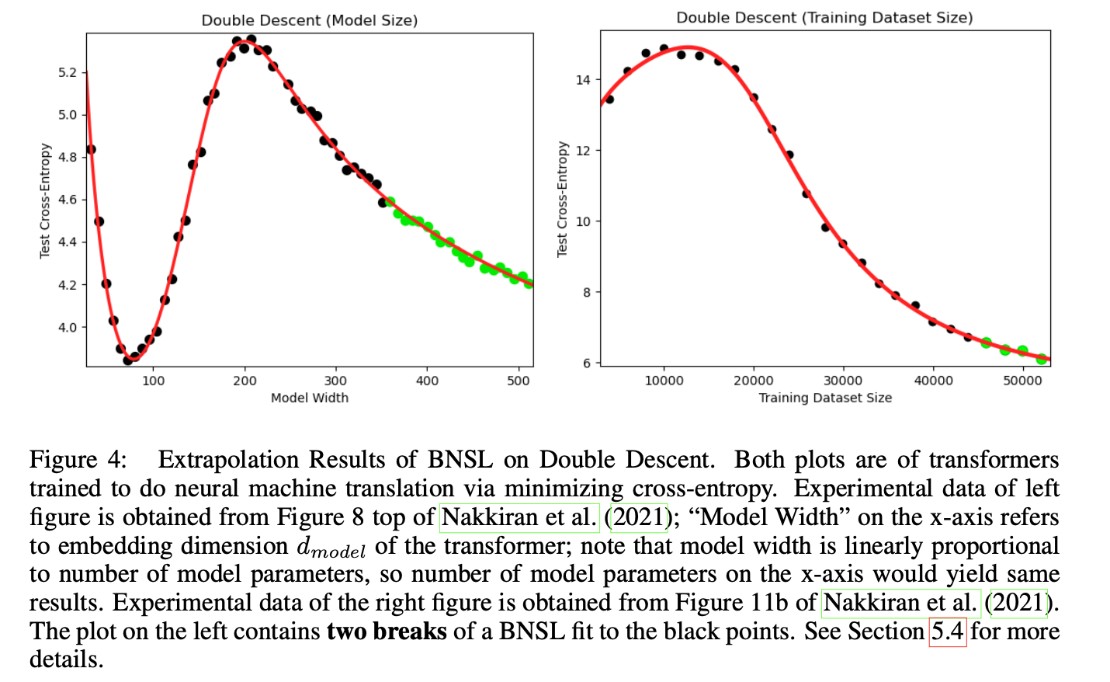
Modeling double descent (Non-monotonic behavior) in linear-linear scale
Notes:
BNSL not only models the double descent behavior and also extrapolate the scaling behavior accurately. On the left there are two breaks.
You might wonder, if the double descent is only seen in a linear-linear scale and the scale of double descent is very small, on a log-log plot all these points will probably form a cluster, I think that’s true. So on a log-log scale, there is probably no double descent.
but still, the first order derivative of M1, M2, M3 and M4 won’t allow them to exhibit non-monotonic even on a linear-linear scale.

Slide 13
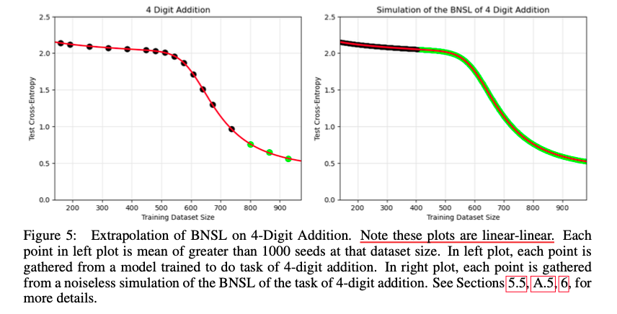
Modeling inflection points in linear-linear scale
Notes:
We have seen inflection points in log-log scale, but here is inflection points in linear-linear scale. Seeds means training runs here.
Here BNSL models the inflection points also in a linear-linear scale, while other functional forms are mathematically unable to express inflection points on a linear-linear plot.

Slide 14
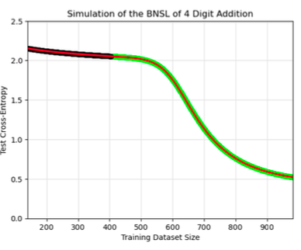
Limitation
If the scaling behavior has at least 1 sufficiently sharp (?) break, BNSL can only extrapolates well if trained up to the data points where the break happens, even if one has infinitely many training examples. If one doesn’t have smooth enough data points, one must go beyond the breaks.
Sufficiently sharp break 1
Notes:
In this plot, with enough simulations of training run results, you would still need to use all the data points up to the first break, which according to the authors is sharp enough. Otherwise, there is no way one can extrapolates the second break or third break.

Slide 15
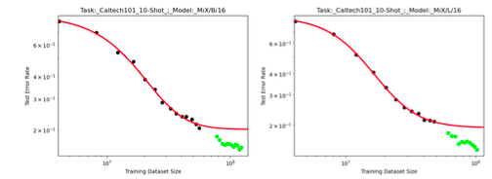
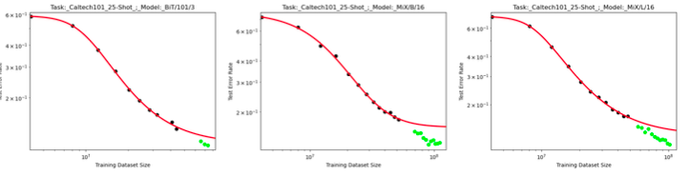
Limitation
If an additional break of sufficient sharpness happens at a scale that is sufficiently larger than the maximum (along the x-axis) of the points used for fitting, there does not (currently) exist a way to extrapolate the scaling behavior after that additional break.
Notes:
Still, I’m not sure how sharp is sufficiently sharp and how much large is sufficiently larger, but from these plots, you can see even when they trained BNSL up to or beyond the data points where the 2nd break happens, it didn’t extrapolates well enough.

Slide 16
Why broken?
On a log–log plot, when f i is not too large and a is subtracted out from the y-axis, this functional form looks like a series of linear segments connected by arcs; the n transitions between the segments are called "breaks", hence the name Broken Neural Scaling Laws (BNSL).

