Slide 1
Smart Ticket Assistant
GenAI-powered ticket categorization and response suggestion tool
Hackathon Demo
Human-in-the-loop
Responsible AI
Transform messy customer messages into clear, prioritized, human-approved actions in seconds.
Demo flow: Ticket input → GenAI analysis → Suggested response → Human validation → Feedback loop

Slide 2
1. Problem Statement
Customer support teams are overloaded with high-volume, diverse and unstructured tickets.
Support receives everything
Agents do manual interpretation
Business impact
Technical issues
Billing questions
Information requests
Complaints
Order tracking
Cancellations
Refunds
Urgent claims
What is the ticket about?
Which category does it belong to?
How urgent is it?
What initial response should be sent?
Which team should handle it?
Is there an existing solution?
Delayed first response
Inconsistent categorization
Wrong routing
Agent overload
Higher support cost
Lower customer satisfaction
The problem is not only the number of tickets — it is the time spent turning ambiguous text into operational action.

Slide 3
2. Data Considerations
The solution depends on clean, relevant, protected and well-labeled ticket data.
Data needed
Data sources
Preparation
Historical support tickets
Assigned categories
Priority / urgency labels
Previous agent responses
Ticket outcome
Resolution status
Escalation status
1. Internal historical dataset
2. Public / open-source datasets
3. Synthetic tickets generated for the demo
Synthetic data helps protect privacy and cover edge cases.
Clean text
Normalize categories
Remove duplicates
Mask sensitive data
Validate label quality
Detect missing information
Keep human feedback
Garbage in, garbage out: the AI can only classify and respond well if the ticket data is clean, anonymized and aligned to the business context.

Slide 4
3. Solution Expectations
A simple UI that helps agents analyze tickets, suggest responses and keep human control.
What the agent inputs
What GenAI returns
What the human does
A single customer ticket
Or a CSV batch of tickets
Optional context from a knowledge base
Policies or response guidelines
Category
Urgency
Sentiment
Customer intent
Missing information
Suggested team
Escalation flag
Suggested response
Confidence score
Reviews the output
Edits the response
Corrects category / urgency
Approves or rejects
Escalates when needed
Saves feedback for improvement
The AI accelerates analysis; the human validates judgment.

Slide 5
Demo Flow
Three steps that show the complete value of the solution.
Part 1
Ticket creation
Part 2
AI analysis + response
Part 3
Human validation
The user or support agent enters a customer ticket and clicks “Analyze ticket”.
Goal: capture the unstructured message and trigger GenAI analysis.
The solution extracts category, urgency, sentiment, intent and missing information.
It also generates a first response the agent can submit or edit.
The agent reviews the AI output, confirms whether the solution is correct, edits it or proposes another action based on experience.
This demonstrates human + AI coexistence: GenAI provides speed and structure; humans provide context, judgment and accountability.

Slide 6
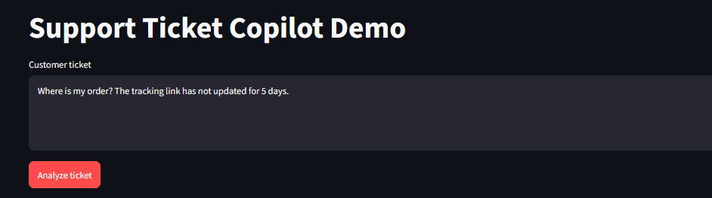
Demo Part 1 — User creates and analyzes a ticket
The agent enters a customer ticket and triggers the analysis.
Part 1
Input
Action
Value
Customer ticket as free-form text.
Click “Analyze ticket”.
No rigid form required.

Slide 7
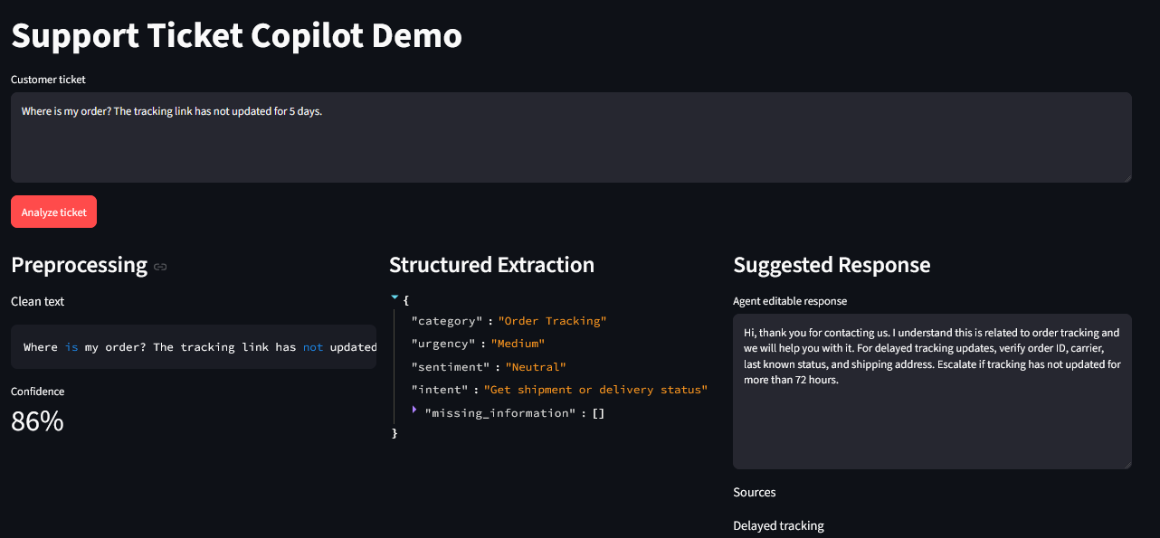
Demo Part 2 — GenAI generates a structured output and response
The AI converts unstructured text into actionable fields and a draft reply.
Part 2
Structured extraction
Suggested response
Confidence
Category, urgency, sentiment, intent and missing information.
Editable draft for the support agent.
Shows when review is needed.

Slide 8
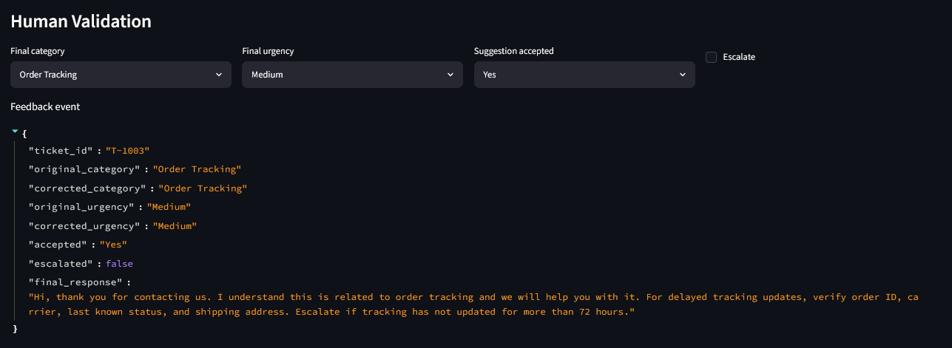
Demo Part 3 — Human validation and feedback loop
The human agent validates, edits or overrides the AI recommendation.
Part 3
Every correction becomes feedback that can improve future suggestions and preserve human expertise.

Slide 9
How GenAI Is Used
The solution demonstrates multiple GenAI capabilities beyond a basic chatbot.
Classification
Extraction
Map tickets to business categories.
Identify urgency, intent, sentiment and missing fields.
Generation
RAG
Draft empathetic and policy-aware responses.
Retrieve approved policy or knowledge base guidance.
Evaluation
Human feedback
Compare output with expected labels and agent feedback.
Capture overrides for continuous improvement.
This is not only response automation — it is decision support for customer operations.

Slide 10
Recommended MVP Architecture and Tools
Fast to build, easy to demo, and realistic enough for implementation.
Streamlit UI
Python + Pandas
Ticket input, CSV upload, editable output
Preprocessing and data handling
OpenAI API
Knowledge Base
Classification, extraction and response generation
CSV / Markdown policies for grounded response guidance
Feedback Store
Export
CSV or SQLite to capture human validation
CSV/JSON result for ticketing systems
Ticket → Preprocessing → GenAI analysis → Knowledge lookup → Suggested response → Human validation → Feedback loop

Slide 11
Success Metrics
What we would measure to prove value after the demo.
AI quality
Operational efficiency
Human oversight
Classification accuracy
Priority accuracy
Response relevance
Escalation detection
Low-confidence detection
Average handling time reduction
Manual triage reduction
Fewer wrong assignments
Faster first response
Higher agent productivity
Human override rate
Approval rate
Feedback volume
Policy compliance
Customer satisfaction trend
Winning metric for the hackathon: reduced handling time while keeping human control.

Slide 12
Smart Ticket Assistant
A GenAI copilot that helps support agents move from messy tickets to clear, prioritized and validated actions.
AI provides
Human provides
Business gains
Speed
Structure
Consistency
Drafting support
Judgment
Empathy
Context
Accountability
Faster responses
Lower workload
Better service quality
The AI accelerates. The human decides. The organization learns.

