Slide 1
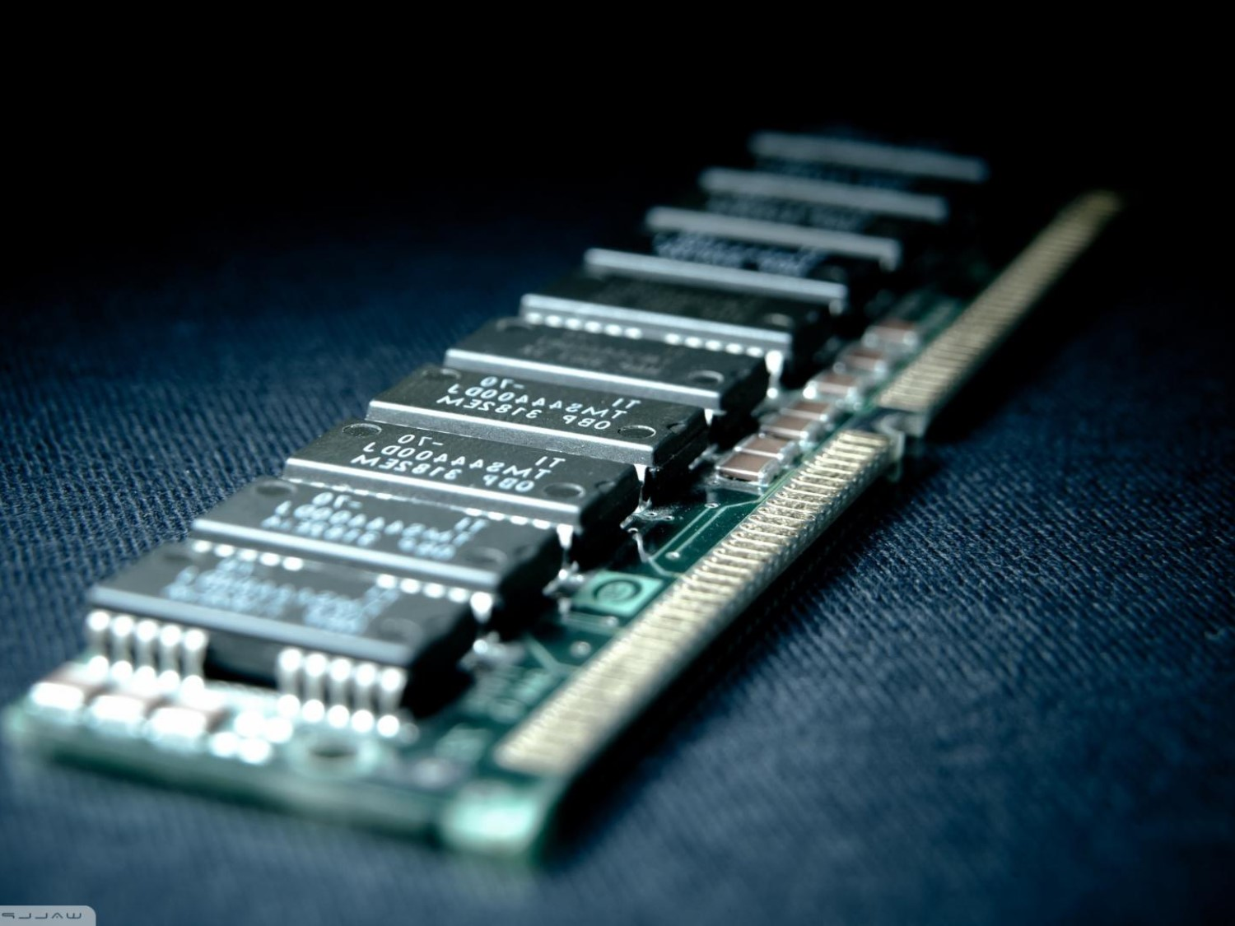

Memory Leaks Detector

Slide 2

Memory Leaks
Daily issues for a developer
It even happens to the best. (chrome, AMD)
Can lead to a crash of the program or Worth.
Many case of memory leaks.

Slide 3


DETECTOR
Locate and Keeps in memory all allocations and deallocation.
Created a file that informs us of memory leaks. (Address, line, function, etc.)

Slide 4

DLL injection
AppInit_DLLs: why i don’t use this.
CreateRemoteThread.

Slide 5
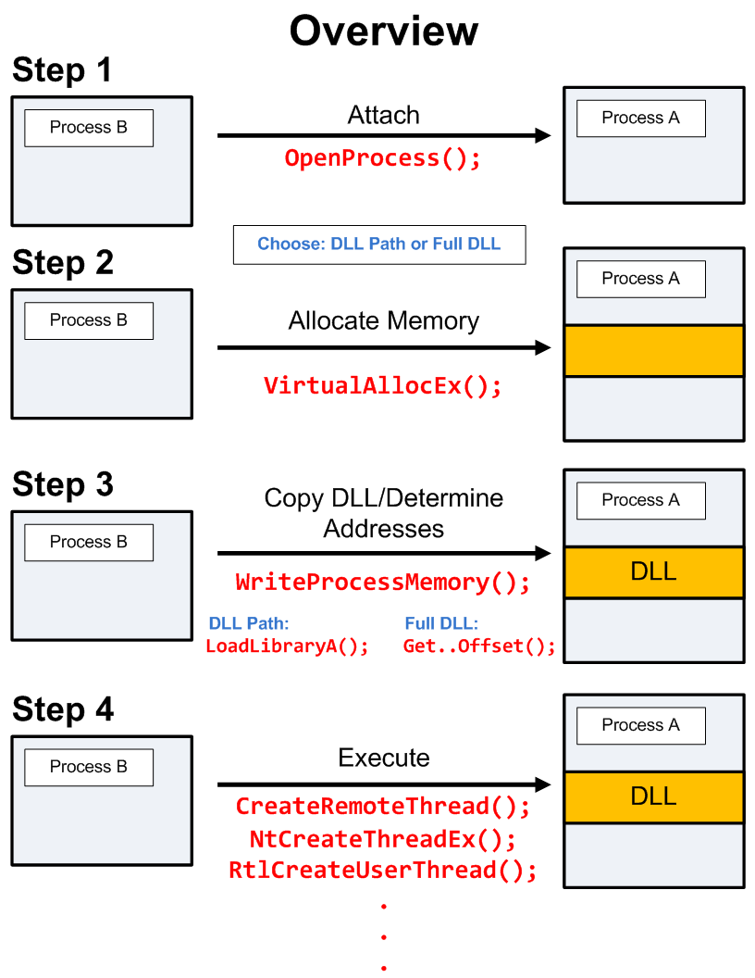
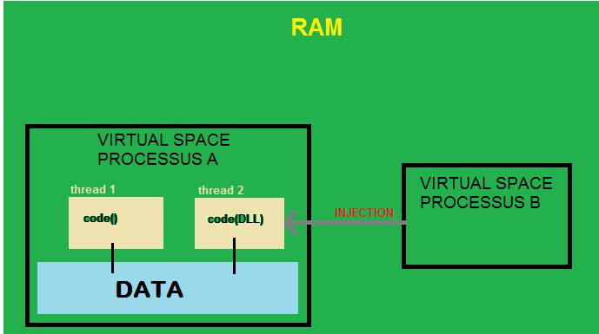
CreateRemoteThread
What the problem?
Open/Create Process
GetProcessAdress of LoadLibrary
VirtualAllocEx
WriteProcessMemory
CreateRemoteThread

Slide 6

Hook
SSDT Hooking: kernel mode
Inline Hooking
IAT hooking

Slide 7
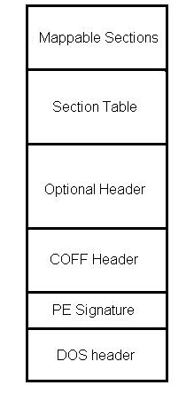
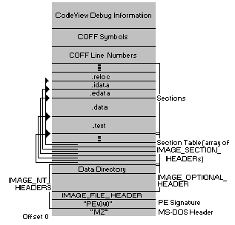
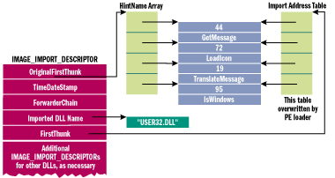
IAT hooking
IMPORT ADRESS TABLE
PE file header

Slide 8
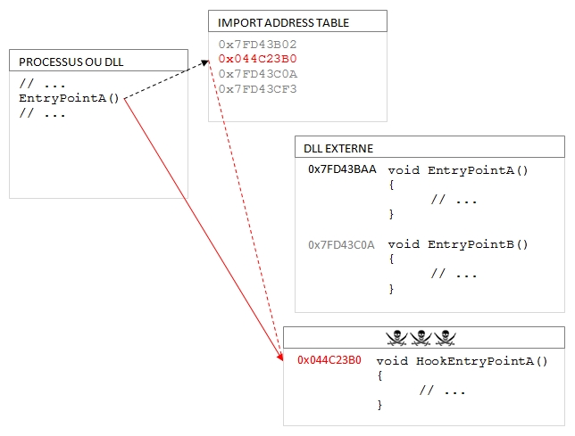
IAT hooking

Slide 9
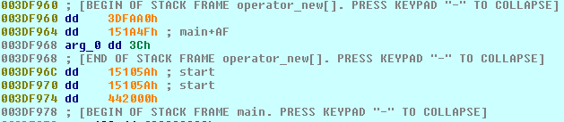
Stack Frame
CaptureStackBackTrace
StackWalker?

Slide 10
Improvements
Release case (stack frame + HeapAlloc)
GUI
Garbage collection.

Slide 11
Demonstation
There is a lot of cases in the target example.

Slide 12
Questions

