Slide 1
5
4
1
w1 | w2 | w3
w1 | w2 | w3
2
3
钟组1加和 钟组2加和 钟组3加和
钟组1加和 钟组2加和 钟组3加和
钟组1加和 钟组2加和 钟组3加和
cov11 | cov12 | cov13
cov21 | cov22 | cov23
cov31 | cov32 | cov33
inv11 | inv12 | inv13
inv21 | inv22 | inv23
inv31 | inv32 | inv33
钟组1加和 钟组2加和 钟组3加和
钟组1加和 钟组2加和 钟组3加和

Slide 2
5
4
1
w1 | w2 | w3
w1 | w2 | w3
2
3
钟组1 钟组2 钟组3
钟组内Cov平均
钟组内Cov加权平均
cov11 | cov12 | cov13
cov21 | cov22 | cov23
cov31 | cov32 | cov33
inv11 | inv12 | inv13
inv21 | inv22 | inv23
inv31 | inv32 | inv33
cov11 | cov12 | cov13
cov21 | cov22 | cov23
cov31 | cov32 | cov33
cov11 | cov12 | cov13
cov21 | cov22 | cov23
cov31 | cov32 | cov33
cov11 | cov12 | cov13
cov21 | cov22 | cov23
cov31 | cov32 | cov33
钟组内Cov加权平均
钟组内Cov平均

Slide 3
5
4
1
w1 | w2
w1 | w2
2
3
钟组间Cov平均
钟组间Cov平均
cov11 | cov12 | cov13 | cov14
cov21 | cov22 | cov23 | cov24
cov31 | cov32 | cov33 | cov34
cov41 | cov42 | cov43 | cov44
cov11 | cov12 | cov13 | cov14
cov21 | cov22 | cov23 | cov24
cov31 | cov32 | cov33 | cov34
cov41 | cov42 | cov43 | cov44
cov11 | cov12 | cov13 | cov14
cov21 | cov22 | cov23 | cov24
cov31 | cov32 | cov33 | cov34
cov41 | cov42 | cov43 | cov44
cov11 | cov12 | cov13 | cov14
cov21 | cov22 | cov23 | cov24
cov31 | cov32 | cov33 | cov34
cov41 | cov42 | cov43 | cov44
钟组间Cov平均
钟组间Cov平均

Slide 4
5
4
w1 | w2 | w3
w1 | w2 | w3
1
2
3
cov11 | cov12 | cov13 | cov14 | cov15
cov21 | cov22 | cov23 | cov24 | cov25
cov31 | cov32 | cov33 | cov34 | cov35
cov41 | cov42 | cov43 | cov44 | cov45
cov51 | cov52 | cov53 | cov54 | cov55
钟组内Cov平均
钟组内Cov加权平均
cov11 | cov12 | cov13
cov21 | cov22 | cov23
cov31 | cov32 | cov33
inv11 | inv12 | inv13
inv21 | inv22 | inv23
inv31 | inv32 | inv33
钟组内Cov加权平均
钟组内Cov平均

Slide 5
预测的样本个数 = (seq length – window size) / window step size – 1
最后一次迭代的预测值不应作为序列的一部分，计算Allan variance
w1 | w2 | w3 | w4 | w5
w1 | w2 | w3
在绿色窗体内计算Allan variance
取tau=1时的variance取倒数
归一化5个序列的variance倒数作为weight
用weight加权绿色窗体中最后一行数据作为对下一时刻的预测
向下滑动窗体，得到(seq length – window size) / window step size – 1个数据点
如何比对两种预测序列的Allan variance？
每次滑动，两者都使用窗体内的点+预测点
待全部滑动完成后，使用两个生成的序列

Slide 6
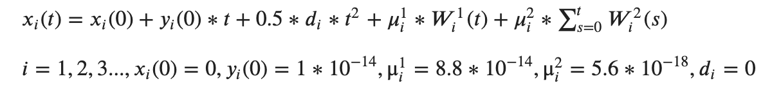
10 ^ (-8) ~ 10 ^ (-14)
10 ^ (-23) ~ 10 ^ (-25)
10 ^ (-31) ~ 10 ^ (-43)
0.9 * 10 ^ (-15) ~ 10 ^ (-15)
-10 ^ (-13) ~ 10 ^ (-13) COS
10 ^ (-16)
10 ^ (-17)
-2.5 * 10 ^ (-15) ~ 2.5 * 10 ^ (-15) SIN

Slide 7
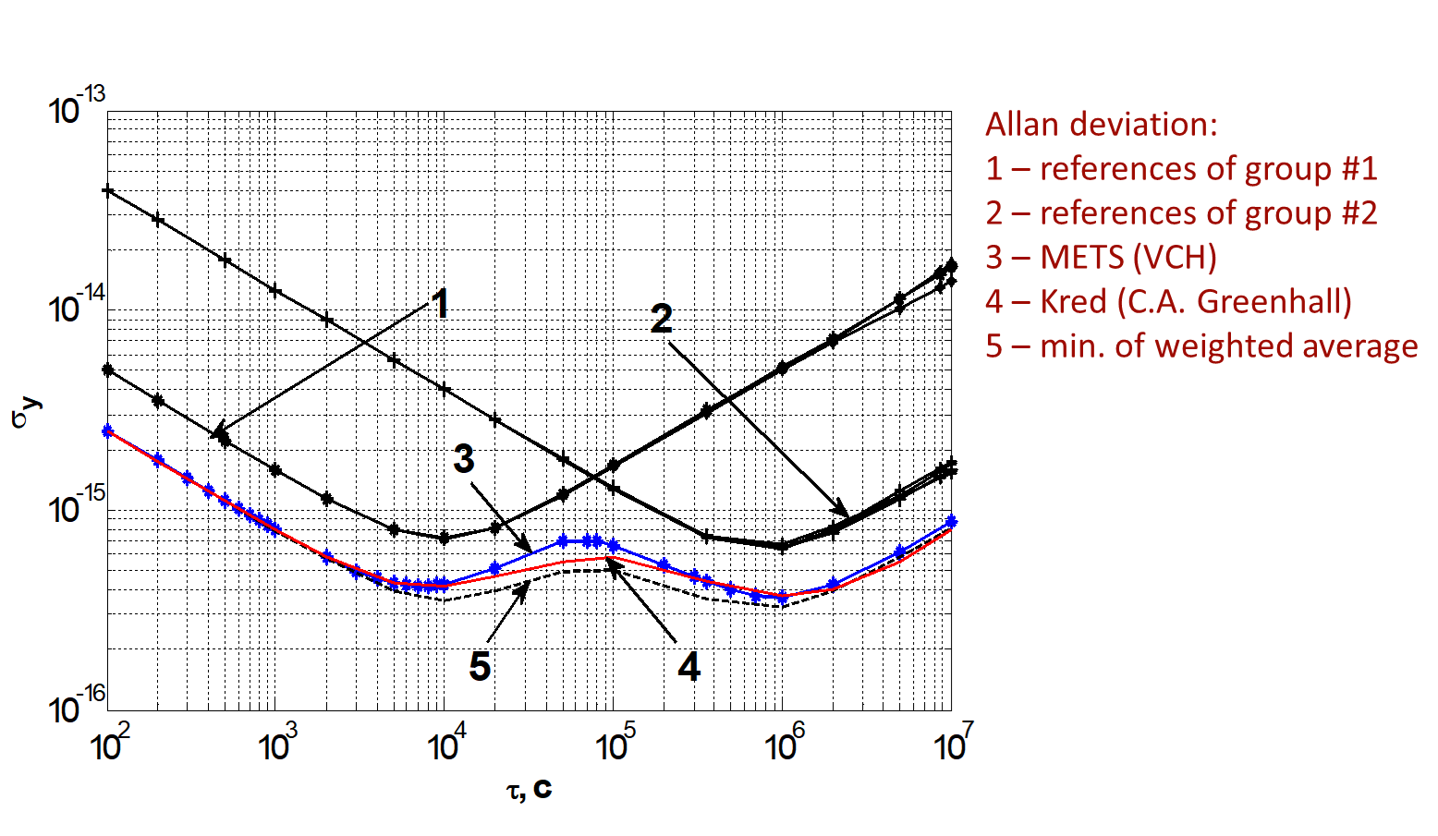
Correlated clocks Un-correlated clocks
Correlated clocks Un-correlated clocks
group_2 - ref_2
- ref_1 + group_1
Calculate Correlation

