Slide 1


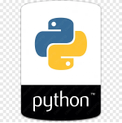
Python Programming
A High-Level, Versatile Language for the Modern Web and AI

Slide 2

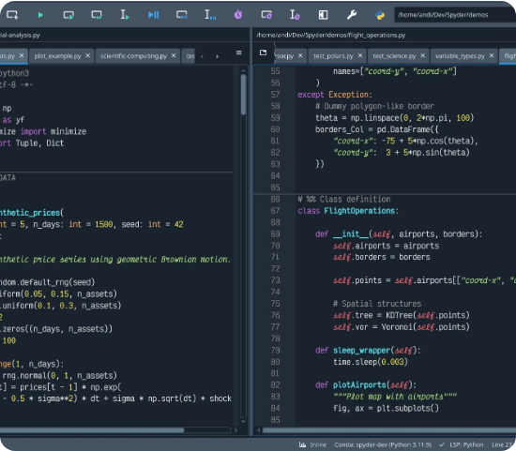
Overview & Key Features
Readability & Simplicity: Emphasizes clean syntax using whitespace indentation, making code easier to read and maintain.
Interpreted Language: Executes code line by line, which facilitates rapid prototyping and easier debugging.
Multi-Paradigm: Supports object-oriented, procedural, and functional programming styles.
Extensive Library: Boasts a vast standard library and active open-source community support.
Cross-Platform: Runs seamlessly on Windows, macOS, and Linux without modification.

Slide 3
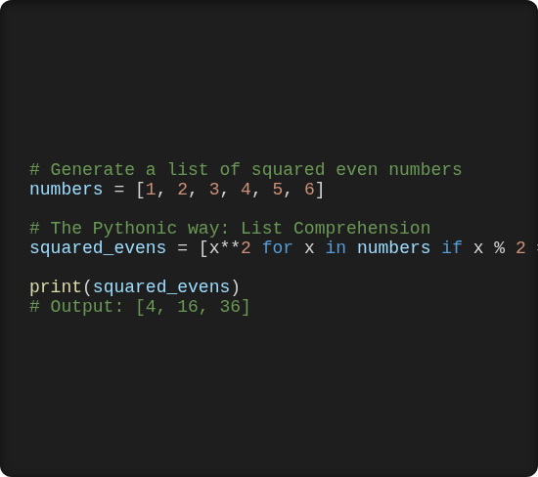
Syntax in Action: List Comprehension
Elegant and Concise
Python allows developers to express complex operations in fewer lines of code compared to other languages.
This snippet demonstrates list comprehension, a powerful feature to create lists based on existing lists in a highly readable format. It efficiently filters even numbers and squares them in a single, expressive line.

Slide 4
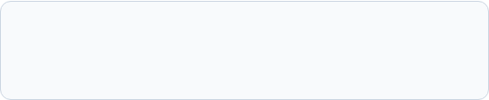

The Math Module: Built-in Capabilities
Python provides a robust math module for complex mathematical operations without needing external libraries.
Example: Calculating the area of a circle using the formula:
Functions: Includes sqrt(), log(), ceil(), and trigonometric functions.
Constants: Provides access to fundamental constants like π (pi) and e (Euler's number).

Slide 5










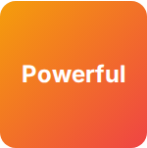
Primary Use Cases
Web Dev
AI & Data
Automation
Robust backend frameworks like Django and Flask power scalable web applications and APIs.
The leading language for Data Science and Machine Learning, utilizing Pandas, TensorFlow, and PyTorch.
Ideal for writing scripts to automate repetitive system tasks, web scraping, and testing workflows.
Scalable

Slide 6


Image Sources
https://banner2.cleanpng.com/20180402/jkq/avhep1sgp.webp
Source: www.cleanpng.com
https://docs.spyder-ide.org/current/_images/editor-standard.webp
Source: docs.spyder-ide.org

