Slide 1

Introduction to Digital Design
Week 2: Number System
Yao Zheng
Assistant Professor
University of Hawaiʻi at Mānoa
Department of Electrical Engineering

Slide 2
Overview
Common number systems
  Common number systems include: Decimal, Binary, Octal, Hexadecimal.
Base conversion
  For convenience, people use other bases (like decimal, hexadecimal) and we need to know how to convert from one to another.
Arithmetic
  How to add, subtract, multiply, etc.
Negative numbers
  There are more than one way to express a number in binary. So 1010 could be -2, -5 or -6 and need to know which one.
Notes:
Overview: four topics
Examples for number systems, introduce base
the radix or base is the numberof unique digits, including the digit zero, used to represent numbers
Base conversion, how to change base
Arithmetic
Three type of negative numbers

Slide 3
Common Number Systems
System | Base | Symbols | Used by humans? | Used in computers?
Decimal | 10 | 0, 1, … 9 | Yes | No
Binary | 2 | 0, 1 | No | Yes
Octal | 8 | 0, 1, … 7 | No | No
Hexa- decimal | 16 | 0, 1, … 9, A, B, … F | No | No
Notes:
Four common base/redix
Why octal hexadecimal: compact representation of binary (groups)

Slide 4
Quantities/Counting (1 of 3)
Decimal | Binary | Octal | Hexa- decimal
0 | 0 | 0 | 0
1 | 1 | 1 | 1
2 | 10 | 2 | 2
3 | 11 | 3 | 3
4 | 100 | 4 | 4
5 | 101 | 5 | 5
6 | 110 | 6 | 6
7 | 111 | 7 | 7
Notes:
Count and see the difference
Note difference after 2 for binary only 2 symbols, need to raise the number of symbol

Slide 5
Quantities/Counting (2 of 3)
Decimal | Binary | Octal | Hexa- decimal
8 | 1000 | 10 | 8
9 | 1001 | 11 | 9
10 | 1010 | 12 | A
11 | 1011 | 13 | B
12 | 1100 | 14 | C
13 | 1101 | 15 | D
14 | 1110 | 16 | E
15 | 1111 | 17 | F
Notes:
7 for octal
And 9 for decimal

Slide 6
Quantities/Counting (3 of 3)
Decimal | Binary | Octal | Hexa- decimal
16 | 10000 | 20 | 10
17 | 10001 | 21 | 11
18 | 10010 | 22 | 12
19 | 10011 | 23 | 13
20 | 10100 | 24 | 14
21 | 10101 | 25 | 15
22 | 10110 | 26 | 16
23 | 10111 | 27 | 17
Etc.
Notes:
15 for hexadecimal

Slide 7
Oct Example: Linux Permissions
Linux default permissions
  File (7), directory (6).
  Each bit in the octal umasks “takes away” a permission.
Octal umask values
  0 : read, write and execute
  1 : read and write
  2 : read and execute
  3 : read only
  4 : write and execute
  5 : write only
  6 : execute only
  7 : no permissions
Octal | Perms
0 | rwx
1 | rw-
2 | r-x
3 | r--
4 | -wx
5 | -w-
6 | --x
7 | ---
Notes:
File permission is 111
uMask of 000 does not take away any thing gives 111 = rwx
Explain the rest
Directory permission is 110
Note each mask has a unique combination
example

Slide 8
Base Sixteen: Another Base Used by Designers
8
A
F
Nice because each position represents four base-two positions
  Compact way to write binary numbers
Known as hexadecimal, or just hex
16
4
16
3
16
2
16
1
16
0
8
A
F
1000
1010
1111
h
e
x
bina
r
y
h
e
x
bina
r
y
0
0000
8
1000
1
0001
9
1001
Q: Write 11110000 in hex
2
0010
A
1010
3
0011
B
1011
4
0100
C
1100
F
0
5
0101
D
1101
a
6
0110
E
1110
Q: Convert hex A01 to binary
7
0111
F
1111
a
1010
0000
0001
Notes:
Hex
Easy conversion to binary
4 to 1

Slide 9
Hex Example: RFID Tag
Batteryless tag powered by radio field
  Transmits unique identification number
  Example: 32 bit id
    8-bit province number, 8-bit country number, 16-bit animal number
    Tag contents are in binary
    But programmers use hex when writing/reading
(b)
Pr
o
vince #
City #
Animal #
(c)
Pr
o
vince
:
7
City
:
160
Animal
:
513
(a)
(d)
00000111
10100000
00000010 00000001
(e)
07
A0
02 01
RFID
tag
(f)
Tag ID in hex: 07A00201
Notes:
Explain RFID tag
example
Where have you seen this before?

Slide 10
Conversion Among Bases
The possibilities:
Decimal
Octal
Binary
Hexadecimal
Notes:
Can convert from any number system to any other number system
But decimal and binary are special, some time use as intermieidate

Slide 11
Quick Example
25₁₀ = 11001₂ = 31₈ = 19₁₆
Base
Notes:
Explain why they are equal

Slide 12
Decimal to Decimal (just for fun)
Decimal
Octal
Binary
Hexadecimal
Notes:
First grade stuff

Slide 13
Weight
125₁₀ => 5 x 10⁰ = 5
2 x 10¹ = 20
1 x 10² = 100
125
Base
Notes:
Explain the weight
Positional number, weight is the position

Slide 14
Binary to Decimal
Decimal
Octal
Binary
Hexadecimal

Slide 15
Binary to Decimal
Technique
  Multiply each bit by 2^{n}, where n is the “weight” of the bit
  The weight is the position of the bit, starting from 0 on the right
  Add the results

Slide 16
Technique Explained
Just add weights
  1₂ is just 1*2⁰, or 1₁₀.
  110₂ is 1*2² + 1*2¹ + 0*2⁰, or 6₁₀. We might think of this using base ten weights: 1*4 + 1*2 + 0*1, or 6.
  10000₂ is 1*16 + 0*8 + 0*4 + 0*2 + 0*1, or 16₁₀.
  10000111₂ is 1*128 + 1*4 + 1*2 + 1*1 = 135₁₀. Notice this time that we didn’t bother to write the weights having a 0 bit.
  00110₂ is the same as 110₂ above — the leading 0’s don’t change the value.
a
2
9
2
8
2
7
2
6
2
5
2
4
2
3
2
2
2
1
2
0
Useful to know powers of 2:
512
256
128
64
32
16
8
4
2
1
a
Practice counting up by powers of 2:
512
256
128
64
32
16
8
4
2
1

Slide 17
Example
Bit “0”
101011₂ => 1 x 2⁰ = 1
1 x 2¹ = 2
0 x 2² = 0
1 x 2³ = 8
0 x 2⁴ = 0
1 x 2⁵ = 32
43₁₀
Notes:
example

Slide 18
Octal to Decimal
Decimal
Octal
Binary
Hexadecimal

Slide 19
Octal to Decimal
Technique
  Multiply each bit by 8^{n}, where n is the “weight” of the bit
  The weight is the position of the bit, starting from 0 on the right
  Add the results
Notes:
Same method except the base is different

Slide 20
Example
724₈ => 4 x 8⁰ = 4
2 x 8¹ = 16
7 x 8² = 448
468₁₀

Slide 21
Hexadecimal to Decimal
Decimal
Octal
Binary
Hexadecimal
Notes:
Hex to decimal

Slide 22
Hexadecimal to Decimal
Technique
  Multiply each bit by 16^{n}, where n is the “weight” of the bit
  The weight is the position of the bit, starting from 0 on the right
  Add the results

Slide 23
Example
ABC₁₆ => C x 16⁰ = 12 x 1 = 12
B x 16¹ = 11 x 16 = 176
A x 16² = 10 x 256 = 2560
2748₁₀

Slide 24
Decimal to Binary
Decimal
Octal
Binary
Hexadecimal
Notes:
Two ways to do that

Slide 25
Using Sum
Desired decimal
Current
Binary
Put 1 in leftmost place without sum exceeding number
Track sum
number:
12
sum
number
16 > 12, too big;
0
(a)
0
16
Put 0 in 16’s place
8
4
2
1
8 <= 12, so put
0
1
(b)
1 in 8’s place,
8
8
current sum is 8
16
4
2
1
8+4=12 <= 12, so put
0
1
1
a
(c)
1 in 4’s place,
12
current sum is 12
16
8
4
2
1
Reached desired 12,
0
1
1
0
0
(d)
so put 0s in remaining
done
places
16
8
4
2
1
Notes:
Nature way, compare and find the largest power of 2 that is smaller than the number, subtract, and repeat

Slide 26
Using Sum
Example using a more compact notation
Desired decimal
Binary
number:
23
number
1
0
1
1
1
sum:
0
16
8
4
2
1
16
(a)
16
(b)
20
a
(c)
22
(d)
23
(e)
Notes:
Compact notion

Slide 27
Using Long Division
Technique
  Divide by two, keep track of the remainder
  First remainder is bit 0 (LSB, least-significant bit)
  Second remainder is bit 1
  Etc.
Notes:
Every time divide by 2
explain with formula an*2^n a(n-1)*2^n-1 + …

Slide 28
Example
125₁₀ = ?₂
2 125
62 1
2
31 0
2
15 1
2
7 1
2
3 1
2
1 1
2
0 1
125₁₀ = 1111101₂

Slide 29
Example: DIP-Switch Controlled Channel
Ceiling fan receiver should be set in factory to respond to channel “73”
Convert 73 to binary, set DIP switch accordingly
Desired value: 73
a
Q:
0
1
0
0
1
0
0
1
(a)
128
64
32
16
8
4
2
1
(b)
sum:
64
72
73
DIP switch
1
channel receiver
0
"34"
0
0
1
0
0
0
1
0
"73"
0
1
0
0
1
0
0
1
InA
if (InA = InB)
InB
Out = 1
else
Ceiling fan
Out = 0
module
Out
(c)
0
Notes:
Comparatoexampler: how to implement it

Slide 30
Octal to Binary
Decimal
Octal
Binary
Hexadecimal

Slide 31
Octal to Binary
Technique
  Convert each octal digit to a 3-bit equivalent binary representation

Slide 32
Example
705₈ = ?₂
7 0 5
111 000 101
705₈ = 111000101₂
Notes:
Use binary as intermediate

Slide 33
Hexadecimal to Binary
Decimal
Octal
Binary
Hexadecimal

Slide 34
Hexadecimal to Binary
Technique
  Convert each hexadecimal digit to a 4-bit equivalent binary representation

Slide 35
Example
10AF₁₆ = ?₂
1 0 A F
0001 0000 1010 1111
10AF₁₆ = 0001000010101111₂

Slide 36
Decimal to Octal
Decimal
Octal
Binary
Hexadecimal
Notes:
Question how to do that

Slide 37
Decimal to Octal
Technique
  Divide by 8
  Keep track of the remainder
Notes:
Long division with base difference

Slide 38
Example
1234₁₀ = ?₈
8 1234
154 2
8
19 2
8
2 3
8
0 2
1234₁₀ = 2322₈

Slide 39
Decimal to Hexadecimal
Decimal
Octal
Binary
Hexadecimal

Slide 40
Decimal to Hexadecimal
Technique
  Divide by 16
  Keep track of the remainder

Slide 41
Example
1234₁₀ = ?₁₆
16 1234
77 2
16
4 13 = D
16
0 4
1234₁₀ = 4D2₁₆

Slide 42
Decimal to Hexadecimal
Easy method: convert to binary first, then binary to hex
Convert 99 base 10 to hex
First convert to binary:
0
1
1
0
0
0
1
1
128
64
32
16
8
4
2
1
Then binary to hex:
6
3
(Quick check: 6*16 + 3*1 = 96+3 = 99)
Notes:
Another way to do that

Slide 43
Binary to Octal
Decimal
Octal
Binary
Hexadecimal

Slide 44
Binary to Octal
Technique
  Group bits in threes, starting on right
  Convert to octal digits

Slide 45
Example
1011010111₂ = ?₈
1 011 010 111
1 3 2 7
1011010111₂ = 1327₈
Notes:
Group

Slide 46
Binary to Hexadecimal
Decimal
Octal
Binary
Hexadecimal

Slide 47
Binary to Hexadecimal
Technique
  Group bits in fours, starting on right
  Convert to hexadecimal digits

Slide 48
Example
1010111011₂ = ?₁₆
10 1011 1011
B B
1010111011₂ = 2BB₁₆

Slide 49
Octal to Hexadecimal
Decimal
Octal
Binary
Hexadecimal
Notes:
Question how to do that

Slide 50
Octal to Hexadecimal
Technique
  Use binary as an intermediary

Slide 51
Example
1076₈ = ?₁₆
1 0 7 6
001 000 111 110
2 3 E
1076₈ = 23E₁₆

Slide 52
Hexadecimal to Octal
Decimal
Octal
Binary
Hexadecimal

Slide 53
Hexadecimal to Octal
Technique
  Use binary as an intermediary

Slide 54
Example
1F0C₁₆ = ?₈
1 F 0 C
0001 1111 0000 1100
1 7 4 1 4
1F0C₁₆ = 17414₈

Slide 55
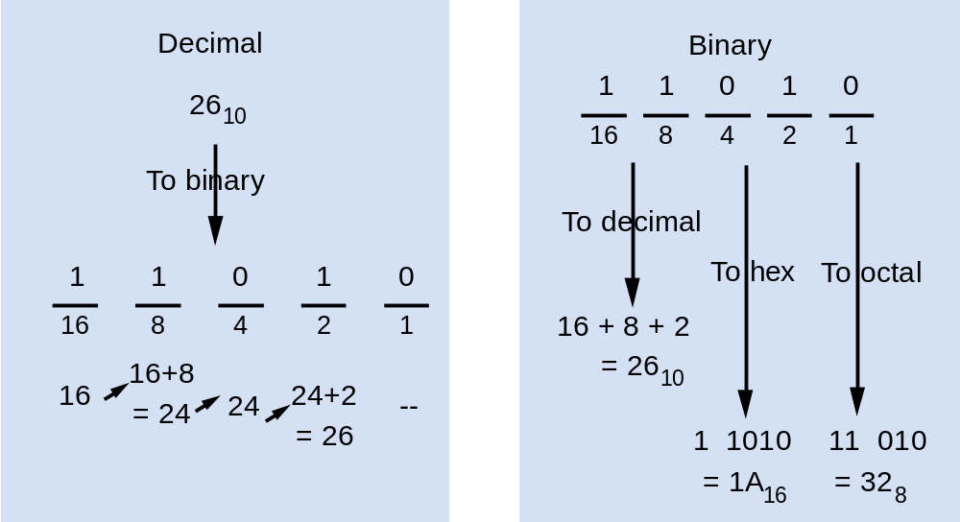
Converting To/From Binary by Hand: Summary

Slide 56
Example Video: Convert from Hex to Binary
Video link.
Notes:
Why said Byte is 8 bits

Slide 57
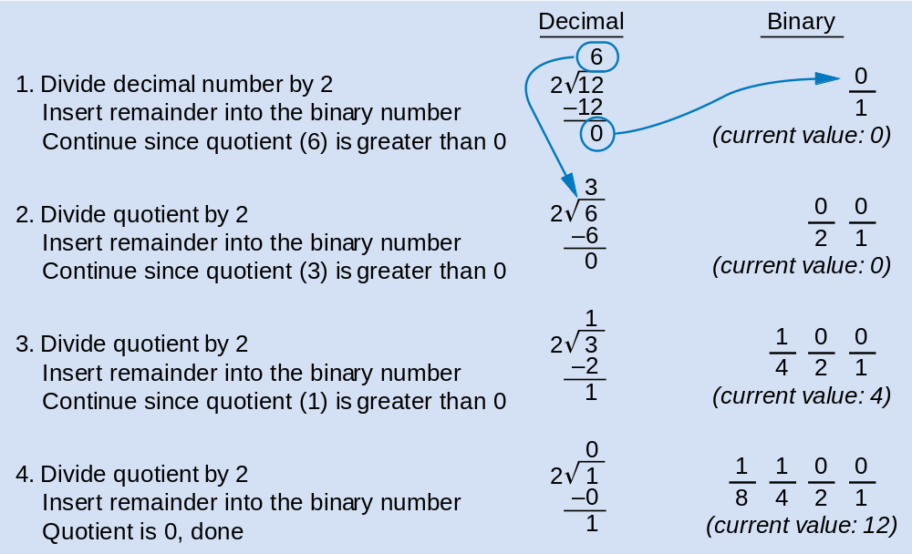
Divide-By-2 Method Common in Automatic Conversion
Repeatedly divide decimal number by 2, place remainder in current binary digit (starting from 1s column)
Note: Works for any base N—just divide by N instead

Slide 58
Example Video: Convert from Decimal to Binary
Video link.
Notes:
Why said Byte is 8 bits

Slide 59
Exercise – Convert ...
Decimal | Binary | Octal | Hexa- decimal
33
 | 1110101
 |  | 703
 |  |  | 1AF
Don’t use a calculator!

Slide 60
Exercise – Convert …
Decimal | Binary | Octal | Hexa- decimal
33 | 100001 | 41 | 21
117 | 1110101 | 165 | 75
451 | 111000011 | 703 | 1C3
431 | 110101111 | 657 | 1AF

Slide 61
Common Powers (1 of 2)
Base 10
Power | Preface | Symbol
10⁻¹² | pico | p
10⁻⁹ | nano | n
10⁻⁶ | micro | μ
10⁻³ | milli | m
10³ | kilo | k
10⁶ | mega | M
10⁹ | giga | G
10¹² | tera | T
Value
.000000000001
.000000001
.000001
.001
1000
1000000
1000000000
1000000000000

Slide 62
Common Powers (2 of 2)
Base 2
Power | Preface | Symbol
2¹⁰ | kilo | k
2²⁰ | mega | M
2³⁰ | Giga | G
Value
1024
1048576
1073741824
What is the value of “k”, “M”, and “G”?
In computing, particularly w.r.t. memory,
the base-2 interpretation generally applies

Slide 63
Review – multiplying powers
For common bases, add powers
a^{b} × a^{c} = a^{b+c}
2⁶ × 2¹⁰ = 2¹⁶ = 65,536
or…
2⁶ × 2¹⁰ = 64 × 2¹⁰ = 64k

Slide 64
Binary Addition (1 of 2)
Two 1-bit values
A | B | A + B
0 | 0 | 0
0 | 1 | 1
1 | 0 | 1
1 | 1 | 10
“two”

Slide 65
Binary Addition (2 of 2)
Two n-bit values
  Add individual bits
  Propagate carries
  E.g.,
1
1
10101 21
+ 11001 + 25
101110 46

Slide 66
Multiplication (1 of 3)
Decimal (just for fun)
35
x 105
175
000
35
3675

Slide 67
Multiplication (2 of 3)
Binary, two 1-bit values
A | B | A × B
0 | 0 | 0
0 | 1 | 0
1 | 0 | 0
1 | 1 | 1

Slide 68
Multiplication (3 of 3)
Binary, two n-bit values
  As with decimal values
  E.g.,
1110
x 1011
1110
1110
0000
1110
10011010

Slide 69
Fractions
Decimal to decimal (just for fun)
3.14 => 4 x 10⁻² = 0.04
1 x 10⁻¹ = 0.1
3 x 10⁰ = 3
3.14

Slide 70
Fractions
Binary to decimal
10.1011 => 1 x 2⁻⁴ = 0.0625
1 x 2⁻³ = 0.125
0 x 2⁻² = 0.0
1 x 2⁻¹ = 0.5
0 x 2⁰ = 0.0
1 x 2¹ = 2.0
2.6875

Slide 71
Fractions
Decimal to binary
.14579
x 2
0.29158
x 2
0.58316
x 2
1.16632
x 2
0.33264
x 2
0.66528
x 2
1.33056
etc.
3.14579
11.001001...

Slide 72
Exercise – Convert ...
Decimal | Binary | Octal | Hexa- decimal
29.8
 | 101.1101
 |  | 3.07
 |  |  | C.82
Don’t use a calculator!

Slide 73
Exercise – Convert …
Decimal | Binary | Octal | Hexa- decimal
29.8 | 11101.110011… | 35.63… | 1D.CC…
5.8125 | 101.1101 | 5.64 | 5.D
3.109375 | 11.000111 | 3.07 | 3.1C
12.5078125 | 1100.10000010 | 14.404 | C.82

Slide 74
Negative Numbers
How do we write negative binary numbers?
Historically: 3 approaches
  Sign-and-magnitude
  Ones-complement
  Twos-complement
For all 3, the most-significant bit (MSB) is the sign digit
  0 ≡ positive
  1 ≡ negative
twos-complement is the important one
  Simplifies arithmetic
  Used almost universally

Slide 75
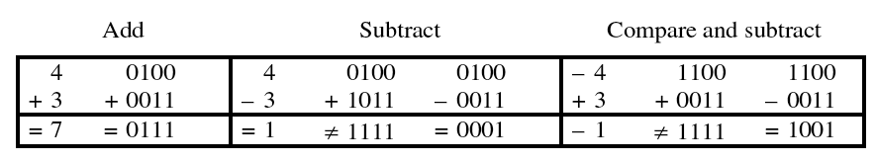
Sign-and-magnitude
The most-significant bit (MSB) is the sign digit
  0 ≡ positive
  1 ≡ negative
The remaining bits are the number’s magnitude
Problem 1: Two representations for zero
  0 = 0000 and also –0 = 1000
Problem 2: Arithmetic is cumbersome

Slide 76
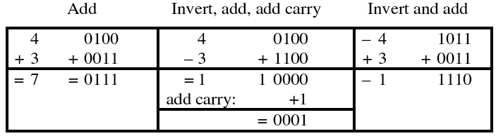
Ones-complement
Negative number: Bitwise complement positive number
  0011 ≡ 3₁₀
  1100 ≡ –3₁₀
Solves the arithmetic problem
Remaining problem: Two representations for zero
  0 = 0000 and also –0 = 1111

Slide 77
Twos-complement
Negative number: Bitwise complement plus one
  0011 ≡ 3₁₀
  1101 ≡ –3₁₀
Number wheel
– 1
0
– 2
1111
0000
+ 1
– 3
1110
0001
+ 2
◆ Only one zero!
◆ MSB is the sign digit
■ 0 ≡ positive
■ 1 ≡ negative
1101
0010
– 4
1100
0011
+ 3
– 5
1011
0100
+ 4
1010
0101
– 6
1001
0110
+ 5
– 7
1000
0111
+ 6
– 8
+ 7

Slide 78
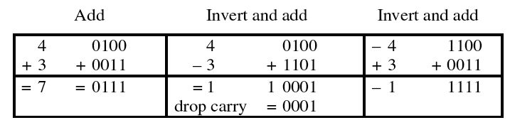
Twos-complement (con’t)
Complementing a complement  the original number
Arithmetic is easy
  Subtraction = negation and addition
    Easy to implement in hardware

Slide 79
Miscellaneous
Twos-complement of non-integers
  1.6875₁₀ = 01.1011₂
  –1.6875₁₀ = 10.0101₂
Sign extension
  Write +6 and –6 as twos complement
    0110 and 1010
  Sign extend to 8-bit bytes
    00000110 and 11111010
Can’t infer a representation from a number
  11001 is 25 (unsigned)
  11001 is –9 (sign magnitude)
  11001 is –6 (ones complement)
  11001 is –7 (twos complement)

Slide 80
Twos-complement overflow
Summing two positive numbers gives a negative result
Summing two negative numbers gives a positive result
Make sure to have enough bits to handle overflow
– 1
0
– 1
0
– 2
1111
0000
+ 1
– 2
1111
0000
+ 1
– 3
1110
0001
+ 2
– 3
1110
0001
+ 2
1101
0010
1101
0010
– 4
1100
0011
+ 3
– 4
1100
0011
+ 3
– 5
1011
0100
+ 4
– 5
1011
0100
+ 4
1010
0101
1010
0101
– 6
1001
0110
+ 5
– 6
1001
0110
+ 5
– 7
1000
0111
+ 6
– 7
1000
0111
+ 6
– 8
+ 7
– 8
+ 7
6 + 4 ⇒ –6
–7 – 3 ⇒ +6

Slide 81
Gray and BCD codes
Decimal
Symbols
0
1
2
3
4
5
6
7
8
9
Gray
Code
0000
0001
0011
0010
0110
0111
0101
0100
1100
1101
Decimal
Symbols
0
1
2
3
4
5
6
7
8
9
BCD
Code
0000
0001
0010
0011
0100
0101
0110
0111
1000
1001

Slide 82
Summary
Common number systems
  Common number systems include: Decimal, Binary, Octal, Hexadecimal
Base conversion
  For convenience, people use other bases (like decimal, hexdecimal) and we need to know how to convert from one to another.
Arithmatics
  How to add, subtract, multiply, etc.
Negative numbers
  There are more than one way to express a number in binary. So 1010 could be -2, -5 or -6 and need to know which one.

