Slide 1
CCNA 1 v3.1 Module 1
Introduction to Networking

Slide 2
Purpose of This PowerPoint
This PowerPoint primarily consists of the Target Indicators (TIs) of this module in CCNA version 3.1.
It was created to give instructors a PowerPoint to take and modify as their own.
This PowerPoint is:
  NOT a study guide for the module final assessment.
  NOT a study guide for the CCNA certification exam.
Please report any mistakes you find in this PowerPoint by using the Academy Connection Help link.

Slide 3
To Locate Instructional Resource Materials on Academy Connection:
Go to the Community FTP Center to locate materials created by the instructor community
Go to the Tools section
Go to the Alpha Preview section
Go to the Community link under Resources
See the resources available on the Class home page for classes you are offering
Search http://www.cisco.com
Contact your parent academy!

Slide 4
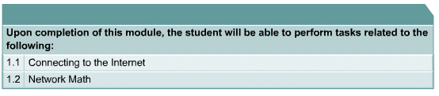
Objectives

Slide 5

Requirements for Internet Connection

Slide 6
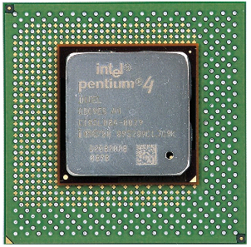
PC Basics

Slide 7
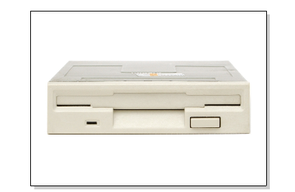
PC Basics

Slide 8
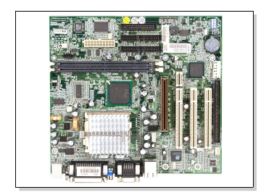
PC Basics

Slide 9
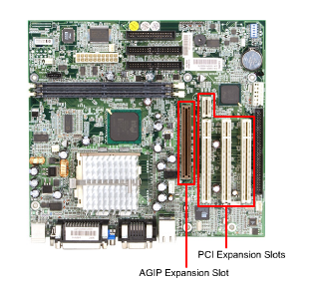
PC Basics
PCI Expansion Slots
AGP Expansion Slot

Slide 10
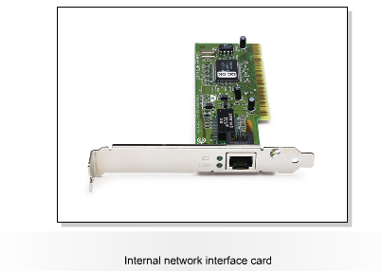
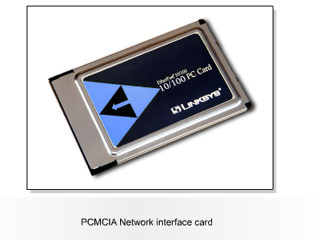
Network Interface Cards

Slide 11
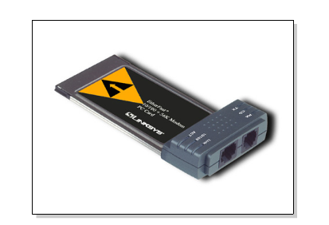
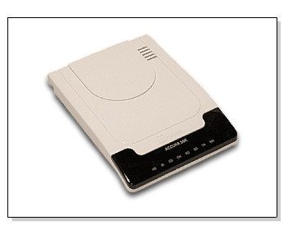
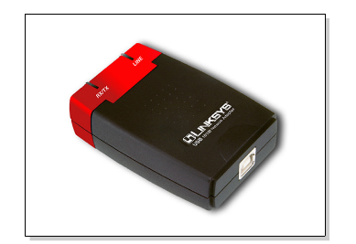
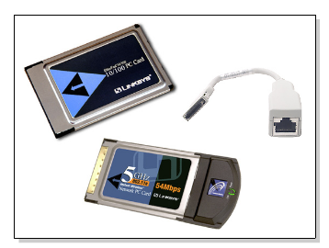
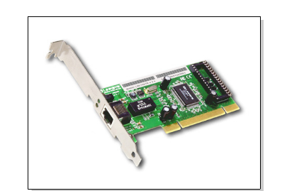
NIC and Modem Installation

Slide 12
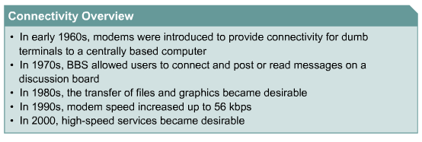
High-Speed and Dialup Connectivity

Slide 13

TCP/IP Description and Configuration

Slide 14
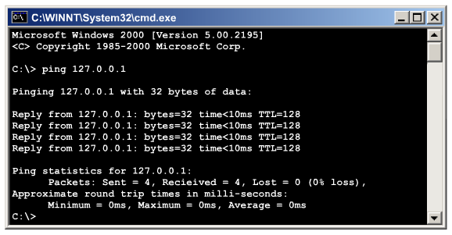
Testing Connectivity with Ping

Slide 15
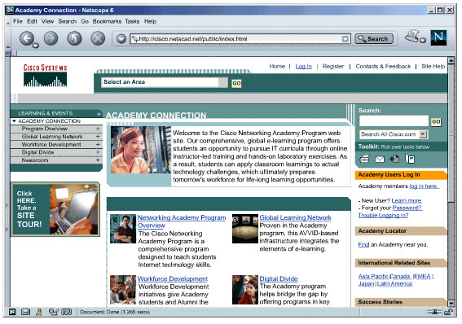
Web Browser and Plug-Ins

Slide 16
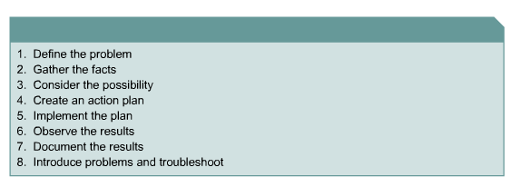
Troubleshooting Internet Connections

Slide 17
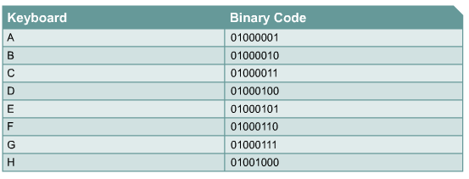
Binary Number System

Slide 18
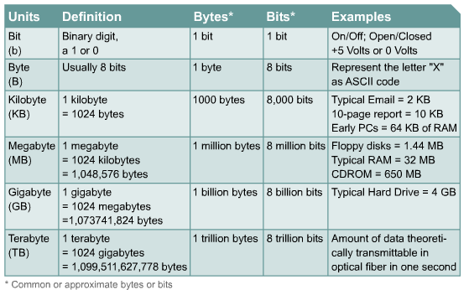
Bits and Bytes

Slide 19
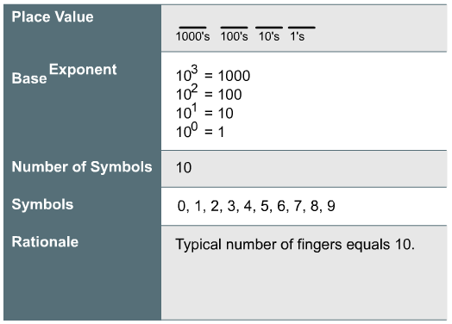
Base 10 Numbers

Slide 20
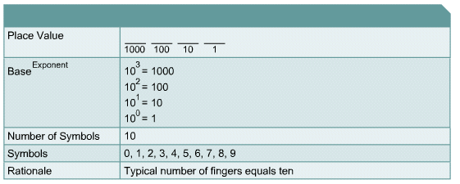
Base 2 (Binary) Numbers

Slide 21
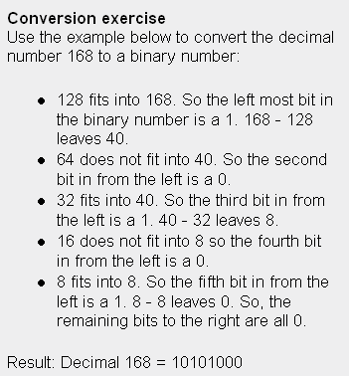
Converting Decimal numbers to 8-bit Binary Numbers

Slide 22
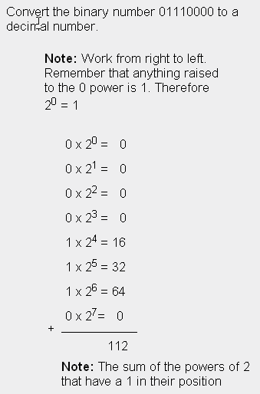
Converting 8-bit Binary Numbers to Decimal Numbers

Slide 23
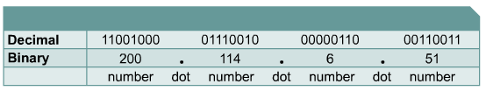
Four-Octet Dotted-decimal Representation of 32-Bit Binary Numbers

Slide 24
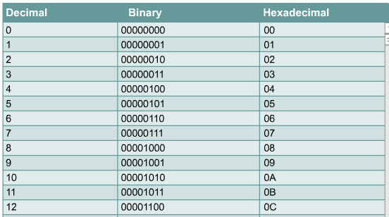
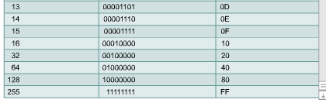
Hexadecimal

Slide 25
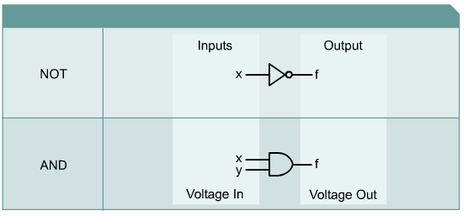
Boolean or Binary Logic

Slide 26
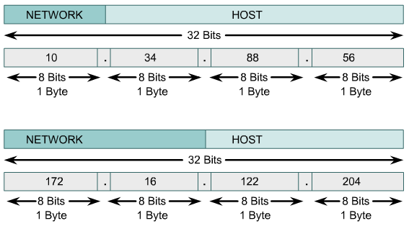
IP Addresses and Network Masks

Slide 27
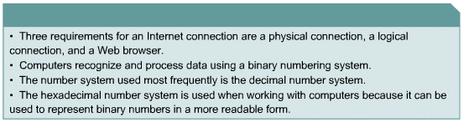
Summary

