Slide 1



Slide 2
Current Functionality
List of all available books on the library
  Regardless of availability (but status will be displayed)
Users to borrow and return books
  Borrow:
    Inputs: username & reasons for borrowing
    Flags the book as unavailable
  Return:
    Input: username
    Flags the book as available

Slide 3
Future Functionality
Automatically determine username of user
Users as admin
Waiting list
Notifications for:
  Due date reminders
  Availability of books on waiting list

Slide 4
Technologies Used
Angular JS
Flask
Python
SQLite
Brackets (Editor)
Github

Slide 5
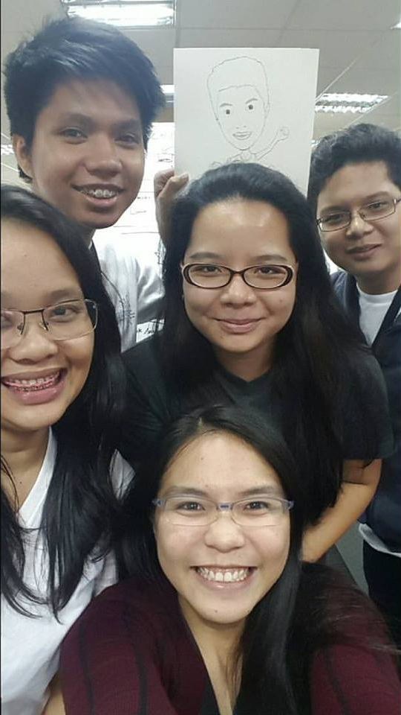
Thank you! ☺

