Slide 1
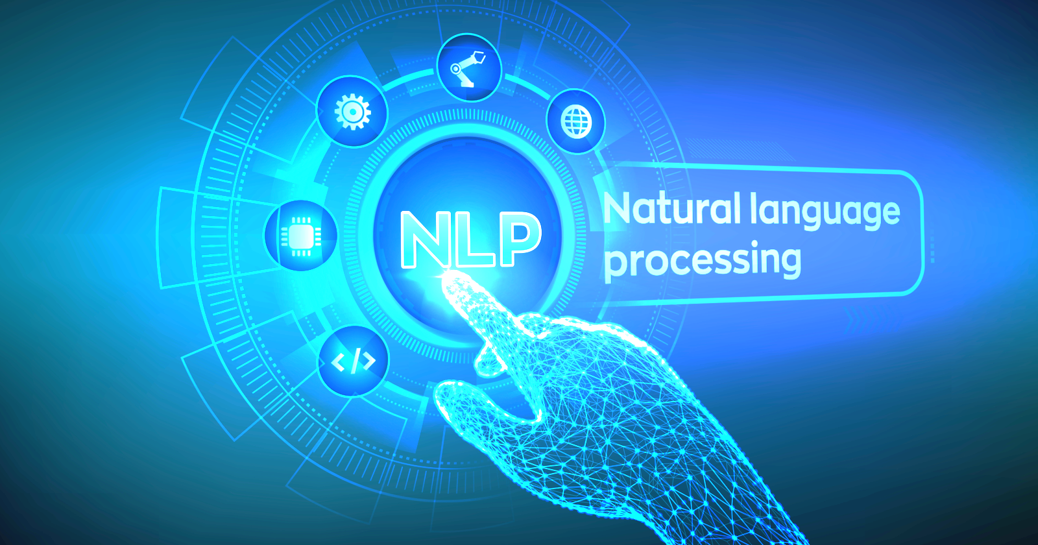
Team member:
Wimonrat, Kritika, Prithvi,Chahat, Sahil Narang

Slide 2
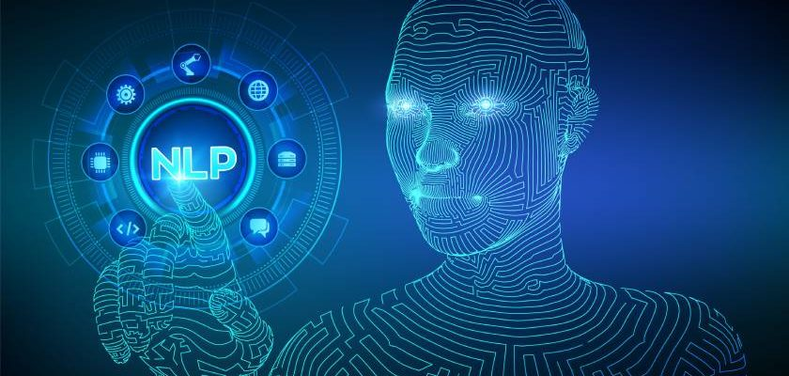
Agenda
What’s NLP (Definition) and Why is NLP important?
How does NLP work?
NLP in today’s world/ real life
NLP methods and application
The future of NLP

Slide 3
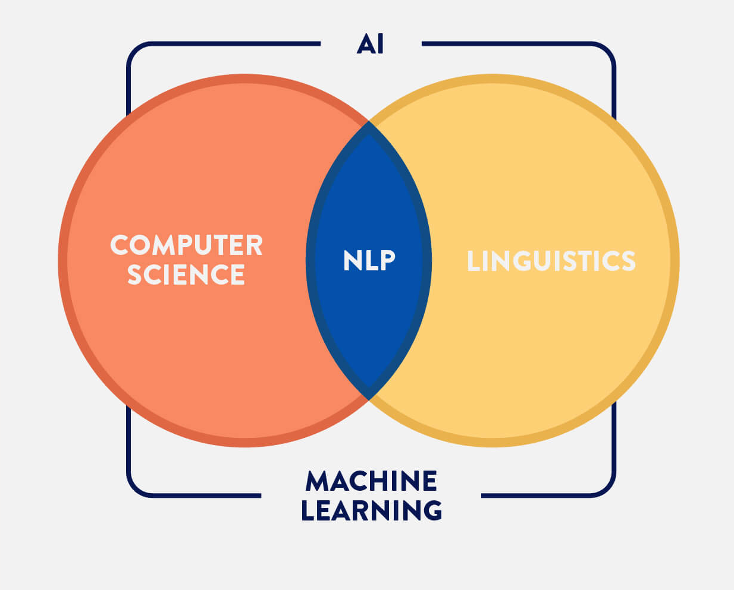

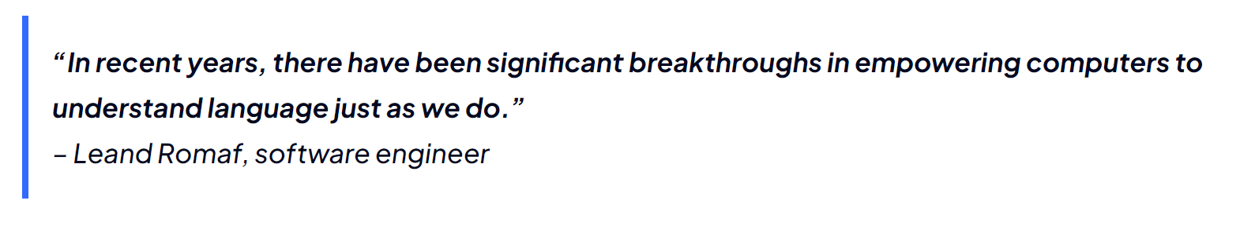
What’s NLP?
Natural language processing (NLP) refers to the branch of computer science—and more specifically, the branch of artificial intelligence or AI—concerned with giving computers the ability to understand text and spoken words in much the same way human beings can.

Slide 4
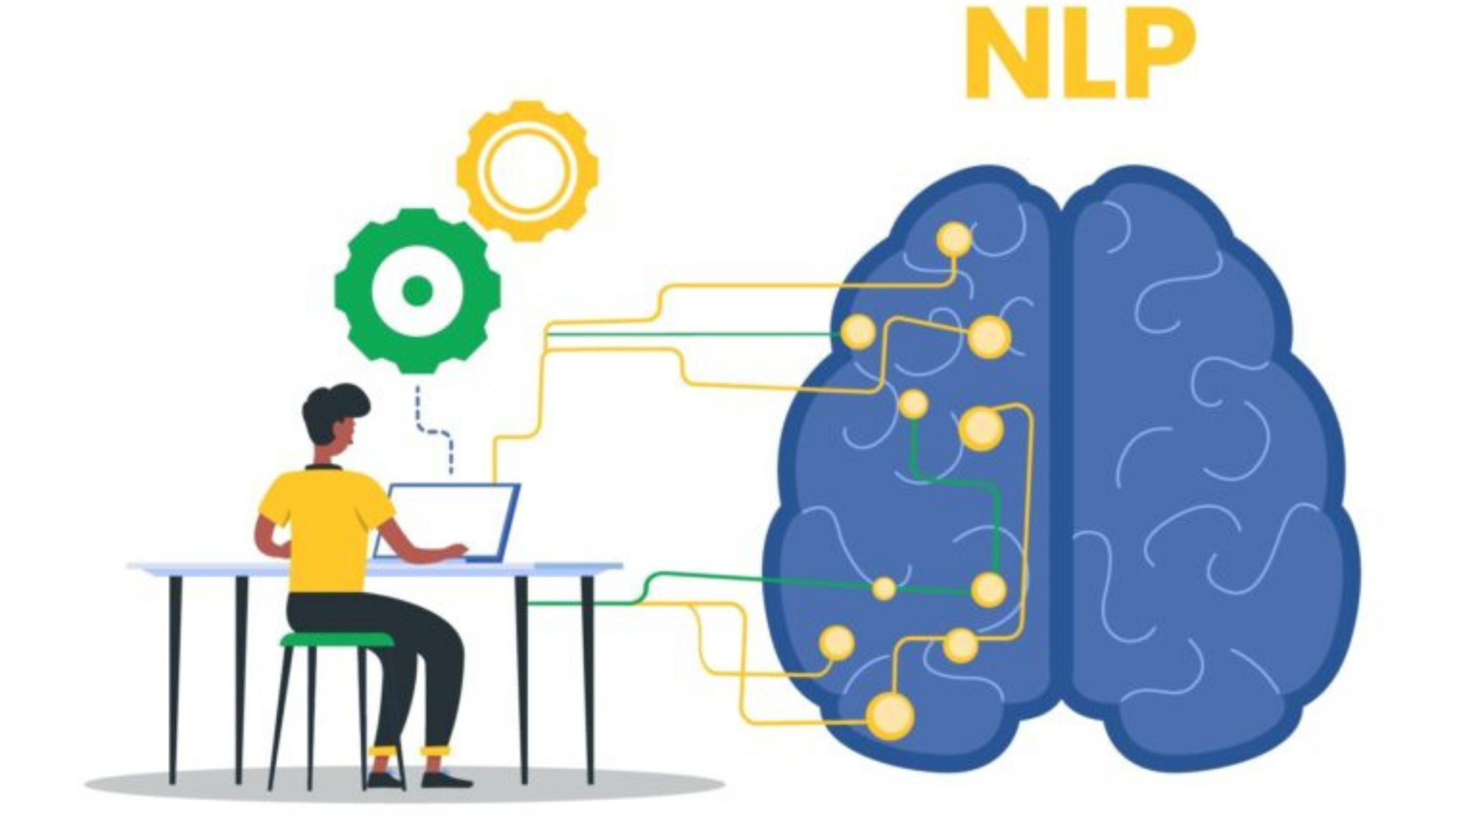
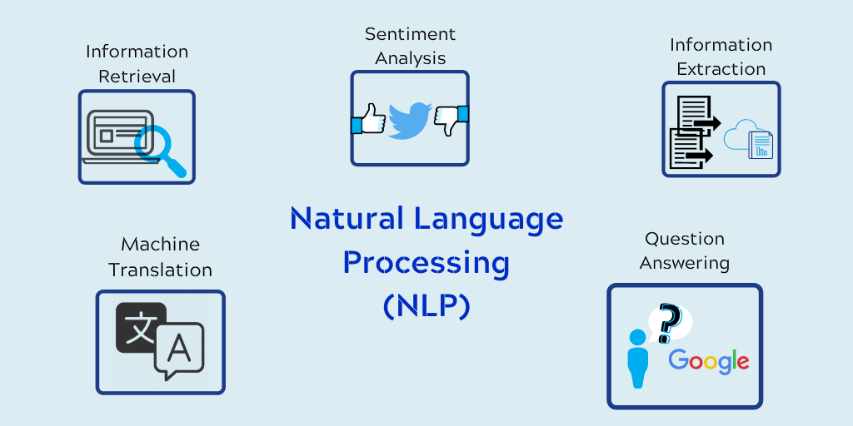
Why is NLP important?
1.Large volumes of textual data
2.Structuring a highly unstructured data source
The most widespread uses of Natural Language Processing

Slide 5
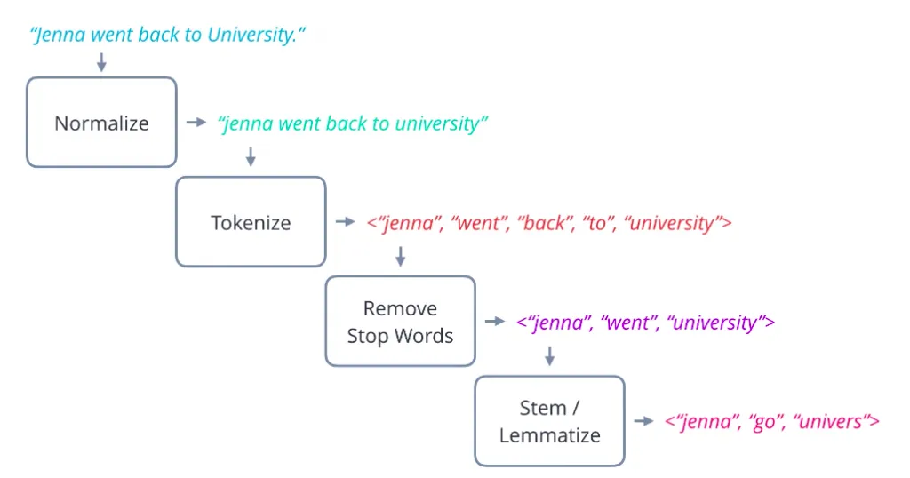
How Does NLP Work?
Uses deep learning and algorithms to interpret and understand human language
NLP Stages:
Tokenization – whereby the text is broken down into semantic units or single clauses,
Stop word removal – removing words that add no unique information
Stemming/lemmatization – transforming words to their root form
Part of Speech Tagging - words are tagged according to grammatical case.

Slide 6
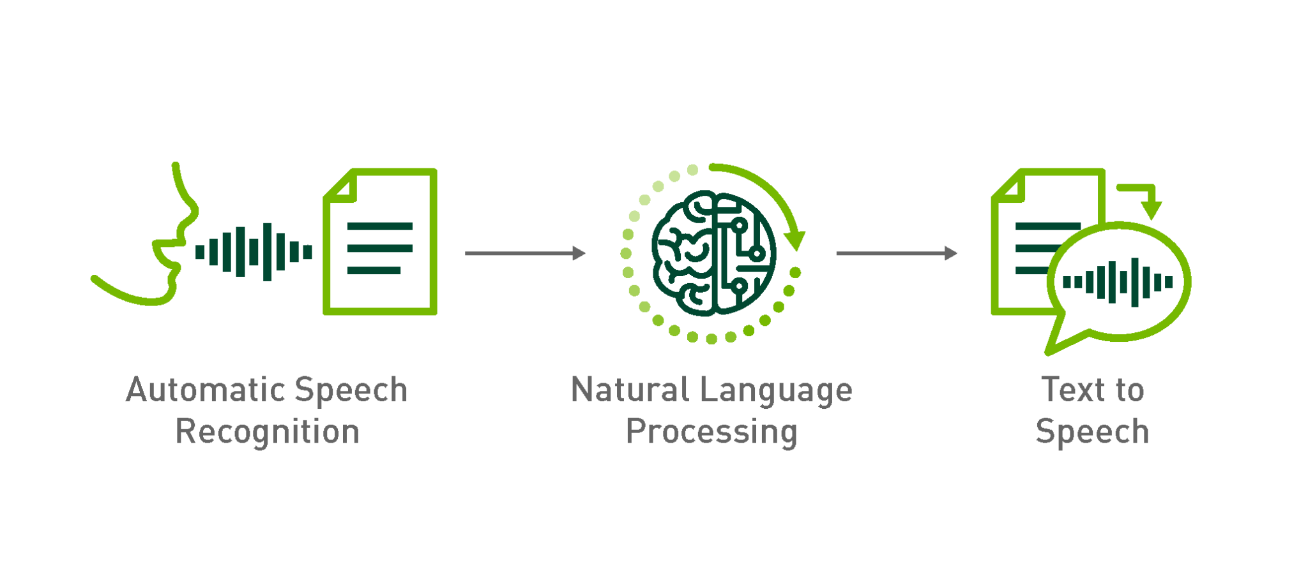
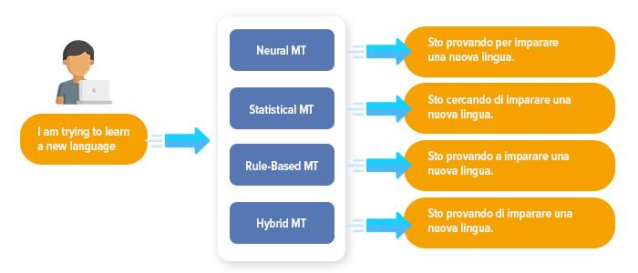
NLP in Today’s real life
Examples:
Speech Recognition: NLP is used in speech recognition systems, which convert spoken words into text. This technology is used in many applications, such as virtual assistants, speech-to-text software, and language learning apps.
Language Translation: NLP is used to translate text from one language to another. Services such as Google Translate and Microsoft Translator use NLP algorithms to provide accurate translations.

Slide 7
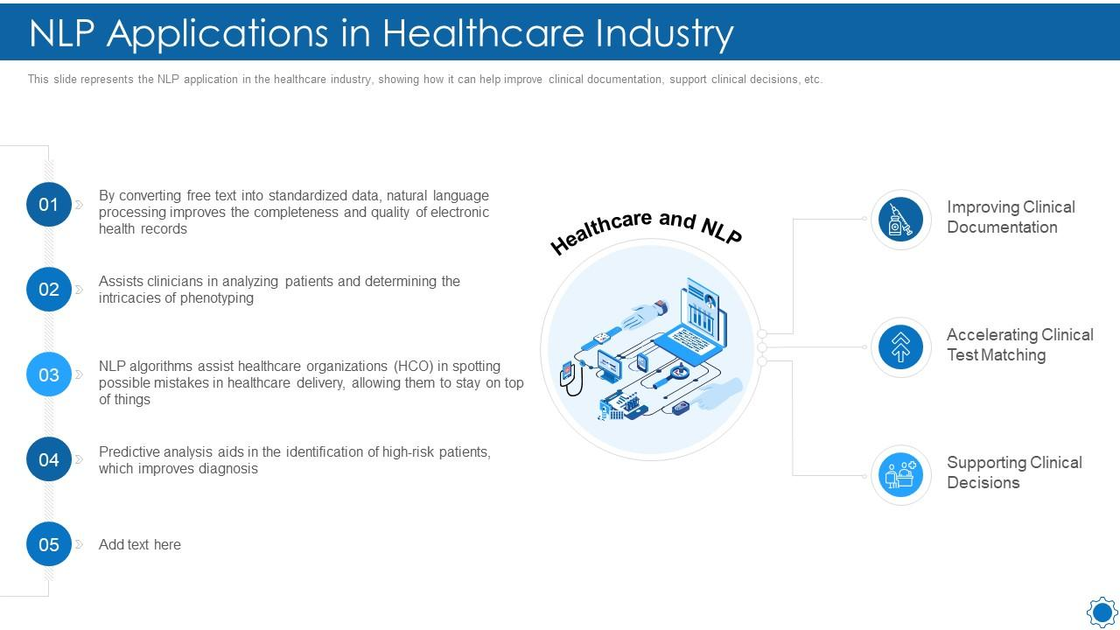
Examples:
Healthcare: NLP is used in healthcare to analyze medical records and help physicians make more informed decisions. NLP algorithms can analyze patient records and identify patterns, helping doctors diagnose diseases and develop treatment plans.
NLP is a powerful tool that is transforming many industries and applications. From search engines and customer service to social media monitoring and healthcare, NLP is helping us understand and process language more effectively, making our lives more efficient and convenient.

Slide 8
Methods of NLP
NLP methods include a wide range of techniques and approaches for processing, analyzing, and generating natural language text. Some common NLP methods include:
Tokenization
Part-of-speech tagging
Named entity recognition
Sentiment analysis
Topic modeling
Machine translation
Text summarization
Question answering

Slide 9
Applications of NLP
NLP has a wide range of application across different industries and domains. Here are some of the most common applications of NLP.
Chatbot and Virtual Assistants
Sentiment Analysis
News and Media
Language Translation
Information Retrieval
Speech Recognition
Fraud Detection
Healthcare

Slide 10
Future of Natural Language Processing
Though NLP has been around for years, its development has been a relatively slow process. In recent years though, it has made massive strides and thus has become part of public consciousness.
About 80% of data around us is unstructured. But with the available information constantly growing in size and increasingly sophisticated, accurate algorithms, NLP is altering the way of interaction between humans and machines.
Intent Recognition
Better Conversational AI Tools
Product Recommendation via NLP
Voice Biometrics over Passwords
Intelligent Automation
Natural Language Generation

Slide 11
Thankyou

