Slide 1
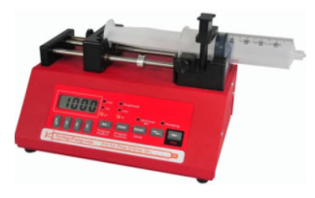
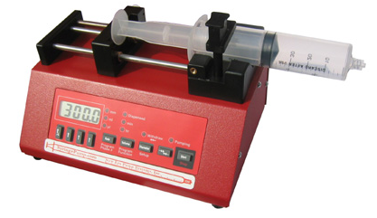
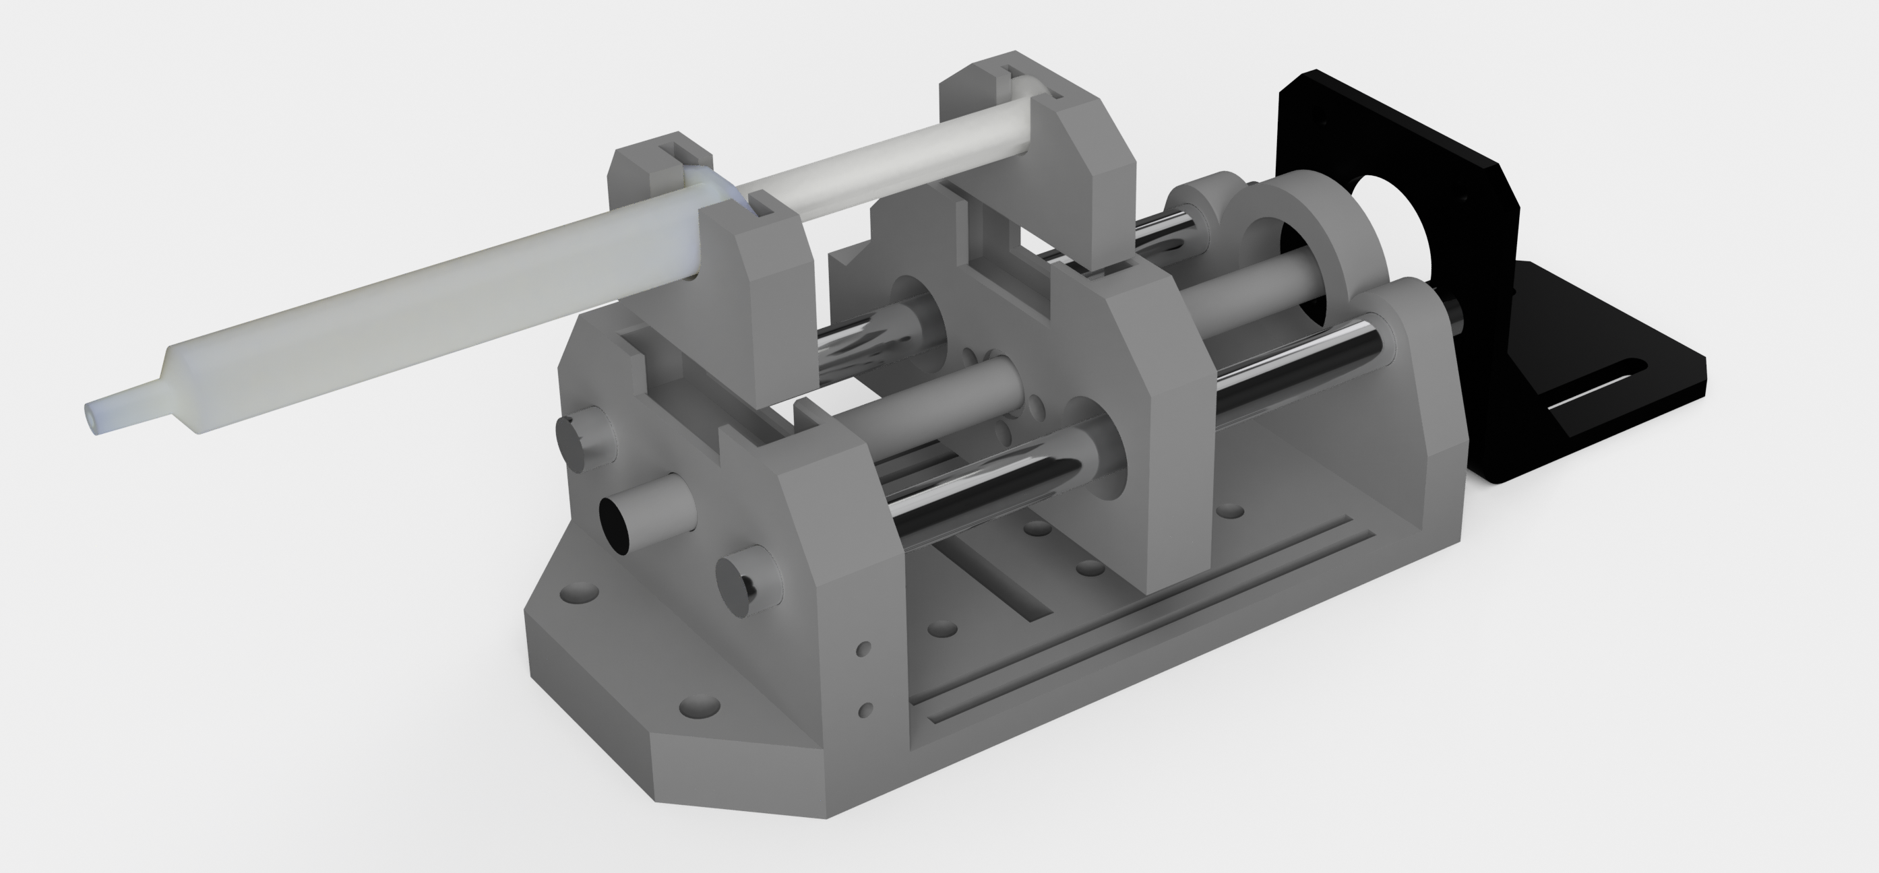
Single Syringe Pump – NE1000
$710 from ABC Scientific
Just Infusion Syringe Pump – NE300
$275 from Syringepump.com
Chromastat 3D Printed Syringe Pump
$80

