Slide 1
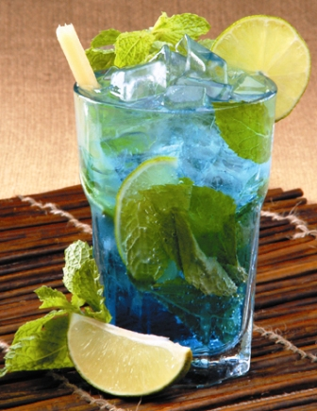
Mojito
rum
sugar
lime
soda
mint

Slide 2

Mockito
setup-execute-assert
EasyMockish syntax
flexibility
ready to play

Slide 3
EasyMock is the best and I don't need anything else... Really?
EasyMock
Mockito

