Slide 1

Big Biological Data Analysis
Mousheng Xu
Dec 2025
Notes:
AI-generated content may be incorrect. ---

Slide 2
Educational Background
B.S. in Genetics, Wuhan University, P. R. China
M.S. in Biochemistry & Molecular Biology, University of Kansas Medical Center
M.S. in Computer Science, University of Kansas
Ph.D. in Bioinformatics & Systems Biology, Boston University
Predoc Fellow in Bioinformatics, Harvard Medical School
Postdoc in Cancer Genetic Epidemiology, Harvard School of Public Health
Notes:
--- This slide references information from the following file: https://d.docs.live.net/8BF200E48EB695D5/Microsoft%20Copilot%20Chat%20Files/moushengxu_resume2d.docx Mousheng Xu holds a Ph.D. in Bioinformatics & Systems Biology from Boston University, where he conducted pioneering research in computational biology. He further advanced his expertise through postdoctoral fellowships at Harvard T.H. Chan School of Public Health and Harvard Medical School, focusing on cancer genetic epidemiology and bioinformatics. His academic foundation is strengthened by two Master's degrees—one in Computer Science from the University of Kansas and another in Biochemistry & Molecular Biology from the University of Kansas Medical Center. Additionally, he completed a Bachelor of Science in Genetics at Wuhan University in China. This diverse educational background equips him with a robust interdisciplinary skill set, combining computational proficiency with deep biological insights, ideal for tackling complex problems in genomics and bioinformatics.

Slide 3
Career Summary: 20+ Years Delivering Impact
2025–Present: Head of Biosciences, Sophyics Pte. Ltd. (Singapore) Quantum-physics for biomedical applications
2021–2024: Head of Bioinformatics, D2M Biotherapeutics (Natick, MA) 11M+ Mendelian Randomization results of causal genes for cancer & immune diseases (world’s 1st)
2018–2021: Sr. Data Analyst / Statistical Geneticist, Booz Allen Hamilton (Boston, MA) Million Veteran Program; NLP for NIDDK
2016–2018: Bioinformatics Analyst II, Dana-Farber Cancer Institute / Harvard (Boston, MA) RNA-seq, ChIP-seq, GUIDEseq analyses, 4 co-authored papers (Science, Nature Cell Bio)
2011–2015: Founder / CEO / CTO, Hubei Vidagen (Wuhan, China) Scaled to 35 employees; Developed 10-patent genetic testing system
2006–2011: Postdoc / Predoc, Harvard Medical School (Boston, MA)
2001–2003: Sr. Software Engineer, Gene Logic Inc. (Berkeley, CA)
1998–2001: Computational Scientist, Celltech R&D (Seattle, WA)

Slide 4
Exemplar RNAseq Analysis
Notes:
--- This slide references information from the following file: https://d.docs.live.net/8BF200E48EB695D5/Microsoft%20Copilot%20Chat%20Files/moushengxu_resume2d.docx NID1 & Melanoma Risk

Slide 5
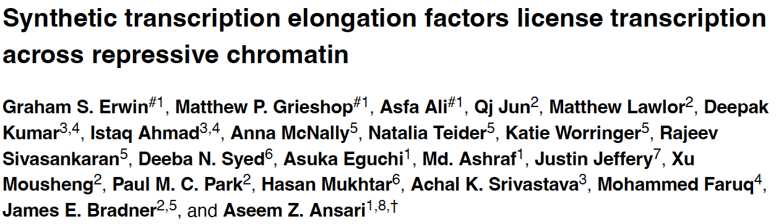
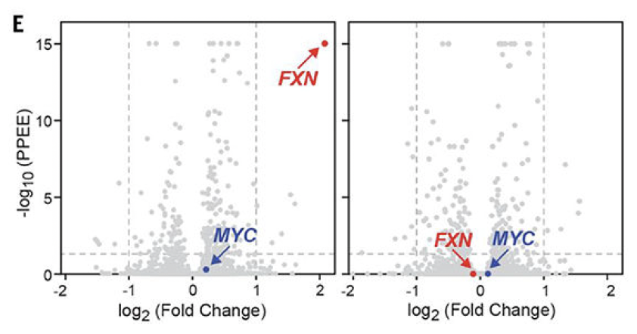
RNAseq Differential Gene Expression Analysis
RNA-seq Differential Gene Expression (DGE) Analysis
RNAseq count: negative binomial distribution
R package: edgeR
Volcano Plot
X: log2(Fold Change)
Y: -log10(P-value)
The higher, the more significant
The Paper
FXN is significantly up-regulated by the treatment
MYC as a control, is not responsive to the treatment
Notes:
--- This slide references information from the following file: https://d.docs.live.net/8BF200E48EB695D5/Microsoft%20Copilot%20Chat%20Files/moushengxu_resume2d.docx The featured GWAS study co-authored by Mousheng Xu, published in Human Molecular Genetics (2011), investigates the genetic basis of melanocytic nevi and their link to melanoma risk. This two-stage GWAS involved a discovery cohort of 9,136 Europeans with self-reported nevus counts and a replication cohort of 3,581 individuals. The study identified the NID1 locus on chromosome 1q42 as significantly associated with nevus count, with lead SNPs rs3768080 and rs10754833 reaching genome-wide significance. Follow-up analyses revealed decreased NID1 expression in nevi and melanoma tissues, providing biological validation for the genetic findings. This study exemplifies a clean GWAS design with robust discovery and replication phases, integrating genetic association with expression data to elucidate disease mechanisms. It highlights the genetic control of nevus count as a contributing factor to melanoma susceptibility, offering insights into cancer risk stratification and potential therapeutic targets.

Slide 6
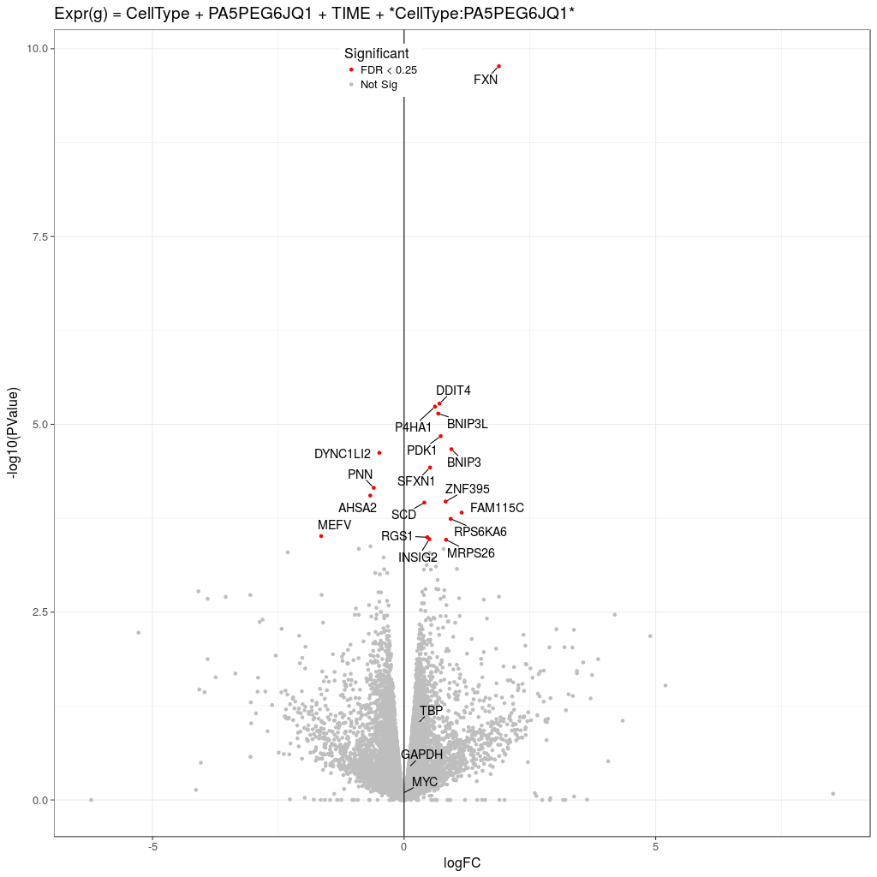
Interaction: Cell Specific Effect
Model:
Expression ~ Cell Type + PA5PEG6JQ1 + TIME + Cell Type:PA5PEG6JQ1
Results:
FXN is the most significantly increased gene by the treatment of PA5PEG6JQ1
Notes:
--- This slide references information from the following file: https://d.docs.live.net/8BF200E48EB695D5/Microsoft%20Copilot%20Chat%20Files/moushengxu_resume2d.docx Mousheng Xu has authored nearly 20 peer-reviewed publications in prestigious journals, reflecting his significant contributions to genomics and bioinformatics. Notable works include: 'Identification and analysis of functional elements in 1% of the human genome by the ENCODE pilot project' (Nature, 2007); 'Synthetic transcription elongation factors license transcription across repressive chromatin' (Science, 2017); 'Functional TRIM24 degrader via conjugation of ineffectual bromodomain and VHL ligands' (Nat Chem Biol, 2018); 'Targeting MYC dependency in ovarian cancer through inhibition of CDK7 and CDK12/13' (eLife, 2018); 'YAP1-Mediated Suppression of USP31 Enhances NFκB Activity to Promote Sarcomagenesis' (Cancer Research, 2018); 'Genome-wide association study identifies 48 common genetic variants associated with handedness' (Nat Hum Behav, 2020); 'Genome-wide association study of survival in patients with pancreatic adenocarcinoma' (Gut, 2012); 'Genome-wide association study identifies nidogen 1 (NID1) as a susceptibility locus to cutaneous nevi and melanoma risk' (Hum Mol Genet, 2011); 'Pathway analysis for genome-wide association study of basal cell carcinoma of the skin' (PLoS ONE, 2011); 'ABO blood group and breast cancer incidence and survival' (Int J Cancer, 2011); 'Genome Wide Association Study to Predict Severe Asthma Exacerbations in Children using Random Forests Classifiers' (BMC Med Genet, 2011); and 'Validation of warfarin pharmacogenetic algorithms in 586 Han Chinese patients' (Pharmacogenomics, 2015). These publications underscore his expertise in GWAS, machine learning, and translational bioinformatics.

Slide 7
Machine Learning Applications
Notes:
--- This slide references information from the following file: https://d.docs.live.net/8BF200E48EB695D5/Microsoft%20Copilot%20Chat%20Files/moushengxu_resume2d.docx Innovative ML Projects

Slide 8
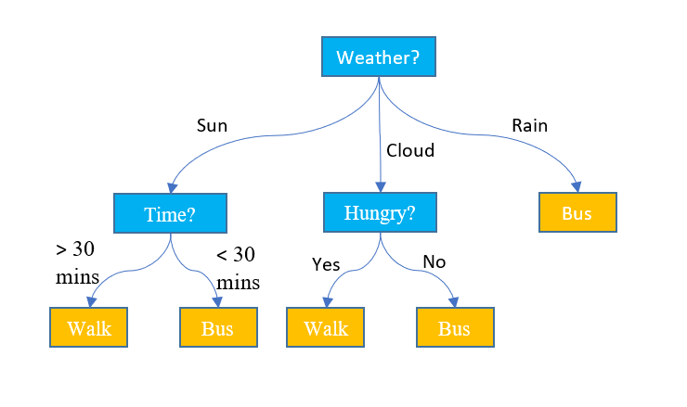
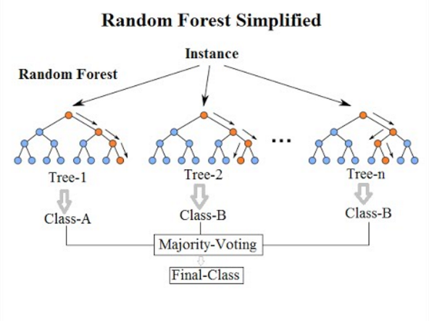
Machine Learning With Random Forests
Random Forests
A decision tree predicts outcomes by splitting data based on feature values
Ensemble of many decision trees (“forest”)
Each tree uses random samples + random features → “random”
Reduces overfitting
Handles nonlinear, high-dimensional data
Provides feature importance
Notes:
--- This slide references information from the following file: https://d.docs.live.net/8BF200E48EB695D5/Microsoft%20Copilot%20Chat%20Files/moushengxu_resume2d.docx Mousheng Xu has applied machine learning techniques to various biomedical and computational challenges. His early work on pediatric asthma exacerbations utilized Random Forests to analyze 550,000 SNPs alongside clinical features, earning recognition at the American Thoracic Society’s 'Scientific Breakthroughs of the Year' symposium and achieving significant download metrics. At Booz Allen Hamilton, he architected a Natural Language Processing (NLP) pipeline for tagging biological study data with Common Data Elements (CDEs) for the National Institute of Diabetes and Digestive and Kidney Diseases (NIDDK). This pipeline incorporated information retrieval techniques such as TF-IDF, Latent Semantic Indexing (LSI), stemming, and stop-word removal. Additionally, Xu developed a public tutorial on applying Long Short-Term Memory (LSTM) networks for stock price prediction using Keras and TensorFlow, showcasing his ability to translate complex ML concepts into accessible educational content. These projects highlight his proficiency in applying ML to real-world problems and his commitment to knowledge dissemination.

Slide 9
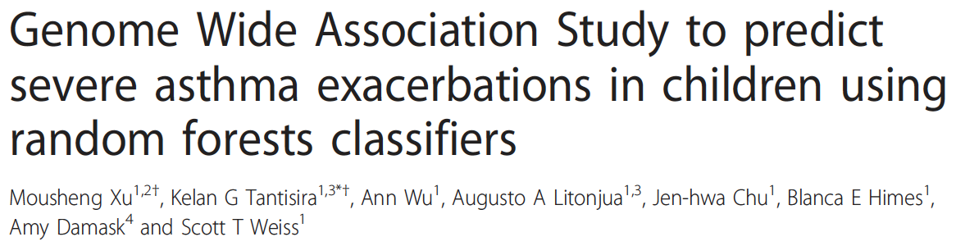
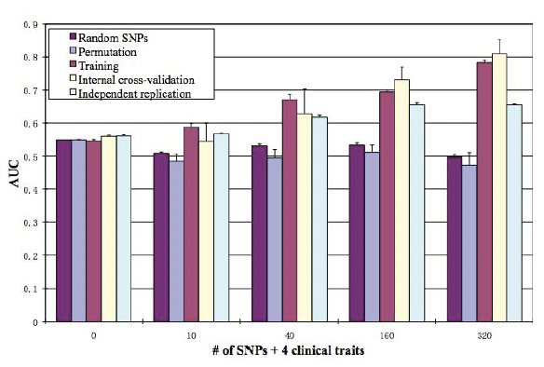
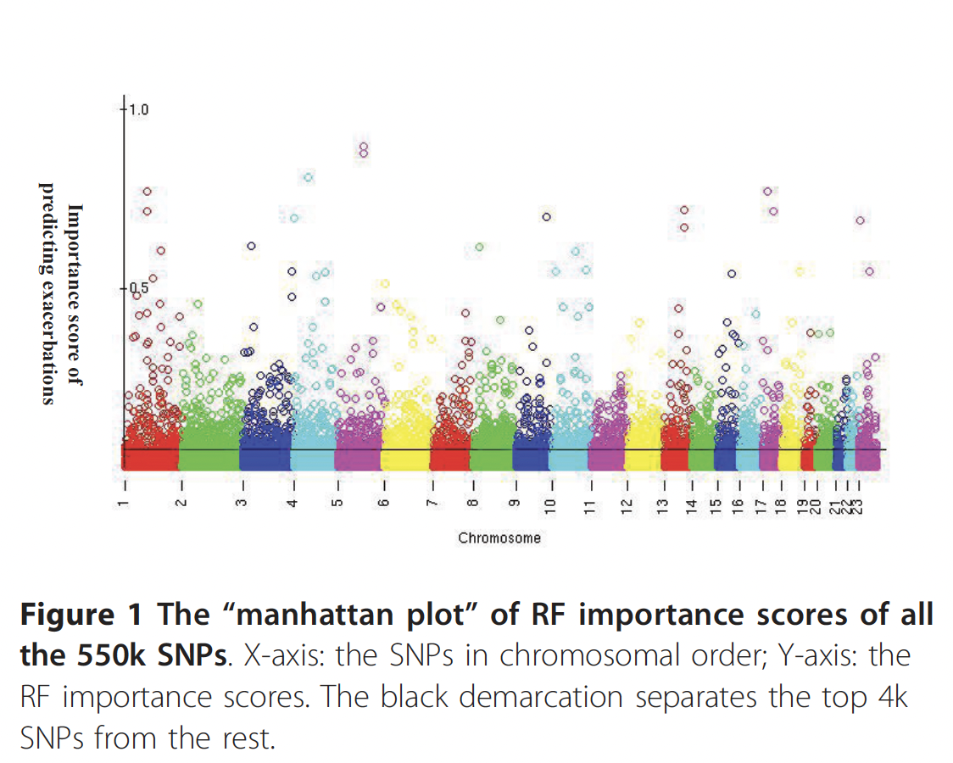
Machine Learning With Random Forests
4 months after publication, Editor:
2009 ATS: scientific breakthroughs of the year
Age
Gender
FEV1%
Treatment
Top SNPs
Random Forests
Asthma Exacerbation?
Yes/No
Notes:
--- This slide references information from the following file: https://d.docs.live.net/8BF200E48EB695D5/Microsoft%20Copilot%20Chat%20Files/moushengxu_resume2d.docx Mousheng Xu has applied machine learning techniques to various biomedical and computational challenges. His early work on pediatric asthma exacerbations utilized Random Forests to analyze 550,000 SNPs alongside clinical features, earning recognition at the American Thoracic Society’s 'Scientific Breakthroughs of the Year' symposium and achieving significant download metrics. At Booz Allen Hamilton, he architected a Natural Language Processing (NLP) pipeline for tagging biological study data with Common Data Elements (CDEs) for the National Institute of Diabetes and Digestive and Kidney Diseases (NIDDK). This pipeline incorporated information retrieval techniques such as TF-IDF, Latent Semantic Indexing (LSI), stemming, and stop-word removal. Additionally, Xu developed a public tutorial on applying Long Short-Term Memory (LSTM) networks for stock price prediction using Keras and TensorFlow, showcasing his ability to translate complex ML concepts into accessible educational content. These projects highlight his proficiency in applying ML to real-world problems and his commitment to knowledge dissemination.

Slide 10
Other Contributions
Notes:
--- This slide references information from the following file: https://d.docs.live.net/8BF200E48EB695D5/Microsoft%20Copilot%20Chat%20Files/moushengxu_resume2d.docx Selected GWAS Studies

Slide 11
Publications — GWAS
• Handedness GWAS (Meta-analysis) — Nat Hum Behav (2020)
• Basal Cell Carcinoma — PLoS One (2011)
• Nevus Count / Melanoma Risk (NID1) — Hum Mol Genet (2011, Co-first)
• Cutaneous BCC & SCC — Hum Mol Genet (2011)
• Pancreatic Adenocarcinoma Survival — Gut (2012)
• Severe Asthma Exacerbation (RF GWAS) — BMC Med Genet (2011)
• eQTL Mapping — Hum Mol Genet (2010)
• ABO & Pancreatic Cancer — Cancer Epidemiol Biomarkers Prev (2010)
• Blood Type & Breast Cancer — Int J Cancer (2011)

Slide 12
Publications — NGS & Functional Genomics
• Synthetic transcription elongation factors — Science (2017)
• YAP1 → USP31 → NFκB (Sarcoma) — Cancer Research (2018)
• TRIM24 degrader — Nat Chem Biol (2018)
• MYC dependency in ovarian cancer — eLife (2018)
• Super-enhancer BCL2 mechanism — Cancer Cell (2018)
• Warfarin pharmacogenetics — Pharmacogenomics (2015)

Slide 13
Publications — Functional Genomics & ML
• ENCODE Pilot Project — Nature (2007)
• Regulatory polymorphisms / eQTL — Genomics (2008)
• Lgl1 regulation during alveolarization — Pediatric Research (2010)
• RF model for asthma exacerbation — BMC Med Genet (2011)
• LSTM stock prediction — Kaggle Tutorial (2018)
• Biological information retrieval — ACM CIKM (1998)

Slide 14
Industry Highlights
Vidagen (Founder): genetic testing; dozens of products; 13-17 medical organizations; ~ a dozen patents; Hundred, Yellow Crane, 3551 Talent Programs
Booz Allen Hamilton (Sr. Data Scientist): Genomic data preparation for Million Veteran Program (MVP); NPL for NIDDK;
D2M Biotherapeutics: causal gene identification for cancers and immune diseases

Slide 15
GTIIT Teaching Vision
Notes:
--- This slide references information from the following file: https://d.docs.live.net/8BF200E48EB695D5/Microsoft%20Copilot%20Chat%20Files/moushengxu_resume2d.docx Evidence and Approach to Teaching, Integrating Computational Analysis into BFE

Slide 16

Passion For Teaching
Educational Contributions
Xu has delivered invited talks and developed widely accessed tutorials on machine learning and genomics.
Mobile Learning Applications
He created educational apps like Fast PSAT Words and Fast SAT Words, showcasing thoughtful content design.
Notes:
--- This slide references information from the following file: https://d.docs.live.net/8BF200E48EB695D5/Microsoft%20Copilot%20Chat%20Files/moushengxu_resume2d.docx Mousheng Xu’s passion for teaching is evident through his extensive history of educational contributions. He has delivered invited talks and presented at prestigious conferences such as the American Thoracic Society, where his work was featured in a special symposium. His commitment to education is further demonstrated by the development of public tutorials on machine learning and genomics, including a widely accessed LSTM stock prediction guide on Kaggle. Additionally, he has created educational mobile applications like Fast PSAT Words and Fast SAT Words, which require thoughtful pedagogy and content design. Xu’s teaching approach emphasizes project-based learning, incorporating hands-on labs such as RNA-seq and GWAS analysis, machine learning for biological data, and reproducible pipeline development. He advocates for flipped classrooms with code-along notebooks and the use of open datasets like UK Biobank, TCGA, GTEx, and curated microbiome data. This approach ensures that students gain practical experience and develop skills relevant to modern bioinformatics and computational biology.

Slide 17

Integrating Computational Analysis into BFE
Computational Biology Applies to Every Area of Life Science
Integrating Data Science Into BFE Research
Benefits to Students and Training
Notes:
--- This slide references information from the following file: https://d.docs.live.net/8BF200E48EB695D5/Microsoft%20Copilot%20Chat%20Files/moushengxu_resume2d.docx At GTIIT, Mousheng Xu envisions a transformative integration of computational analysis into Biological Food Engineering (BFE). His plan includes harmonizing omics data—such as metagenomics and metabolomics—with dietary logs to enable causal inference using Mendelian Randomization and colocalization techniques. This integration aims to uncover diet-related biomarkers and enhance food safety through contamination detection pipelines. Xu also proposes applying machine learning and artificial intelligence to BFE, including predictive quality control using Random Forests and XGBoost for fermentation yields, and deep learning for imaging-based contaminant detection. Furthermore, he plans to implement cloud-based computational pipelines using platforms like HAIL and Apache Arrow, develop containerized workflows, and establish reproducible data commons. His industry experience in deploying MR and coloc pipelines at scale positions him to immediately contribute to GTIIT’s research infrastructure and curriculum development, fostering a data-driven approach to food and health sciences.

Slide 18

Why Me?
Academic and Industry Expertise
Combines strong academic background with real-world industry experience bridging theory and practice.
Data-Driven Insights
Develops reliable and explainable genomics and machine learning pipelines to extract actionable insights from complex data.
Commitment to Education
Delivers scalable education through public tutorials, mobile apps, and conference presentations.
Vision for GTIIT Lab
Plans to establish functional labs integrating computational analysis and student research in Biological Food Engineering.
Notes:
Mousheng Xu offers a compelling blend of academic excellence, industry experience, and a deep passion for teaching. His proven track record in developing reliable and explainable genomics and machine learning pipelines demonstrates his ability to turn complex, messy data into actionable insights. With experience in both academia and industry, he bridges the gap between theoretical research and practical application. His commitment to education is evident through his public tutorials, mobile apps, and conference presentations, showcasing his ability to teach at scale. At GTIIT, Xu plans to immediately establish a functional lab environment, leveraging his expertise in pipeline development and cloud computing. His vision includes integrating computational analysis into Biological Food Engineering, fostering student research, and building reproducible data infrastructures. This holistic approach positions him as an ideal candidate to contribute to GTIIT’s mission of advancing interdisciplinary science and education.

Slide 19
Thank You!
Notes:
Final Value Proposition

