Slide 1
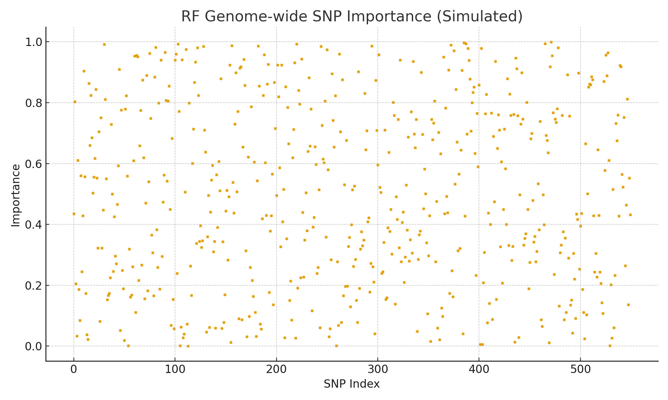
Machine Learning for Genome-wide Association (Random Forests)
• Predict severe asthma exacerbation using clinical + genome-wide SNPs
• Inputs: Age, Gender, FEV1%, Treatment, 550k SNPs
• RF importance computed for all SNPs; cross-validation + replication

Slide 2
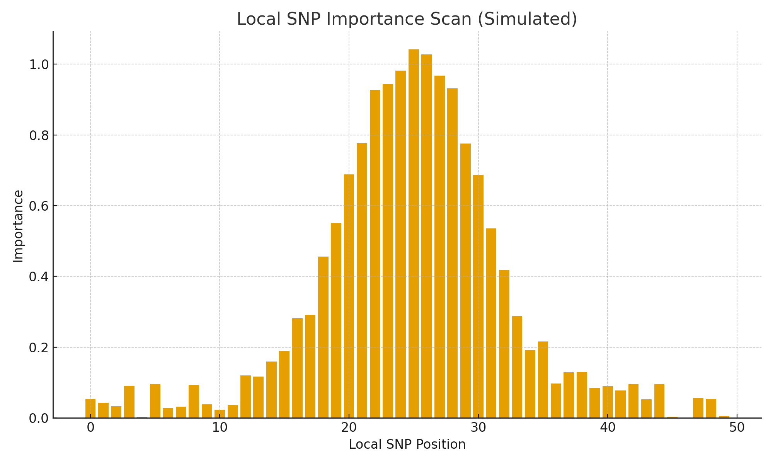
Local SNP Importance Scanning ('Chromosome Walking')
• RF highlights multi-SNP local clusters
• Local scan reveals contiguous SNP peaks
• Demonstrates how RF performs feature selection

