Slide 1



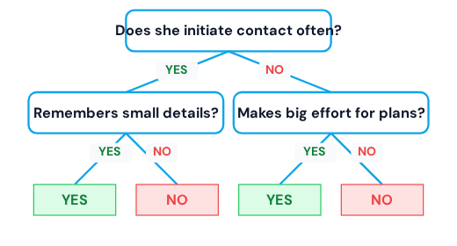
Illustrative Example: Does She Love Me?
1. DECISION TREE (SINGLE CLASSIFIER)
2. RANDOM FOREST (ENSEMBLE VOTING)
Averaging the predictions of multiple diverse trees mitigates the instability of a single tree, leading to a robust prediction.
Trees must be diverse (Random Samples + Random Features).
Final result is determined by **Majority Vote** (Classification) or **Averaging** (Regression).

