Slide 2


Standard Mode
The getKanban Board Game can be played in one of three modes. This slide deck is for Standard mode.
Slide decks for Advanced and Quick Play modes, as well as the Facilitator’s Guide, and Apple Keynote versions of each are available for download at www.getkanban.com
If you are new to the game and will be facilitating it, start by downloading and reading the Facilitator’s Guide.
This deck includes Game Setup, Instructions, and Debrief suggestions. It contains many animations, so it is best to view it in Slide Show view (play it) rather than edit view.
Contents
Setup
Instructions
Debrief
Game version: 4.0
Slide deck version: 4.0-std-pp-beta
© getKanban Ltd, 2013.

Slide 3
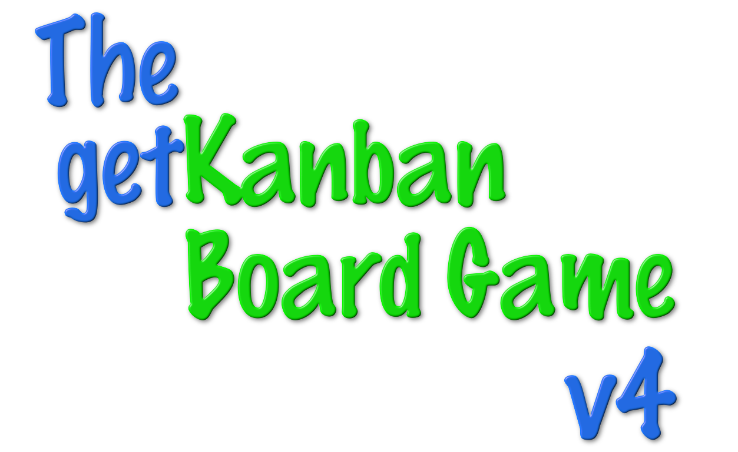
Setup: Standard Mode

Slide 4
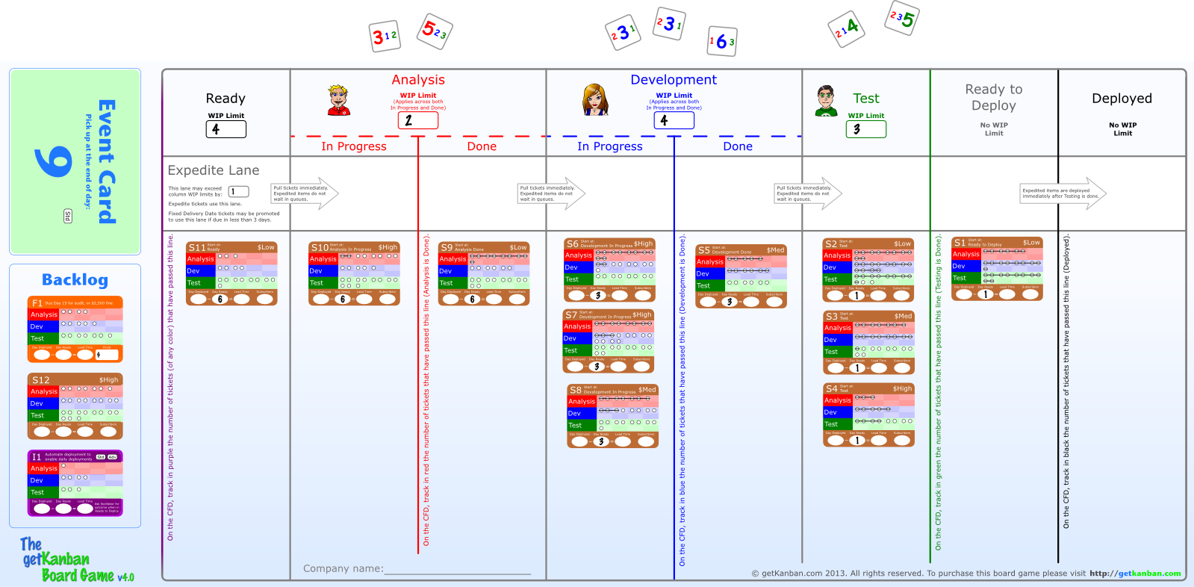

Set up the Board
Set up each board as shown. Place tickets S1 – S11 in the column indicated “Start at” on the ticket. For example, S1 starts at Ready to Deploy:
Stack remaining tickets in their designated areas in the Backlog to the left of the board.

Slide 5
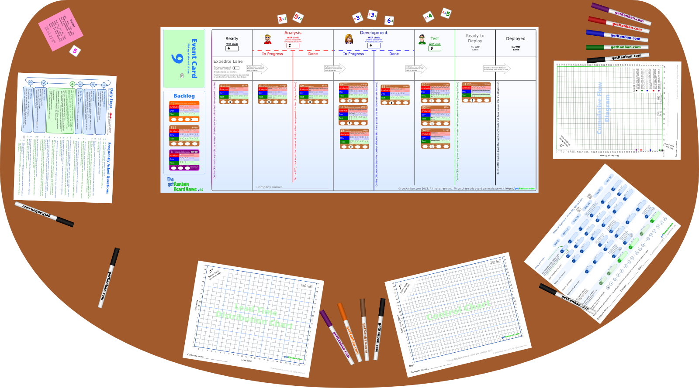
Lay out the remaining components
Lay out the components of the game as shown.
Ensure that: 1. The green deck of Event Cards is used, not the blue or yellow; 2. The Daily Steps guide has the correct side facing up (Adv, Std); 3. The correct color marker pens are placed with the correct charts.

Slide 6
Instructions: Standard Mode

Slide 7



Modes of Play
The game can be played in one of three modes, represented by these labels:
Quick Play
Standard
Advanced
We are playing in Standard mode.
If you see a label in the game, the labelled item is only used in the indicated mode. If there is no label, the item is used in all modes.

Slide 8
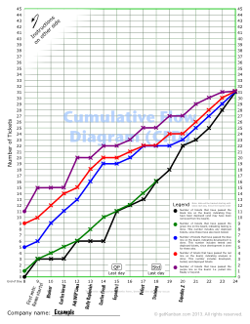
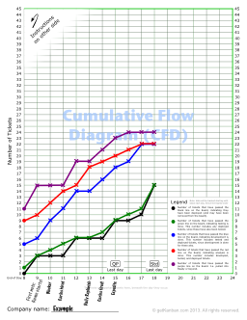
What to Expect
Advanced Mode
Standard Mode

