Slide 1

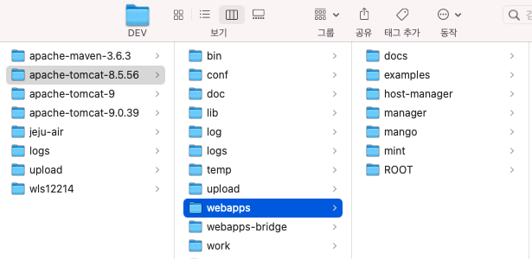

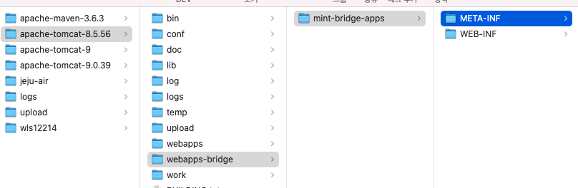
{TOMCAT_HOME}/conf/server.xml 내에 Service (name=“bridge”) 추가하고 mint-bridge-app는 {TOMCAT_HOME}/webapps-bridge 에 배치한다.
서비스 포트는 8080, 9080 두개로 설정함
<?xml version="1.0" encoding="UTF-8"?>
<Server port="8005" shutdown="SHUTDOWN">
<Listener className="org.apache.catalina.startup.VersionLoggerListener" />
<Listener className="org.apache.catalina.core.AprLifecycleListener" SSLEngine="on" />
<Listener className="org.apache.catalina.core.JreMemoryLeakPreventionListener" />
<Listener className="org.apache.catalina.mbeans.GlobalResourcesLifecycleListener" />
<Listener className="org.apache.catalina.core.ThreadLocalLeakPreventionListener" />
<GlobalNamingResources>
<Resource name="UserDatabase" auth="Container"
type="org.apache.catalina.UserDatabase"
description="User database that can be updated and saved"
factory="org.apache.catalina.users.MemoryUserDatabaseFactory"
pathname="conf/tomcat-users.xml" />
<Resource auth="Container" defaultAutoCommit="false" driverClassName="oracle.jdbc.driver.OracleDriver"
factory="org.apache.tomcat.jdbc.pool.DataSourceFactory" initialSize="5" maxActive="100" maxWait="10000"
minEvictableIdleTimeMillis="3600000" minIdle="5" name="jdbc/iip-db" password="iipshl" testOnBorrow="true"
testOnReturn="false" testWhileIdle="true" timeBetweenEvictionRunsMillis="10000" type="javax.sql.DataSource"
url="jdbc:oracle:thin:@idc.mocomsys.com:31521:IIP"
username="iipshl" validationQuery="SELECT 1 FROM DUAL"/>
</GlobalNamingResources>
<Service name="Catalina">
<Connector port="8080" protocol="HTTP/1.1"
connectionTimeout="20000"
redirectPort="8443" />
<Engine name="Catalina" defaultHost="localhost">
<Realm className="org.apache.catalina.realm.LockOutRealm">
<Realm className="org.apache.catalina.realm.UserDatabaseRealm"
resourceName="UserDatabase"/>
</Realm>
<Host name="localhost" appBase="webapps"
unpackWARs="true" autoDeploy="true">
<Valve className="org.apache.catalina.valves.AccessLogValve" directory="logs"
prefix="localhost_access_log" suffix=".txt"
pattern="%h %l %u %t &quot;%r&quot; %s %b" />
</Host>
</Engine>
</Service>
<Service name="bridge">
<Connector port="9080" protocol="HTTP/1.1"
connectionTimeout="20000"
redirectPort="9443" />
<Engine name="Catalina" defaultHost="localhost">
<Realm className="org.apache.catalina.realm.LockOutRealm">
<Realm className="org.apache.catalina.realm.UserDatabaseRealm"
resourceName="UserDatabase"/>
</Realm>
<Host name="localhost" appBase="webapps-bridge"
unpackWARs="true" autoDeploy="true">
</Host>
</Engine>
</Service>
</Server>
기본 service
bridge service 추가

